Slide 1
Sentiment Analysis
Detect the Bangla text

Slide 2
Sentiment Analysis - Detect the sentiment of Bangla text.
Presented By :
Name: Shoaib Alam Name: Fowzia Yesmin
Reg. no: 2013331064 Reg. no: 2013331037
Year/Semester: 4/2 Year/Semester: 4/2 Dept: CSE. Dept: CSE.
Supervised By :
Name: Md. Masum
Designation: Associate Professor
Dept: CSE, SUST .

Slide 3
What is Sentiment Analysis?
Sentiment analysis is an automated system which uses various machine learning techniques on a user’s or author’s opinion to detect the sentiment.
Characterize different emotions.
Measuring the emotional tone of texts.
Emerging research topic.

Slide 4
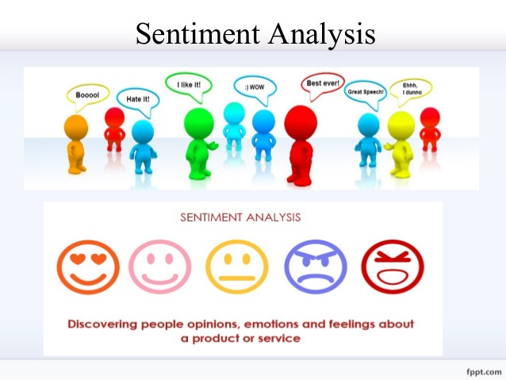
What is Sentiment Analysis?

Slide 5
Why Sentiment Analysis?
Mainly because of the web huge volumes of opinionated text
Polarize human statement and build statistical report.
Estimate the acceptance of comment

Slide 6
Sentiment Analysis on Bangla Language
Sentiment analysis in Bangla language is one of the most well studied problem in the field of NLP.
Though Bangla is one of the most spoken languages in the world, it still lacks significant research efforts in the area of NLP.

Slide 7
Sentiment Analysis on Different Activities
Bangla Language
English
Language
Social Media
Newspapers & Blogs

Slide 8
Why We Select Facebook?
Generally Facebook is more common social networking site than Twitter.
Facebook contain more Bangla comments and status than any other social networking site.
We are working on Bangla language. So, Facebook is the best option to retrieve Bangla data.

Slide 9
Facebook comment Classification
Positive
Smiley, Wink, Tongue, Angel, Shades, Blush, Rock on , Favor .
Negative
Frown, Shock, Skeptical, Evil, Angry, Fail , Against .

Slide 10
Positive & Negative Dataset
The size of our initial collected data is more than 1,00,000 sentences. The sentences in the dataset were sourced from Facebook which were posted by users as comments.
In our dataset, there are sentences of various types. There are not only Bangla and English sentences, but also, Banglish sentences. The figure below presents a snapshot of our collected dataset.

Slide 11
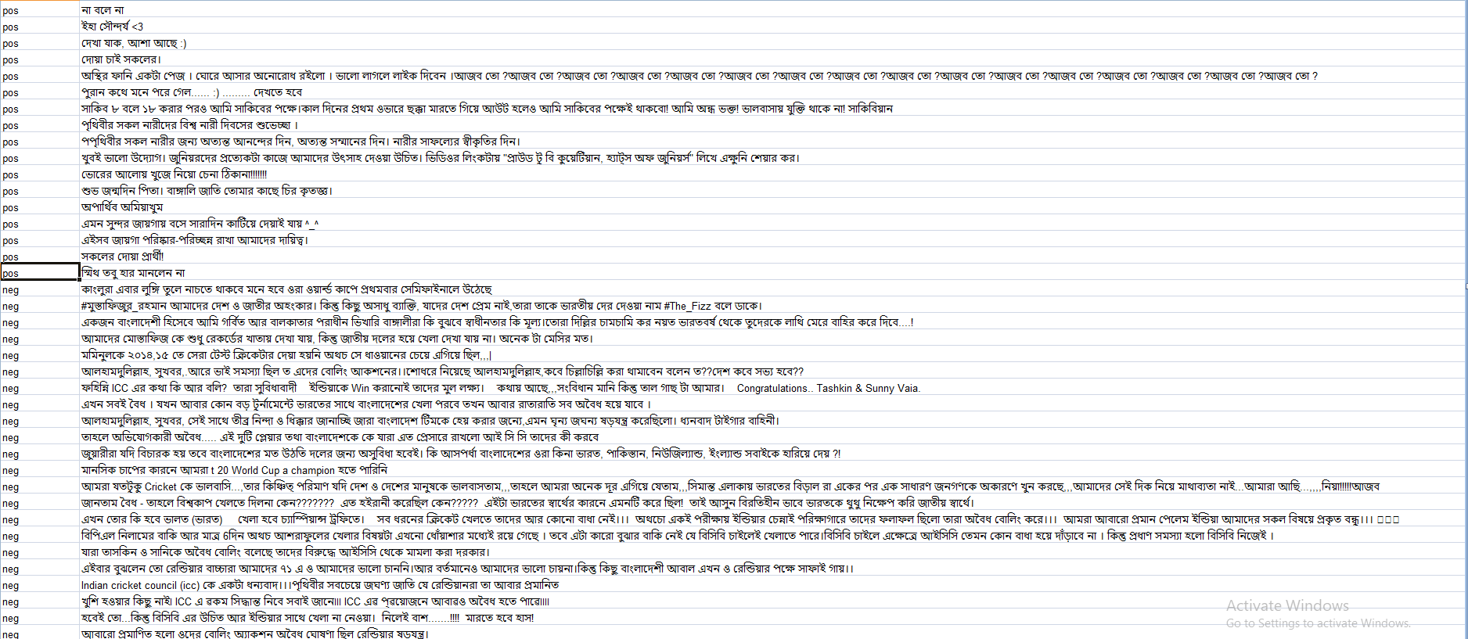
Data Collection

Slide 12
Data processing
Collected user’s comment form Facebook manually.
Give them a structural formal.
Tagged them either positive or negative.
We collected around 8000 of sentences for positive and negative comments.

Slide 13
Previous Work
We have collected a corpus to conduct our thesis.
We have done literature review to understand which algorithm would be fit for our purpose.
We have selected some features to analyze which combination of features will serve the best accuracy.

Slide 14

Methodology
Feature Selection
Count Vector
TF-IDF
Model Selection
Naive Bayes
Decision Tree
Logistic Regression
K-Nearest Neighbor
Support Vector Machine

Slide 15
Performance Analysis

Slide 16
Future Plans
Opening new doors for the writers, bloggers, and businessmen .
Analyzing percentage of product acceptance to customers.
Strategizing to improve the product quality of business.
Predicting stock market outcomes .

Slide 17
Thank You!!

