Slide 1

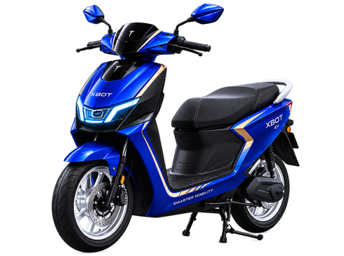
RIDE THE
FUTURE
Smarter mobility for modern cities.
PREMIUM
CRAFTED WITH PRECISION
FUTURISTIC
FORWARD-THINKING DESIGN
RELIABLE
ENGINEERED FOR CONFIDENCE
EXPLORE XBOT EV →
XBOT EV
ONE VISION. LIMITLESS FUTURE.
PREMIUM. FUTURISTIC. RELIABLE.

Slide 2
XBOT EV
Governance Plan — Instagram Feed
1. Purpose
2. Why We Use This
Purpose: Build instant product impact in a square feed format where users scroll fast and decide within seconds whether the brand looks credible.
Why this format: Instagram feed is strong for visual recall, product announcement, portfolio proof, and reusable campaign content. A square composition gives equal priority to brand, scooter, message, and CTA.
3. How It Benefits The Organization
4. Governance Controls
Organizational benefit: improves brand recognition, creates a reusable campaign asset, supports product awareness, and gives marketing a clean template for future launches.
Controls used: official palette, approved brand attributes only, visible logo clear space, no unverified product claims, same hero scooter, and platform-safe text hierarchy.
5. QA / Evidence Before Submission
QA evidence: checked for readability, consistent colors, claim safety, product focus, editable text layers, and correct 1080 × 1080 format.
MVP → BACKEND-STYLE GOVERNANCE THINKING → QA → DEPLOYMENT-READY EXPORTS → DOCS → SUBMISSION

