Slide 1

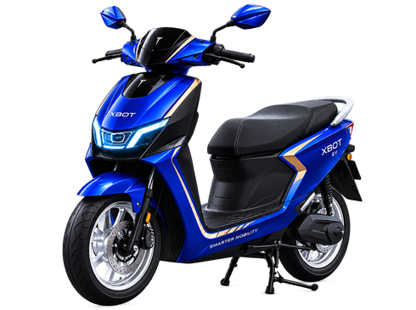
SMARTER
MOBILITY.
STRONGER
FUTURE.
INTELLIGENT
SMARTER EXPERIENCES
FUTURISTIC
LEADING THE FUTURE
RELIABLE
BUILT TO PERFORM
EXPLORE XBOT EV →
ONE VISION. LIMITLESS FUTURE.

Slide 2
XBOT EV
Governance Plan — Instagram Story
1. Purpose
2. Why We Use This
Purpose: Create a vertical, mobile-first brand experience that feels more immersive than the feed post and pushes one simple action: Explore XBOT EV.
Why this format: Stories use full-screen attention, so the design uses vertical hierarchy, larger headline rhythm, and a clear CTA near the bottom thumb zone.
3. How It Benefits The Organization
4. Governance Controls
Organizational benefit: supports campaign reach, mobile engagement, and paid/social story placements while keeping the same brand system intact.
Controls used: same colors, logo system, scooter, claim-safe benefit words, consistent tone, and less dense copy so the vertical format stays readable.
5. QA / Evidence Before Submission
QA evidence: checked safe area, top logo visibility, bottom CTA visibility, text contrast, no unsupported booking claim, and correct 1080 × 1920 format.
MVP → BACKEND-STYLE GOVERNANCE THINKING → QA → DEPLOYMENT-READY EXPORTS → DOCS → SUBMISSION

