Slide 1

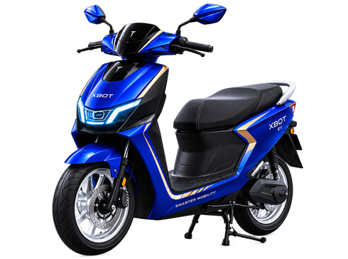
SMARTER MOBILITY. STRONGER FUTURE.
SMARTER MOBILITY.
STRONGER FUTURE.
Intelligent electric mobility for the modern rider.
PREMIUM
INTELLIGENT
GLOBAL
ONE VISION. LIMITLESS FUTURE.

Slide 2
XBOT EV
Governance Plan — Facebook Cover
1. Purpose
2. Why We Use This
Purpose: Build a wide brand billboard for profile/page visibility, using a calmer composition that communicates the brand identity at a glance.
Why this format: Facebook cover space is wide and shallow, so the design separates message on the left and scooter on the right, avoiding cramped text.
3. How It Benefits The Organization
4. Governance Controls
Organizational benefit: strengthens page professionalism, supports campaign consistency across platforms, and gives the organization a reusable hero banner.
Controls used: minimal copy, approved brand attributes, wide-safe composition, logo prominence, consistent color palette, and no unverifiable performance claims.
5. QA / Evidence Before Submission
QA evidence: checked wide readability, central/safe area composition, brand alignment, low text clutter, and correct 1640 × 624 working size.
MVP → BACKEND-STYLE GOVERNANCE THINKING → QA → DEPLOYMENT-READY EXPORTS → DOCS → SUBMISSION

