Slide 1

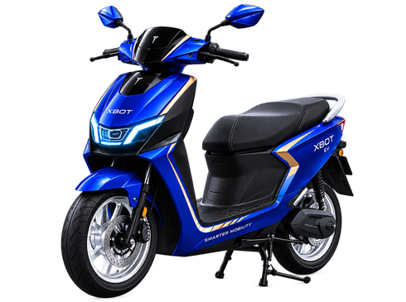
MASTERPIECE CAMPAIGN
PLAN & GOVERNANCE
Editable campaign system for three platform assets: Instagram Feed, Instagram Story, and Facebook Cover.
CLAIM-SAFE • BRAND-GOVERNED • PLATFORM-READY • EDITABLE

Slide 2
Requirement Map
Mandatory / Expected / Optional separated before execution.
Mandatory
Expected
Distinction-Level
• 3 final images
• Correct platform sizes
• Brand consistency note
• Short case study
• Editable versions for revision
• Clear logo placement
• Consistent color palette
• Clean typography hierarchy
• Same product identity
• Different composition per platform
• Claim-safe copy
• Governance rationale per task
• QA checklist before submission
• Organizational benefit explained
• Reusable campaign system
DECISION: ONE BRAND SYSTEM, THREE PURPOSE-BUILT LAYOUTS.

Slide 3
Execution Governance Workflow
01
02
03
04
05
06
MVP
Persistence
Testing
Deployment
Docs
Submission
Create core campaign visual system
Maintain shared brand rules and claim-safe copy
Check size, contrast, layout, and wording
Export platform-ready assets
Add rationale, governance, and case study
Package editable files and final outputs
Governance principle: Every creative decision must be traceable to brand guidelines, platform purpose, or user behavior — not personal taste.

Slide 4
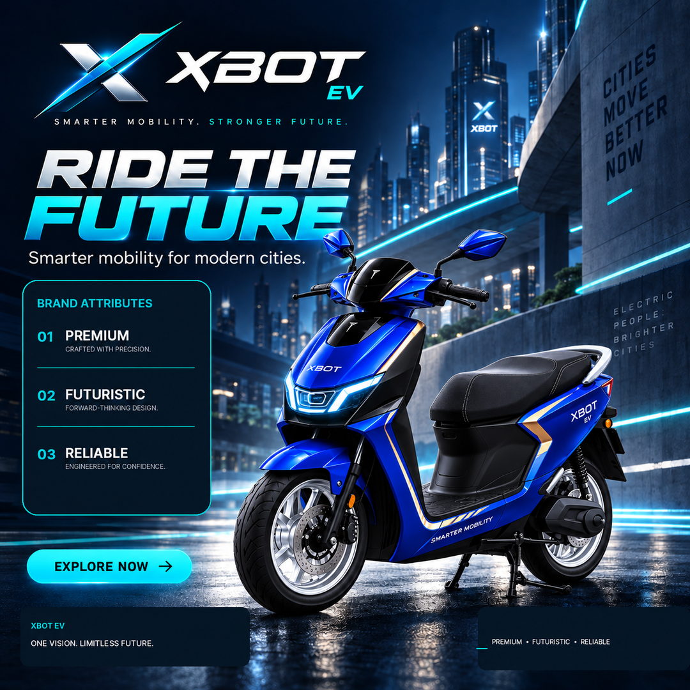

Task 1A — Instagram Feed
Purpose
Why We Use This
Purpose: Build instant product impact in a square feed format where users scroll fast and decide within seconds whether the brand looks credible.
Why this format: Instagram feed is strong for visual recall, product announcement, portfolio proof, and reusable campaign content. A square composition gives equal priority to brand, scooter, message, and CTA.
Governance Controls
Organization Benefit
Controls used: official palette, approved brand attributes only, visible logo clear space, no unverified product claims, same hero scooter, and platform-safe text hierarchy.
Organizational benefit: improves brand recognition, creates a reusable campaign asset, supports product awareness, and gives marketing a clean template for future launches.
QA Evidence
QA evidence: checked for readability, consistent colors, claim safety, product focus, editable text layers, and correct 1080 × 1080 format.
1080 × 1080 • PRODUCT-IMPACT LAYOUT

Slide 5
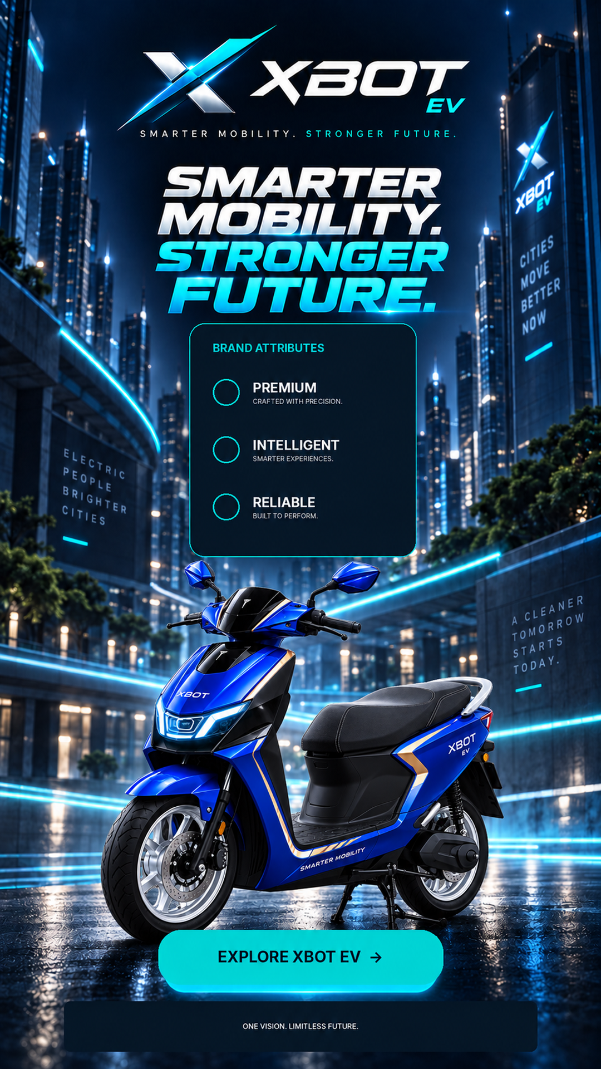

Task 1B — Instagram Story
Purpose
Why We Use This
Purpose: Create a vertical, mobile-first brand experience that feels more immersive than the feed post and pushes one simple action: Explore XBOT EV.
Why this format: Stories use full-screen attention, so the design uses vertical hierarchy, larger headline rhythm, and a clear CTA near the bottom thumb zone.
Governance Controls
Organization Benefit
Controls used: same colors, logo system, scooter, claim-safe benefit words, consistent tone, and less dense copy so the vertical format stays readable.
Organizational benefit: supports campaign reach, mobile engagement, and paid/social story placements while keeping the same brand system intact.
QA Evidence
QA evidence: checked safe area, top logo visibility, bottom CTA visibility, text contrast, no unsupported booking claim, and correct 1080 × 1920 format.
1080 × 1920 • MOBILE-FIRST VERTICAL LAYOUT

Slide 6
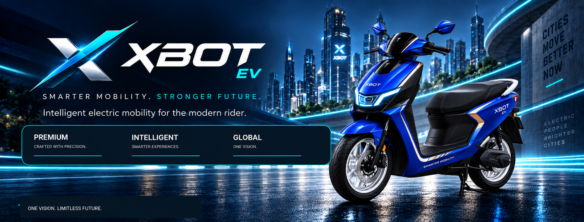

Task 1C — Facebook Cover
Purpose
Why We Use This
Purpose: Build a wide brand billboard for profile/page visibility, using a calmer composition that communicates the brand identity at a glance.
Why this format: Facebook cover space is wide and shallow, so the design separates message on the left and scooter on the right, avoiding cramped text.
Governance Controls
Organization Benefit
Controls used: minimal copy, approved brand attributes, wide-safe composition, logo prominence, consistent color palette, and no unverifiable performance claims.
Organizational benefit: strengthens page professionalism, supports campaign consistency across platforms, and gives the organization a reusable hero banner.
1640 × 624 • WIDE BRAND-BILLBOARD LAYOUT
QA Evidence
QA evidence: checked wide readability, central/safe area composition, brand alignment, low text clutter, and correct 1640 × 624 working size.

Slide 7
Case Study & Final Submission Governance
Objective
Approach
Create three XBOT EV social media assets that look premium, futuristic, and reliable while remaining safe for assessment use and aligned with the supplied brand identity.
I used one campaign system, then adapted composition by platform. Feed focuses on impact, Story focuses on vertical engagement, and Facebook Cover focuses on wide brand presence.
Why This Benefits The Organization
Governance Controls
This gives XBOT EV a reusable design system, supports brand recall across platforms, reduces inconsistent campaign output, and keeps marketing copy safer by avoiding unsupported product claims.
Brand palette, logo clear space, typography hierarchy, platform dimensions, claim-safe vocabulary, visual consistency, editability, and final package traceability.
Submission Checklist
✓ 3 editable PPTX files
✓ 3 platform-specific layouts
✓ Claim-safe wording
✓ Purpose and rationale after each task
✓ Brand consistency and organizational benefit included
✓ Master governance deck included
READY FOR SUBMISSION AFTER FINAL MANUAL REVIEW OF SPELLING, LOGO PLACEMENT, AND REQUIRED FILE FORMATS.

