Slide 1
YouTube Trending Video Analytics
Shobana Balusamy
Email : shobana1115@gmail.com

Slide 2
Introduction
YouTube's trending section reflects global viewing interests.
This project analyzes trending video data from 6 regions: CA, DE, FR, GB, IN, and US.

Slide 3
Abstract
We analyzed over 200,000 video records using Python and Power BI.
Focus: category trends, sentiment effects, and regional engagement.

Slide 4
Tools & Technologies Used
- Python (Pandas, TextBlob): data cleaning and sentiment analysis
- Power BI: dashboard creation and interactive visuals
- Excel: intermediate storage and export

Slide 5
Steps Involved
1. Cleaned & merged datasets
2. Performed sentiment analysis on titles
3. Aggregated metrics (views, sentiments, trending days)
4. Exported data to Excel
5. Created a Power BI dashboard with filters and KPIs

Slide 6
Data Storytelling & Key Insights
- US had the highest views; GB videos trended longer
- Positive sentiment slightly boosted average views
- Entertainment & Music led across all regions
- Dashboard allows filter-based trend exploration

Slide 7
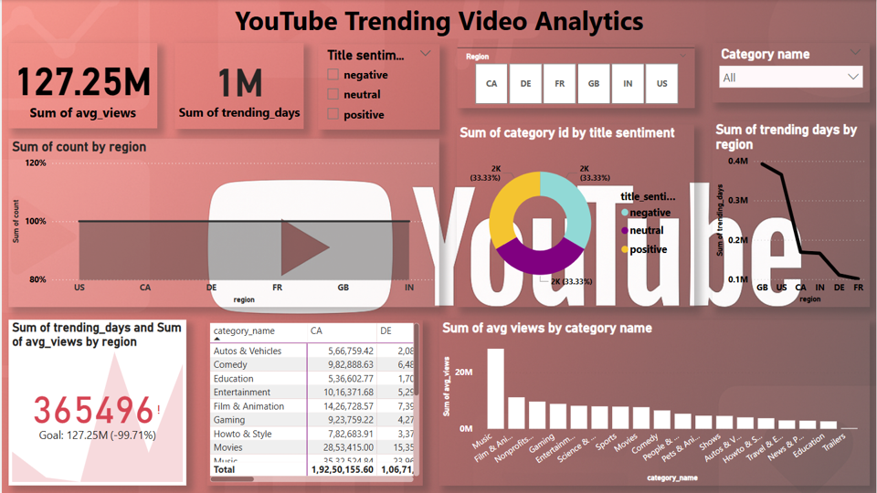
Dashboard

Slide 8
Conclusion
This project reveals how regional preferences and sentiment shape video trends.
Power BI dashboard helps uncover insights for creators and marketers.

