Slide 1
Simple Sales Performance Dashboard
Visualizing sales by Month, Region, and Category
Dataset: Superstore Sales

Slide 2
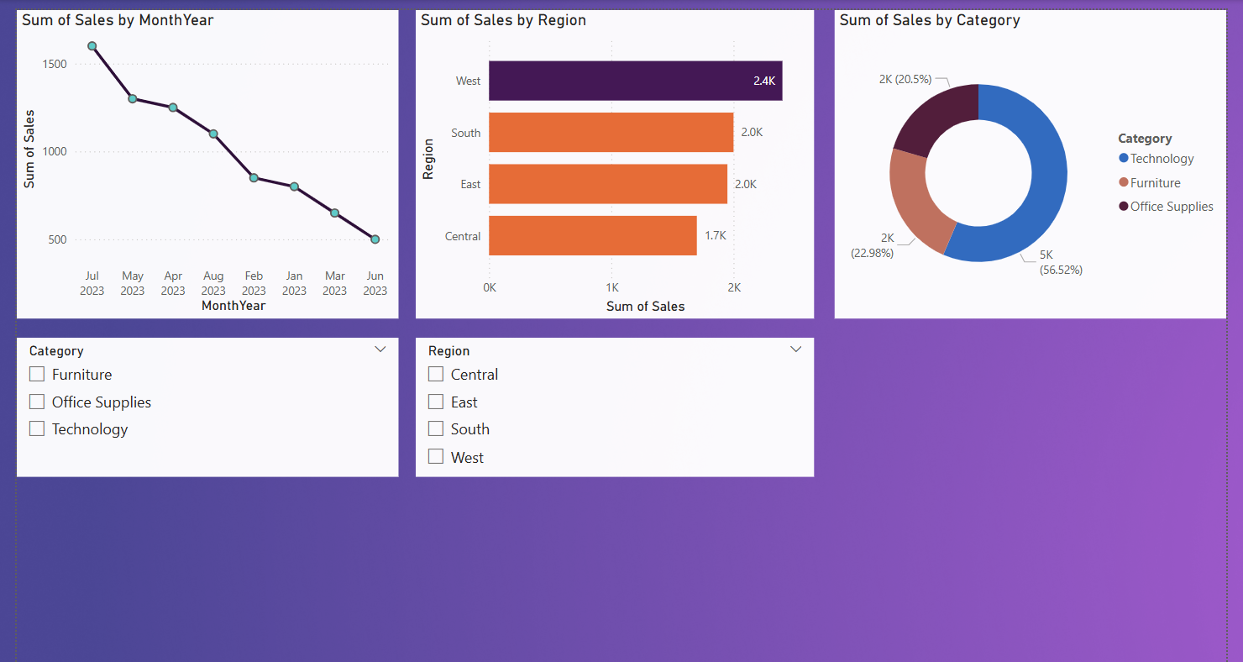
Sales Dashboard

Slide 3
Key Insights
📌 West region consistently had the highest sales across all months, especially peaking in Q3.
📌 Sales showed a steady rise toward the end of the year, with November being the best-performing month.
📌 Technology category led the sales figures, followed by Furniture. Office Supplies had the lowest share.
📌 Despite high sales, some regions like Central had lower profit margins, indicating potential cost concerns.

Slide 4
Conclusion & Recommendations
✅ Focus on promoting Technology products in underperforming regions
✅ Consider deeper analysis into profit margins by region
✅ Expand sales campaigns during Q3–Q4 to maximize yearly revenue

