Slide 1
Data Visualization and Storytelling with Power BI
Mastering Visual Storytelling with Sales Data
Shobana Balusamy | 01 Jun 2025

Slide 2
Objective & Tools
Objective: Create visualizations that convey a compelling story
Tools: Power BI
Deliverables: Visual report (Dashboard screenshots)
Outcome: Master the art of visual storytelling with charts and graphs

Slide 3
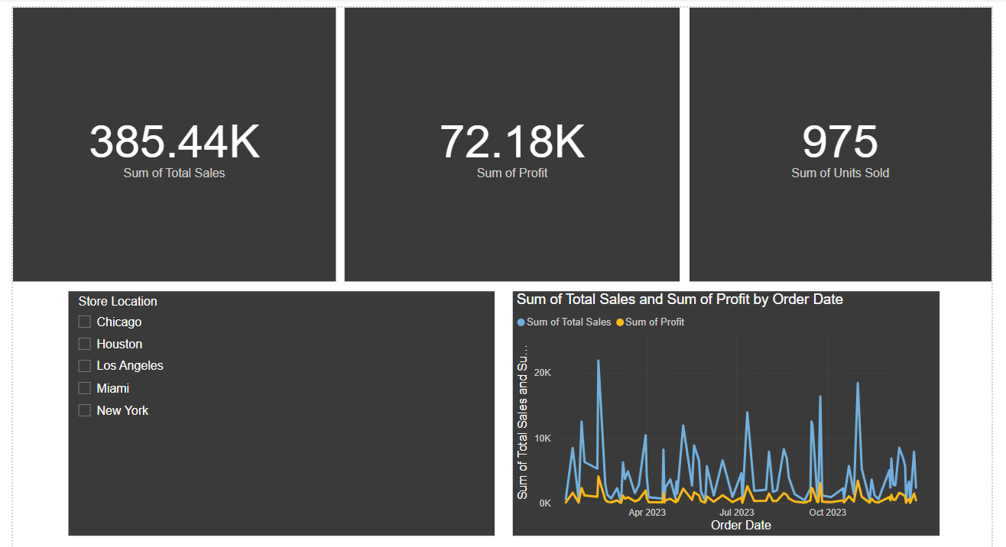
Dashboard

Slide 4
Avoid Clutter & Color Overuse
Limit color palette to 3-4 colors
Use consistent colors for categories
Avoid unnecessary gridlines and labels
Compare cluttered vs. clean chart examples

Slide 5
Highlight Key Takeaways & Add Context
Use titles and annotations to explain insights
Highlight top-performing products, regions, or months
Add narrative text boxes on slides/screenshots
Example: Sales peak in December due to holiday season

Slide 6
Focus on Business Insights
Understand what the data tells us
Identify opportunities and risks (e.g., declining sales region)
Link visuals to actionable decisions
Example: West region sales grew 15% QoQ; invest more marketing there

Slide 7
Summary & Storyboard
Recap key insights from the visual report
Use storyboard format to guide stakeholders through the story
Encourage questions and next steps

