Slide 1
Sales Performance Dashboard
Power BI Report Summary for Business Stakeholders

Slide 2
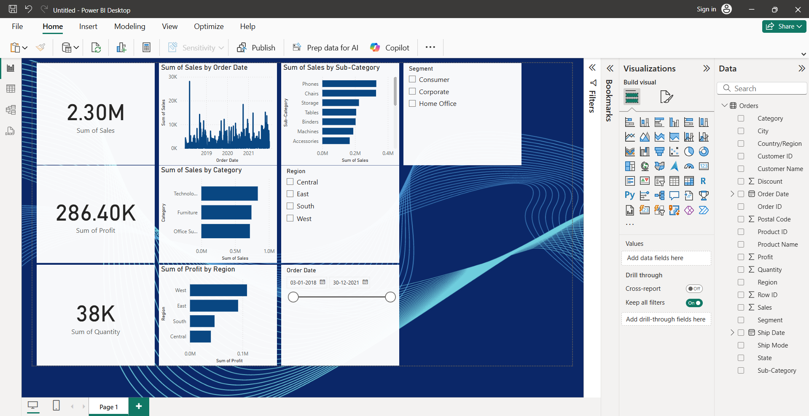
Dashboard Overview

Slide 3
Key Performance Indicators (KPIs)
Total Sales
Total Profit
Sales Growth %
Total Orders / Quantity

Slide 4
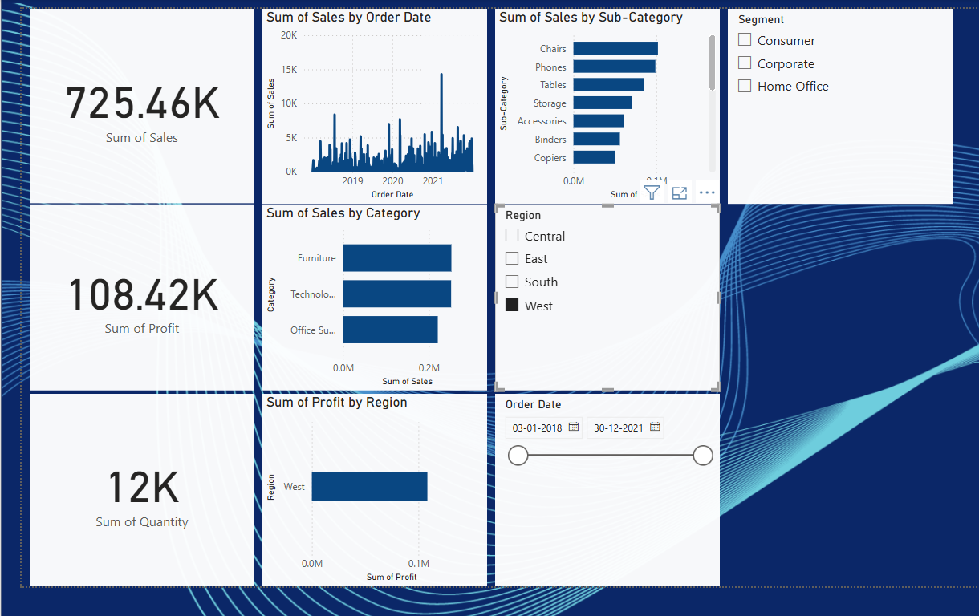
Insights
Sales are highest in the West region

Slide 5
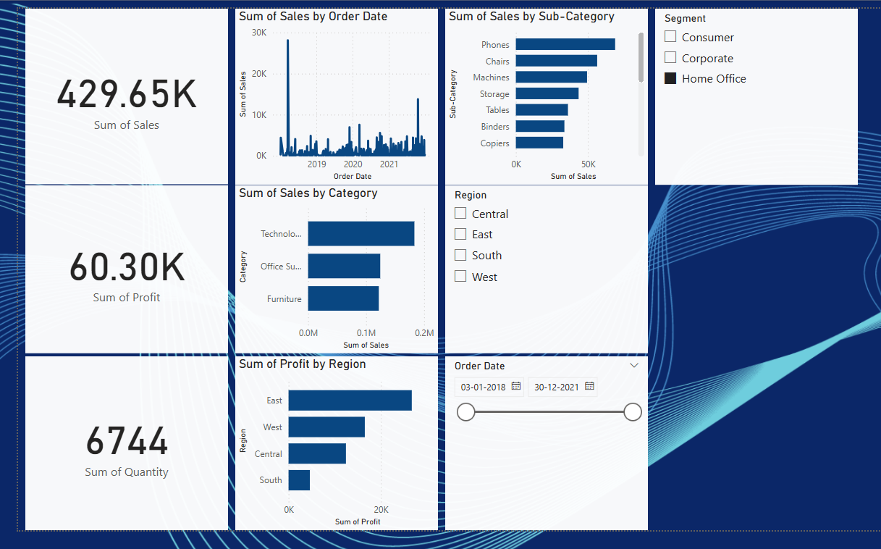
Office Supplies have the lowest profit margins

Slide 6
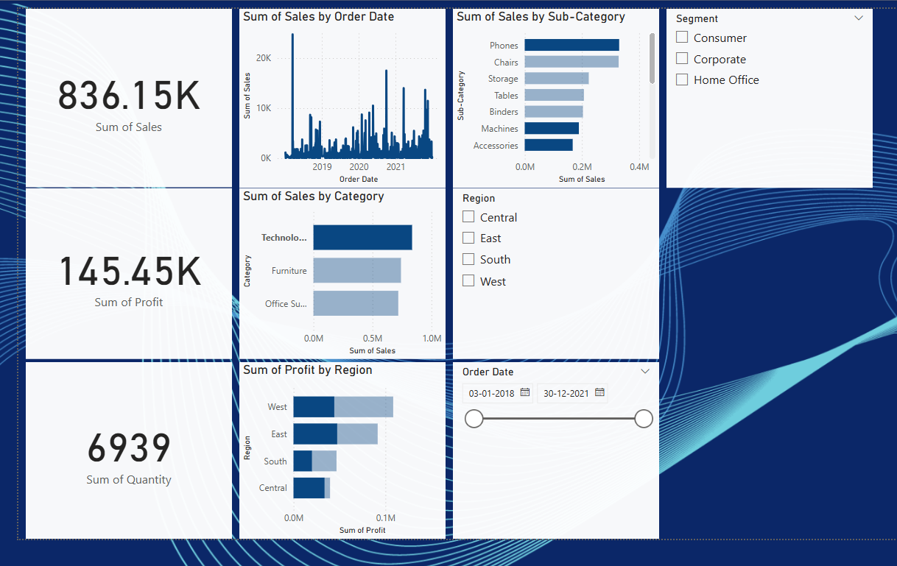
Technology category drives most of the revenue

Slide 7
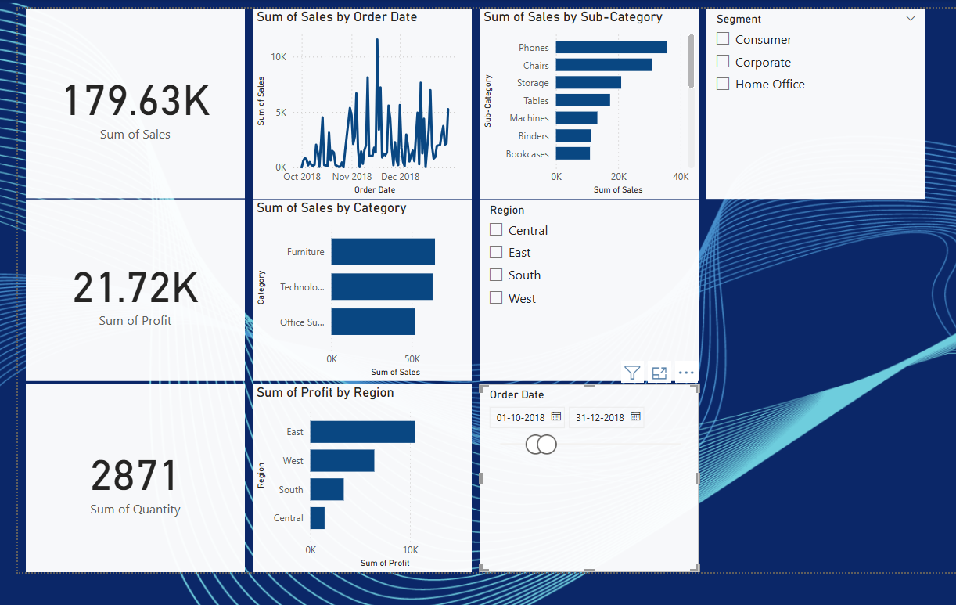
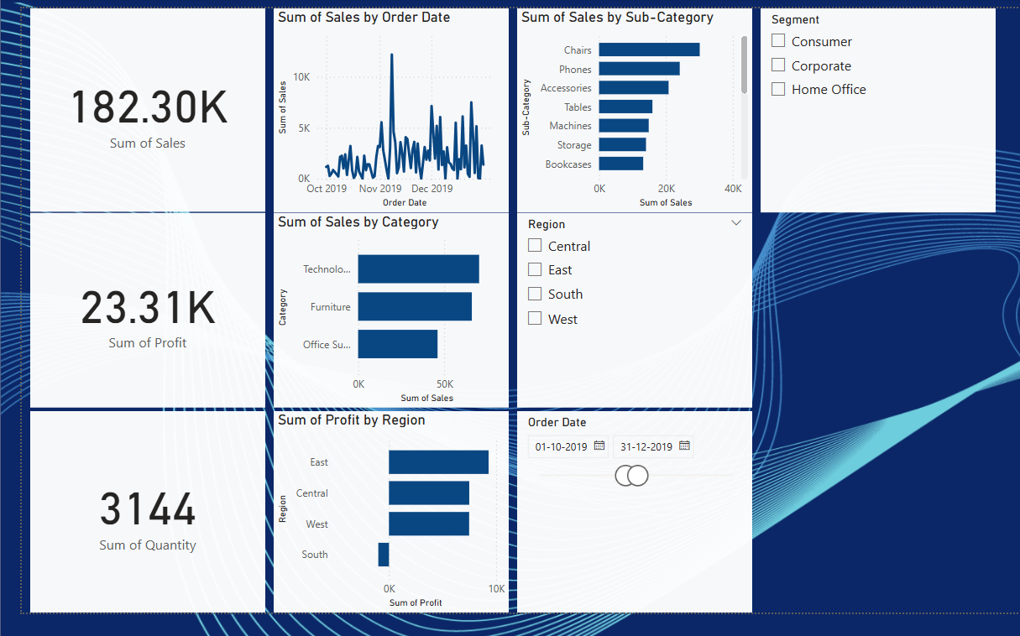
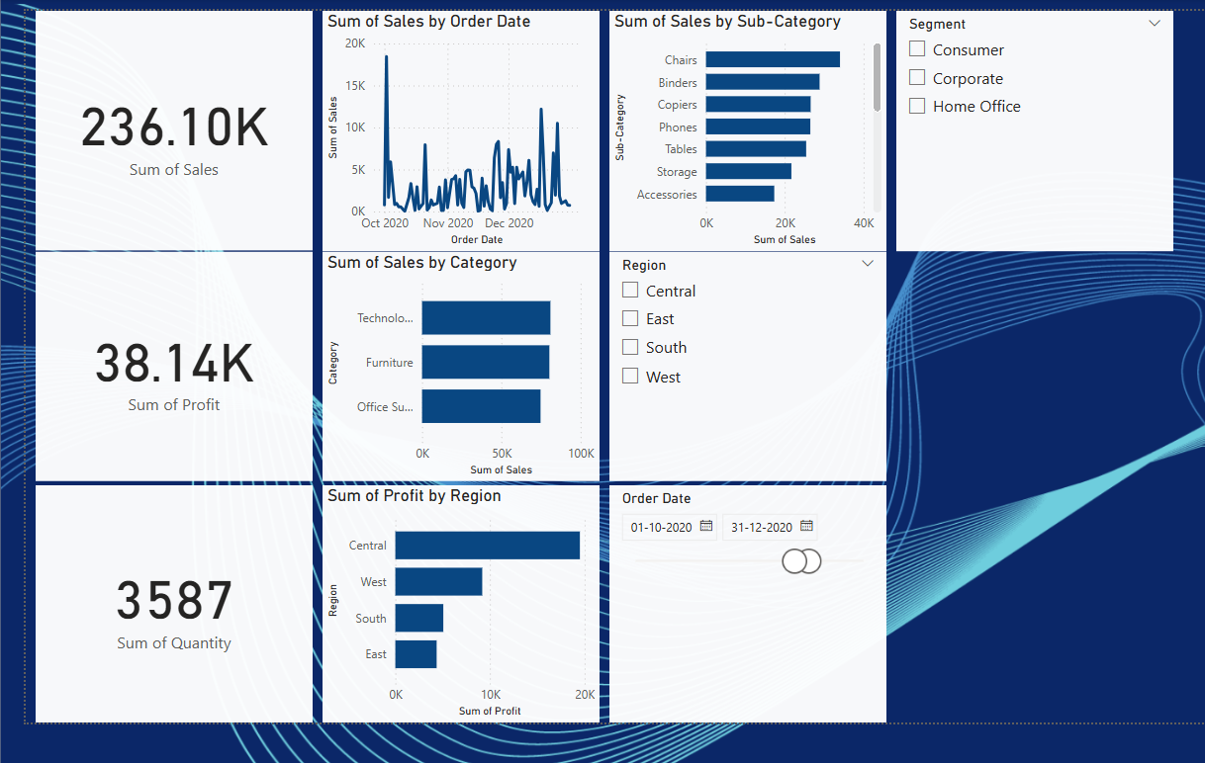
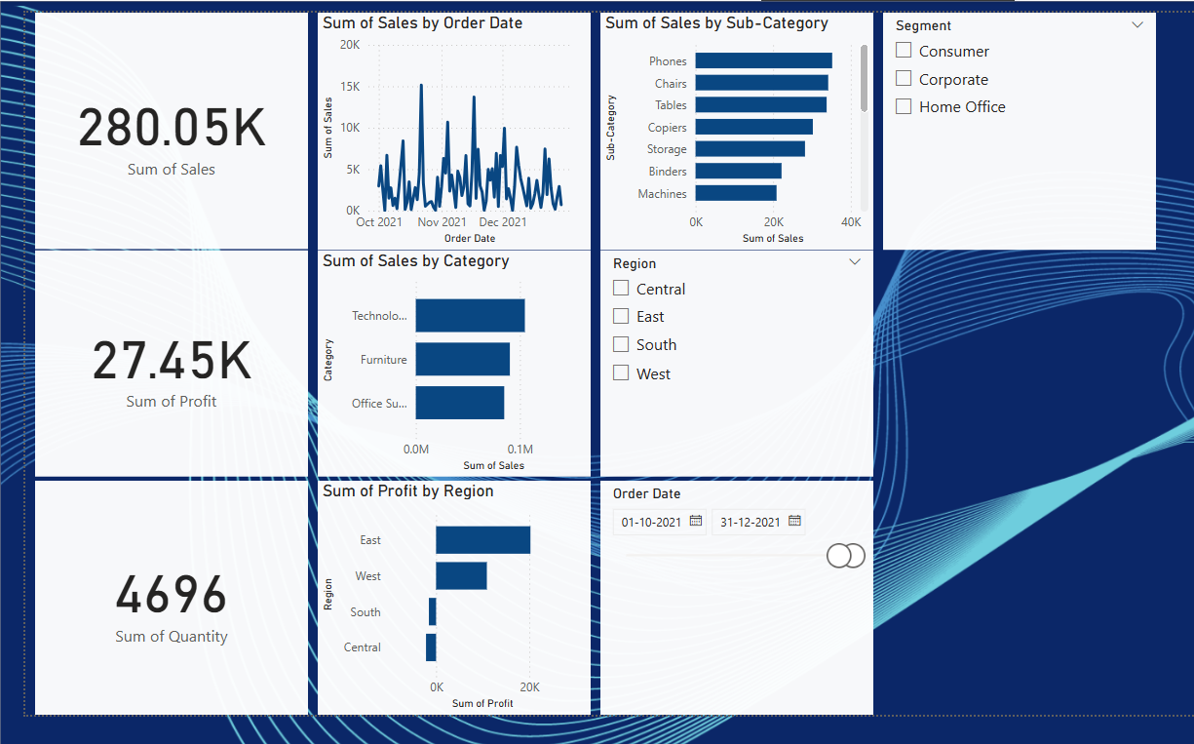
Q4 shows consistent sales spikes annually
2018
2019
2020
2021

Slide 8
Recommendations
Increase marketing focus on the West region
Review discount strategy on Office Supplies
Invest more in Technology category growth
Prepare for increased inventory demand in Q4

Slide 9
Appendix
Data Source: Sample Superstore Excel Dataset (from kaggle)
Tool Used: Power BI
Report Author: Shobana Balusamy
Date Created: 30-05-2025

