Slide 1
MACHINE LANGUAGE
Hackathon

Slide 2
agenda
Exploratory Data Analytics (EDA)
Feature Engineering
Model Building
Model Tuning
Model Performance

Slide 3
Exploratory Data Analytics (EDA)
Imbalanced Dataset
Outliers in age, length of service and no: of trainings.
Outliers in this dataset are valid as it belongs to employee’s age, service and trainings belongs to several department.
Numerical features doesn’t contribute much to target whereas all categorical features have strong relationship with target
Length of service and age features have correlation
Previous Year Rating and Education has null values

Slide 4
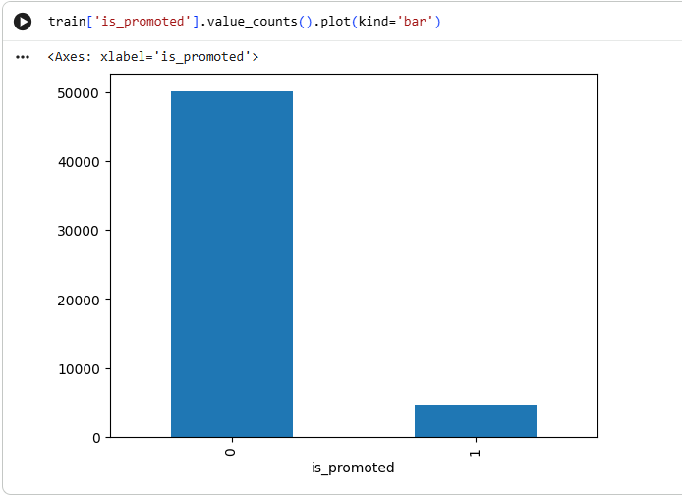
EDA OBSERVATION

Slide 5
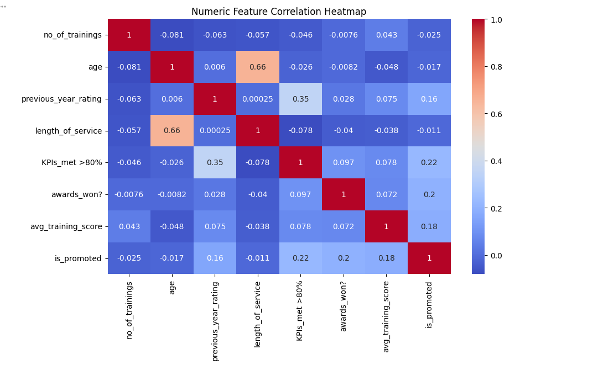
EDA OBSERVATION

Slide 6
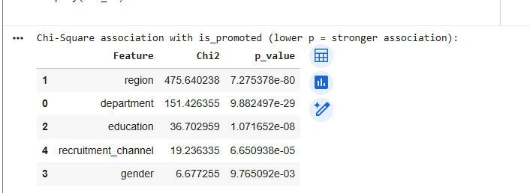
EDA OBSERVATION

Slide 7
Model Building - Approaches
Imbalanced Dataset – Used hyper parameters
Threshold Tuning
Oversampling and Undersampling before Scaling
LogisticRegression with Regularization techniques
Not tried Decision Tree as RandomForestClassifier enhanced approach is used
Bagging algorithm – RandomForestClassifier
Boosting algorithm - XGBoostClassifier

Slide 8
Model TUNING
Algorithm | Parameter | Threshold | Train/Test Score | Submission Score
LR | LogisticRegression(C=0.5, class_weight='balanced', penalty=None, random_state=42) | 0.35 | Train score : 0.3754699537750385 Test score : 0.3794642857142857 | 0.34
LR | LogisticRegression(C=0.5, class_weight='balanced', penalty=None, random_state=42) | 0.55 |  | 0.38
LR | LogisticRegression(C=3, class_weight='balanced', penalty='l1', random_state=42, solver='saga') | 0.55 |  | 0.38
RF | RandomForestClassifier(class_weight='balanced', max_features=None) | 0.35 | Train score : 0.9982733430734493 Test score : 0.46889226100151743 | 0.47
RF | Same as above | 0.55 |  | 0.47
RF | Same as above | 0.55 |  | 0.47
RF | US | default |  | 0.38

Slide 9
Model TUNING
Algorithm | Parameter | Threshold | Train/Test Score | Submission Score
XGB |  | 0.55 |  | 0.48
XGB | XGBClassifier(base_score=None, booster=None, callbacks=None, colsample_bylevel=None, colsample_bynode=None, colsample_bytree=0.9, device=None, early_stopping_rounds=None, enable_categorical=False, eval_metric=None, feature_types=None, feature_weights=None, gamma=None, grow_policy=None, importance_type=None, interaction_constraints=None, learning_rate=0.1, max_bin=None, max_cat_threshold=None, max_cat_to_onehot=None, max_delta_step=None, max_depth=5, max_leaves=None, min_child_weight=None, missing=nan, monotone_constraints=None, multi_strategy=None, n_estimators=None, n_jobs=None, num_parallel_tree=None, ...) | 0.35 | Train score : 0.41104972375690607 Test score : 0.38784713980536434 | 0.34
XGB | Same as above | 0.55 |  | 0.43
XGB with oversampling | Same as above | 0.35 |  | 0.34
XGB with oversampling | Same as above | 0.55 |  | 0.40

Slide 10

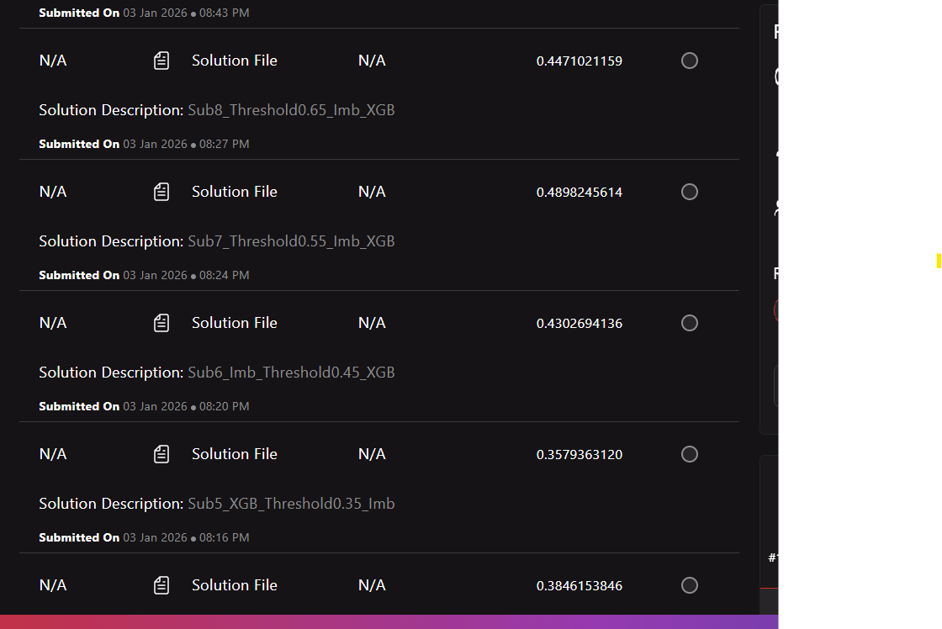
Submission SCORE TREND

Slide 11
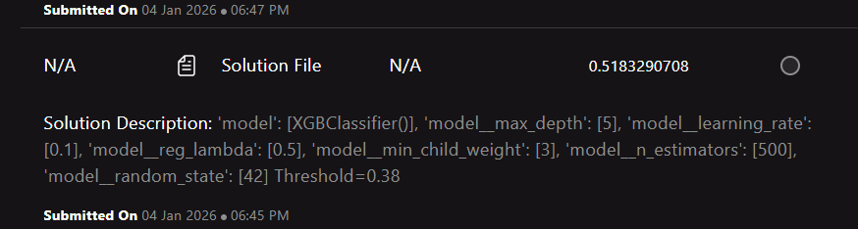

XGB Parameter TUNING – Max Score

Slide 12
Cloud Services
Cloud Service | Service URLS
Fast API | https://console.cloud.google.com/run/detail/europe-west1/promotionfastapi?project=project-4fbc3260-9165-45b9-bb7
Web UI | https://console.cloud.google.com/run/detail/asia-south1/employeepromotion?project=project-4fbc3260-9165-45b9-bb7

Slide 13
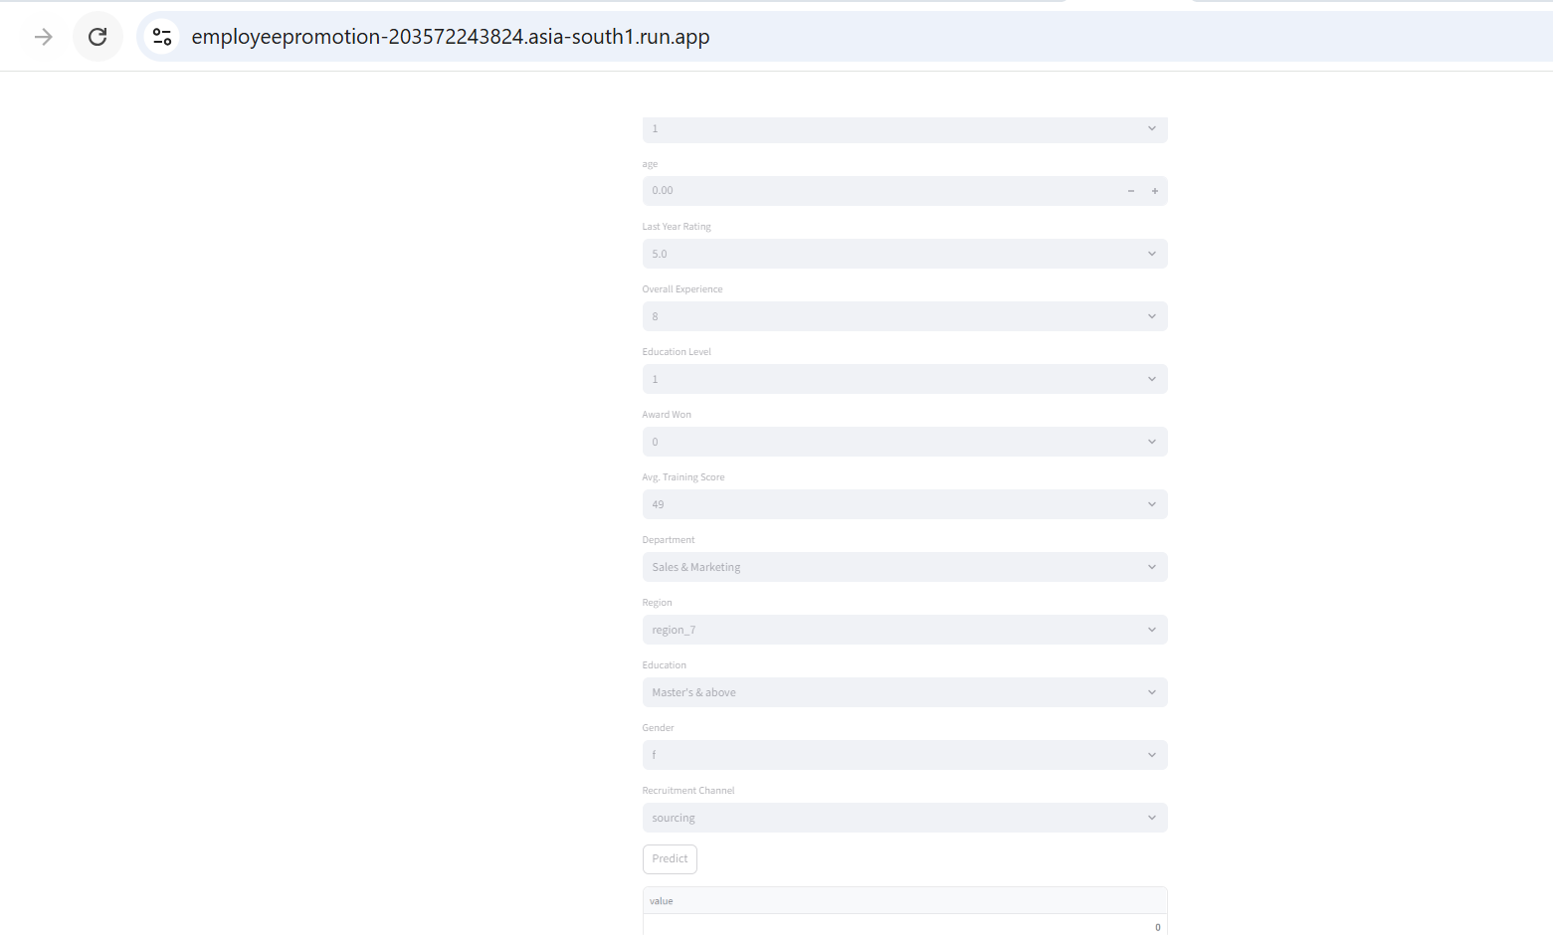
Web UI

Slide 14
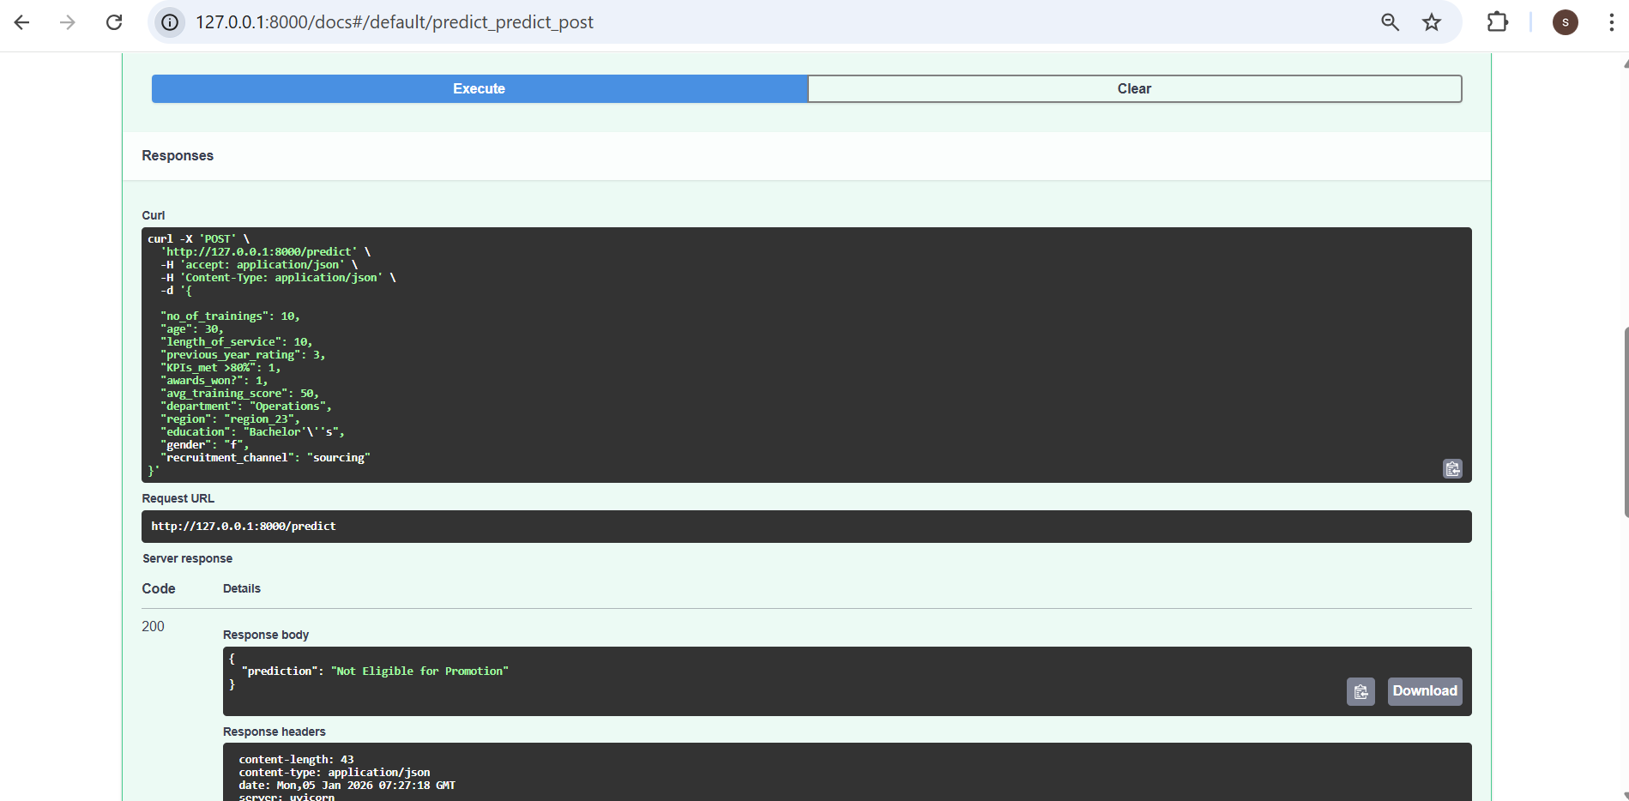
Fast API

Slide 15
Repository LINKS
Repo | Service URLS
Source Code | https://github.com/ShobanaSamyayyah/MLHackathonEmpPromotion
Fast API | https://github.com/ShobanaSamyayyah/PromotionFastAPI
Web UI | https://github.com/ShobanaSamyayyah/EmployeePromotion

Slide 16
Thank you
Shobana Samyayyah

