Slide 1
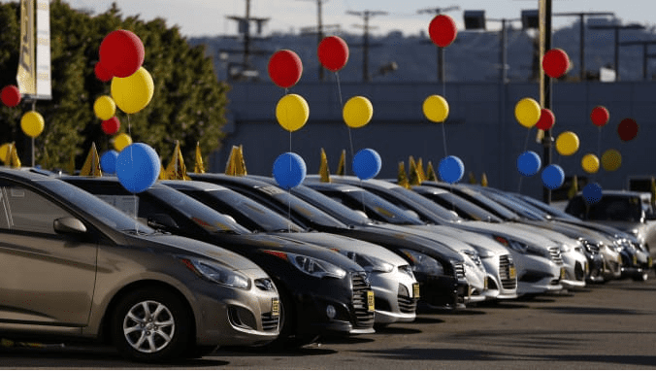
EDA on Car sales data
By
Shobana Elango
shobanaelango@ymail.com
shobanaelangocook@gmail.com
7200288649
August 2020 Batch
Term 1 & 2 Project

Slide 2
Introduction
Cars run primarily on roads, seat one to eight people, have four tires, and mainly transport people rather than goods. Cars came into global use during the 20th century, and developed economies depend on them.
It is useful to analyze and see the pattern of car sales data of different brands and model over a period of time to see the evolution and use of cars by the general population which could help in more sales of cars and investment in the right brand, model, version and type by a dealership which people prefer which in turn boost more sales and bring about profit.

Slide 3
Problem Statement Questions to be answered:
Top 10 Most Purchased Car brands
Most preferred model from the top 10 car brands
Top 10 highest price of cars bought by users
Correlation of cars and other variables
Cars registration pattern through years
Pattern of Car brands without Registration
Most preferred body type in the past 10 years
Top most preferred body type car brands of all time
Top most preferred body type car brands in the last 10 year
Years with most car purchase
Preference of people based on engine type – Petrol or Diesel

Slide 4
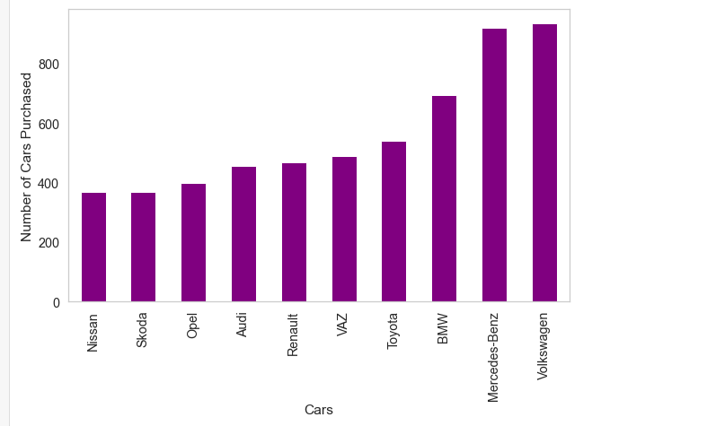
Top 10 Most Purchased Car brands
We can see from the plot that the most preferred car brand of all time is Volkswagen
and the others are the top 10 most preferred models

Slide 5
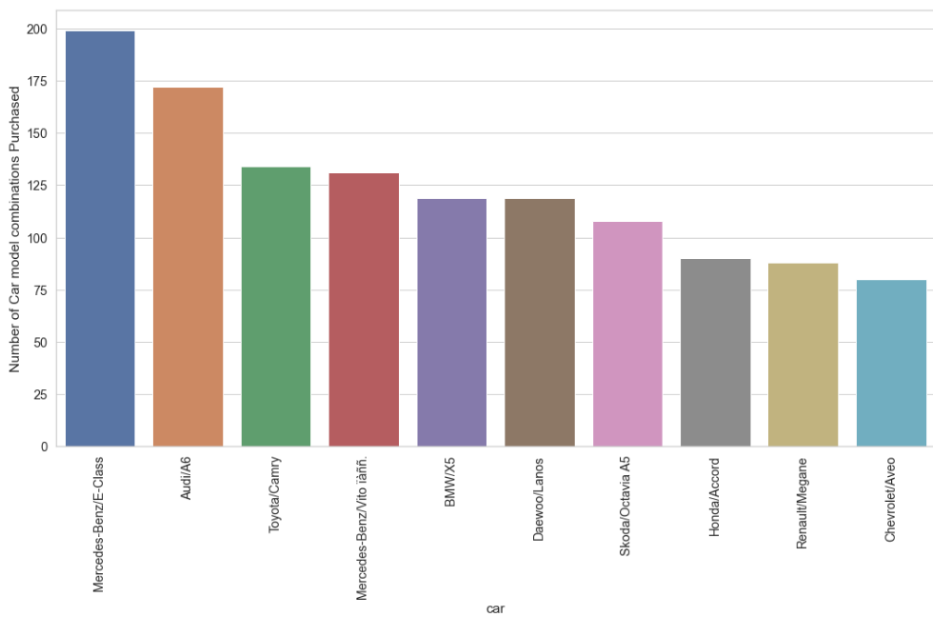
Most preferred model from the top 10 car brands
Mercedes-Benz and E-Class is the most purchased Car brand model by users

Slide 6
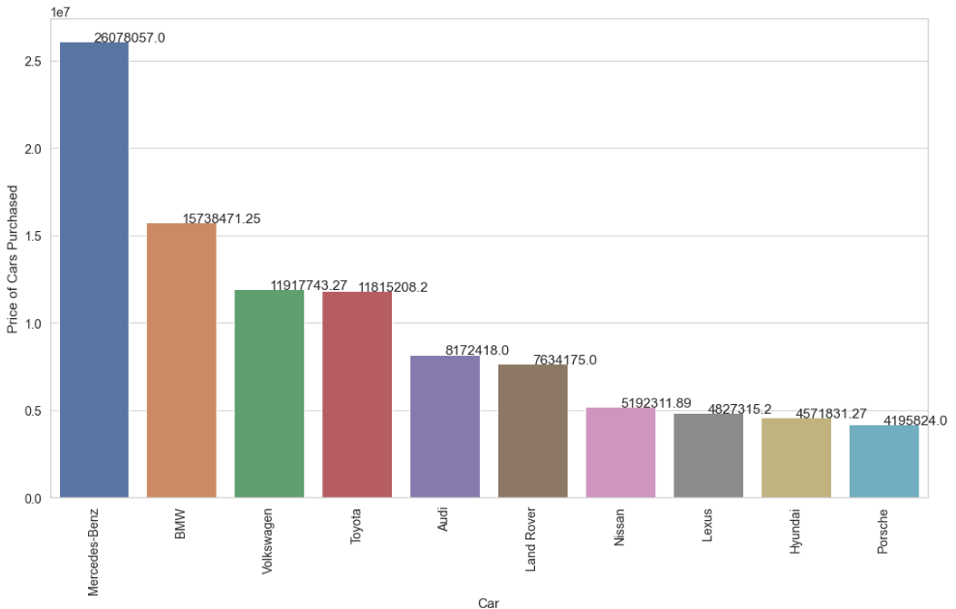
Top 10 highest price of cars bought by users.
Mercedes-Benz is the costliest car preferred most by users

Slide 7
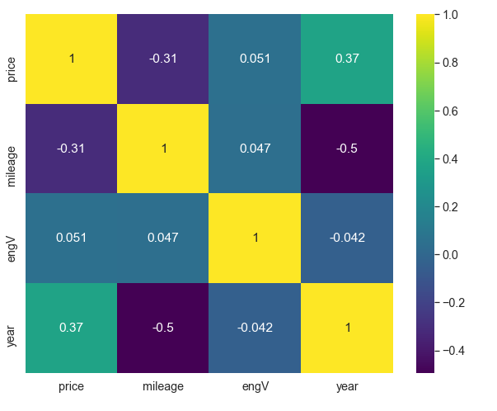
Correlation of cars and other variables
There is a positive correlation to Year of purchase and price of the cars

Slide 8
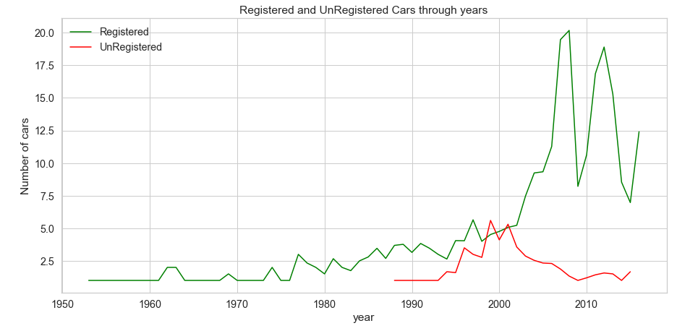
Cars registration pattern through years

Slide 9
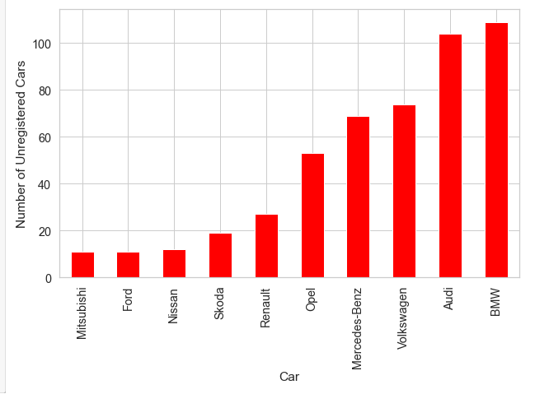
Pattern of Car brands without Registration
BMW and Audi are the top two unregistered car brands of all time

Slide 10
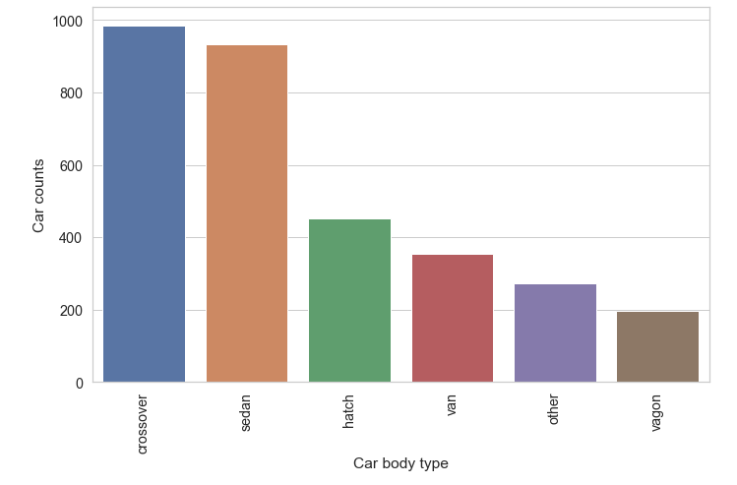
Most preferred body type in the past 10 years
From the bar plots, we can see that crossover is the most preffered body type
followed by Sedan

Slide 11
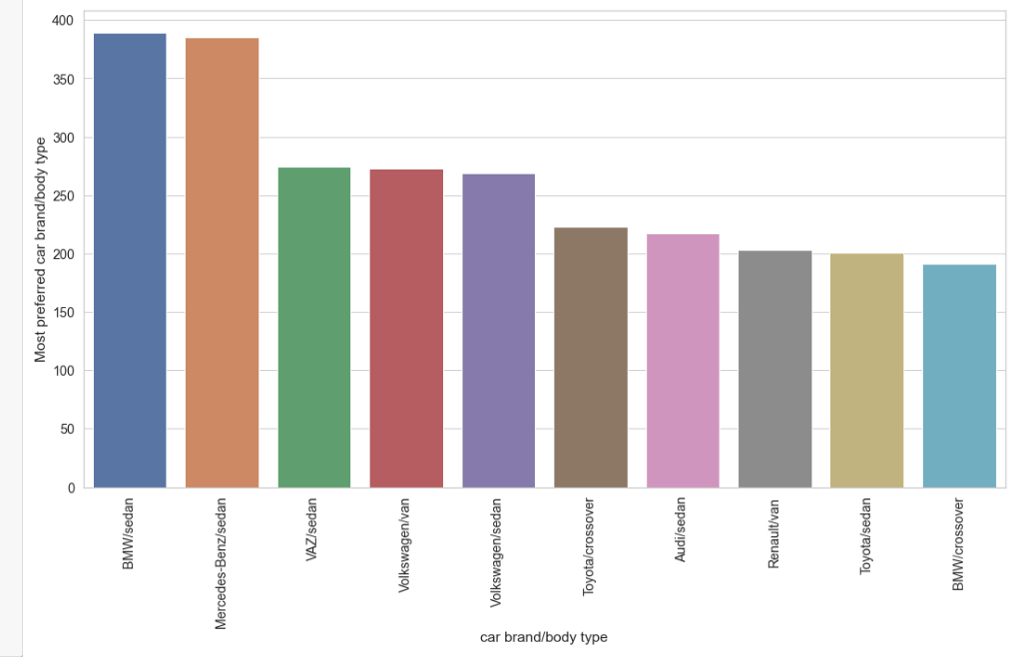
Top most prefered body type car brands of all time
BMW-sedan is the most preferred car brand/body type combination
and the rest shows the top 10 combination prefered by users in general

Slide 12
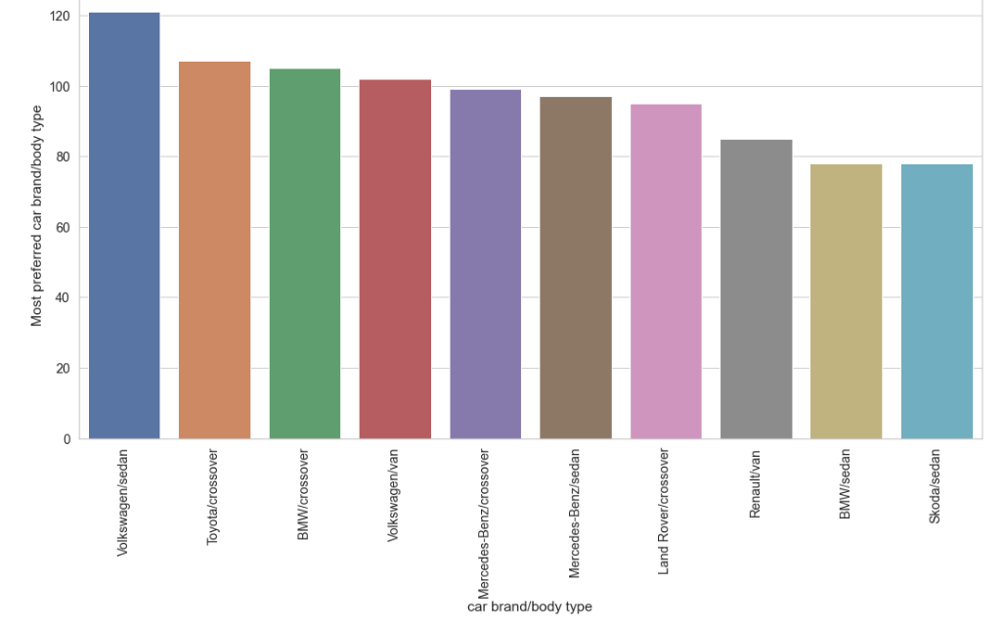
Top most preferred body type car brands in the last 10 years
Volkswagen/Sedan is the most preferred combination of car/body type in the last 10 years

Slide 13
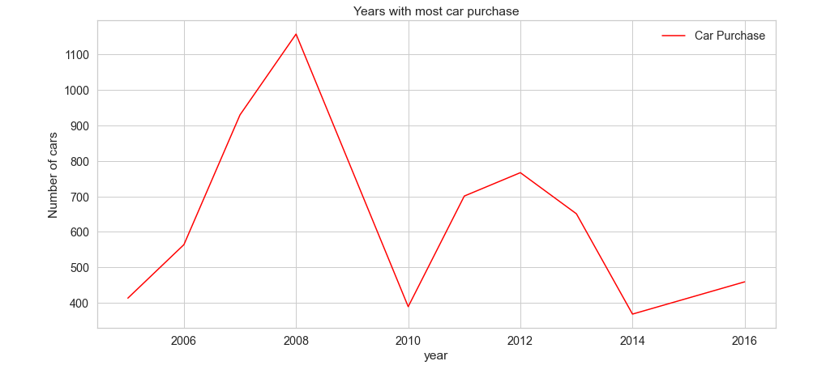
Years with most car purchase.
From the graph, we can see that 2008 has the most car sales of all years

Slide 14
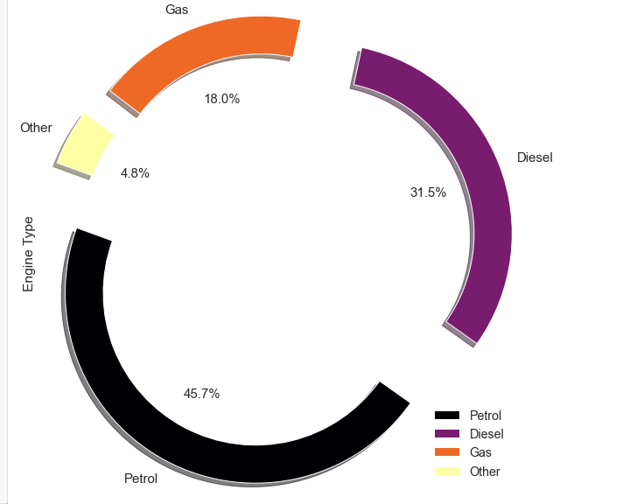
Preference of people based on engine type
From the Donut chart its evident that Petrol Engines are most preferred
by people followed by Diesel

Slide 15
Summarization
Conclusion
We have identified best performing car brands, models, engine types and body types based on car sales data
Actionable Insights
From the list of most preferred purchase insights based on car brands, models, engine types, body types and versions, the car showrooms and dealerships can invest in the correct types of cars which would yield higher sales.
Also based on the increase in the car sales pattern, the dealership can make low risk investments.
This data can be used to bid on car companies in share market and the insights can be of huge help in automotive industries

