Slide 1
CURRENCY EXCHANGE RATE FORECASTING BY USING SARIMA MODEL
PRESENTED BY
SANJAI S (2116210701230)
SHOBAN KUMARESAN (2116210701245)
SIDDARTH V(2116210701249)

Slide 2
ABSTRACT
In an increasingly globalized economy, currency exchange forecasting helps firms and investors manage risks and maximize rewards.
It is a critical component of financial decision-making. Time series analytic techniques that can capture temporal patterns and exchange rate variations, like SARIMA (Seasonal Autoregressive Integrated Moving Average), have become more popular.
This work provides a thorough analysis and implementation of the SARIMA algorithm.
The SARIMA algorithm is a powerful tool for modeling and predicting the intricate dynamics of exchange rates because it combines seasonal fluctuations with the autoregressive (AR), differencing (I), and moving average (MA) components.

Slide 3
INTRODUCTION
In today's worldwide economy, anticipating currency exchange rates is essential to financial planning and decision-making.
To manage risks, maximize investments, and seize market opportunities, firms, investors, and regulators need to be able to forecast exchange rates with enough accuracy.
Modern statistical techniques, like Seasonal Autoregressive Integrated Moving Average (SARIMA) models, have become effective instruments for time series analysis and foreign currency forecasting in recent years.
With trillions of dollars changing hands every day, the foreign exchange market, or forex market, is the biggest and most liquid financial market in the world.

Slide 4
OBJECTIVES
Identify Trends and Seasonality: Analyze historical exchange rate data to uncover underlying trends (upward, downward, or flat) and seasonal patterns (e.g., monthly fluctuations). The SARIMA model excels at capturing these characteristics in time series data.
Develop a Reliable Forecasting Model: Build a SARIMA model that effectively captures the identified trends and seasonality. This model will be used to predict future exchange rates for a specified timeframe.
Evaluate Model Performance: Assess the accuracy of the SARIMA model using appropriate metrics like Root Mean Squared Error (RMSE) or Mean Absolute Error (MAE). This helps determine the model's effectiveness in predicting exchange rates.
Inform Decision-Making: Provide valuable insights derived from the forecasts. This information can be used by businesses and individuals to make informed decisions about currency conversions, hedging strategies, and international financial transactions.

Slide 5
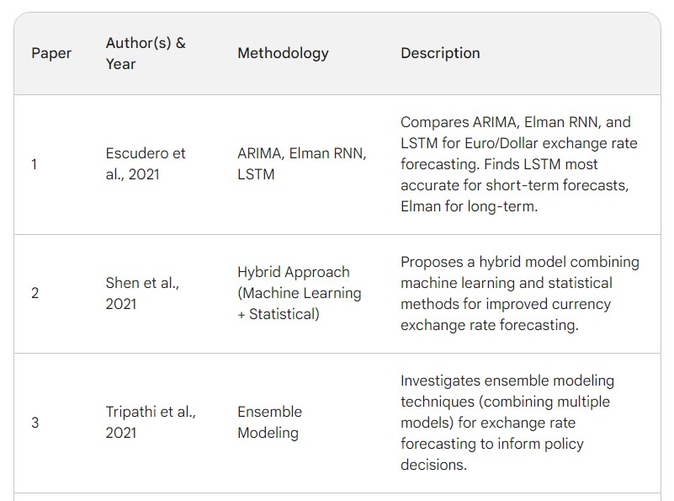
LITERATURE SURVEY

Slide 6
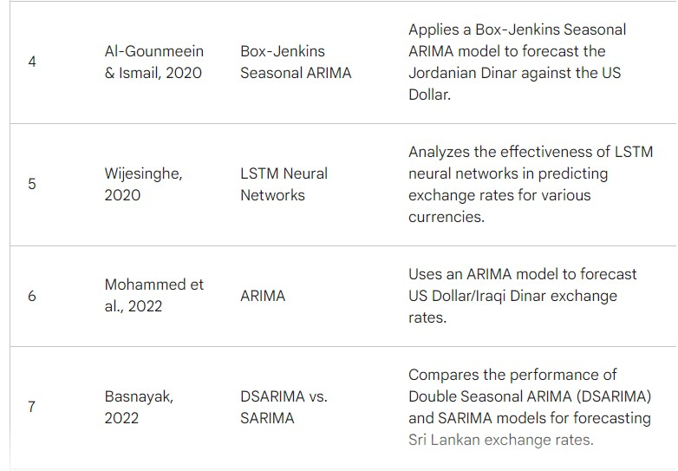
LITERATURE SURVEY (CONT.)

Slide 7
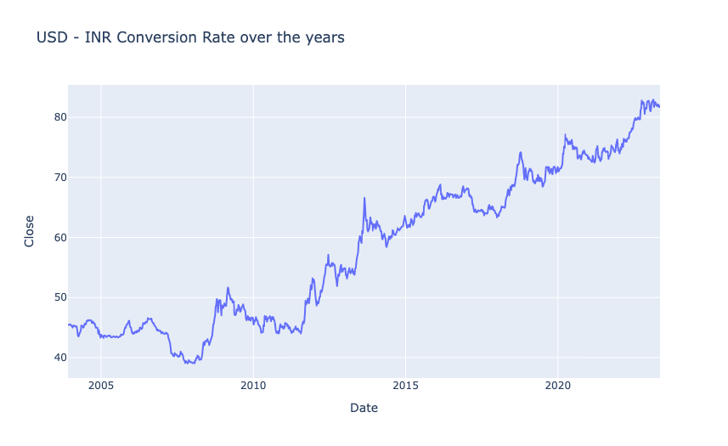
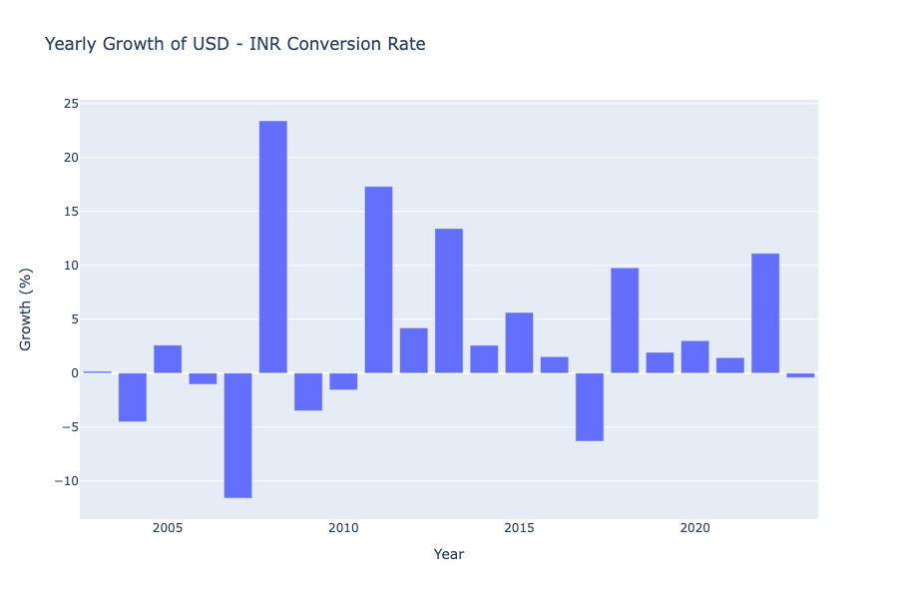
PROJECT DESCRIPTION
USD – INR Conversion Rate Analysis
Yearly Growth of USD – INR Conversion Rate

Slide 8
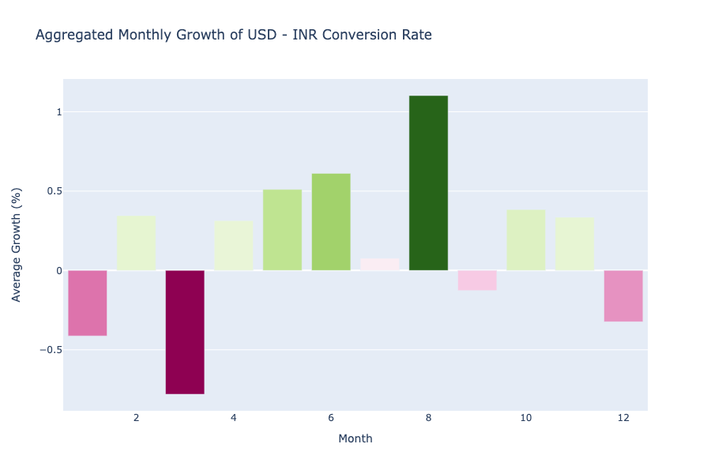
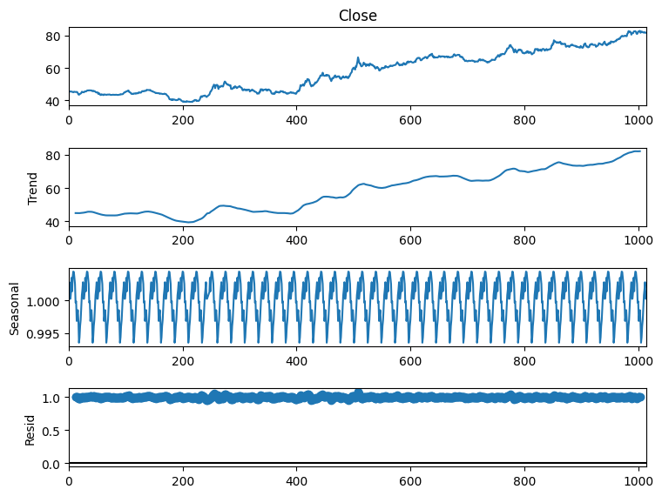
PROJECT DESCRIPTION (CONT.)
Monthly Growth of USD – INR Conversion Rate
Forecasting Exchange Rates Using Time Series Forecasting

Slide 9
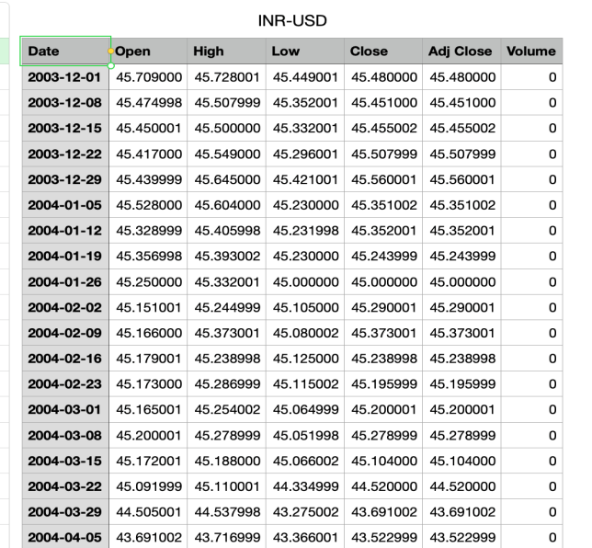
DATASETS
It looks like from the figure 6, the data is a time series for currency exchange rates in the financial domain. The dates in the rows are probably daily dates spanning from December 2003 to March 2004.
The currency rate in Indian rupees (INR) for one US dollar (USD) on that date is displayed in the columns.
A stock or future tracking the exchange rate may be the subject of the additional columns for high, low, closing, and modified closing prices.

Slide 10
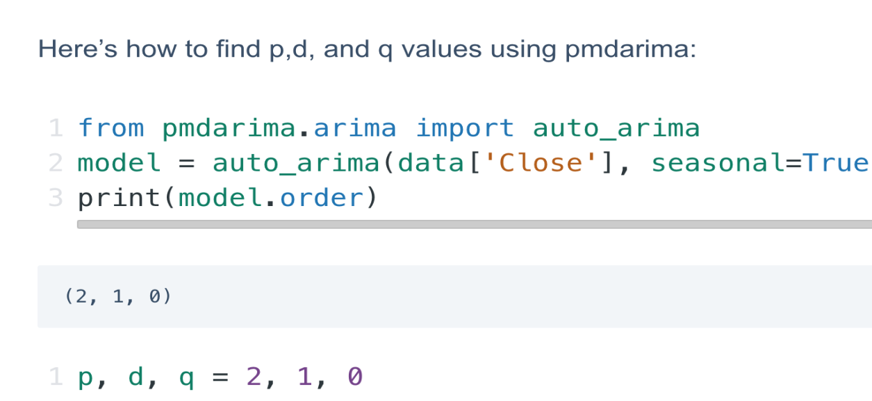
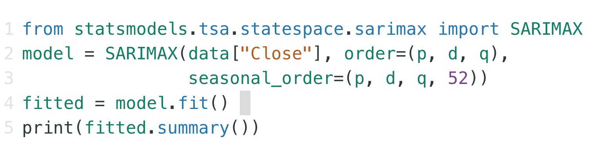
RESULTS AND DISCUSSION
Here’s how to find p,d, and q values using pmdarima

Slide 11
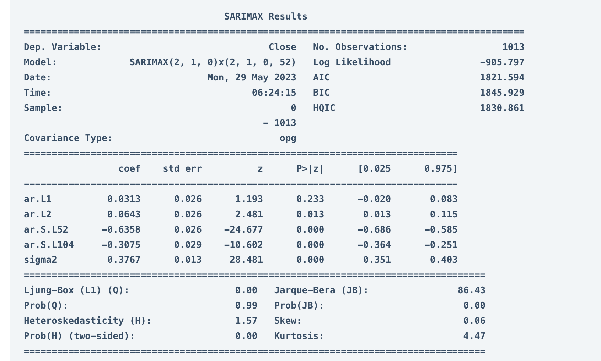
RESULTS AND DISCUSSION(CONT.)
SARIMAX (2, 1, 0)x(2, 1, 0, 52) - This is the specific SARIMA model formula used in the analysis. It defines the number of autoregressive (AR) terms (2), differencing steps (1), and moving average (MA) terms (0) for the model itself, along with seasonal AR terms (2), seasonal differencing (1), and seasonal MA terms (0, 52). Log Likelihood: -1013.797 - This is a statistical measure used to assess how well the model fits the data. Lower values indicate a better fit.

Slide 12
CONCLUSION AND FUTURE WORK
Beyond forecasting, implementing USD-INR conversion rates requires careful consideration. Several methods cater to different needs.
Currency converter APIs offer a convenient and accurate solution, fetching real-time or historical data through code integration.
Web scraping provides a free alternative, but requires programming knowledge and maintenance due to potential website changes.
Manual lookups on financial websites are readily available but lack real-time updates and may be cumbersome for bulk conversions.
Lastly, storing historical data offline presents a cost-effective option, but the data can become outdated.

Slide 13
REFERENCES
Recurrent neural networks and ARIMA models for euro/dollar exchange rate forecasting P Escudero, W Alcocer, J Paredes - Applied Sciences, 2021
An effective hybrid approach for forecasting currency exchange rates ML Shen, CF Lee, HH Liu, PY Chang, CH Yang - Sustainability, 2021
Exchange rate forecasting using ensemble modeling for better policy implications M Tripathi, S Kumar, SK Inani - Journal of Time Series Econometrics, 2021
Forecasting the exchange rate of the Jordanian Dinar versus the US dollar using a Box-Jenkins seasonal ARIMA model RS Al-Gounmeein, MT Ismail - International Journal ,
Time series forecasting: Analysis of LSTM neural networks to predict exchange rates of currencies S WIJESINGHE - Instrumentation, 2020
US Dollar/IQ Dinar currency exchange rates time series forecasting using ARIMA model PA Mohammed, SA Obed, IM Ali - Cihan University, 2022
Forecasting exchange rates in Sri Lanka: a comparison of the double seasonal autoregressive integrated moving average models (DSARIMA) and SARIMA B Basnayak –
Journal of Science of the..., 2022
8. Turkish lira Exchange rate forecasting using time series models MAH Ashour, IAH Al-Dahhan - IJASOS-International E …, 2020

Slide 14
REFERENCES
Forecasting foreign currency exchange rate using convolutional neural network MM Panda, SN Panda, PK Pattnaik - IJACSA) International Journal of …, 2022
Impact of Exchange Rate Devaluation in Ethiopia and Forecasting Foreign Exchange Rate Using ARIMA Model T Alamneh, Malebo - European Journal of Business and …, 2021
Forecasting exchange rates: An empirical application to Pakistani rupee M ASADULLAH, A BASHIR… - The Journal of Asian …, 2021
Forecasting Consumer Price Index and Exchange Rate using ARIMA Models: Empirical Evidence from Nigeria A Ibrahim, UM Sani, VO Olokojo - FUDMA Journal of …, 2022
A Kalman filter-based hybridization model of statistical and intelligent approaches for exchange rate forecasting M Khashei, B Mahdavi Sharif - Journal of Modelling in Management, 2021
FOREX trend analysis using machine learning techniques: INR vs USD currency exchange rate using ANN-GA hybrid approach PK Sarangi, M Chawla, P Ghosh, S Singh… - Materials Today …, 2022
US dollar/Turkish lira exchange rate forecasting model based on deep learning methodologies and time series analysis H Yasar, ZH Kilimci - Symmetry, 2020
Forecasting exchange rate of Pakistan using time series analysis S Akhtar, M Ramzan, S Shah, I Ahmad… - Mathematical …, 2022

