Slide 1
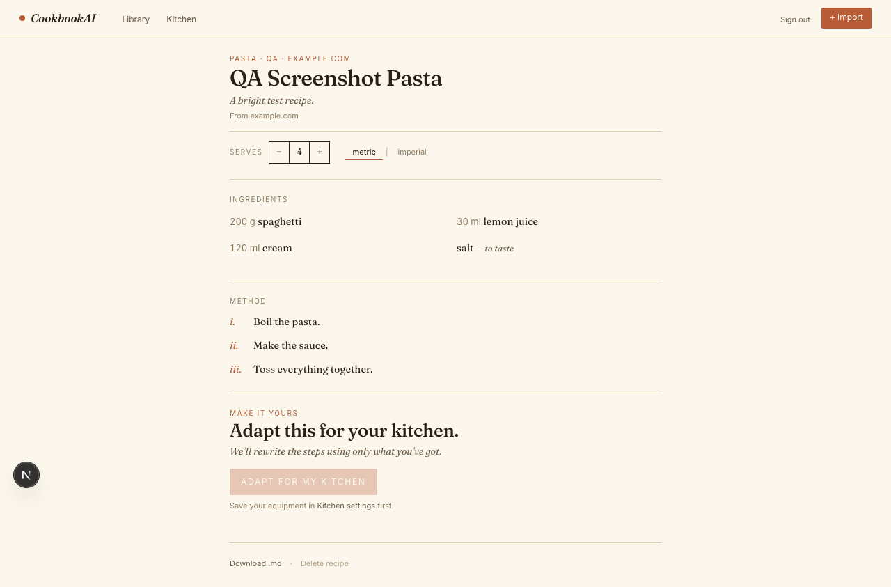
PITCH DEMO
CookbookAI brings recipes home.
A personal cookbook that imports recipes from websites and YouTube, then adapts them to the kitchen a user actually has.
URL
AI
Library
Import from recipe pages and YouTube links
Extract, structure, and adapt method steps
Save the result as a private recipe
WARM DOMESTIC + EDITORIAL DISCIPLINE
CookbookAI pitch demo
01

Slide 2
THE PROBLEM
Home cooks discover everywhere, but cook from nowhere.
Recipes live across blogs, videos, screenshots, bookmarks, and pasted notes. The saving is messy; the adapting is still manual.
Friction compounds at the exact moment the user wants to cook, not organize.
Recipe sites
YouTube
Kitchen reality
Long pages, paywalls, JS-heavy markup, SEO clutter.
Recipe may be a blog link, description text, or transcript.
Different servings, units, appliances, and pantry constraints.
Today the cook does the reconciliation.
CookbookAI pitch demo
02

Slide 3
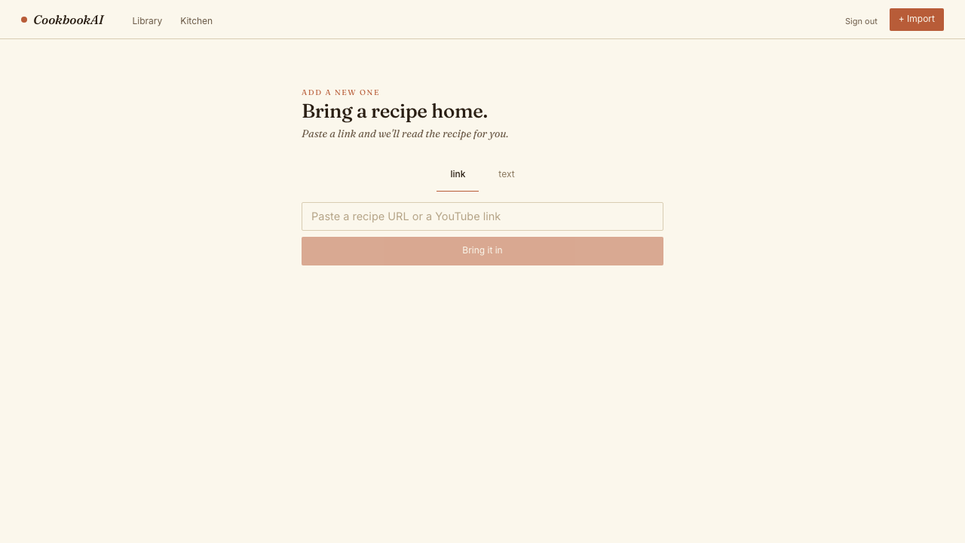
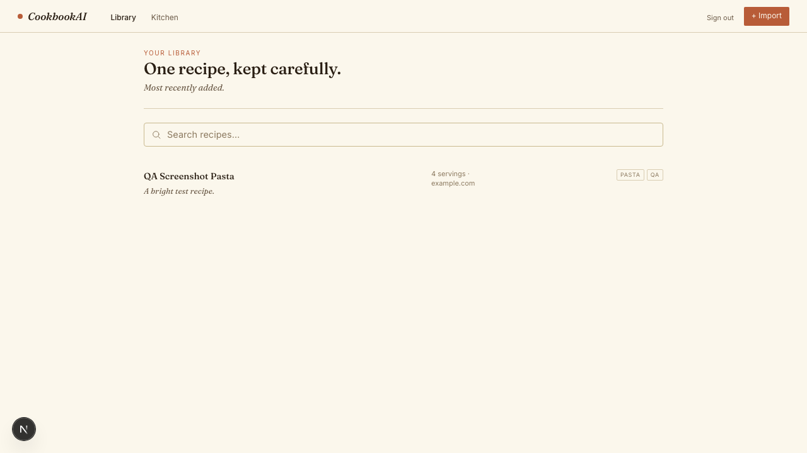
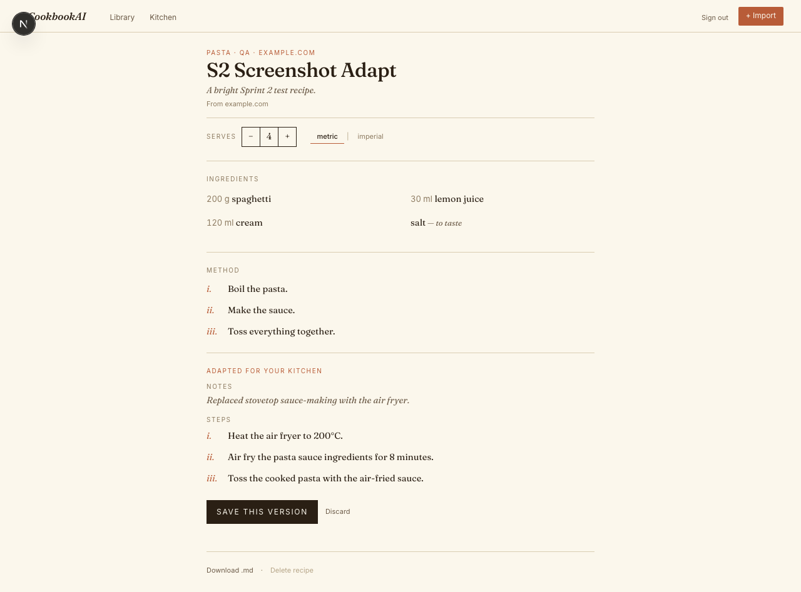
PRODUCT LOOP
The app collapses discovery, extraction, and adaptation into one kitchen loop.
The value is not another recipe box. It is a maintained cooking workflow.
Bring it in
Structure it
Keep it
Make it yours
URL, YouTube, or pasted text.
AI returns title, ingredients, servings, method.
Private library with search and source provenance.
Scale servings, convert units, adapt to equipment.
ACTUAL PRODUCT STATES
CookbookAI pitch demo
03

Slide 4
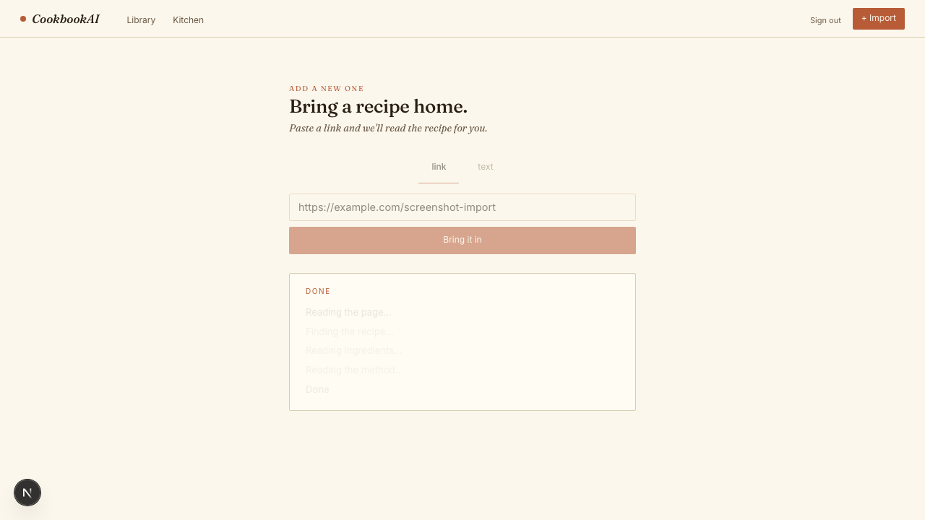
DEMO SEQUENCE
The demo reads as three simple user moments.
Paste a link. See the extraction state. Open the saved recipe as a clean, cookable page.
1. READ THE PAGE
2. SAVE TO LIBRARY
3. COOK FROM RECIPE
The screenshots are intentionally quiet: typography, source metadata, and ingredient structure do the work.
CookbookAI pitch demo
04

Slide 5
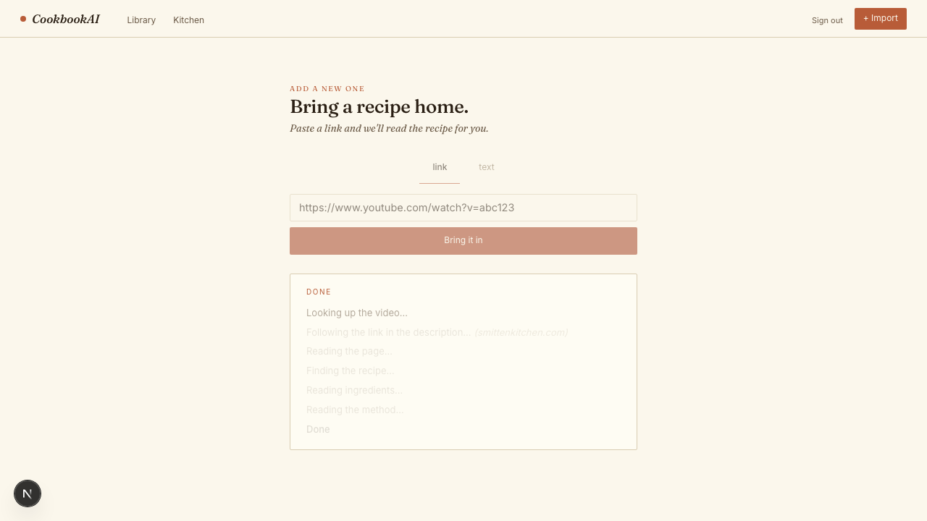
IMPORT RESILIENCE
YouTube is treated as a source tree, not a dead end.
CookbookAI first follows recipe-looking links, then recipe text in the description, then public transcript fallback. Sprint 7 plans an opt-in video-capable AI fallback after those paths fail.
Description link
YouTube URL
Prefer recipe-looking blog URLs over sponsor links.
Watch, shorts, or youtu.be input.
Description text
Extract when the recipe is written in the video description.
Public transcript
Fallback only when link and text paths fail.
Source continuity: original video metadata can stay attached even when the recipe resolves through another URL.
CookbookAI pitch demo
05

Slide 6
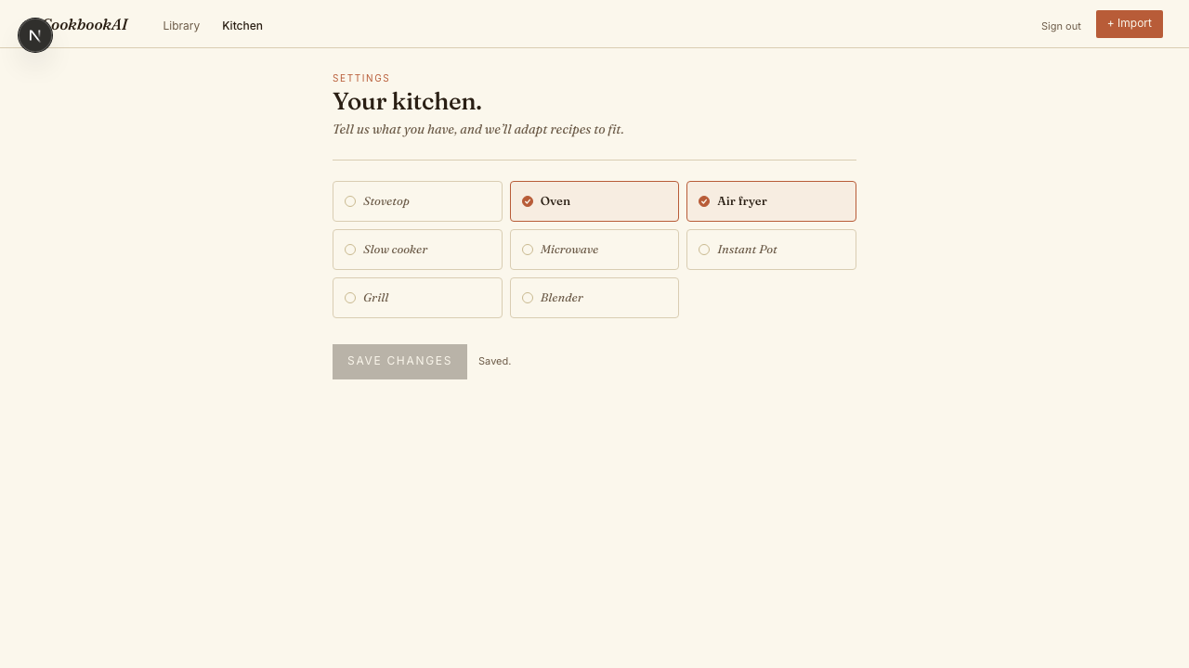
PERSONALIZATION
Adaptation starts from the kitchen the user actually has.
AI changes the method, not the cook.
A saved equipment profile gives the AI a grounded constraint. The original method remains intact; adapted steps are shown as a version the cook can accept or discard.
EQUIPMENT PROFILE
ADAPTED VERSION
CookbookAI pitch demo
06

Slide 7
TRUST POSTURE
The AI boundary is useful because it is constrained.
The product posture is not magic. It is typed JSON output, source provenance, private recipes, and provider routing that can be swapped without changing the user workflow.
Source layer
AI provider
Recipe record
Input
Fetch, YouTube description/transcript, optional Browserbase
Ollama locally; Gemini production default; Groq planned for text
Private library, original source, adapted steps preserved
URL, YouTube, or pasted text
NO USER-FACING PROVIDER TOGGLE
NO PAYWALL OR PRIVATE-CONTENT BYPASS
ORIGINAL AND ADAPTED STEPS STAY SEPARATE
CookbookAI pitch demo
07

Slide 8
OPERATING MODEL
The cost story improves as the library learns what it has already seen.
No fabricated unit economics here: the current product uses architecture choices that make the expensive work avoidable or configurable.
Reuse
Serverless
Providers
URL deduplication copies known recipes instead of repeating AI extraction.
Vercel functions and managed Postgres avoid an always-on backend server.
Ollama, Gemini, Anthropic fallback, and planned Groq branch stay behind one boundary.
PITCH-SAFE NOTE
The deck should not claim revenue, retention, or cost reduction percentages until live product data exists.
CookbookAI pitch demo
08

Slide 9
ROADMAP
Sprint 7 turns reliable import into richer, safer recipe output.
The next planned sprint keeps the same product discipline: nutrition uses USDA data, video fallback stays opt-in, and Groq is text-only provider work.
Macro estimates
Direct video fallback
Groq GPT-OSS
Calories, protein, carbs, fat per serving and full recipe. USDA source; uncertainty visible.
Only after link, description, and transcript fail. Disabled by default; Gemini path.
Configurable text provider branch for extraction and adaptation smoke tests.
PLANNED, NOT SHIPPED
Pitch framing: CookbookAI is learning to recover more recipes while staying explicit about source, confidence, and provider capability.
CookbookAI pitch demo
09

Slide 10
CLOSE
The pitch ask: validate the kitchen loop with real recipe sources.
The strongest next demo is not a feature tour. It is a live import/adapt loop using messy URLs and videos the audience already knows.
1. Bring sources
2. Run the loop
3. Decide the wedge
A small set of real recipe URLs, YouTube videos, and pasted recipes.
Import, save, scale, convert units, adapt to available equipment.
Which pain wins first: import reliability, kitchen adaptation, or macro estimates.
DEMO-READY NARRATIVE
CookbookAI is a calmer way to turn internet recipes into something someone can cook tonight.
CookbookAI pitch demo
10

