Slide 1

ONLINE EXAMINATION SYSTEM
Project
by
C.V.Shobha
V.Rajitha

Slide 2
ABSTRACT
OnlineExams is being launched because a need for destination that is beneficial for both institutes and students.
This site is an attempt to remove the existing flaws in the manual system of conducting exam.
Online Exam System fulfills the requirements of the institutes to conduct the exams online.
They do not have to go to any software developer to make a separate site for being able to conduct exams online.
Students can give exam without the need of going to any physical destination.
They can view the result at the same time.Thus the purpose of the site is to provide a system that saves the efforts and time of both the institutes and the students.
1

Slide 3
INTRODUCTION
Online Exam System is a web application that establishes a network betweenthe institutes and the students.
Institutes enter on the site the questions they want in the exam.
These questions are displayed as a test to the eligible students.
The answers enter by the students are then evaluated and their score is calculated.
This score then can be accessed by the institutes to determine the passes students or to evaluate their performance

Slide 4
It is created by using html,css and javascript.It consist 4 modules:
Home module
Login module
Subjects module
Instructions module
Exam module
Return module

Slide 5
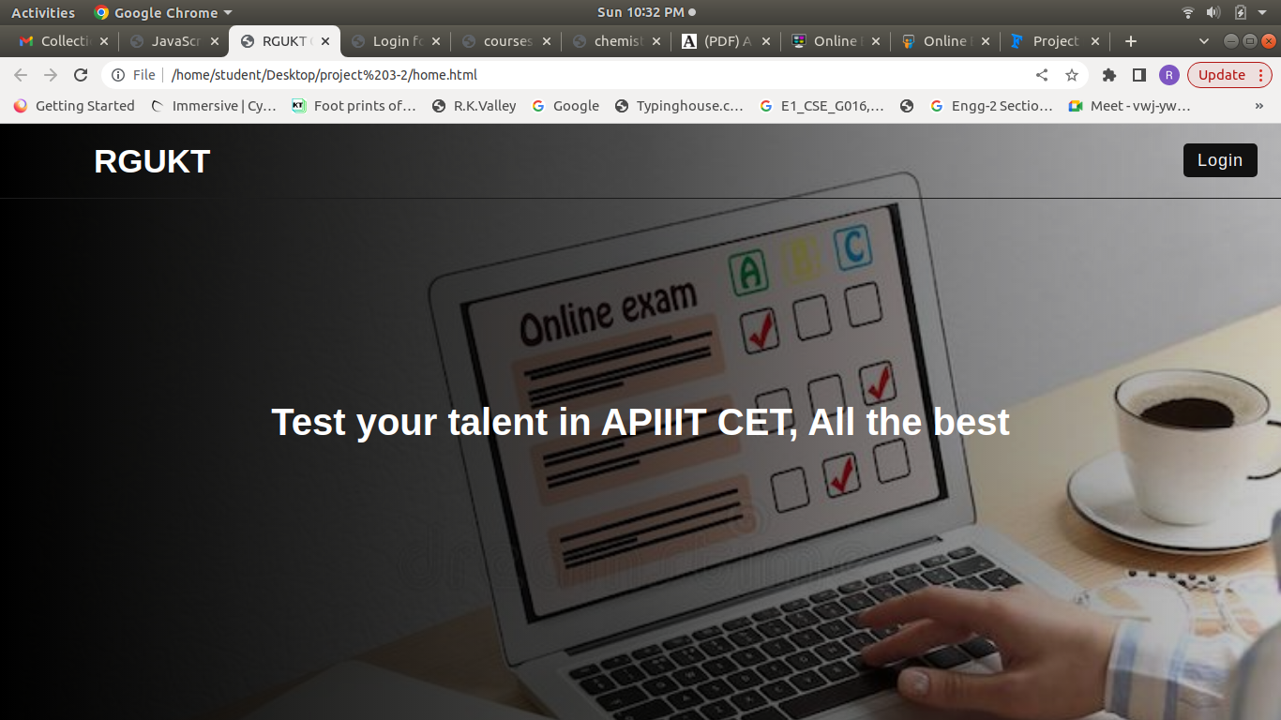
HOME MODULE
In home page module there is name of exam and having a option of Login.Login Module will be open by clicking on the Login option.

Slide 6
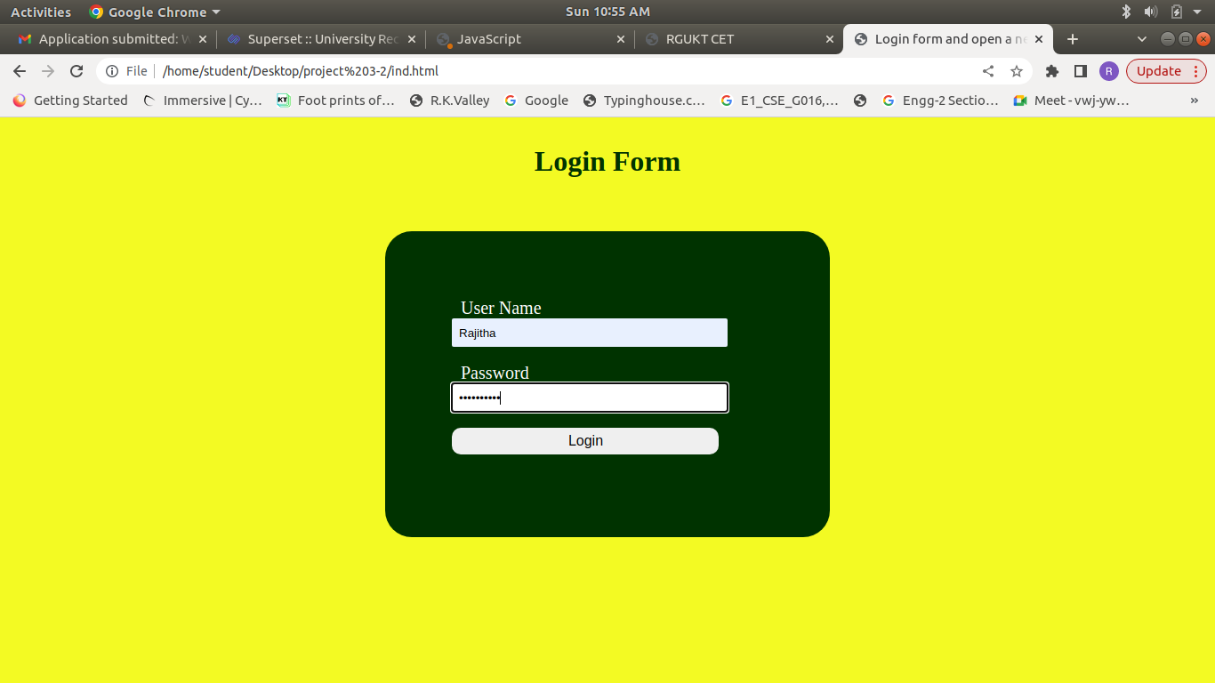
LOGIN MODULE
In Login module there is Login Form consist with Username and password.
By giving valid credentials Login option will move to courses module otherwise it shows “invalid username and password”

Slide 7

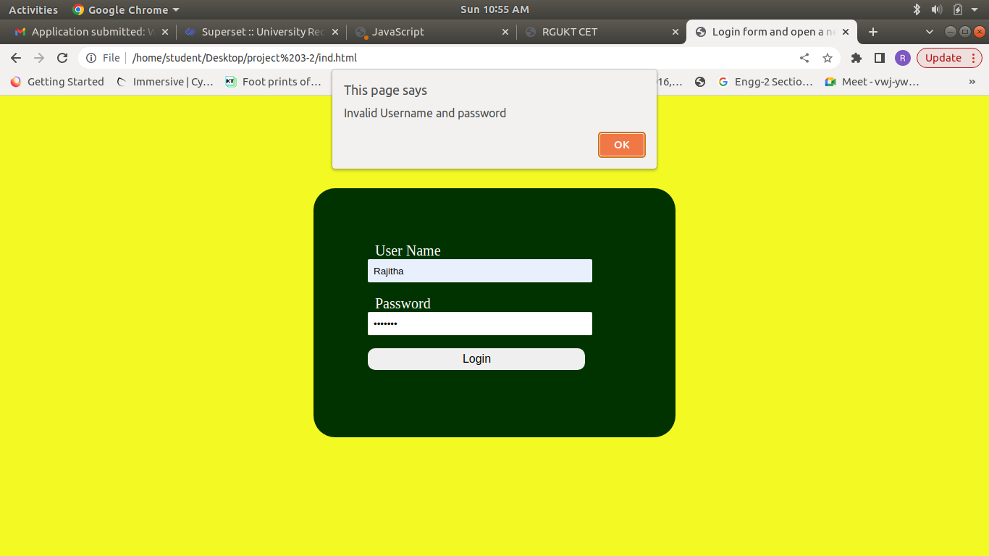
Invalid Username and Password:

Slide 8
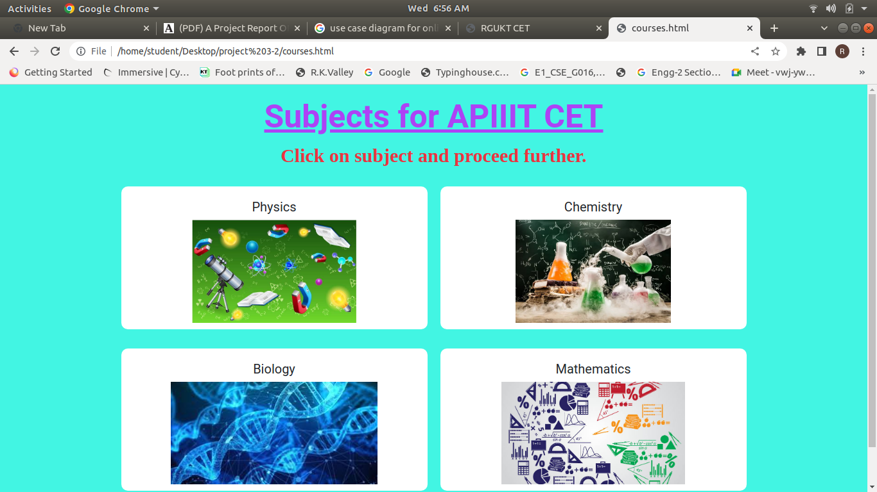
SUBJECTS MODULE
9
Courses module consist with subjects.By selecting the subject name student can attempt the exam.student have to click on subject and proceed further

Slide 9
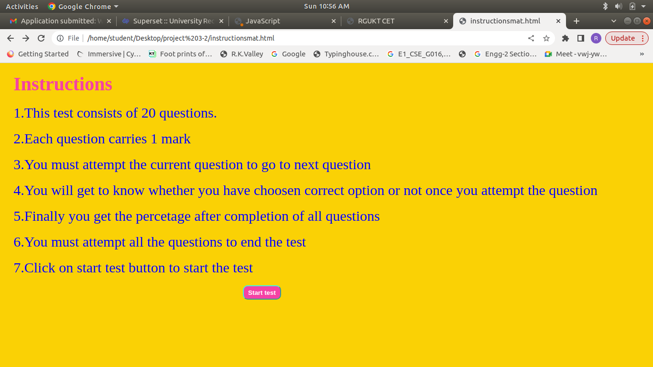
INSTRUCTION MODULE
10
Instruction module consist some instructions for student before writing exam.It is useful to the students while writing the exam.By click on “start test” exam will be start

Slide 10
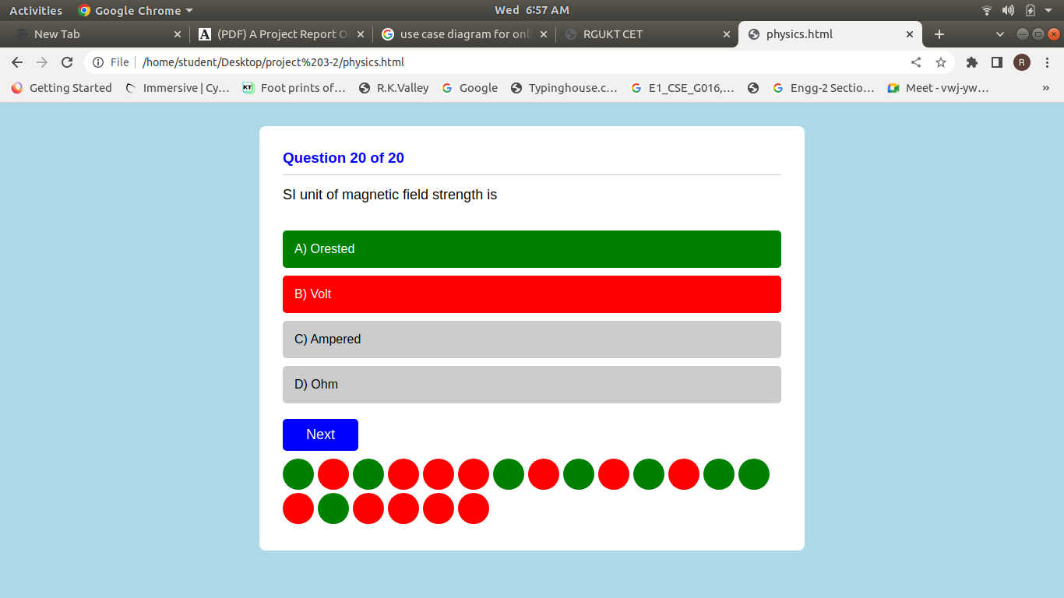
EXAM MODULE
In exam module question and options will display ,after selecting one option next question will display.without selceting a option clicking on the next will display a message “Please select an option”.After completing all questions it will move to return page.

Slide 11

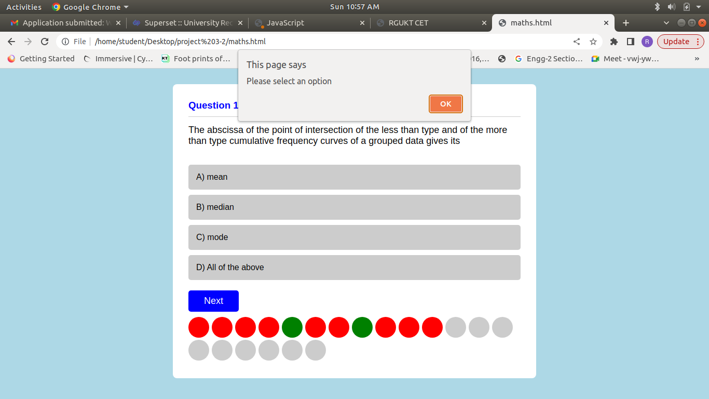
without selceting a option clicking on the next will display a message “Please select an option”

Slide 12
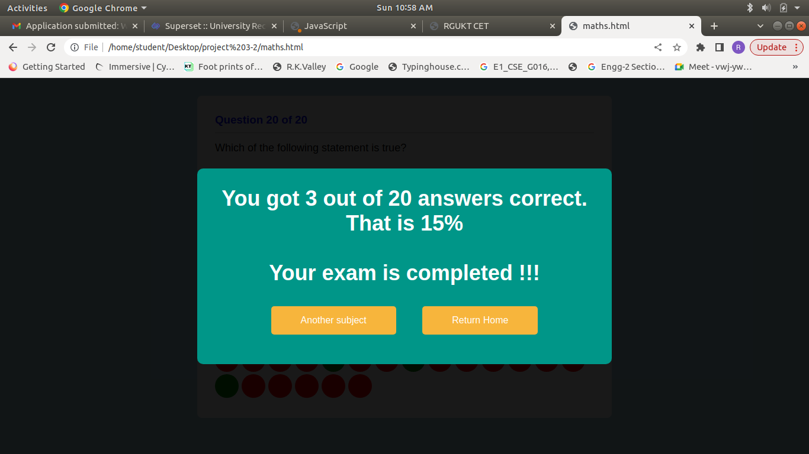
RETURN MODULE
In return page it displays marks and percentage of the exam and consist two options,one is another subject,by clicking on it shows courses page and student can take another exam.second option isreturn home,by clicking on it returns to home page

Slide 13
CONCLUSION
The package was designed in such a way that future modifications can be done easily.
The following conclusions can be deduced from the development of the project.
● Automation of the entire system improves the efficiency
● It provides a friendly graphical user interface which proves to be better when compared to the existing system.
●It gives appropriate access to the authorized users depending on their permissions.
●It effectively overcomes the delay in communications.

Slide 14
Reference:
For HTML
https://www.w3schools.com/html
For CSS
https://www.w3schools.com/css
For JavaScript
https://www.w3schools.com/javascrpit

Slide 15

THANK YOU!!!!!

