Slide 1
Lecture VOICE-TO-NOTES GENERATOR
SCRIBEXA AI
Presented By:
Student Name – SHOBHAN SATPATHY
College Name- Siksha ‘O’ Anusandhan University – Institute of Technical Education and Research, Bhubaneswar, Odisha
Department – Department of CSE

Slide 2
OUTLINE
Problem Statement
Proposed System/Solution
System Development Approach (Technology Used)
Algorithm & Deployment
Result
Conclusion
Future Scope
References

Slide 3
Problem Statement
Lecture Voice-to-Notes Generator
Students frequently miss key points during lectures as it’s difficult to listen and write notes simultaneously. A solution is required that can convert spoken lectures into text using speech to-text AI and then summarize the content into clear study notes, quizzes, or flashcards using generative AI.

Slide 4
Proposed Solution
Scribexa AI is an intelligent study assistant designed to help students convert
educational content into structured learning materials. The system accepts
multiple input formats such as audio lectures, PDF documents, images
containing handwritten or printed notes, and YouTube lecture links. It
processes the content using AI-powered technologies and automatically
generates study notes, flashcards, and multiple-choice questions (MCQs).
The objective of the system is to reduce the time students spend on manual
note-taking and make learning more efficient, interactive, and accessible.

Slide 5
System Approach
Programming Langurage Used : Python 3.14 (64 bit)
Frontend : Streamlit- These frontend provides a simple and user-friendly interface for uploading files and viewing generated study materials.
AI & Processing Technologies :
Google Gemini API (gemini-2.5-flash) – Content generation
OpenAI Whisper – Speech-to-text transcription
PyMuPDF – PDF text extraction
Pytesseract OCR – Image text extraction
yt-dlp – YouTube lecture processing
Database : SQLite - Used for storing transcripts, notes, flashcards, and quiz content for future access.
Supporting Libraries : FPDF2, Pillow, OpenCV, NumPy, Python Dotenv
Deployment : GitHub, Streamlit Community Cloud

Slide 6
Algorithm & Deployment
Algorithm :
User uploads an Audio, PDF, Image, or YouTube lecture.
The system extracts text using Whisper, PyMuPDF, OCR, or yt-dlp.
Extracted content is processed by the Gemini AI model.
AI generates Study Notes, Flashcards, and MCQs.
Results are displayed, stored in SQLite, and made available for download.
Deployment :
Source code hosted on GitHub.
Application deployed on Streamlit Cloud.
API keys managed securely using Environment Variables and Streamlit Secrets.
Accessible through any web browser without local installation..

Slide 7
Result
Successfully developed Scribexa AI, an AI-powered learning assistant using Streamlit.
Implemented support for multiple input formats including PDF documents, audio recordings, images, and YouTube lecture links.
Integrated text extraction, OCR, transcription, and content processing modules into a unified workflow.
Designed a study material generation pipeline capable of producing Notes, Flashcards, and MCQs.
Integrated SQLite database for storing processed lecture content and generated resources.
Developed an intuitive dashboard for content upload, processing, and result visualization.
Demonstrated the feasibility of converting raw educational content into structured learning resources for efficient revision and self-learning.
Note: During deployment, occasional limitations were observed due to external AI API quota restrictions; however, the overall system architecture, workflow, and user interface were successfully implemented and validated.

Slide 8
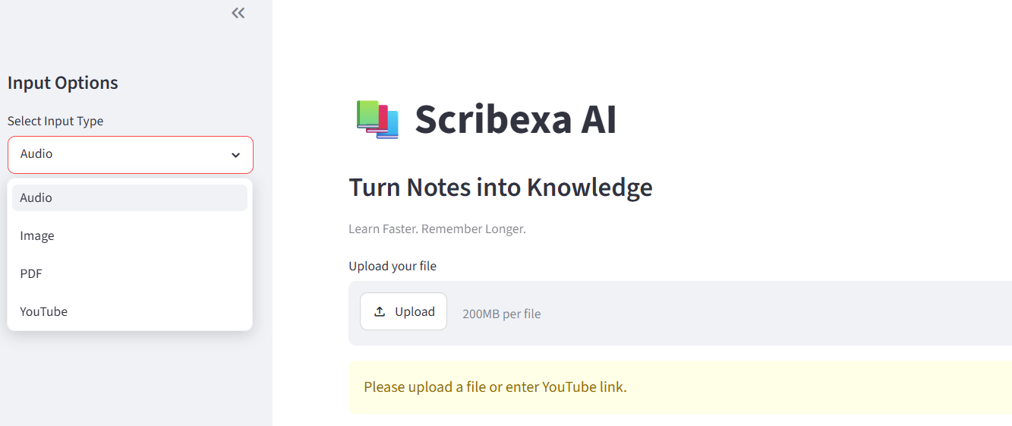
Result
Home Page :

Slide 9
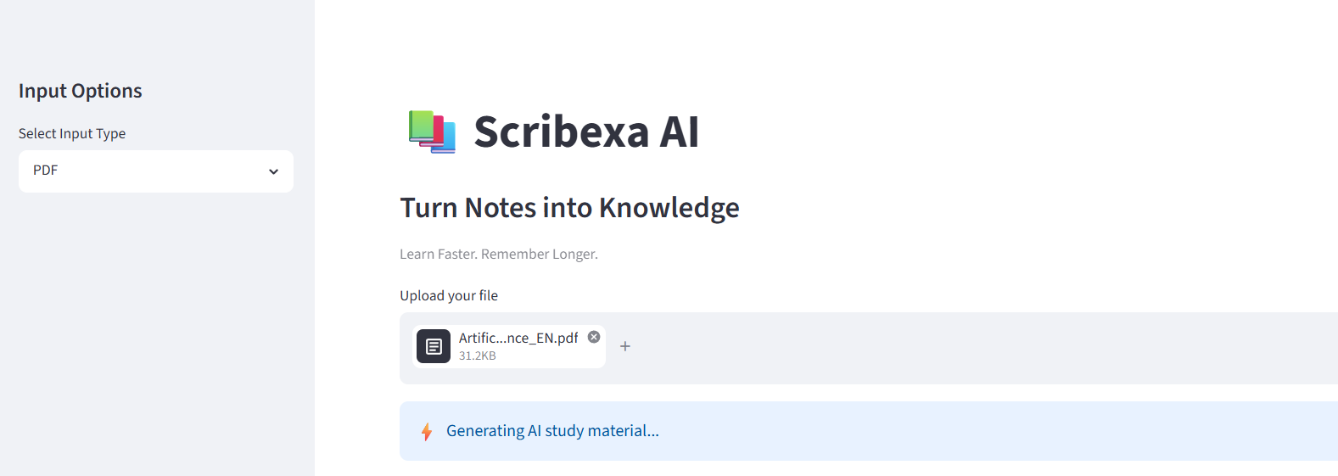
Result
File Upload Interface :

Slide 10
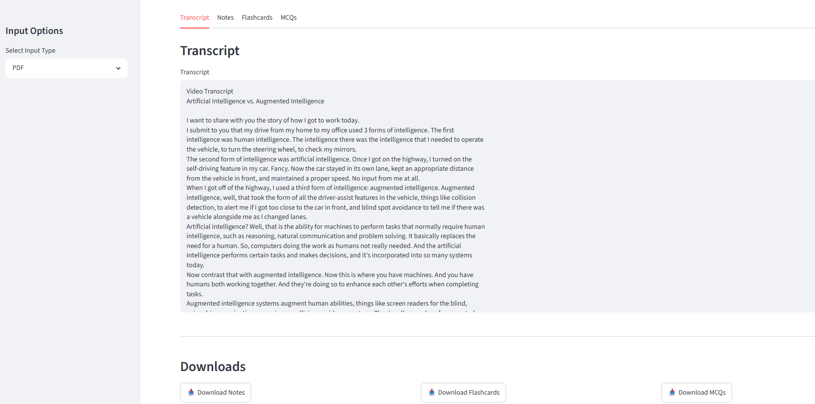
Result
Results/Output Interface (or tab layout) :

Slide 11
Conclusion
Scribexa AI presents a unified platform for processing educational content from multiple sources, including PDFs, audio files, images, and YouTube lectures. The project successfully demonstrates the design and implementation of an AI-assisted learning workflow that integrates content extraction, transcription, document processing, and study material generation capabilities within a single application.
The developed system provides an intuitive user interface and a modular architecture that can be extended with different AI models and services. During deployment and testing, limitations related to external AI API quotas and service availability affected the consistency of content generation. However, the overall application architecture, workflow design, preprocessing modules, and user interaction pipeline were successfully implemented and validated.
The project highlights the potential of AI-powered educational tools in simplifying content processing and supporting efficient learning experiences.

Slide 12
Future scope
Several enhancements can further improve the capabilities of Scribexa AI:
Integration of more reliable and scalable AI models for study material generation.
Support for locally hosted LLMs to reduce dependency on external API quotas.
Interactive AI chatbot for answering questions based on generated notes.
Personalized learning recommendations based on user preferences.
Multi-language support for content extraction and study material generation.
Student progress tracking and performance analytics dashboard.
Mobile application support for improved accessibility.
AWS/GCP/Azure Cloud database integration for secure storage and synchronization.
Advanced quiz generation with automatic scoring and feedback.
Integration with Learning Management Systems (LMS) and educational platforms.
These improvements can transform Scribexa AI into a comprehensive AI-powered learning and revision platform.

Slide 13
References
OpenAI Whisper Documentation : (https://github.com/openai/whisper)
Hugging Face Inference API Documentation : (https://huggingface.co/docs)
Streamlit Documentation : (https://docs.streamlit.io)
PyMuPDF Documentation : (https://pymupdf.readthedocs.io)
Pytesseract OCR Documentation : (https://pypi.org/project/pytesseract)
yt-dlp Documentation : (https://github.com/yt-dlp/yt-dlp)
Python Official Documentation : (https://docs.python.org)
SQLite Documentation : (https://www.sqlite.org/docs.html)
Pillow (PIL) Documentation : (https://pillow.readthedocs.io)
Speech Recognition and Natural Language Processing Research Papers, Articles,
and Technical Documentation consulted during project development.

Slide 14
Deployment & Github links :
Live Demo Deployment Links :
Streamlit App: (https://scribexa-ai-edunet-ibm.streamlit.app/)
Landing Page : (https://scribexa-ai-landing-page.lovable.app/)
GitHub Repo Link :
GitHub: (https://github.com/Shobhan-04/scribexa-ai-edunet-ibm)

Slide 15
THANK YOU

