Slide 1
Task 4: Dashboard Design Sales Performance Dashboard
Elevate Labs Internship
Shobhish Balakrishnan

Slide 2
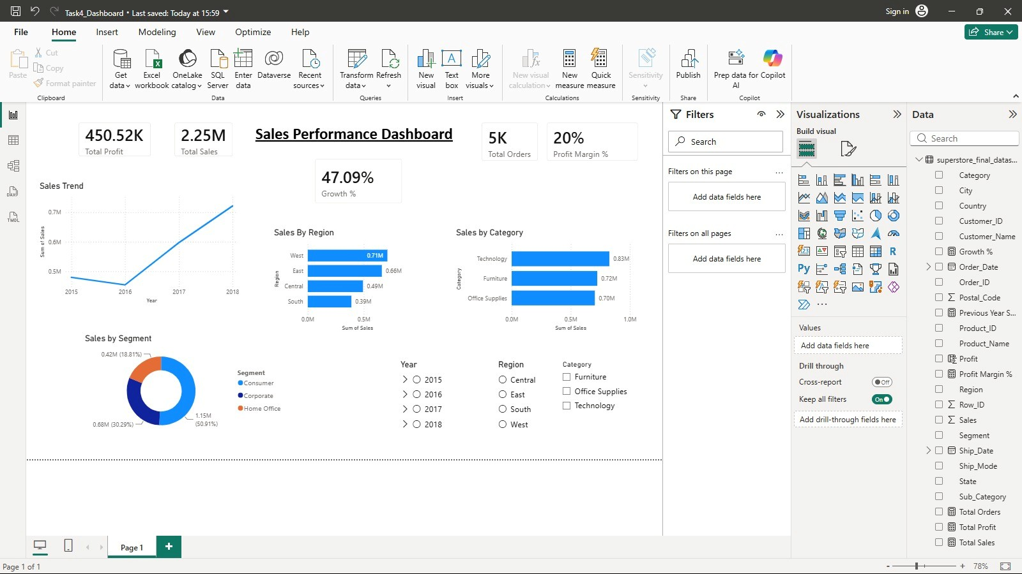
Dashboard Overview
Built using Power BI

Slide 3
Key Insights
Performance
Total Sales: 2.25M
Total Profit: 450K
Regional Insights
West region recorded highest sales
Customer Insights
Consumer segment contributed maximum revenue
Trend Analysis
Sales showed consistent growth over time

Slide 4
Business Recommendations and Conclusion
Focus on expanding sales in high-performing regions such as West to maximize revenue growth
Implement targeted strategies to improve performance in low-performing regions
Increase investment in top-performing product categories to drive higher profitability
Launch customer-focused promotional campaigns for high-value segments like Consumer
Monitor sales trends regularly to identify seasonal patterns and future opportunities
Use dashboard insights to support data-driven decision-making and business planning

