Slide 1
Adaptive PPG
Quality Assessment
Detect what is wrong with a PPG (heartbeat light-sensor) signal.
01
02
03
04
Detect problem
Targeted fix
Measure
Real-data test
Detect what is wrong with the signal.
Clean it with a fix suited to that problem.
Measure the cleanup against ground truth.
Test on real expert-labeled data.

Slide 2
Datasets, Preprocessing and Splitting
4,535 segments from four sources, split by person.
Resample to 125 Hz; cut into 2,000-sample segments.
Drop broken segments; scale amplitude per source, training data only.
80/20 split by recording group; no person in both sets.
Practice data: 5 synthetic artifacts plus Clean = 6 classes.
Datasets (125 Hz, 16 s segments)
Source | Segments
Original CSV | 2,576
Cuff-Less BP (UCI) | 600
PPG-DaLiA (UCI, sitting still only) | 564
BUT PPG (PhysioNet, expert good quality only) | 795
Total | 4,535
02

Slide 3
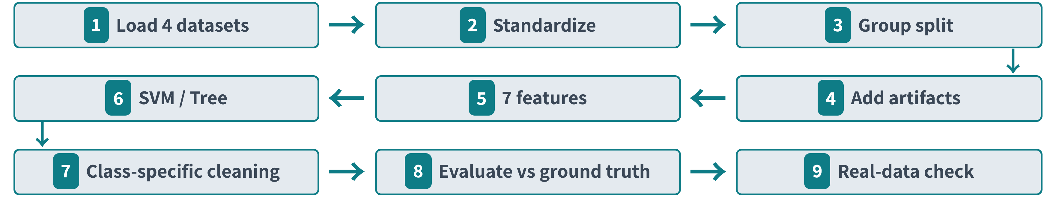
Nine-step pipeline built on seven features
Kurtosis: how peaky the waveform is
Zero-crossing rate: how often the signal crosses zero, a noise cue
Low-frequency energy ratio: share of slow drift energy, flags baseline wander
Lag-1 autocorrelation: how closely each sample follows the previous, a smoothness cue
All 7 features: kurtosis, skewness, amplitude entropy, zero-crossing rate, lag-1 autocorrelation, low-frequency energy ratio, standard deviation.
03

Slide 4
Model Choice and Results
Why SVM
Test accuracy
SVM (RBF): curved boundaries, strong with 7 features
Decision Tree kept for interpretability
Logistic regression too linear; KNN slow, opaque
Random forest redundant; deep CNN needs more data
Model | Test accuracy
SVM (RBF) | 93.4% (95% CI 92.6-94.2)
Decision Tree | 91.4%
Overfitting check
5-fold group CV; SVM settings [from notebook]; runtime [ms per 16 s signal, from notebook].
Train 95.9% vs test 93.4%: mild overfitting, 2.4-point gap.
Cleaning results
Per-source accuracy
Cleaning: motion correlation 0.948 to 0.955; baseline wander matches reference 0.9955 but over-smooths truth (0.72); muscle noise drops 0.904 to 0.843.
Per source: CSV 98.3%, BUT 97.4%, Cuff-Less 86.8%, DaLiA 75.6%.
04

Slide 5
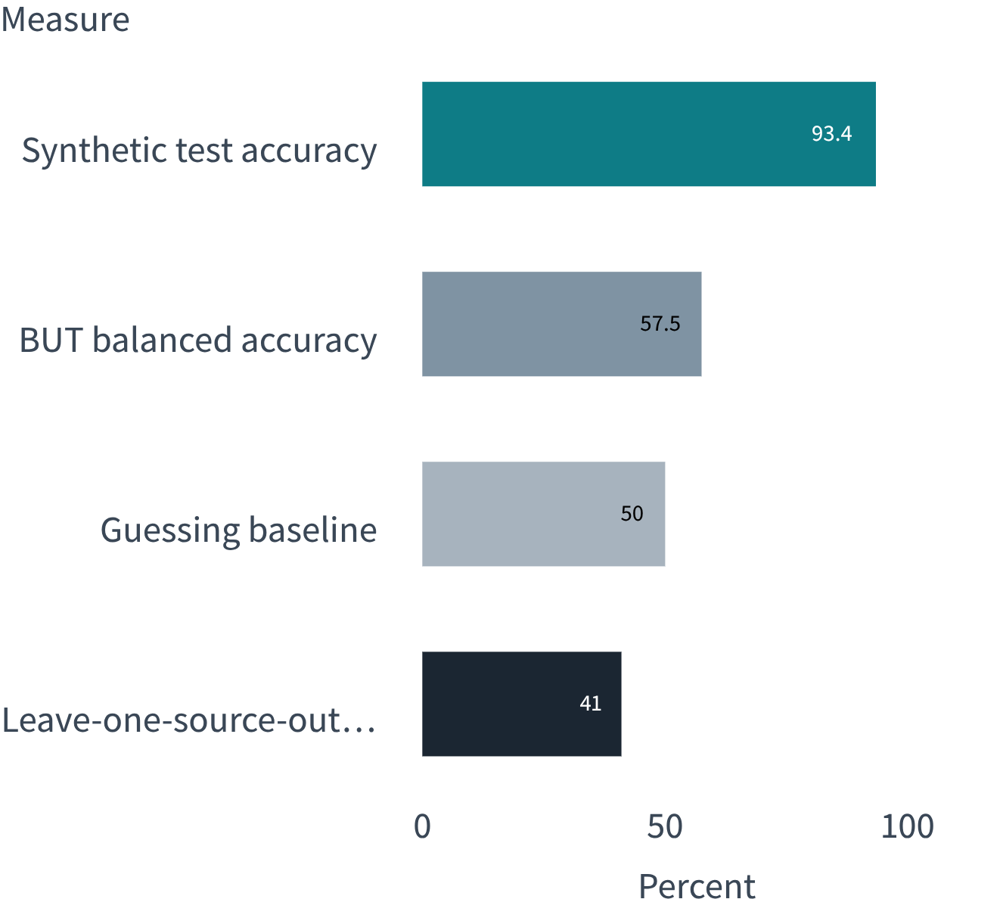
Real-World Validation, Limitations and Conclusion
Synthetic test accuracy is 93.4%; real-world transfer is weaker.
BUT PPG balanced accuracy is 57.5%; guessing is 50%.
83% of poor recordings were called Clean.
Features trained on real labels reach AUC 0.689.
Leave-one-source-out accuracy: 41%.
Works on synthetic artifacts; real-world use needs real labeled training data.
BUT PPG balanced accuracy 57.5%; 50% is guessing.
05

