Slide 1
Recommendations for Reducing Power Imports to Bend, Oregon
November 29, 2012
Authors
Zach Wahl, Nathan Anderson, Molly Winterrowd,
Trevor Bramwell, Tyler Franklin

Slide 2
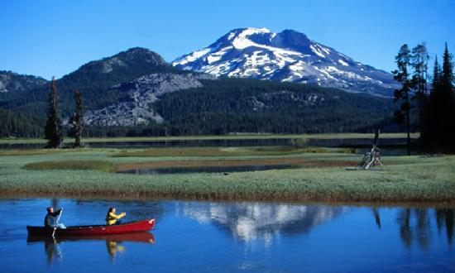
Bend, Oregon
Population | Households | Land Area | Education of High School or Greater | Labor Force
77,905 | 31,596 | 33.01 mi² | 90.2% | 68.9 %

Slide 3
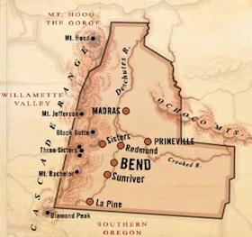
Proposed Solutions
Incandescent, LED and CFL Light Bulbs
Hydro Power
Transit Optimization
Biofuels
Solar Power

Slide 4
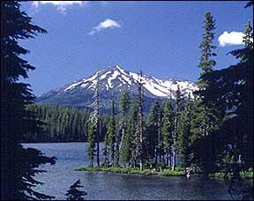
Outline
Background
Define terms
Materials needed
Implementation
Method(s)
Benefits
Negative Factors
Costs
Feasibility
In general?
For Bend, Oregon

Slide 5
Incandescent, LED and CFL LIGHT BULBS
MOLLY WINTERROWD

Slide 6
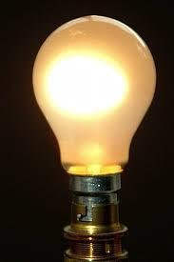
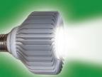
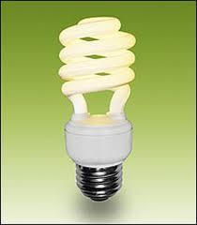
Background
Proposal: To exchange incandescent light bulbs with LED or CFL light bulbs in households, focusing on the Bend, Oregon community.
-What is Incandescent light?
A light that is emitted after being heated
-What does LED stand for?
Light-Emitting Diodes
-What does CFL stand for?
Compact Fluorescent Light
Materials Needed
Community support
Participation
Light bulbs
LED
INCANDESCENT
CFL

Slide 7

Implementation
Currently in bend (Energy Star Homes)^{[2]}
Incandescent light bulbs are very inefficient and up to 98% of the energy they consume is wasted as heat, not light^{[1]}
Method 1: Educate and advertise
OR
Method 2:Incentive program

Slide 8
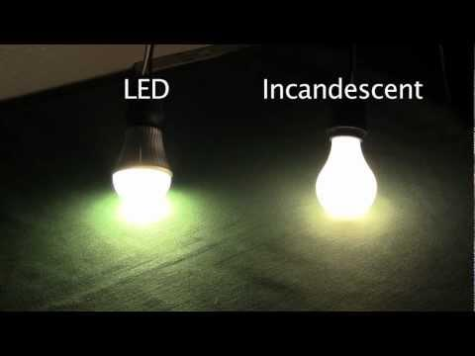
Benefits
LED:^{[3]}
life span of 50 times that of an incandescent light bulb
Very durable
Uses 6-8 Watts of energy compared to the 60 Watt incandescent bulb
Reduces air pollution and greenhouse emissions
The bulbs run cooler

Slide 9
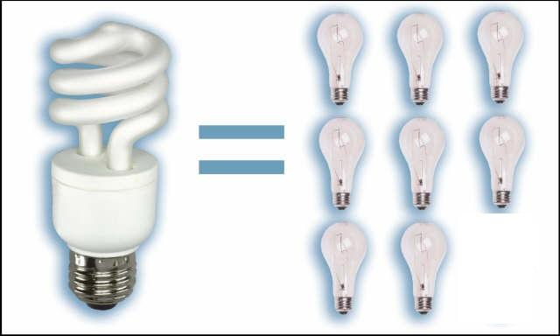

Benefits
CFL:^{[3]}
8x longer lifespan than incandescent bulbs^{[5]}.
13-15 less Watts of energy used compared incandescent bulb
Costs less than incandescent bulbs per year

Slide 10

Negative Factors
LED | CFL
Most expensive light bulb option (per unit) | Contains mercury, which is a toxic gas
The availability of these bulbs are more limited in the stores | Require specific disposal methods
 | Not very durable
 | Sensitive to humidity
 | Take a while to turn on/warm up
 | Can omit an odor, smoke or catch on fire

Slide 11

Costs
Costs per Bulb:
Annual Operating Cost:
(based on the assumption that one household uses on average of 30 incandescent bulbs per year)
LED | CFL | Incandescent
$30.00 | $15.00 | $2.50
LED | CFL | Incandescent
$33.00 | $77.00 | $329.00

Slide 12

Costs
Below shows how long a light bulb lasts if left on for 24 hours a day
LED: 2,084 days or 5.7 years
CFL: 334 days
Incandescent: 50 days
Annual Overall Cost:
LED: $195.00 per year
CFL: $572.00 per year
Incandescent: $876.50 per year

Slide 13
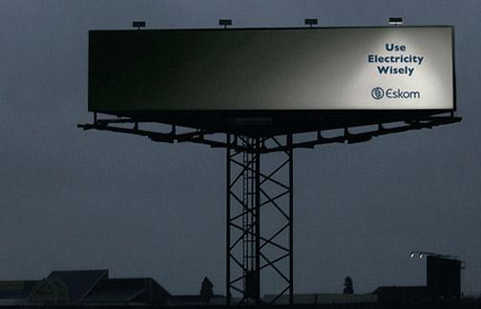
Costs
Cost of Implementation:
It would take approximately 150 homes to save 1 MJ/s worth of energy, if each household replaced 30 light bulbs with either LED or CFL bulbs.
Incandescent bulbs: $131,500 per year compared to...
-LED: $29,300 per year
-CFL:$85,800 per year
-50/50 mix of LED & CFL: $57,500
a) Educate and advertise
Advertisements: $7,500+
LED or CFL light bulbs
b) Incentive Program:
LED or CFL light bulbs

Slide 14

Feasibility
Payback
Jobs created
In general:Yes
(Would promote LED bulbs
over CFL)
In Bend, Oregon: Yes

Slide 15
HYDRO POWER
Tyler Franklin

Slide 16
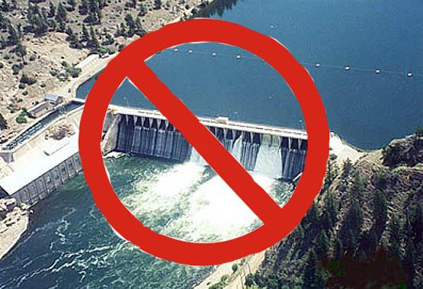
Background
Proposal: To create a small conduit hydroelectric power station for the city of Bend.
What is a small conduit power station? A facility that produces 1 to 20 MW and typically does not require a dam.

Slide 17
Implementation
The site chosen for construction is the Outback water reservoir just outside town.
The power station would utilize eleven miles of existing pipeline from the Bridge Creek intake facility.
The support infrastructure is already in place.
The facility will house one turbine rated at 1.6 megajoules per second^{[9]}.

Slide 18
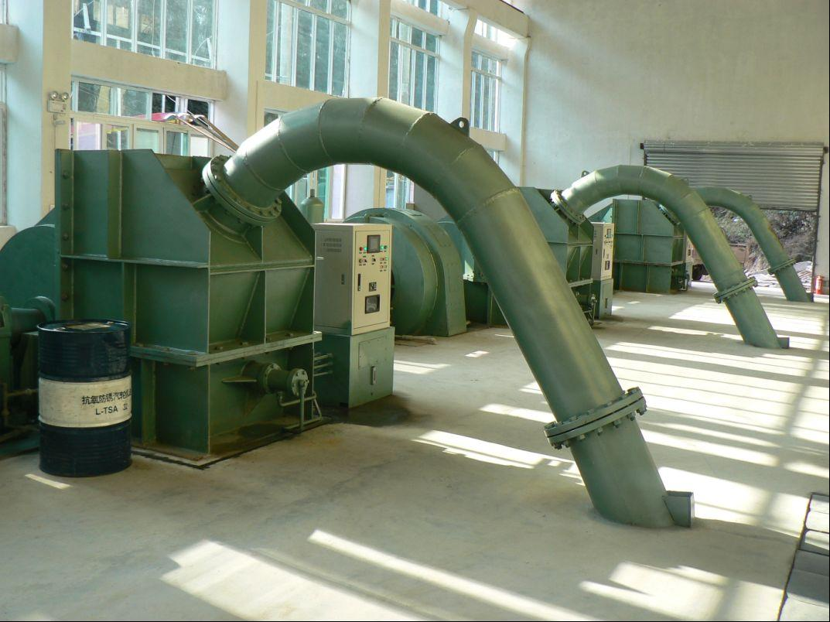
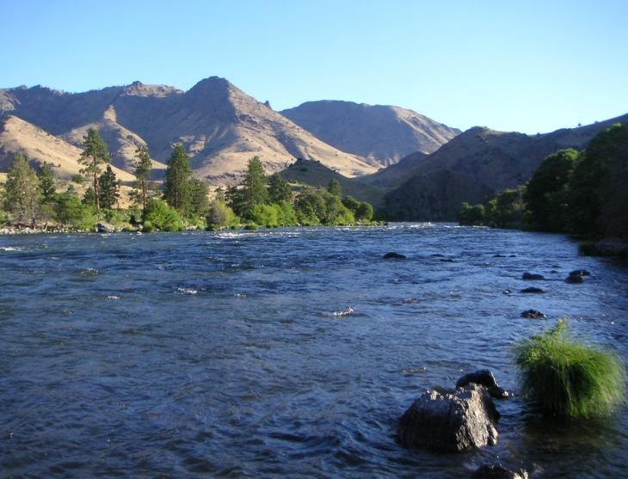
Benefits
Renewable energy that has zero emissions.
90% energy to electricity conversion^{[10]}.
Free and abundant fuel source, water.
Very low maintenance.
Reliable.
Very low production cost per kilowatt^{[10]}.

Slide 19

Negative Factors
Environmental impact?
Community water flow issues?
Drop off in summer months^{[9]}.

Slide 20
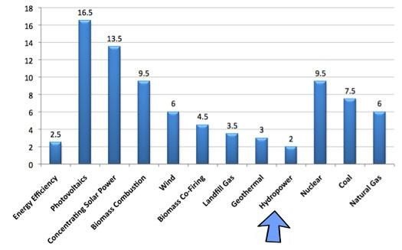
Costs
1.6 megawatt turbine ~ $100,000
50 ft. by 35 ft. by 12 ft. power station ~ $35,000
20 inch pipe ~ $2500
Estimated total construction cost: $137,500

Slide 21
Feasibility
The infrastructure already exists!
Quick payback: ≤ 1 year [9].
Small job creation.

Slide 22
TRANSIT OPTIMIZATION
ZACH WAHL

Slide 23
Background
53 percent of commuters in Bend travel alone on a 10 mile round trip to work.^{[15]}
There are 28,642 commuters in Bend.^{[13]}
To reduce power input by 1 MJ/s , approximately 1,346 commuters would need to use public transit.

Slide 24
Implementation
Method 1: Make transit free.
Implement a Transit Operating Fee to cover the cost of running public transit
Method 2: Operate a new bus route.
Purchase a new bus and have it dedicated to the worker dense areas of the cities.

Slide 25
Benefits
Method 1:
Less vehicles on city roads
Less Carbon Dioxide emissions
Tax revenue diverted to other areas of city government (Fire, Police, Parks and Rec)
Method 2:
Easier access to transit

Slide 26
Negative Factors
Method 1:
Fee imposed on utility customers
Method 2:
Route clutter

Slide 27
Costs
Method 1:
No noticeable cost difference to city
Single family residents ~ $3.73/month^{[17]}
Business' ~ varies
Method 2:
1 Large, Heavy-Duty Transit Bus ~ $300,000 – $400,000^{[19]}
Cost of operation ~ $350,000/yr^{[18]}

Slide 28
Feasibility
Method 1:
Feasible for Bend
Corvallis saw 37.9% increase in ridership in first year^{[16]}
Bend needs only 1,346 person increase
Roughly 5% of commuters
Low cost
City will benefit with tax revenue directed to other areas (Fire, Police, Parks and Rec).

Slide 29
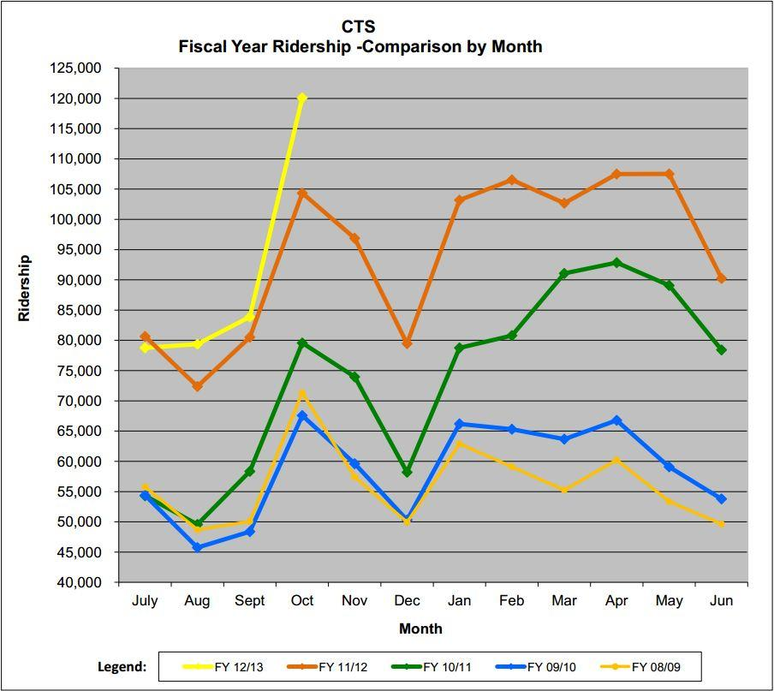

Slide 30
Feasibility
Method 2:
Not feasible
Large cost with little return
Would create excess routes in small areas.

Slide 31
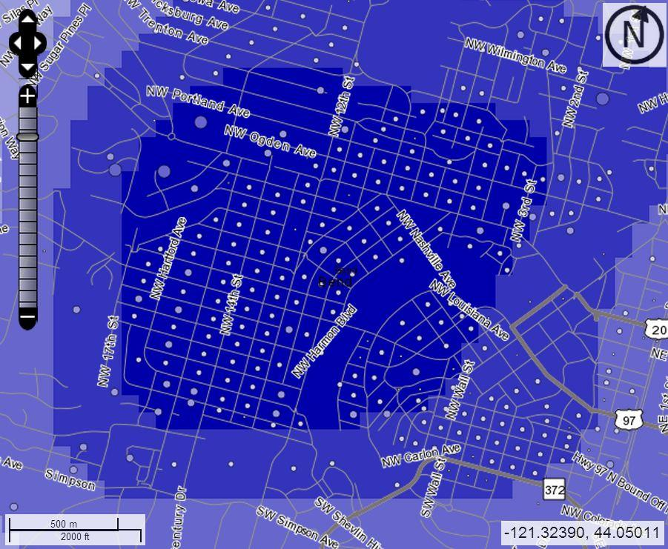
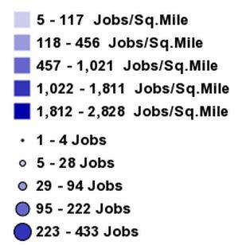
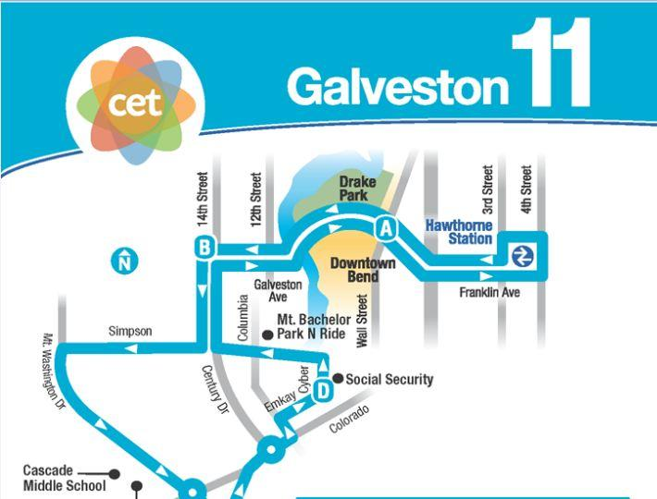
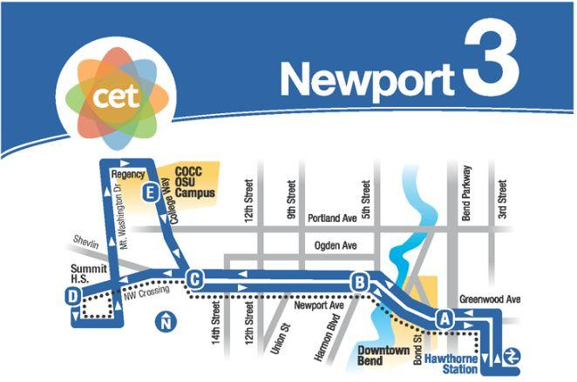

Slide 32
BIOFUELS
Nathan Anderson

Slide 33
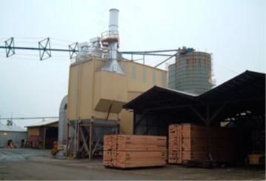
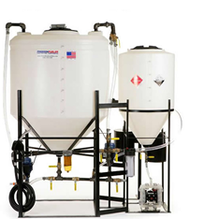
Background
Types of biofuels
•Biodiesel
•Biomass
Feasibility of each
•Cost/Benefits analysis
•Negative factors
•Payback period
•Creation of jobs

Slide 34
Biomass
Costs: $5 Million- $30 Million
Benefits:
•Uses no demanded resources
•Provides a local outlet for mill waste lowering transportation emissions.
•Provides a local outlet for forest service bio-waste lowering danger of forest fires.
•Creates jobs in the both the timber industry and the forest service.
•Can provide electricity for more than 700 homes.
•Will qualify for “Blue Sky” program.
•Creates jobs

Slide 35
Biomass
Negative Factors:
•Electrical power is not as cheap as it is from other sources.
•Will necessitate hike in energy prices (.07$ per kWh)
•Large startup costs.
Power:
•Enough for 700 homes. About 7 mega joule/second for a large operation.
Payback Period
•Depends on operation size. Average will be 1-5 years.

Slide 36
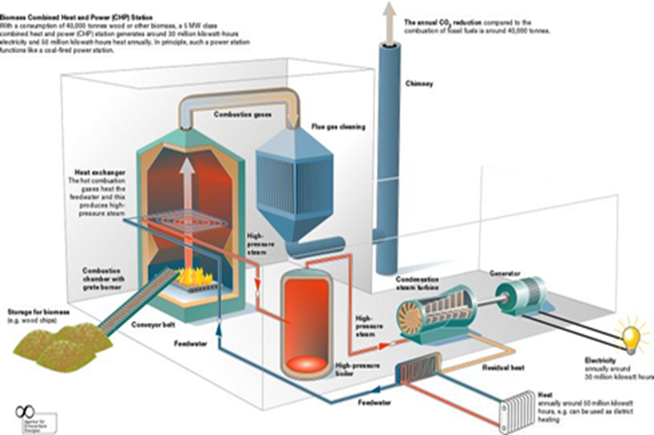

Slide 37
Biodiesel
Costs:
•$500-55,000 start up
•Continued cost of supplementary additives (.05$/Gal)
•Disposal of residual waste (depends on operation)
Benefits:
•Can be accomplished on both small and large scales
•There are many outfits offering several different possible configurations of small to large prefabbed production facilities.
•Cleaner auto/heavy equipment CO2 emissions.
•Creates outlet for used oil restaurants currently have to pay to dispose of.

Slide 38
Biodiesel
Negative Factors:
•Startup costs can be very high for a large operation.
•Raw material supply is subject to fluctuation due to economy.
•Uses electricity in creation of clean fuel.
Power:
•900 gallons per day for large processors equates to 1.25 Mega joule/second
Payback Period:
•Depends on operation size. Average will be 1-2 years.

Slide 39
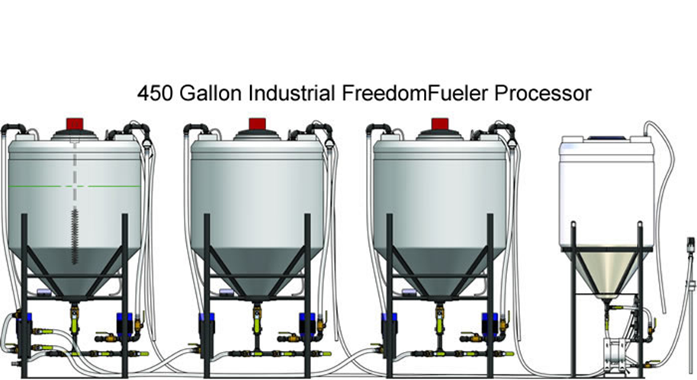

Slide 40
SOLAR POWER
TREVOR BRAMWELL

Slide 41
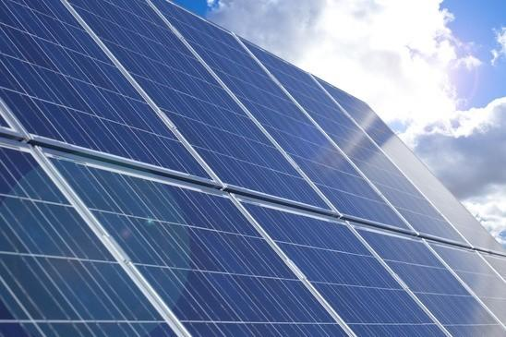
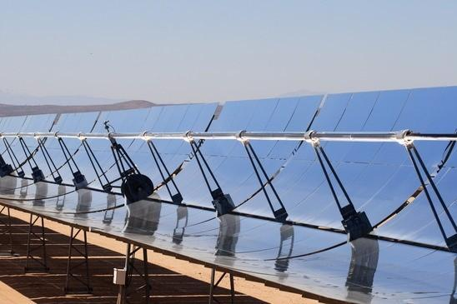
Background
2 types of solar power
Photovoltaic (PV)
Concentrated Solar Power (CSP)
Photovoltaic
Concentrated Solar Power

Slide 42
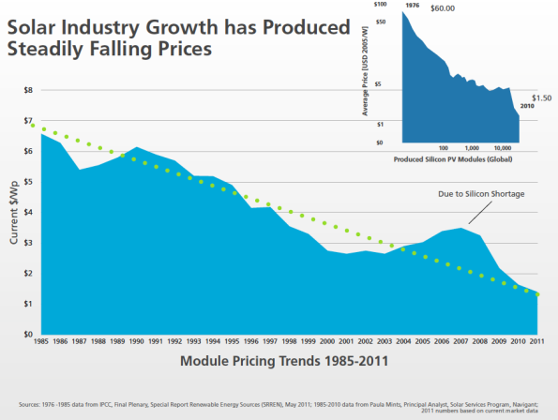
Background
PV panels continue to be cheaper^{[27]}

Slide 43
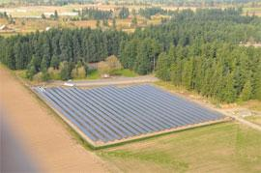
Implementation
Build 1 MW facility in Bend, Oregon
~ 6 acres of land
1.76 MW Baldock Solar Station in Oregon

Slide 44
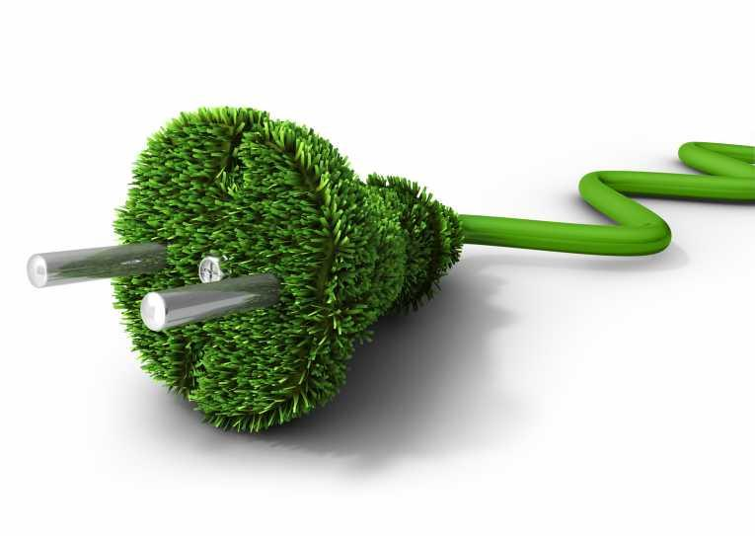
Benefits
3-5 jobs
1 MW clean renewable energy
Generate revenue

Slide 45
Costs
Panels | $1,000,000
Inverter | $200,000
Installation | $15,000
Land | $75,000
Tax Credit^{[28]} | -$75,000
Total | $1,215,000

Slide 46
Feasibility
Payback in less than 2 years
$0.1527/kWh for Solar^{[29]}
Avg. 7.6 hours of sun a day in Bend, Oregon each year^{[30]}
~ $400,000 a year
Not very feasible
Too high startup cost

Slide 47
Ranking (from best to worst)
1)Transit Optimization
2)LED and CFL Light bulbs
3)Hydro Power
4)Biofuels
5)Solar Power

Slide 48
REFERENCES
[1] B. C. Howard, “MSN,” Energy-efficient light bulbs: How much do you really save?. [Online].Available: http://realestate.msn.com/energy-efficient-light-bulbs-how-much-do-you-really-save. [Accessed: Nov.18, 2012]
[2] U.S. Environmental Agency, “Energy Star: New Homes,” Builders in Bend. [Online]. Available: http://www.energystar.gov/index.cfm?fuseaction=new_homes_partners.showAreaResults&s_code=OR&msa_id=34. [Accessed: Nov. 19, 2012]
[3] U.S. Department of Energy, “2006 Partner Resource Guide,” Energy Star Qualified Light Bulbs. [Online]. Available: http://www.energystar.gov/ia/partners/manuf_res/CFL_PRG _FINAL.pdf. [Accessed: Nov. 20, 2012]
[4] Unknown, “Easy Web Calculators,” Incandescent Bulbs vs. Compact Fluorescent and LED Light Bulbs. [Online]. Available: http://www.easywebcalculators.com/cf.htm. [Accessed: Nov. 20, 2012]
[5] Design Recycle inc.,“Comparison Chart,” LED Lights vs. Incandescent Light Bulbs vs. CFLs. [Online]. Available: http://www.designrecycleinc.com/led%20comp%20chart.html. [Accessed: Nov. 20, 2012]
[6] T. Brueski,“Local Marketing Ideas,” How Much Does Radio Advertising Cost?. [Online]. Available: http://localmarketingideas.com/how-much-does-radio-advertising-cost/.[Accessed: Nov. 22, 2012]
[7] N. Kokemuller, “eHow,” How Much Does It Cost to Use Billboard Advertising? [Online]. Available: http://www.ehow.com/info_8234497_much-cost-use-billboard-advertising.html. [Accessed: Nov. 24, 2012]
[8] Squidoo, “Light Bulbs-Let's compare,” The Light Bulb Wars. [Online]. Available: http://www.squidoo.com/incandescent-versus-CFL-versus-LEDl. [Accessed: Nov. 28, 2012]
[9] Federal Energy Regulatory Commission, “Initial consultation document in support of FERC exemption of small conduit hydroelectric facilities for the Bend conduit project”, City of Bend, August 2011, [ONLINE], Available: bendoregon.gov/modules/showdocument.aspx?documentid=3990, [Accessed: Nov. 11th, 2012]
[10] National Hydropower Association, “Why Hydro?”, National Hydropower Association, [ONLINE], Available: http://hydro.org/why-hydro, [Accessed: Nov. 11th, 2012]

Slide 49
REFERENCES
[11] Federal Energy Regulatory Commission, “Bend hydroelectric project, draft conduit exemption application”, City of Bend, [ONLINE], Available: http://bendoregon.gov/modules/showdocument.aspx?documentid=6775, [Accessed: Nov. 11th, 2012]
[12] J. Tuo, “Pelton water turbine for hydraulic power plant”, Alibaba, [ONLINE], Available: http://www.alibaba.com/product-gs/478173986/Pelton_Water_Turbine_for_Hydraulic_Power.html, [Accessed: Nov. 12th, 2012]
[13] U.S. Census Bureau, Selected Economic Characteristics,2006-2010 American Community Survey 5-Year Estimates. [Online]. Available: http://factfinder2.census.gov/faces/tableservices/jsf/pages/productview.xhtml?src=bkmk. [Accessed: Nov. 16, 2012].
[14] U.S. Census Bureau, Home Area Profile Report, OnTheMap Application and LEHD Origin-Destination Employment, Statistics (Beginning of Quarter Employment, 2nd Quarter of 2002-2010). [Online]. Available: http://onthemap.ces.census.gov/. [Accessed: Nov. 16, 2012]
[15] Oregon Employment Department, “Oregon's Metro Commuters: Distance, Direction, and Net Flows” Oregon Employment Department. [Online]. Available: http://www.qualityinfo.org/olmisj/ArticleReader?itemid=00007546#seg0006. [Accessed: Nov. 16, 2012].
[16] City of Corvallis, Oregon, FARES/FARELESS, Corvallis Transit System is fareless!.[Online]. Available: http://www.corvallisoregon.gov/index.aspx?page=175. [Accessed: Nov 16, 2012]
[17] City of Corvallis, Oregon, “Frequently Asked Questions on the Transit Operations Fee”, City of Corvallis.[Online]. Available: http://www.corvallisoregon.gov/modules/showdocument.aspx?documentid=4248. [Accessed: Nov 16, 2012]

Slide 50
REFERENCES
[18] United States. Department of Transportation, Transit Bus Life Cycle Cost and Year 2007 Emissions Estimation. Final Report: July 2, 2007. [Online]. Available: http://www.fta.dot.gov/documents/WVU_FTA_LCC_Final_Report_07-23-2007.pdf. [Accessed: Nov. 16, 2012].
[19] Oregon. Department of Transportation, Oregon Vehicle Description and Useful Life Standards. [Online]. Available: http://www.oregon.gov/ODOT/PT/docs/capital/vehicle-descriptions-useful-life-standards.pdf. [Accessed: Nov. 16,2012]
[20] EV World, “Energy notes: Energy in natural processes and human consumption, some numbers” EV World. [Online]. Available: http://www.evworld.com/library/energy_numbers.pdf [Accessed: Nov. 17, 2012].
[21] United States. Department of Transportation (RITA), Average Fuel Efficiency of U.S. Light Duty Vehicle. [Online]. Available: http://www.bts.gov/publications/national_transportation_statistics/html/table_04_23.html [Accessed: Nov. 16, 2012].
[22] City of Corvallis, Oregon, “CTS Ridership”, City of Corvallis.[Online]. Available: http://www.corvallisoregon.gov/modules/showdocument.aspx?documentid=4250. [Accessed: Nov 22, 2012]
[23] Solar Technology [Online]. Available: http://www.seia.org/policy/solar-technology. [Accessed: Nov 28, 2012]
[24] Energy prices: two trends (2 graphs) [Online]. Available: http://rwer.wordpress.com/2012/03/12/energy-prices-two-trends-2-graphs/. [Accessed: Nov 28, 2012]
[25] Oregon commissions 1.75 MW solar highway project [Online]. Available: http://www.solarserver.com/solar-magazine/solar-news/current/2012/kw35/oregon-commissions-175-mw-solar-highway-project.html. [Accessed: Nov 28, 2012]
[26] President Obama Addresses Clean Energy Standard, Dependence On Oil [Online]. http://www.earthtimes.org/energy/obama-clean-energy-standard-dependence-oil/637/. [Accessed: Nov 28, 2012]

Slide 51
REFERENCES
[27] Solar Energy facts – Concentrated Solar Power (CSP) Vs Photovoltaic panels (PV) [Online]. http://www.renewablegreenenergypower.com/solar-energy-facts-concentrated-solar-power-csp-vs-photovoltaic-pv-panels/. [Accessed: Nov 28, 2012]
[28] Solar Electric [Online]. Available: http://energytrust.org/public-sector/incentives/equipment-upgrades-remodels/SolarElectric/SolarElectric2/
[29] Levelized Cost of New Generation Resources in the Annual Energy Outlook 2012 [Online]. Available: http://www.eia.gov/forecasts/aeo/electricity_generation.cfm
[30] Solar Data [Online]. Available:http://solardat.uoregon.edu/SolarData.html.
[31] Oregon Global Warming Commission, (2009 January). Report to the Legislature [Online] http://www.oregon.gov/ENERGY/gblwrm/gwc/docs/09commissionreport.pdf
[32] Whole Building Design Guide. (2012) Biomass for Electricity Generation [Online] http://www.wbdg.org/resources/biomasselectric.php
[33] Freedom BioFuelers. (2012, January 1) [Online] http://thebiodieselstore.com/biodiesel-processors
[34] J. O’Rielly. (2011, December 1) [Online] Use of CHP and Renewable Sourses of Energy for Industrial Boilers.

