Slide 1
Java API for XML-Based Web Services (JAX-WS): Uses and Examples

Slide 2
Devloment and deployment of JAX-WS

Slide 3
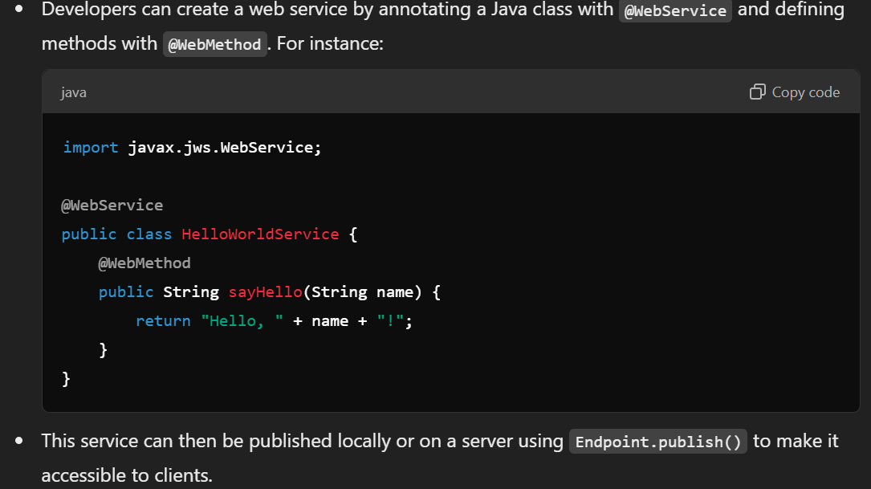
Creation of web service

Slide 4
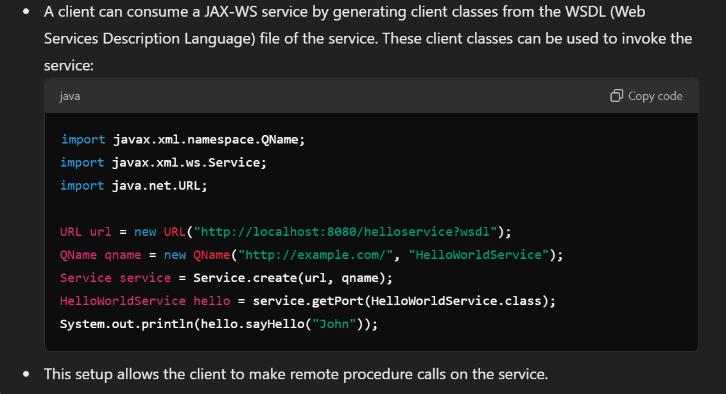
Consumption of web services

Slide 5
Examples of JAX-WS Uses

Slide 6
Enterprise Integration
JAX-WS allows different applications within a large enterprise to communicate with each other seamlessly. This is particularly useful in scenarios where various systems developed over time using different technologies need to be integrated into a cohesive solution.
Example: An ERP system integrating with multiple services such as inventory management, accounting, and customer relationship management (CRM).

Slide 7
Legacy System Integration
JAX-WS enables communication with legacy systems that may not support modern web technologies. Through SOAP-based messaging, JAX-WS can facilitate integration by using XML, which is widely supported.
Example: Connecting a Java-based modern application to a legacy COBOL-based system in a financial institution.

Slide 8
Service-Oriented Architecture (SOA) and Microservices Support
In SOA and microservices architectures, services are designed to be independent and reusable across applications. JAX-WS allows these services to communicate using standardized messages, promoting interoperability.
Example: A set of microservices in a healthcare application that can process patient records, handle billing, and interface with external lab services.

Slide 9
Cloud-Based Services
. With the growing use of cloud infrastructure, JAX-WS can help create SOAP web services that interact with cloud applications. This is beneficial for organizations adopting cloud-native strategies who need reliable, secure web services for mission-critical functions.
Example: An organization hosting an inventory management service on the cloud to allow various vendor applications to access stock data securely.

