Slide 1
JAVA API FOR XML-BASED RPC (JAX-RPC)
By- Ashmeet singh
CSE-2 batch-2
Roll no : 2021UCS1639

Slide 2
INTRODUCTION
Java API for XML-based RPC (JAX-RPC) is a Java API for building web services and clients using XML-based Remote Procedure Calls (RPC). It allows applications to communicate across platforms by invoking methods remotely over the internet, enabling Java applications to call and be called by other applications, regardless of the underlying platform, through standardized protocols.
JAX-RPC relies on SOAP (Simple Object Access Protocol), an XML-based protocol, for message exchange. This XML messaging ensures interoperability, meaning Java applications can seamlessly interact with non-Java services, like those built on .NET or PHP. Another key component is the Web Services Description Language (WSDL), which provides a structured XML format to describe available web service operations, their parameters, and how clients should interact with the service.
The JAX-RPC development process involves several steps. First, a service interface defines methods for the web service, specifying the available operations. This interface is used to generate a WSDL file, describing the service in a standardized XML format. The WSDL is then used to create client-side stubs (proxies) and server-side ties, which handle message serialization and deserialization, allowing the service to be called as if it were a local Java method.

Slide 3
Key features
Remote Procedure Calls (RPC): JAX-RPC facilitates communication between distributed applications by invoking remote methods or procedures across the network. This is done by defining methods on the server (service provider) that clients can call remotely as if they were local methods.
SOAP and XML-based Protocols: JAX-RPC primarily uses SOAP, a protocol for exchanging structured information in web services. SOAP messages are XML-based, which makes them platform-agnostic, allowing different systems to interoperate.
Web Services Definition Language (WSDL): JAX-RPC relies on WSDL files to describe the web service's interface in a standard format. WSDL specifies the available operations, the input and output data types, and the message formats, allowing clients to know how to interact with the service.
Synchronous and Asynchronous Calls: JAX-RPC supports synchronous (blocking) and asynchronous (non-blocking) method calls, enabling flexibility depending on the application’s requirements.

Slide 4
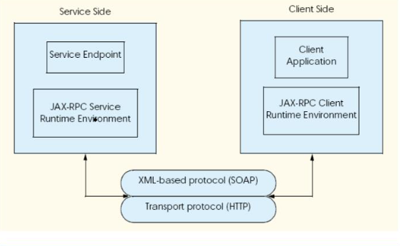
JAX-RPC Architecture
Server-Side Architecture
Service Endpoint Interface (SEI):Similar to the client side, the SEI on the server defines the web service’s methods. This interface provides a contract between client and server, ensuring they agree on method signatures.
The JAX-RPC service runtime environment: It is the execution framework that manages the lifecycle of JAX-RPC web services and handles the communication between client and server applications through SOAP messages. It involves various components to process requests, create responses, and manage protocols, all ensuring interoperability across different platforms and languages. Here’s an outline of the JAX-RPC runtime environment:

Slide 5
JAX-RPC Architecture
Client Application
The client application is the main program that uses the web service.
It directly interacts with the client stub (proxy), treating remote methods as local ones.
The client application initiates requests by calling methods on the stub, allowing for easy access to the service without needing to manage SOAP messaging manually.
Client Stub (Proxy)
The client stub, also known as the proxy, is a generated Java class that represents the remote web service locally.
It provides a local interface that mirrors the service's operations, allowing the client application to call remote methods as if they were local methods.

Slide 6
Advantages
1. Platform Independence
JAX-RPC uses SOAP (Simple Object Access Protocol) and XML for message communication, making it platform-neutral.
As XML and SOAP are universally supported standards, JAX-RPC allows Java applications to interact seamlessly with services on any platform (e.g., .NET, Python) that supports SOAP-based web services.
2. Interoperability
JAX-RPC ensures that Java applications can communicate with web services built in different languages and environments.
By following the WSDL (Web Services Description Language) and SOAP standards, JAX-RPC facilitates interaction across diverse systems, making it well-suited for enterprise applications that need to integrate with legacy systems or third-party applications.
3. Ease of Development
JAX-RPC abstracts away much of the complexity involved in SOAP messaging, including serialization, deserialization, and network communication.
Developers can generate client stubs and server-side ties directly from WSDL files, simplifying the process of creating clients and web services and reducing the potential for errors.

Slide 7
Advantages
4. Automatic Data Binding
JAX-RPC automatically handles the conversion of Java objects to XML for outgoing requests and XML back to Java objects for incoming responses.
This automatic data binding between XML and Java data types allows developers to work directly with Java objects, making the development process more efficient and code more readable.
5. SOAP Fault Handling
JAX-RPC translates SOAP faults into Java exceptions, making it easy for developers to handle errors consistently.
The exception mechanism allows for structured error handling, improving the robustness and reliability of applications.
6. HTTP/HTTPS Support
JAX-RPC supports communication over HTTP and HTTPS, enabling services to communicate across firewalls and making it suitable for internet and enterprise-level applications.
The HTTPS support also provides a layer of security for data transmission, which is essential for sensitive applications.

Slide 8
Conclusion
In conclusion, the Java API for XML-Based RPC (JAX-RPC) serves as a powerful framework for enabling seamless communication between Java applications and web services.
By leveraging standard protocols like SOAP and XML, JAX-RPC ensures platform independence and interoperability, allowing diverse systems to work together effectively.
Its ability to abstract the complexities of message handling and automatic data binding simplifies the development process, making it easier for developers to create robust, reliable applications. Additionally, the support for HTTP/HTTPS enhances security and accessibility, vital for modern distributed environments.
As a well-established standard within the Java ecosystem, JAX-RPC continues to provide value, especially in scenarios requiring integration with legacy systems and existing web services. Despite the emergence of newer APIs like JAX-WS, JAX-RPC remains a relevant tool for building effective and interoperable web services, making it a cornerstone of Java's web service capabilities.

