Slide 1
Practical Applications of WS-BPEL(Web Services Business Process Execution Language)
Siddhant Aggarwal
2021ucs1689
Notes:
is an XML-based language used for defining and orchestrating business processes through web services. It allows businesses to automate workflows by integrating various web services, facilitating interactions between applications, and managing complex business processes across distributed environments.

Slide 2
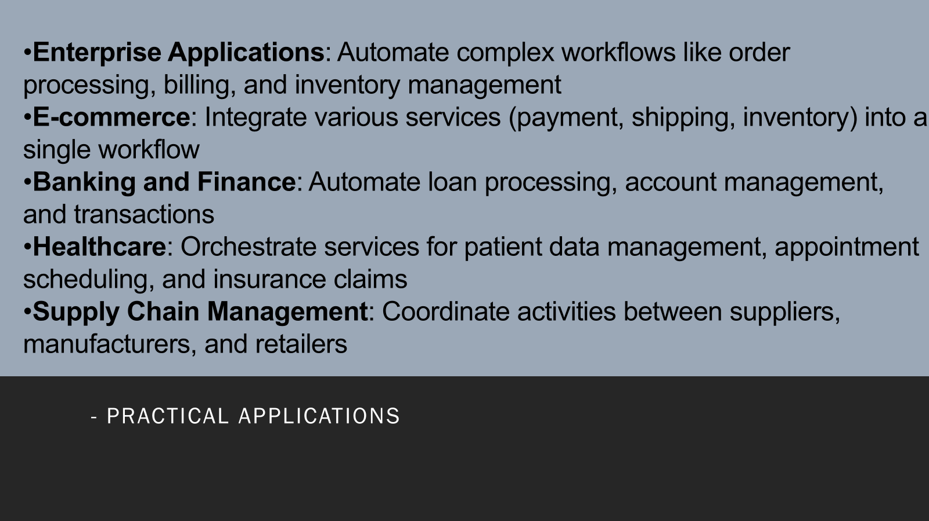

Slide 3
Enterprise Applications
Automates end-to-end workflows for complex business processes like order fulfillment, making processes faster and more efficient.
Enables seamless integration of multiple departments (e.g., sales, finance, logistics) through web services, reducing manual handoffs.
Facilitates real-time tracking and reporting of workflow progress, improving visibility and decision-making across the organization.

Slide 4
E-commerce
Orchestrates critical services such as payment processing, inventory management, and shipping to ensure a smooth customer experience.
Provides flexibility for integrating third-party services, such as external payment gateways or shipping providers.
Enables real-time updates on order status and inventory availability, enhancing customer satisfaction and inventory accuracy.

Slide 5
Banking and Finance
It automates loan processing workflows by coordinating services for credit checks, approvals, and disbursements.
It supports account management tasks like opening accounts, updating customer details, and processing account closures efficiently.
It improves the speed and reliability of transaction processing, such as funds transfers and bill payments, by integrating multiple banking services.

Slide 6
Healthcare
Integrates various services for patient data management, allowing healthcare providers to access and update patient records securely.
Automates appointment scheduling workflows, integrating with patient management and notification systems for better patient experience.
Facilitates insurance claims processing by coordinating between healthcare providers, insurance companies, and billing systems to streamline claims approval.

Slide 7
Supply Chain Management
Coordinates procurement, manufacturing, and logistics activities, ensuring smooth operations across the supply chain.
Enables real-time communication between suppliers, manufacturers, and retailers, improving inventory management and demand forecasting.
Enhances visibility and traceability in the supply chain, allowing businesses to track product movement and respond to disruptions quickly.

