Slide 1

A Dissertation Report
PRESENTATION
HIRRD (Job Portal Application)
SUBMITTED BY
SUPERVISED BY
Ms. ZAIRA BANO
SHOBHIT KUMAR SHARMA
2021-310-203
B.TECH
SUBMITTED TO
Department of Computer Science & Engineering School of Engineering Sciences & Technology JAMIA HAMDARD

Slide 2
INTRODUCTION
Effortless Hiring : Hirrd is a job portal designed to simplify the hiring process for both job seekers and recruiters with a clean, user-friendly interface.
Smart Job Searching : Powered by React.js, Supabase, and Clerk, it offers real-time updates, secure logins, and tools for job tracking and application management, ensuring a smooth and engaging experience.

Slide 3
OBJECTIVE
To build a user-friendly job portal that simplifies the hiring process for both job seekers and recruiters through a clean and responsive interface.
To enable efficient job browsing and application tracking with real-time updates and smooth job management features.
To ensure secure access and data privacy using Clerk authentication, while maintaining platform scalability and accessibility across devices.
To create a modern, environment-friendly system leveraging Supabase for performance and reliability.

Slide 4
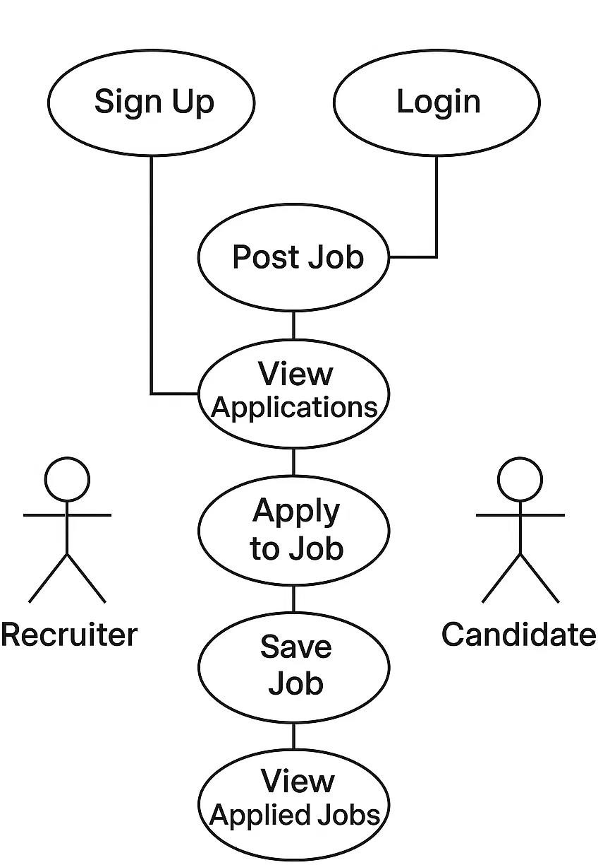
UML Use Case Diagram

Slide 5
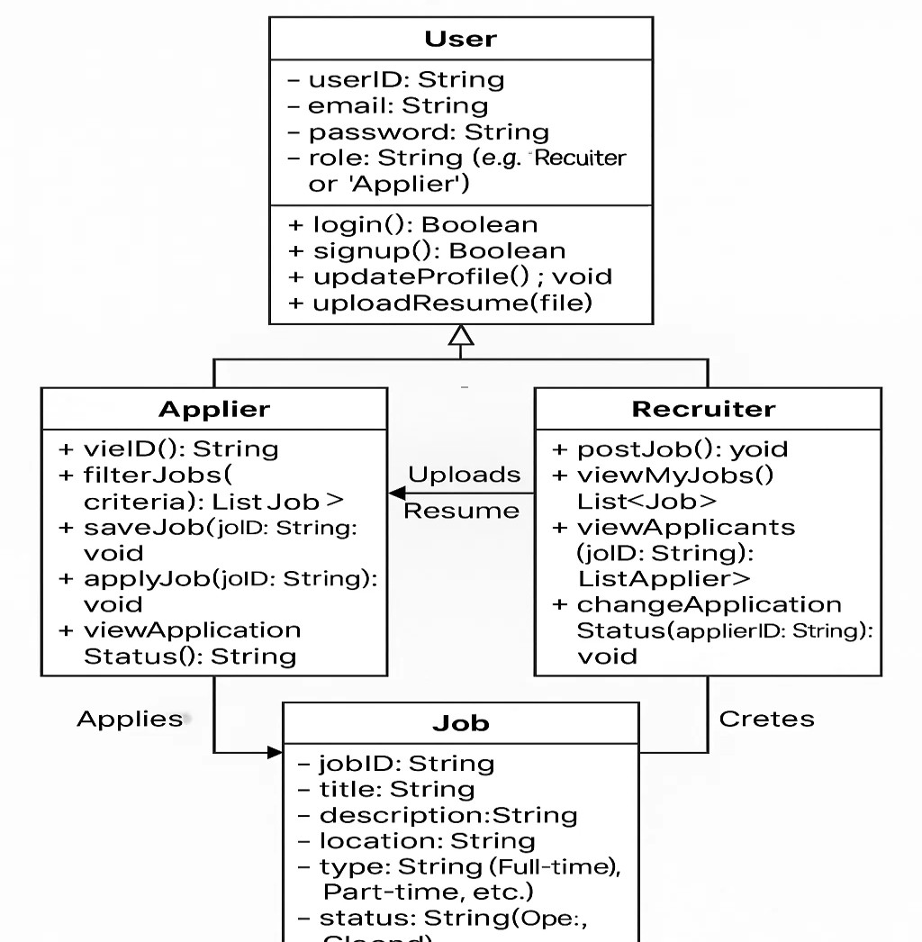
UML Class Diagram

Slide 6
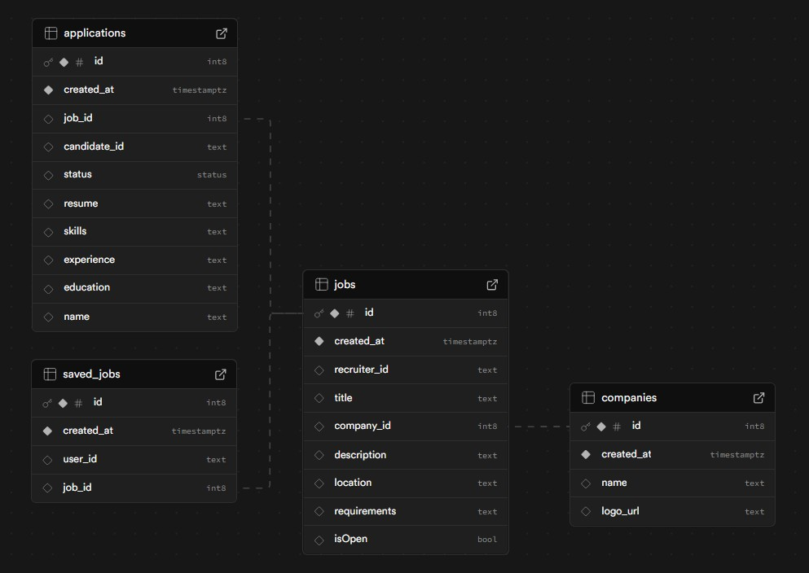
ER Diagram

Slide 7
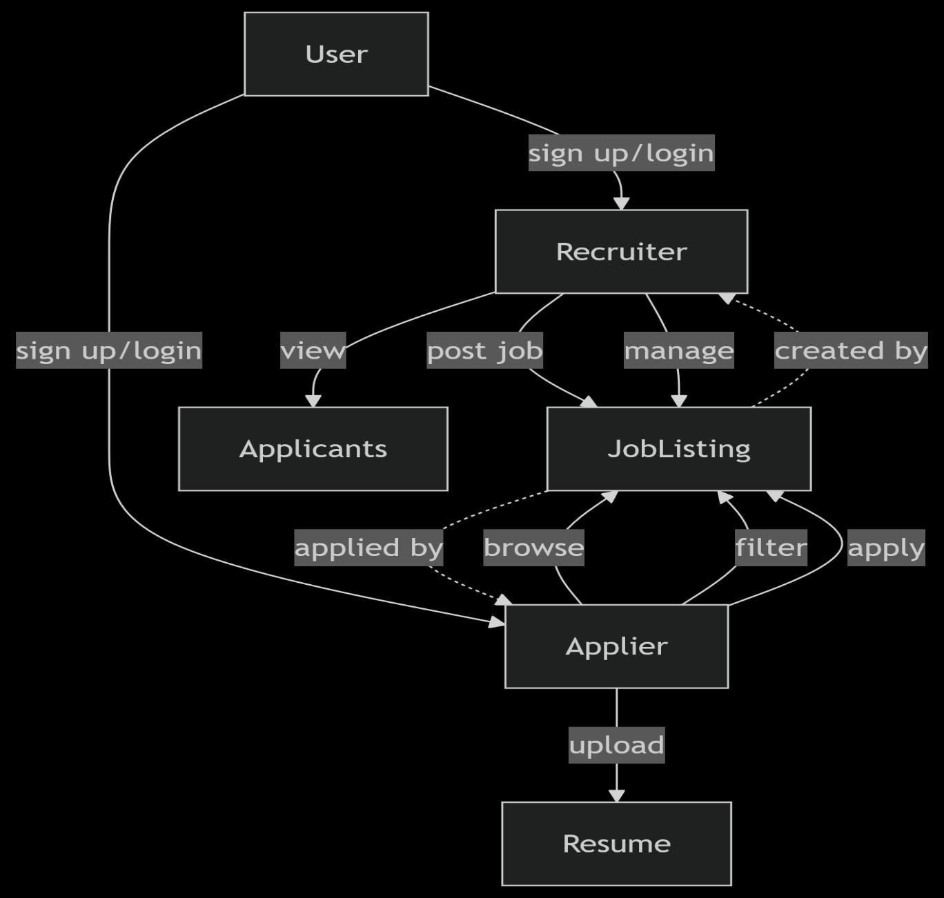
UML Sequence Diagram

Slide 8
Summary input validations and checks
Robust Input Validations
Ensuring Data Integrity & Security:
Hirrd implements comprehensive form validations across all user-facing features to enhance usability and prevent errors.
Required Fields: Enforced in login, signup, job creation, and applications (e.g., title, description, email). → “Title is required.”
Email Format Check: Validates email using regex during signup. → “Please enter a valid email address.”
Password Validation: Ensures strength (min. 8 chars) and confirms match. → “Passwords do not match.”

Slide 9
Numeric & Range Validation: Applied to experience input. → “Enter valid experience ≥ 0.”
File Upload Restrictions: Accepts only valid image/PDF files with size limits. → “Invalid file type or size exceeds limit.”
Location Check: Ensures valid location input in job creation and filters.
Cross-field Matching: Confirms password match during signup. → “Passwords must match.”
Duplicate Account Prevention: Avoids account creation with an existing email. → “This email is already registered.”
Application Review Validation: Prevents empty submissions. → “Applications cannot be empty.”

Slide 10
Summary of different reports
Reports & Insights
Hirrd generates multiple reports to help administrators, recruiters, and developers monitor platform activity, improve performance, and guide future improvements.
User Activity Report Tracks user signups, login trends, and active users. Use Case: Monitor platform growth and user engagement.
Job Listings Summary Report Summarizes all job postings by company, location, and status. Use Case: Analyze job posting trends and identify high-traffic listings.
Application Reviews Report Details total and saved/deleted job applications. Use Case: Identify popular job listings and user interest.

Slide 11
4. GA4 Analytics Report Uses Google Analytics 4 to capture user interactions (e.g., clicks, searches, form attempts). Use Case: Understand user behavior, improve UX, and optimize engagement.
5. Company Listings Report Provides job creators with a summary of their posted jobs and applications. Use Case: Help recruiters manage and track their listings effectively
6. Error & Validation Logs Logs real-time system and validation errors with timestamps and triggers. Use Case: Support debugging and improve overall system reliability.

Slide 12
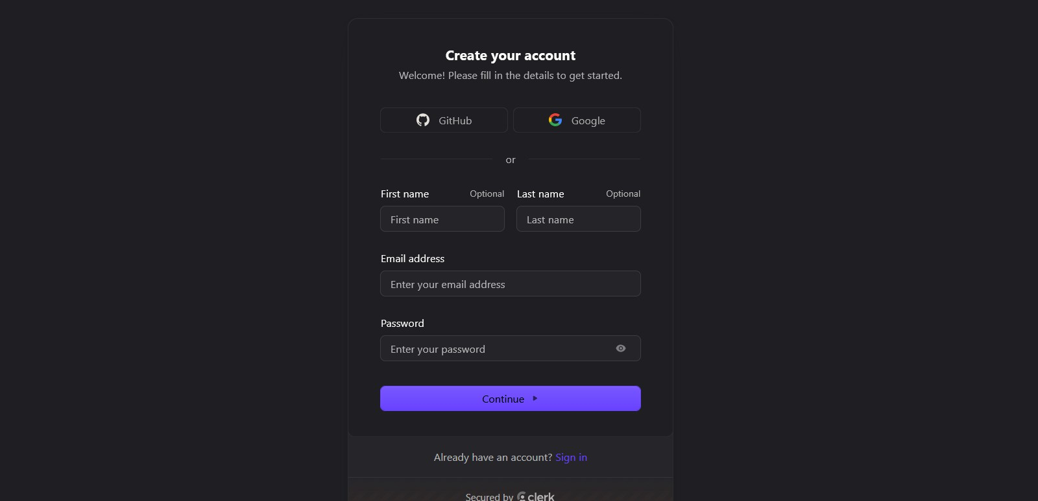
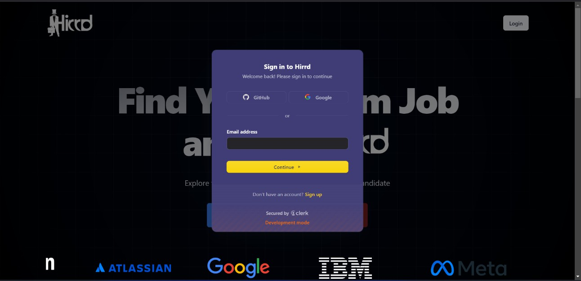
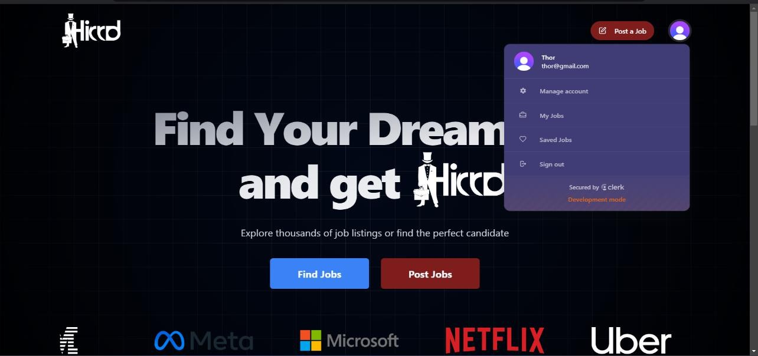
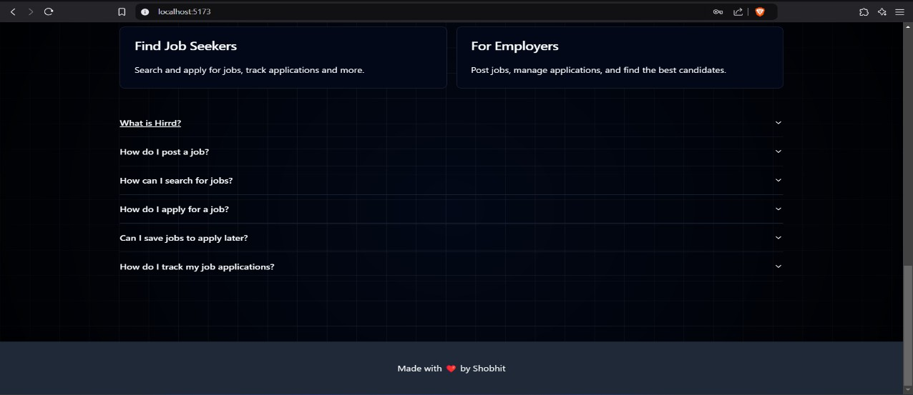
Snapshots

Slide 13
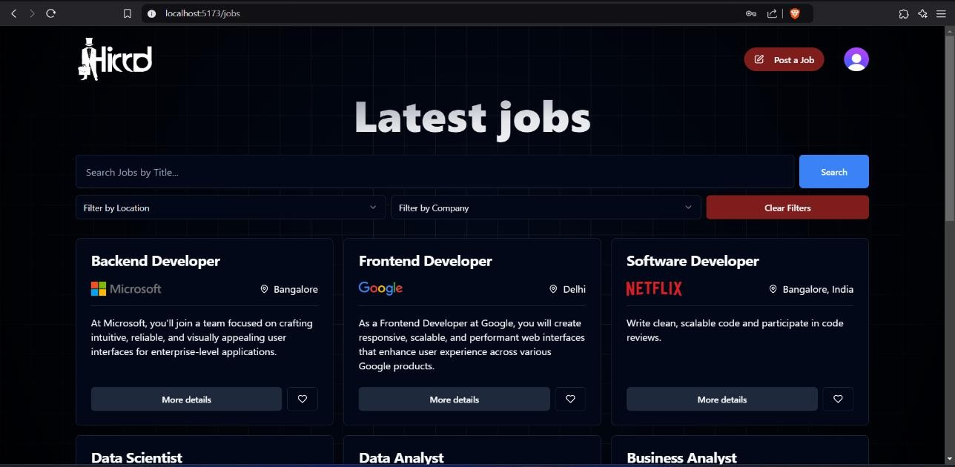
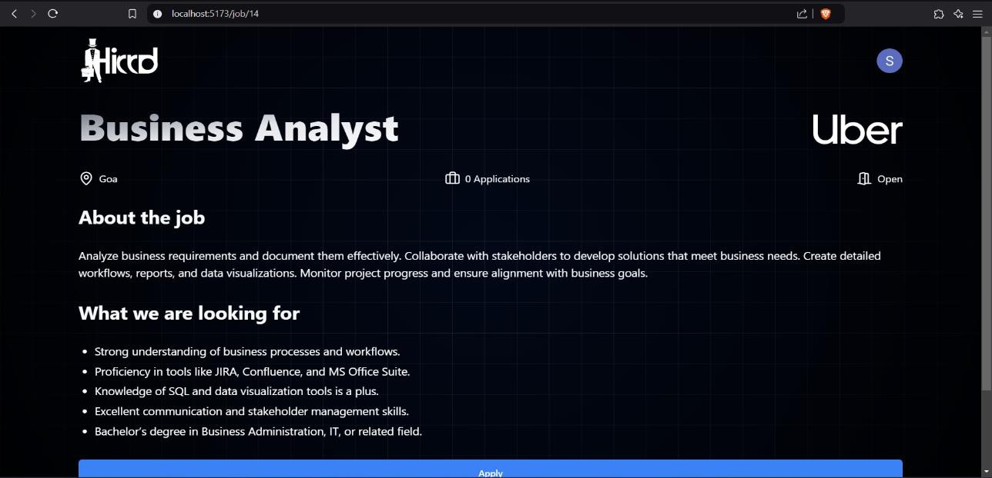
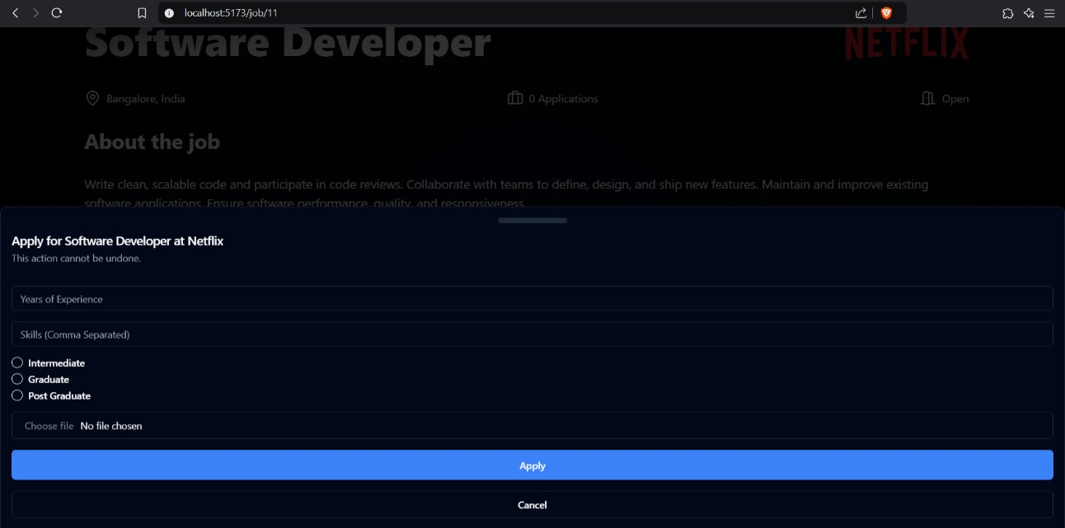
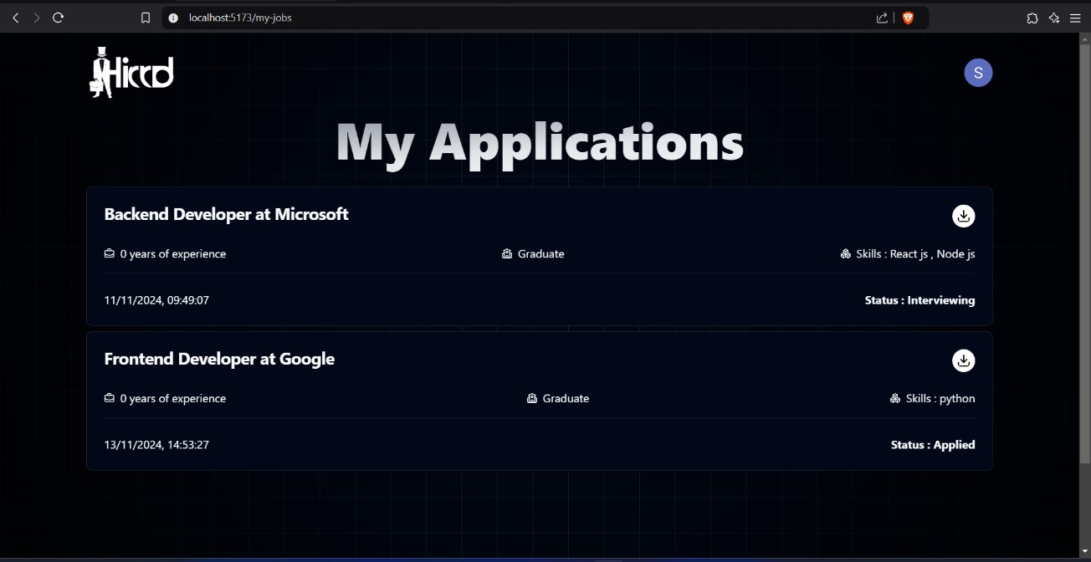

Slide 14
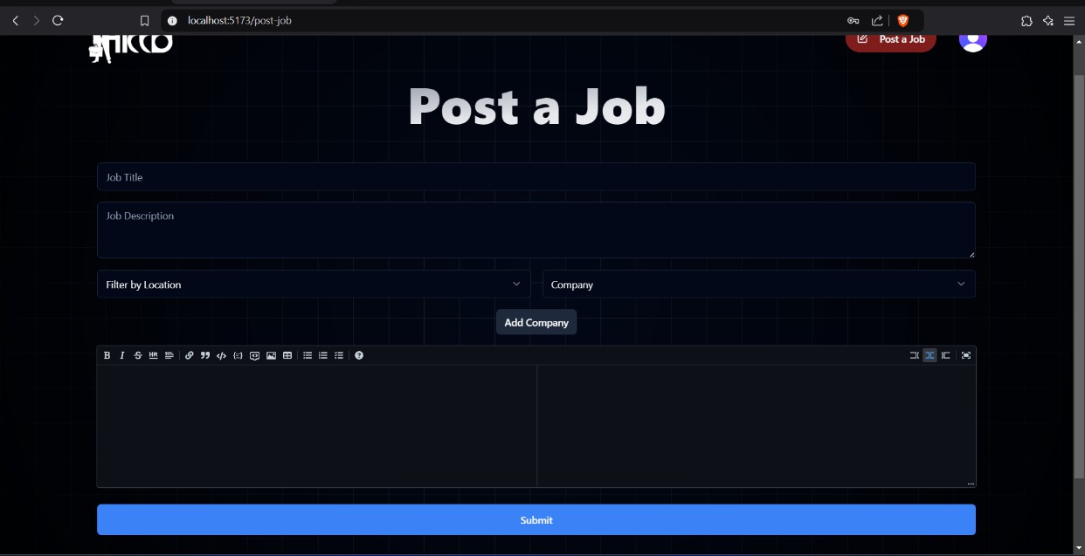
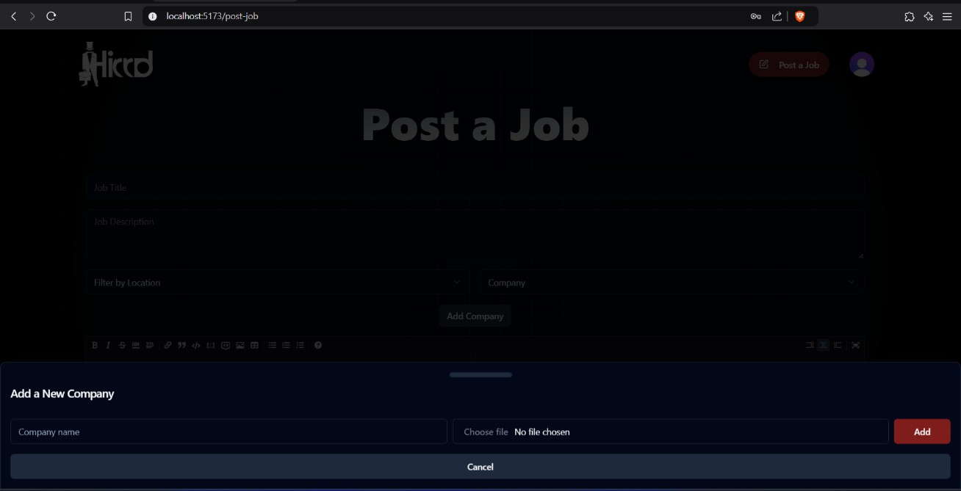
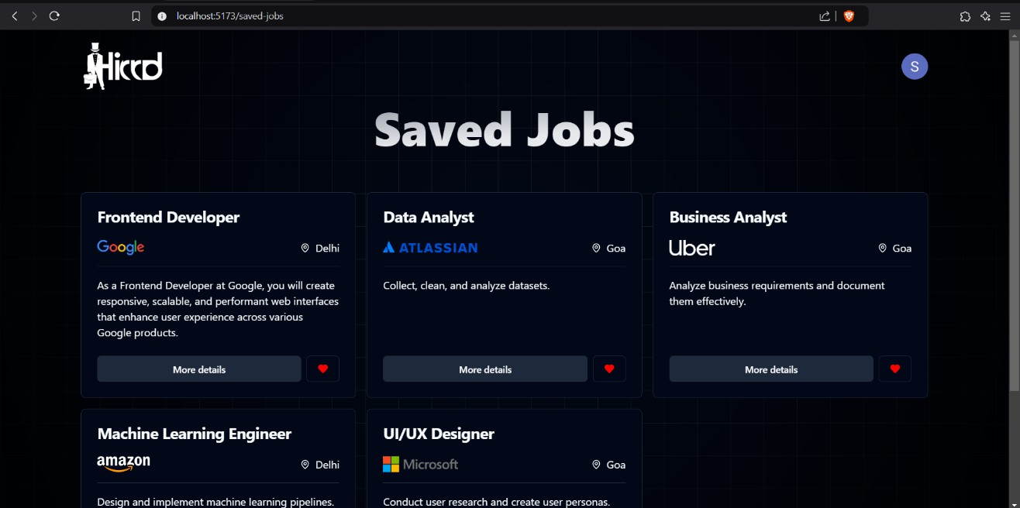
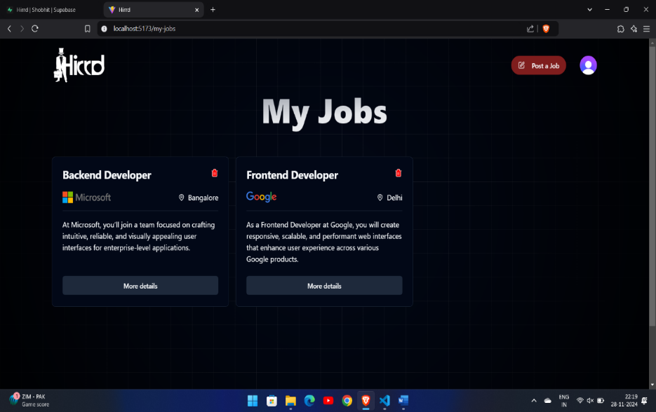

Slide 15
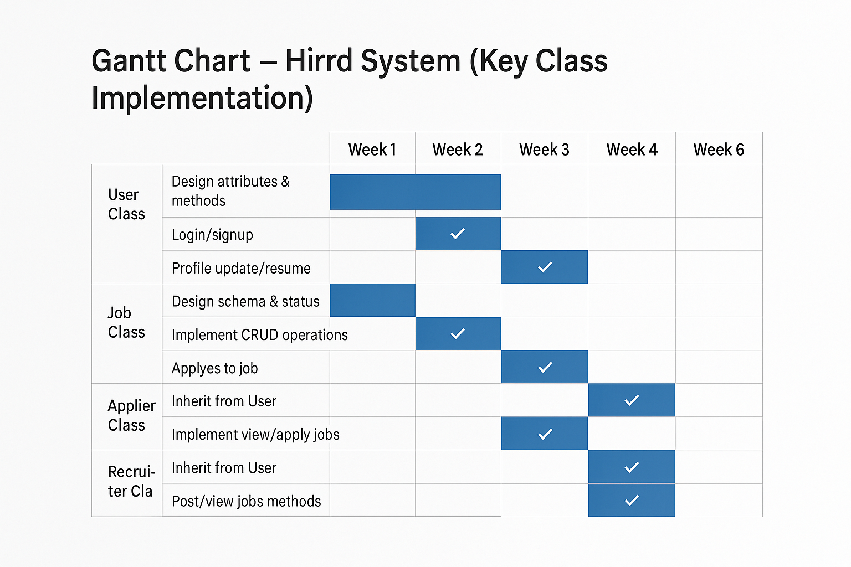
Gantt Chart

Slide 16
CONCLUSION
The Hirrd Job Portal is an intuitive and secure platform for job seekers and recruiters, built with React, Tailwind CSS, Supabase, and Clerk. It offers a responsive design, real-time updates, and seamless user authentication, allowing job seekers to easily apply and recruiters to manage listings and track applications. The integration of Supabase ensures reliable backend services, while Clerk enhances security. Deployed on Vercel, the platform provides excellent performance, scalability, and global accessibility.

Slide 17
LIMITATIONS
Password recovery and account deletion require manual admin support.
No integration with third-party job boards or resume parsing tools.
Admin dashboard and role-based access control are not implemented.
Resume upload is limited to one file per candidate.
No real-time chat or messaging between recruiters and candidates.

Slide 18
Future Scope
Automate password recovery and account deletion.
Integrate resume parsing and LinkedIn profile support.
Develop an admin dashboard with role-based access control.
Add real-time chat or messaging between recruiters and candidates.
Implement multi-language support.
Introduce advanced job filters (e.g., experience, salary, job type).
Integrate analytics for tracking user engagement and job performance.

Slide 19
Bibliography
IEEE Software Requirements Specification Format – IEEE Std 830-1998.
Supabase Documentation – https://supabase.com/docs
Clerk Authentication Documentation – https://clerk.dev/docs
React Official Documentation – https://reactjs.org/docs
Stack Overflow – https://stackoverflow.com
MDN Web Docs – https://developer.mozilla.org
W3C HTML and CSS Standards – https://www.w3.org/
Express.js Official Documentation – https://expressjs.com/

Slide 20
THANK YOU

