Slide 1

Boschlers
Jio Artificial Intelligence Hackathon
Code Gladiators 2019
CG_TEAM_ LSSTN
Shobhit, Harshit, and Pons from BOSCH

Slide 2
Executive Summary
Traffic congestion caused by vehicle is an alarming problem at a global scale and it has been growing exponentially. Car parking problem is a major contributor and has been, still a major problem with increasing vehicle size in the luxurious segment and confined parking spaces in urban cities. Searching for a parking space is a routine (and often frustrating) activity for many people in cities around the world and contributes to loss of time and money, stress for the drivers as well environmental impact due to unnecessary fuel burning.
Smart Parking systems can be a boon in such scenarios. They can be deployed to obtain information about available parking spaces in a particular geographic area and process in real-time to place vehicles at available parking spots. With the help of smart parking system, there would be no congestion in parking lot because the available slot is given by our smart parking app.
As part of this challenge we have tried to built a brain for a smart parking app using image processing and machine learning using python libraries. Our project takes the image of a parking lot and at any time can provide the list of total parking spaces and how many available for parking.

Slide 3
Problem at hand
Develop a model to identify the parking slots, its vehicle occupancy, vehicle color and pose from a given image/images.
The model should take an image as input and return all detected parking slots in the image in Json format.
Each detection result from the model should be a list of 5 (cx,cy,v,c,p) values:
First two should represent the centre coordinates cx, cy of the detected parking slot
Third value should represent the vehicle occupancy v in the parking slot. It should be 1 if the vehicle is present in the parking slot and 0 otherwise.
Fourth value should represent the color_code c (0-8 values for White-0, Silver-1, Black-2, Grey-3, Blue-4, Red-5, Brown-6, Green-7, Others-8)
Fifth value should represent the pose p (0 for front facing i.e front of the car is looking at the camera, 1 for back, back of the car is looking at the camera )

Slide 4
Solution Approach
We have built a Convolutional Neural Network (CNN) based on images of parking slots segregated based on occupied and empty space.
For a specific parking lot our program can process the image to find the total parking slots available
For a new incoming image for that parking lot, the program can count the number of slots available and then show the empty slots pictorially and store in JSON format.
Car Color Detection we have used K-means Clustering model (scikit-learn).
Car Front and Back side detection we have used Microsoft Azure Cognitive service Vision API and called in Python

Slide 5
Assumptions
In the input image the slots needs to be aligned with x-axis.
The parking is only for cars.
Our program assumes that image covers only parking lot.
The Config file will contain all the tuning parameters like epoch, batch size, gap etc.

Slide 6
Approach for parking slot detection and occupancy with (cx, cy)
We have roughly divided the challenge into 2 parts
Image processing to identifying the no of slots
Used python OpenCV library for core image processing
Canny, Houghline transform for identifying lines and parking slots
Initial config file setup for tuning the processing – one time setup for a specific parking lot.
Identified parking slots list is stored in a pickle file.
Processing new Input image to find the available slots and calculate cx and cy
New image is divided into individual slots based on the stored slot list.
Created bounding box and defined cx and cy with the formula and plotted with red and green dots.

Slide 7
Approach for car front and back face detection)
We have roughly followed below 3 steps:- 1.Selected data set having front side and back side of the car 2.Used Microsoft Azure Cognitive Services Vision library to train the model on dataset for front and back side of car 3.Calculating probability if the car is facing front or back side to the camera based on the trained images

Slide 8
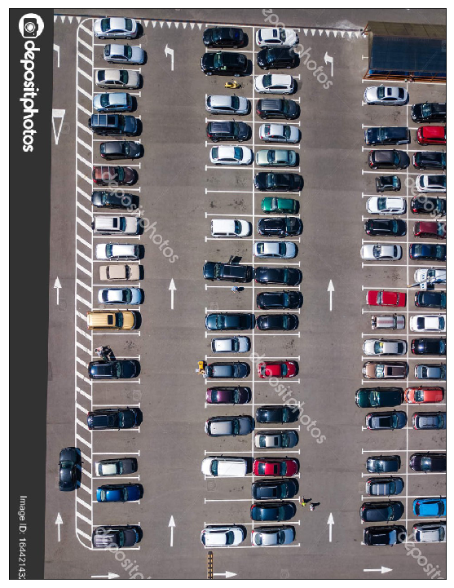
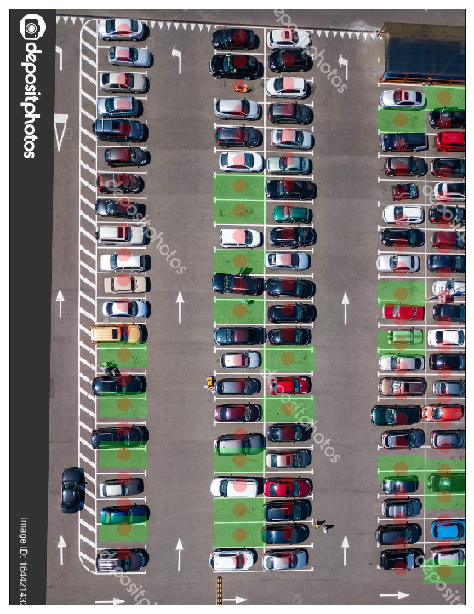
Demo/ Prototype
Input Image
Output Image

Slide 9
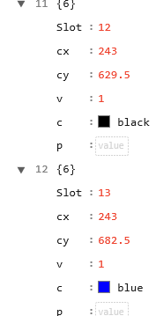
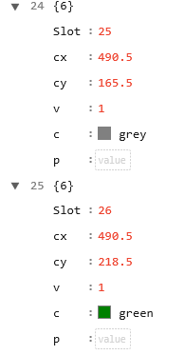
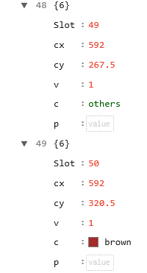
JSON Preview

Slide 10
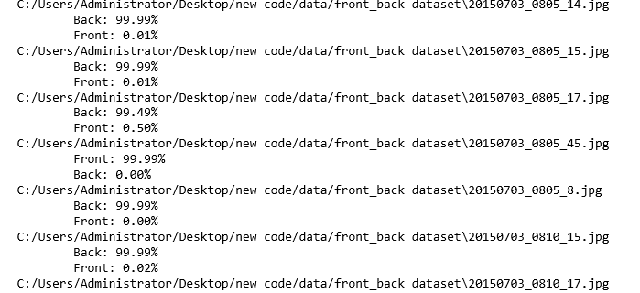
Car Front and Back Prediction

Slide 11
Technology Stack
Python 3.7.3
Keras
Tensorflow
Jupyter Notebook
OpenCV
Pillow
Pickle
Matplotlib
Numpy
VGG16
Import_ipynb
WebColors
Sklearn
Microsoft Cognitive Service
Vision API

Slide 12
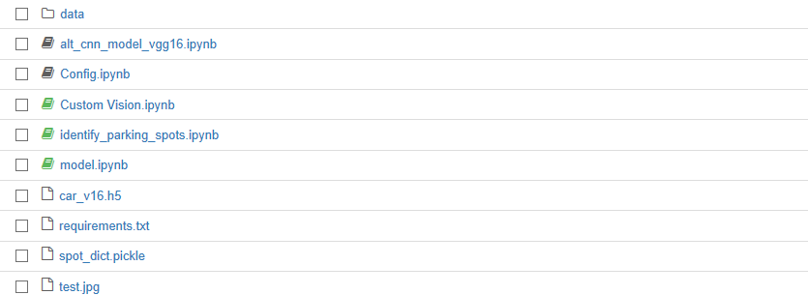
Folder Structure
Result JSON and Training and Testing dataset
Model creation file
Configuration files
Custom vision implementation of Front and Back Side of Car
Detecting empty slot and assigning 0,1
Prediction are done in this file
Model is stored in this file
Requirement file
Identified slots are stored in this file
Image after slots identfied

Slide 13
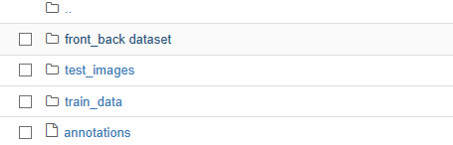
Folder Structure
Dataset for detecting front and back view of the car
Front
Test Dataset
Train Dataset
Result JSON file

Slide 14
Thank you

Slide 15
Appendix
VGG16 CNN Model
https://machinelearningmastery.com/use-pre-trained-vgg-model-classify-objects-photographs/
https://www.learnopencv.com/keras-tutorial-using-pre-trained-imagenet-models/
https://neurohive.io/en/popular-networks/vgg16/
OpenCV
https://opencv-python-tutroals.readthedocs.io/en/latest/py_tutorials/py_imgproc/py_houghlines/py_houghlines.html
https://docs.opencv.org/2.4/doc/tutorials/imgproc/imgtrans/hough_lines/hough_lines.html

