Slide 1

PowerPoint Presentation
Of Project
On
“ShoppingBricks”
Submitted by:-
Shobhit Jaiswal
Roll No.-1602714857 MCA 3rd Year

Slide 2
Introduction
The ShoppingBricks is the part of the sample application that provides customers with online shopping. Through a Web browser, a customer can browse the catalogue, place items to purchase into a virtual shopping cart. Create and sign in to a user account, and purchase the shopping cart contents by placing an order. After placing an order for selected items a user can make payment with through a credit card or through cash on delivery. There is no need to wait in long queue for purchase. Customer can purchase products sitting at home by viewing images of different category of products and adding in shopping cart.
ShoppingBricks will use some sort of shopping cart - this is a virtual trolley into which a person can place items, take them to the checkout when you want to pay. The checkout must be in a secure server in order for your transaction to be secure (in case of card payment).

Slide 3
Project Problem
The problem in existing system is mentioned below-
Time Consuming process
Difficulty to finding the products
Inconvenient
Difficult to compare prices
High Price
Limited Products
Limited operation period
Less information about the product.

Slide 4
Requirement Specifications
Minimum requirements for project development are as follows-
FRONT END
i) Presentation Layer: Java Server Pages
User friendly
Separation of work (design and coding)
Write once and run anywhere
ii) Middle tier: Java Beans and Servlet.
iii) Database Layer: MySQL
iv) Web development language: HTML5, CSS, and BOOTSTRAP.

Slide 5
SOFTWARE REQUIREMENTS
Windows 10/Windows 8
MySQL
JSP & Java
Apache Tomcat Server
Hibernate & Spring Framework
Eclipse Oxygen IDE
Google Chrome or Microsoft Edge browser.
HARDWARE REQUIREMENTS
Intel Core i3 2GHz Processor
4 GB RAM
10 GB Hard Disk

Slide 6
Company Profile
Company Name: - Apex TG India Pvt. Ltd.
Company Address: - E-20, E-Block, Sec-63, Noida-201307, UP
Apex TG India Pvt. Ltd. focuses on delivering sophisticated technology-enabled solutions, consulting and Training to maximize complex business needs. Founded in 2007 and based in New Delhi NCR Noida. We deal in IT Consulting, Training and Development services and providing substantial and concrete results to the clients from across the globe. We provide technical, management and personal skills development, focused on developing better brains for better business

Slide 7
Project Modules
Project is divided into following modules-
A. ADMIN MODULE
Admin can perform following tasks:
a) Add/Remove Products
b) Update Product information 25
c) Access the Database
d) Add/Block Users
B. USER MODULE
Users can perform the following task:
a) Signup
b) Sign In
c) Change Password
d) Request for password from Admin if forgot the password.
f) Browse products/View products
g) Select the products and Add to Cart
h) Place Order
i) Make Payment

Slide 8
C. VISTORS
a) Browse the web sites
b) View the products

Slide 9
Data Flow Diagram
A DFD has the purpose of clarifying system requirements and identifying major transformation means how data is flowing at various level between source destinations. A DFD consist of a series of bubbles Joint by lines. The bubbles represent data transformation and the lines represent data flow.
The DFD is one of the most important tools to be used by system analyst. The main merit of DFD is that can provide an overview of what files are used, and where the results flow. The graphical representation of the system makes it a good communication tool between a user and an analyst.

Slide 10
Context Level DFD

Slide 11
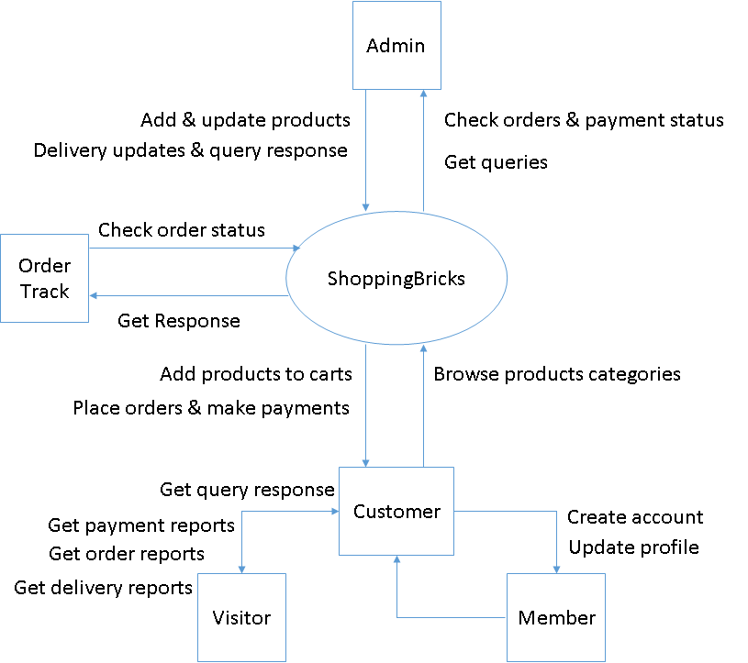
Level 1 DFD

Slide 12
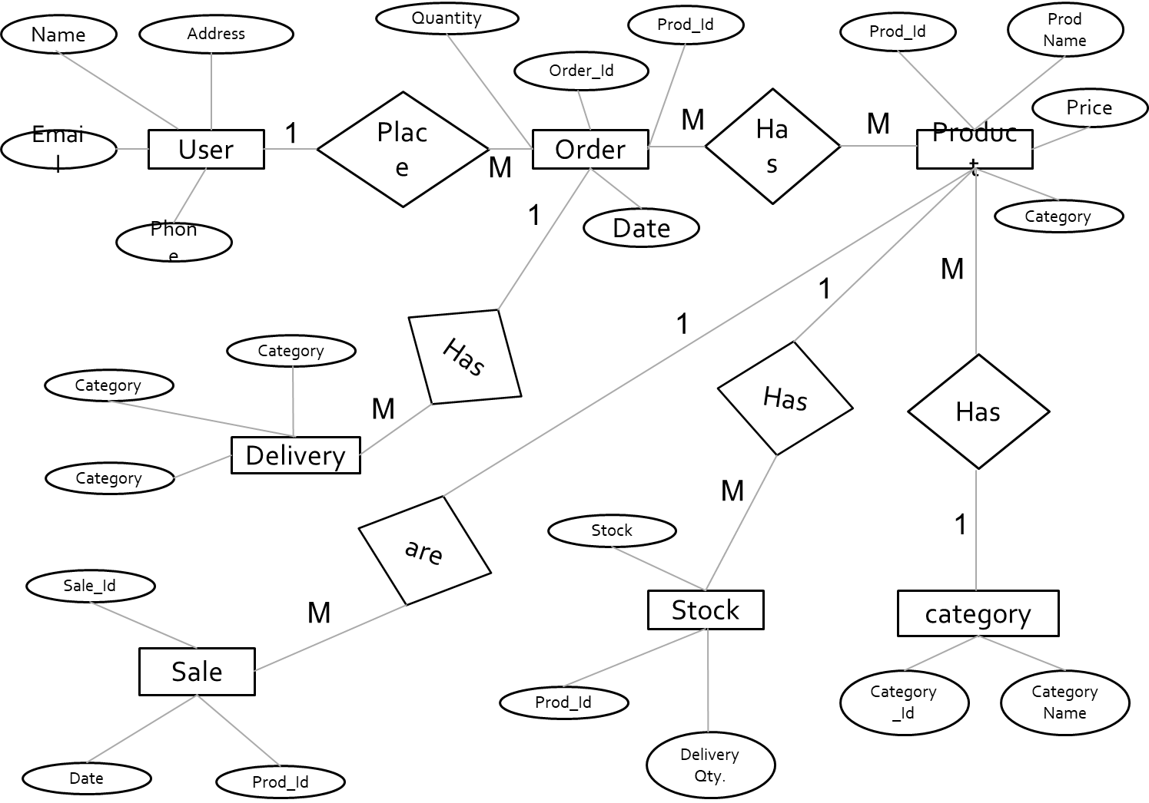
E-R Diagram

Slide 13
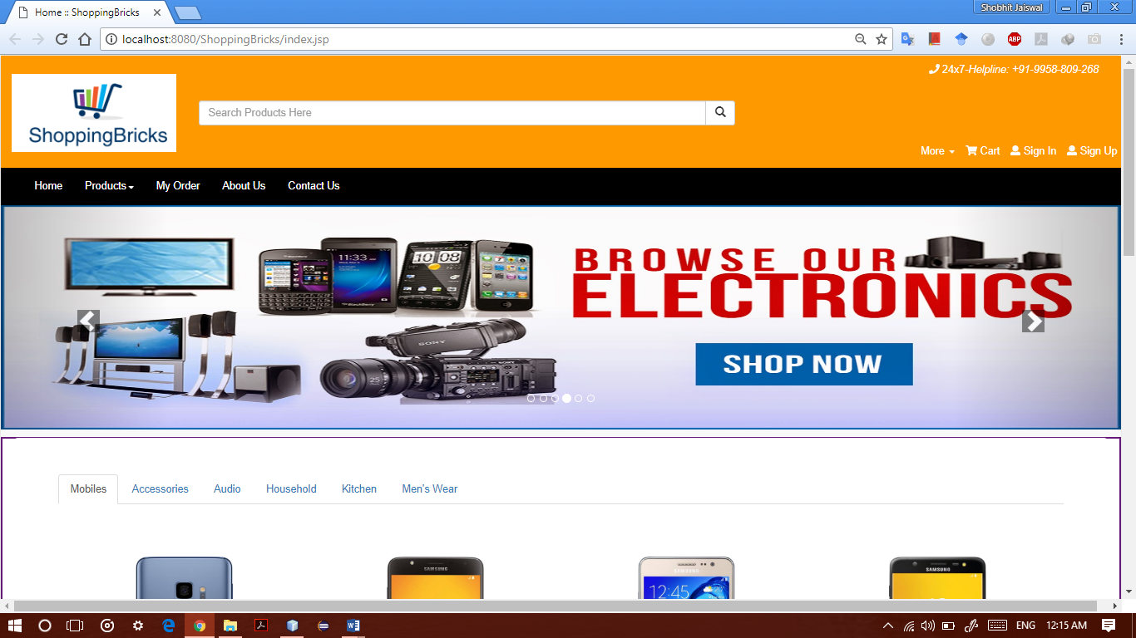
Project Snapshots
Home Page

Slide 14
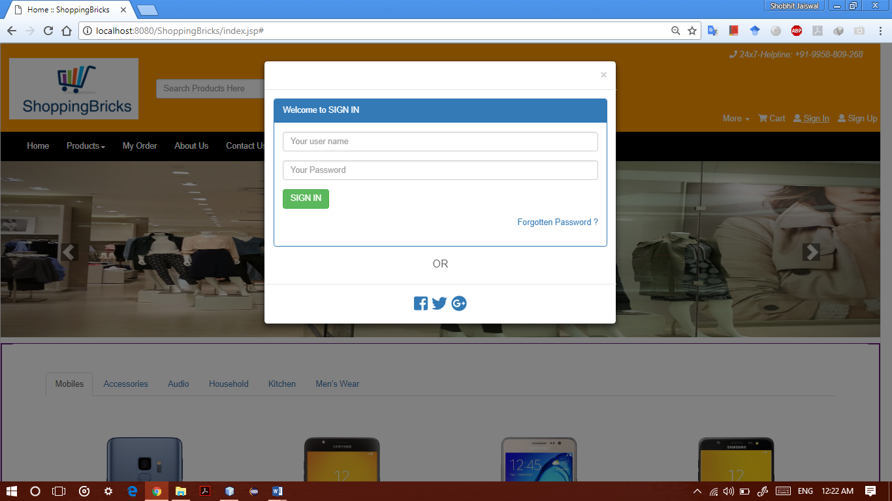
Login Form

Slide 15
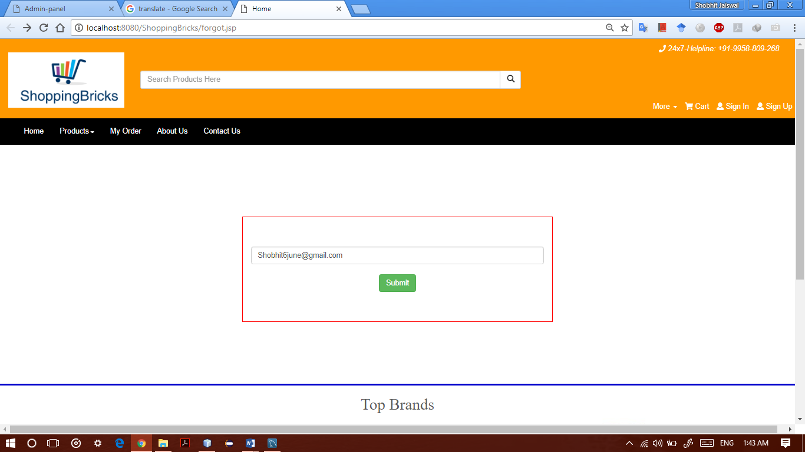
Forgot Password Page

Slide 16
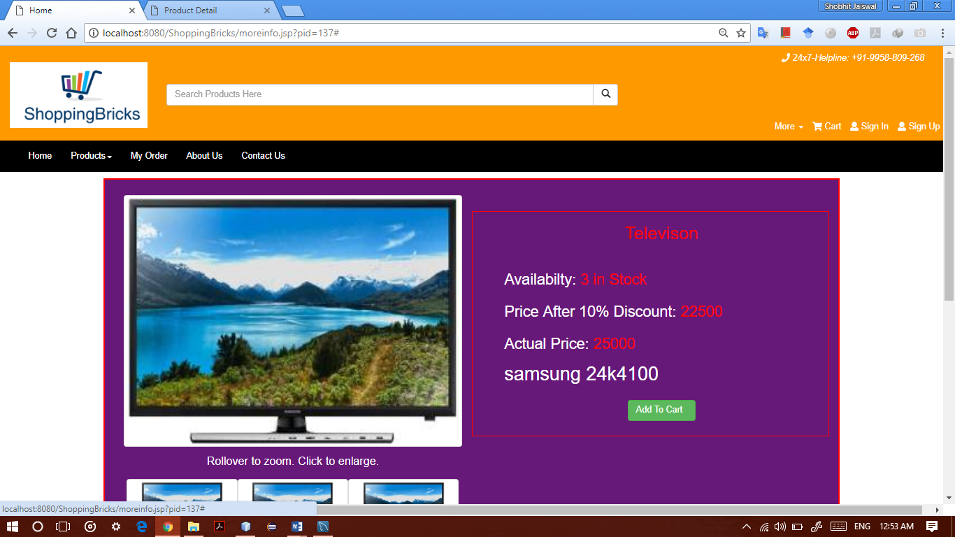
Product Info Page

Slide 17
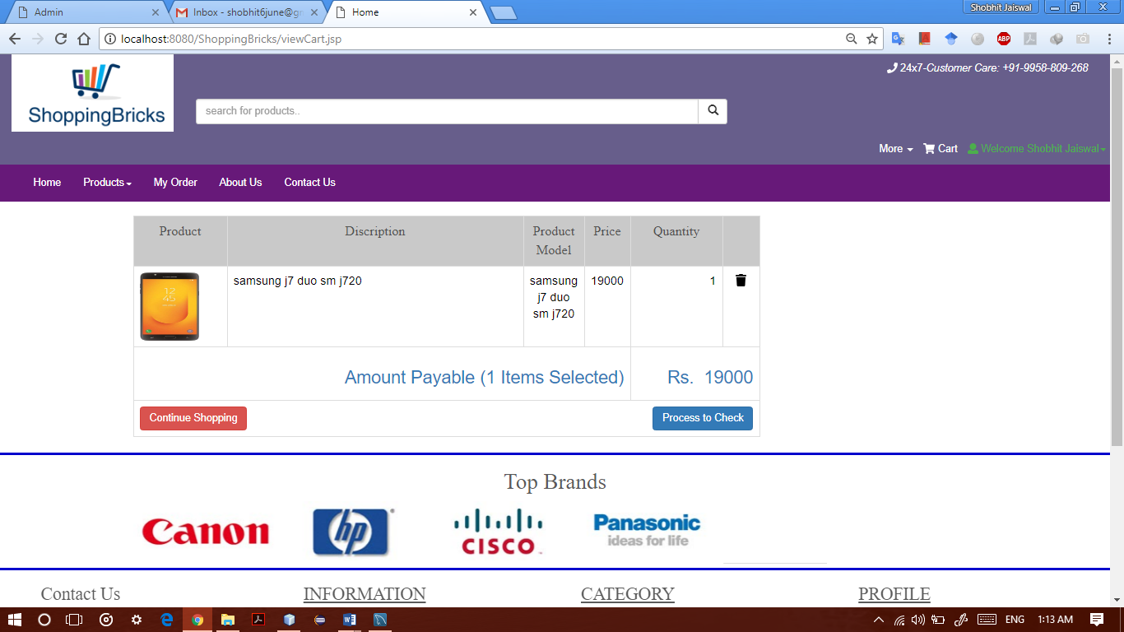
View Cart Page

Slide 18
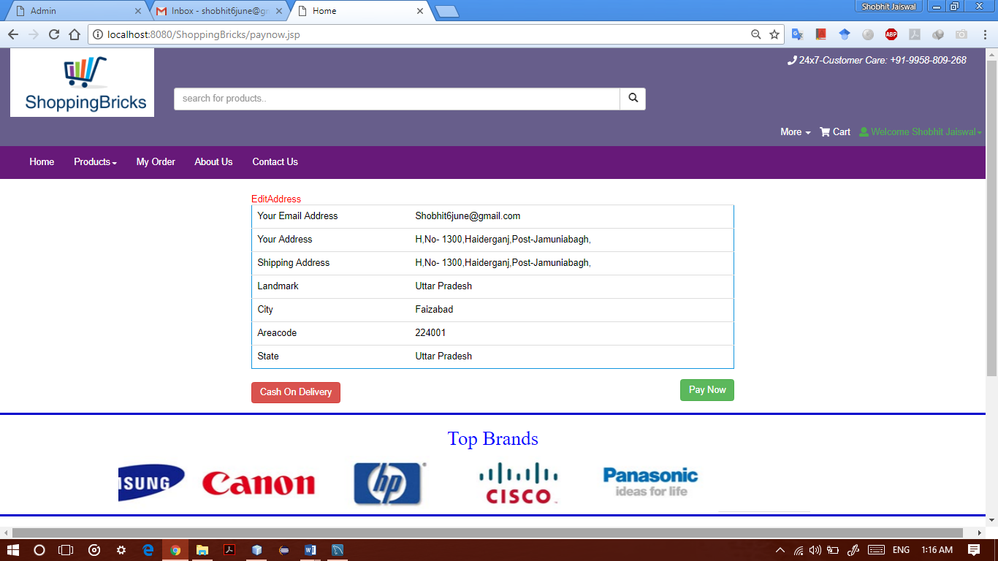
Payment Page

Slide 19
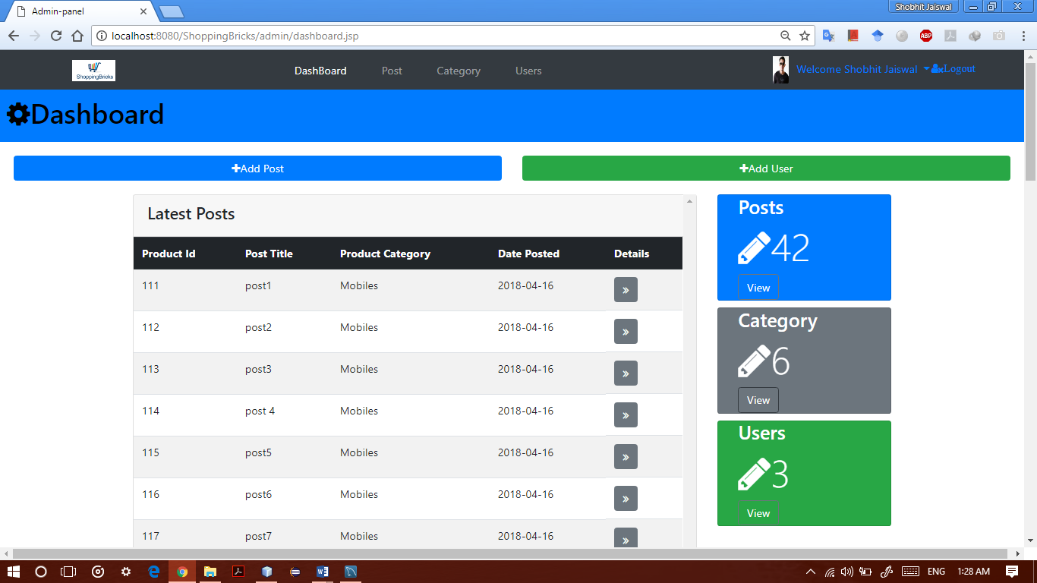
Admin Dashboard

Slide 20
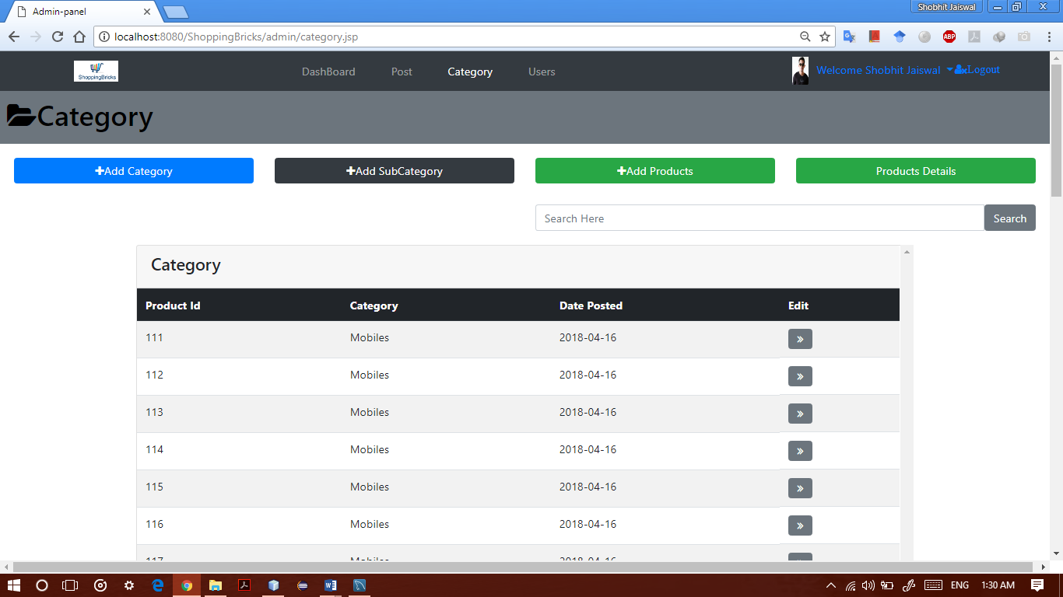
Admin Product Upload Page

Slide 21
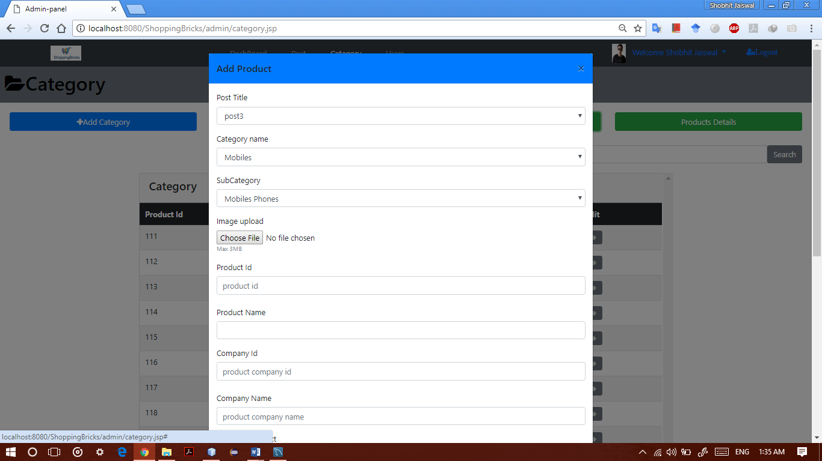
Admin Add Products Form

Slide 22
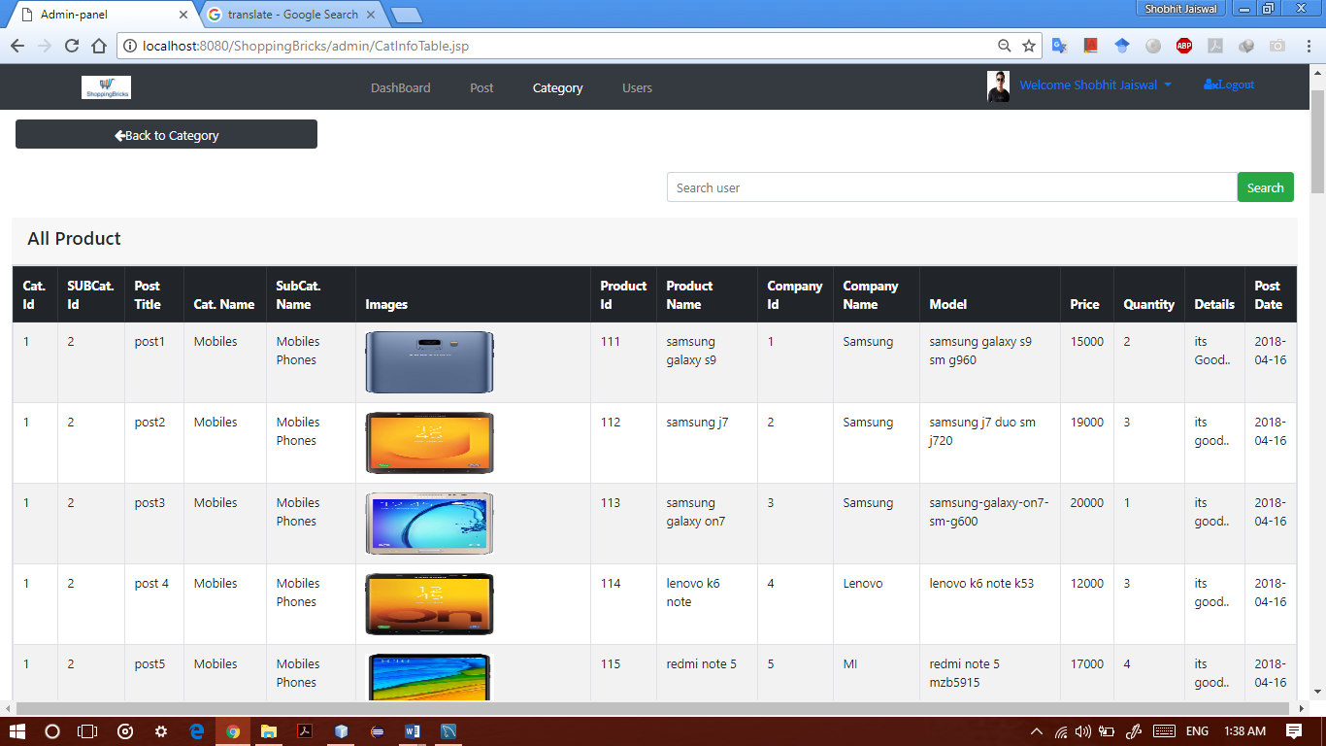
View All Products Page

Slide 23
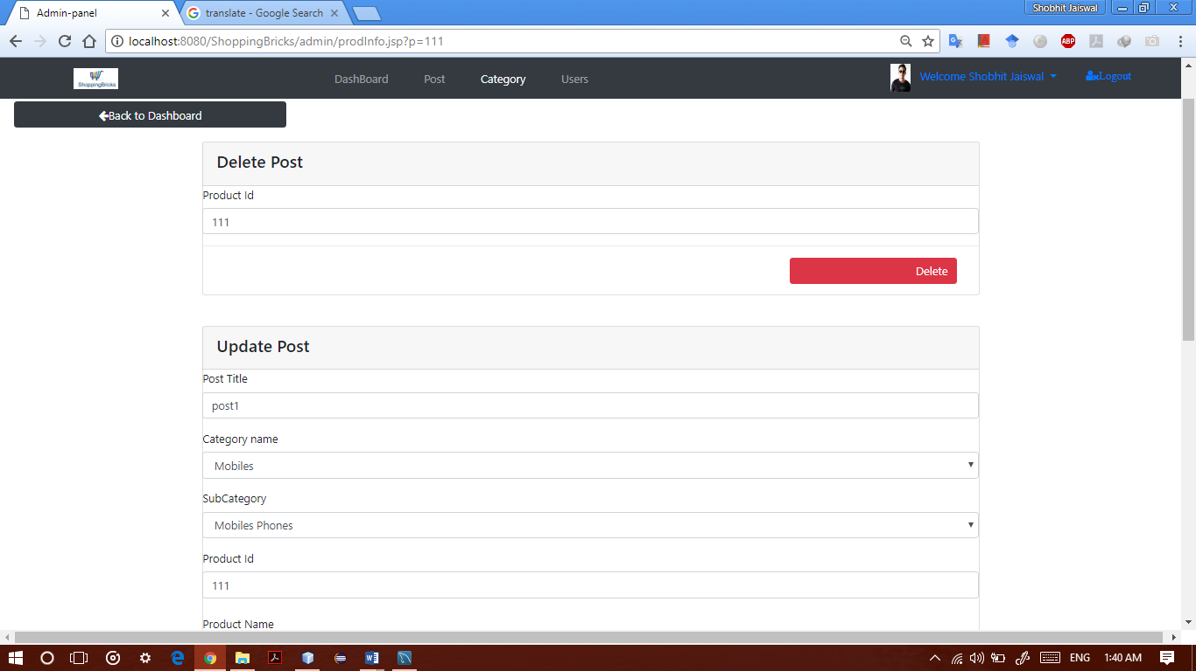
Admin Product Info Page

Slide 24
Special Features
The success of many websites is determined by not only the products offered and how well the website is marketed, but also by the features the website offer both the customer and the website owner. As a business owner, it is important that you have the tools to manage your website and that the administrative features fit with your business processes.
The major features of this product are as follows:
ShoppingBricks allows any visitor to search any products.
In addition, it also provides content management capabilities.
ShoppingBricks provides secure payment Gateway for transactions.
It also provides efficient ease-to-use checkouts.
ShoppingBricks also provides promotion and code discount tools to its users.

Slide 25
Future Scope
The system can be used as online shopping portal in real life. Anyone who wants to sell their items online or wants to build online store, he/she can use this application for their use.
Uses of new controls of JSP into this website and fully responsive website.

Slide 26
Conclusion
The project titled as “ShoppingBricks” is a web based application. This website provides facility for selling good quality branded products with a very reasonable rates. This website is developed with scalability in mind. Additional modules can be easily added when necessary. The website is developed with modular approach. All modules in the system have been tested with valid data and invalid data and everything work successfully. Thus the system has fulfilled all the objectives identified and is able to replace the existing system. The extra tools are provided in this website like tooltip to identify the work “what to do with this website”.
The project has been completed successfully with the maximum satisfaction of the organization. The constraints are met and overcome successfully. The system is designed as like it was decided in the design phase. The project gives good idea on developing a full-fledged application satisfying the user requirements.
The system is very flexible and versatile. This website has a user-friendly screen that enables the user to use without any inconvenience. Validation checks induced have greatly reduced errors. Provisions have been made to upgrade the website. The application has been tested with live data and has provided a successful result. Hence the website has proved to work efficiently.

