Slide 1

Carpool Management
Presented By:
Shobhit Sagar
Nitin
Monika Chaudhary
Jitendra Tyagi
Chetan Pal
Abhishek Tyagi

Slide 2


Slide 3
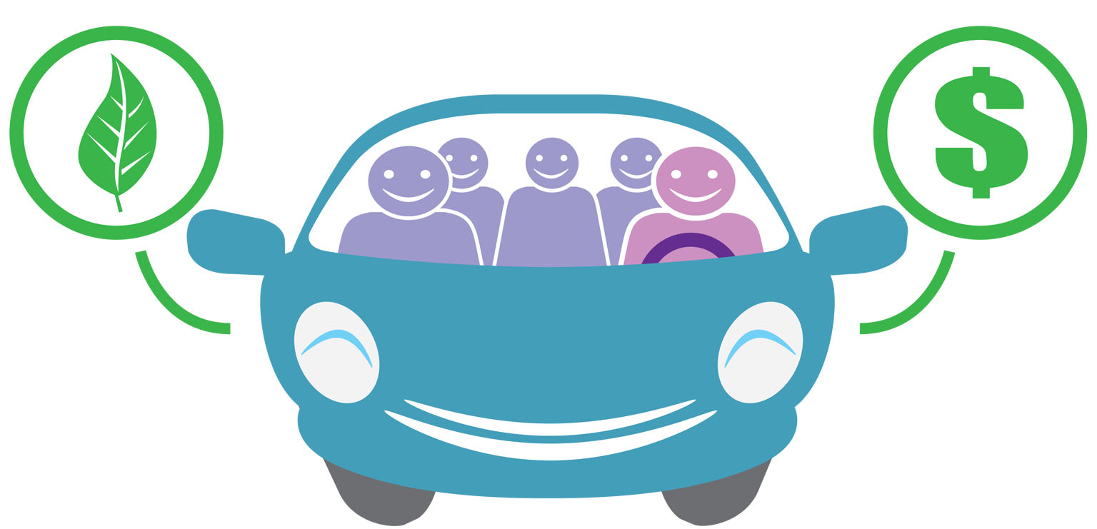
Introduction:-

Slide 4
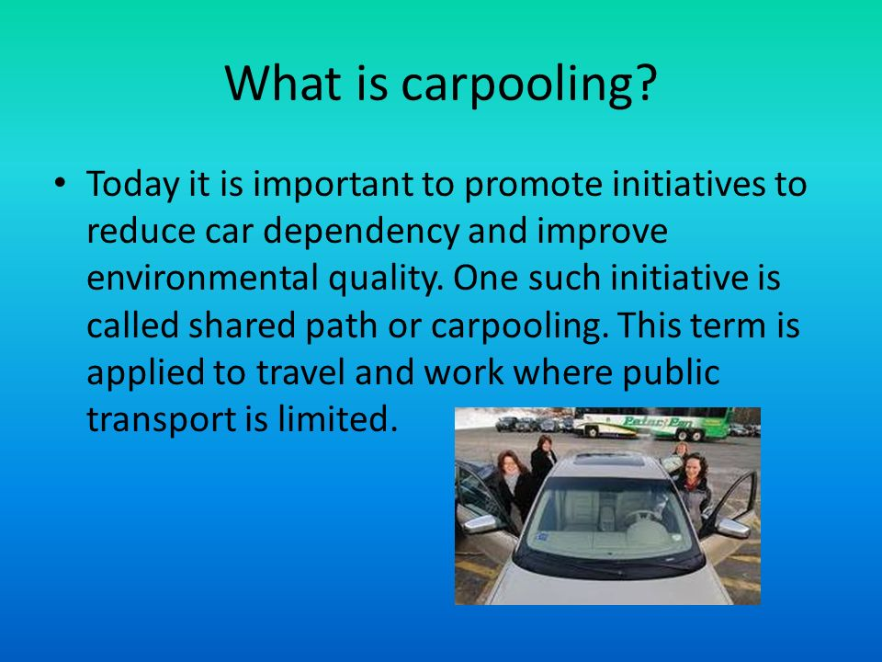

Slide 5
Benefits:-
Save Your Money
Reduce Traffic
Reduce The Fuel Consumption
Helps To The Environment
Very Convenient Options
Helps You Make New Friends

Slide 6
Why carpool is Important?
Carpooling is also a more environmentally friendly and sustainable way to travel as sharing journeys reduces air pollution, carbon emissions, traffic congestion on the roads, and the need for parking spaces.

Slide 7
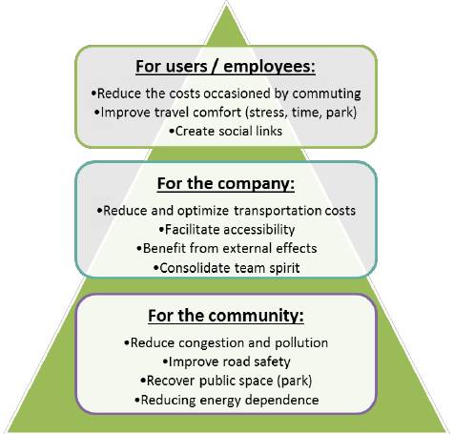

Slide 8

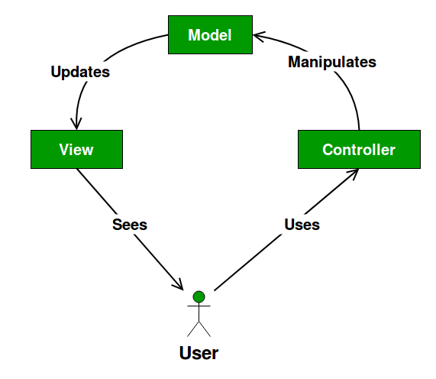
APPROACH USED:
MVC
(MODEL VIEW CONTROLLER)

Slide 9
DATA FLOW DIAGRAM

Slide 10
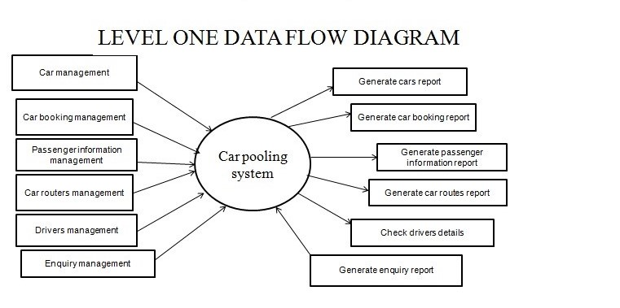

Slide 11
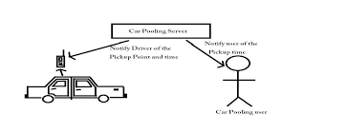
How To Get Started
Check out Carpool.com to find carpool partners.
Make a schedule with your carpool partners.
Make a plan about how will share driving responsibilities and cost.

Slide 12
Functions:-
Login – logging onto the web server.
Register - Register in the carpooling.
Carpool search – search other members participating in the carpool.
Create Carpool – create carpooling for special events.
Join Carpool – join others carpool.
View Carpool detail – view detail of the one-time event schedules.
Delete Carpool detail - delete own created carpool.

Slide 13
TeCHNOLOGY USED:
HTML
CSS
BOOTSTRAP
JSP
SERVLET
Programming Language-JAVA
Database-MYSQL

Slide 14
SNAPSHOTS

Slide 15
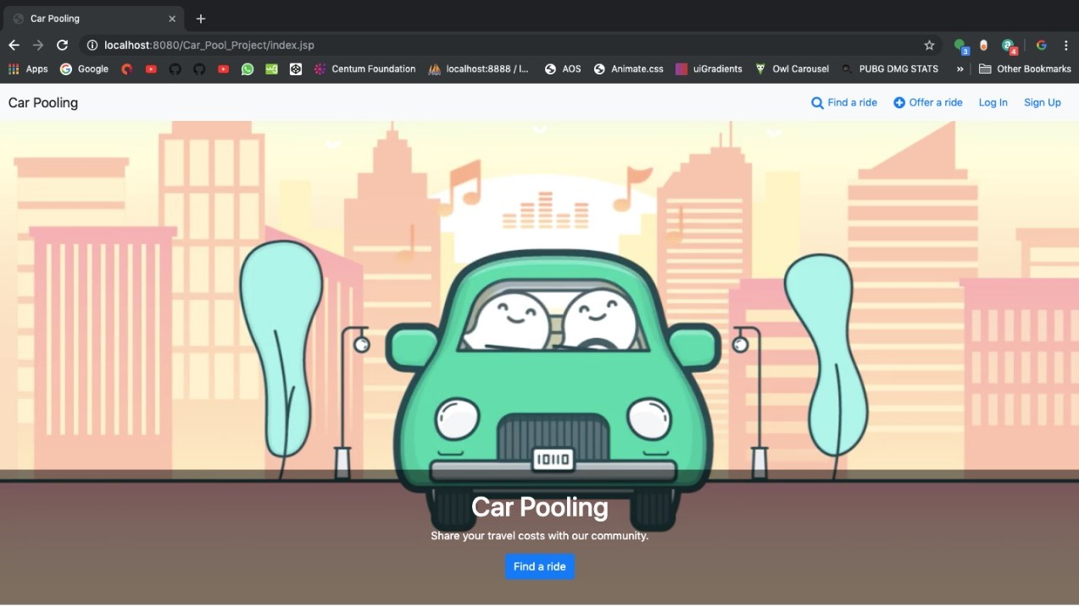

Slide 16
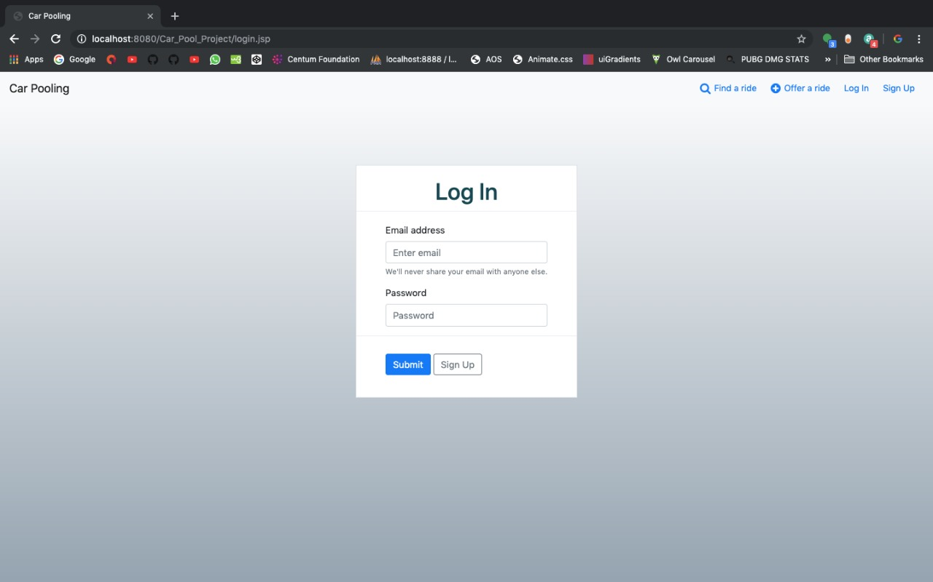

Slide 17
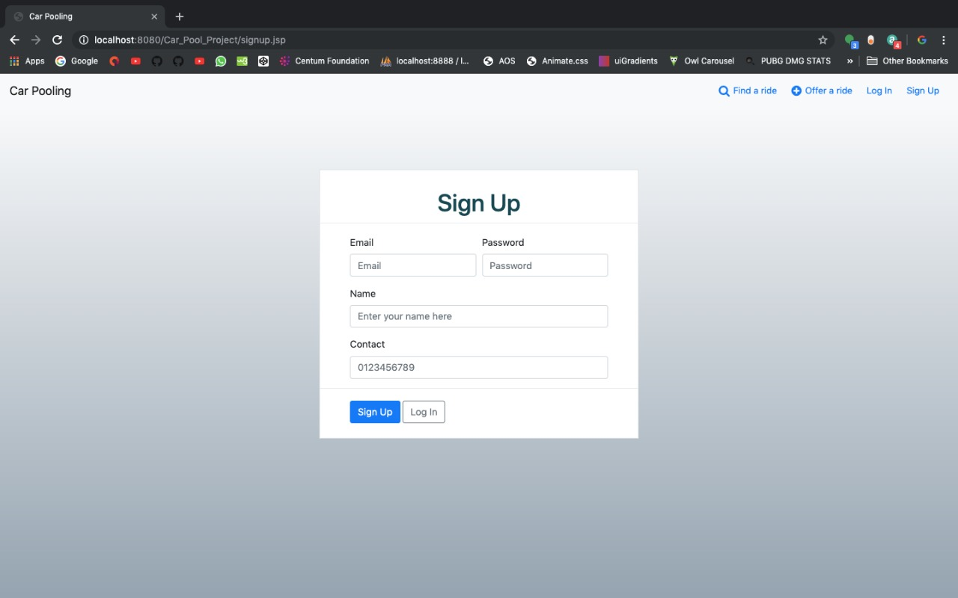

Slide 18
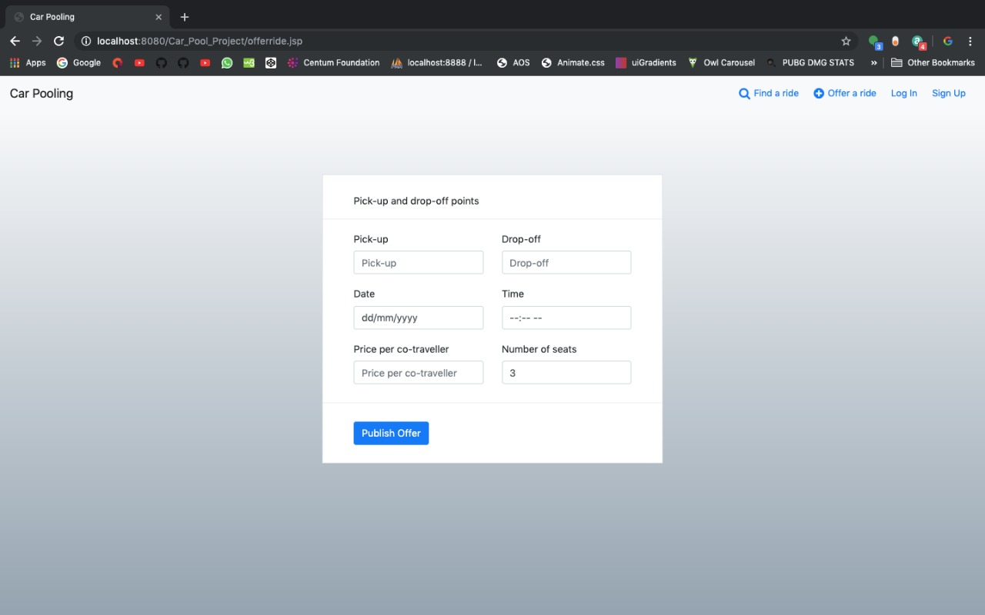

Slide 19

THANKYOU

