Slide 1

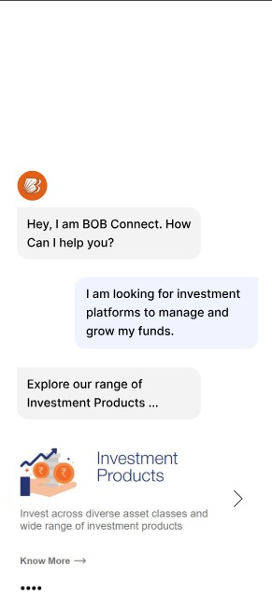
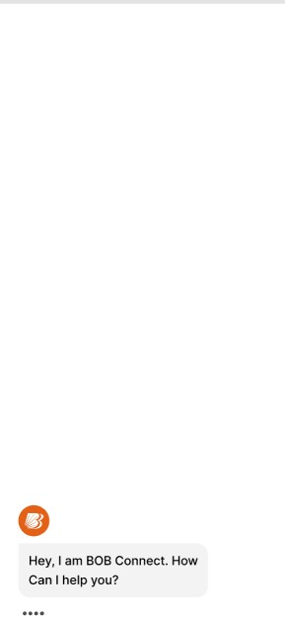

BOB Connect Bank of Baroda Hackathon 2024
Your Team Name : SCube Innovators
Your team bio : We are a diverse group of experts committed to innovation, delivering top-tier solutions that meet our clients’ needs.
Date : 30 - 06 - 24

Slide 2

Problem Statement
Current marketing materials, financial reports, and educational content lack personalization, failing to address individual customer preferences and needs. The challenge is to develop an AI system that integrates with customer data to dynamically generate and tailor content for each customer in real-time, improving customer engagement and satisfaction through personalized communication.

Slide 3
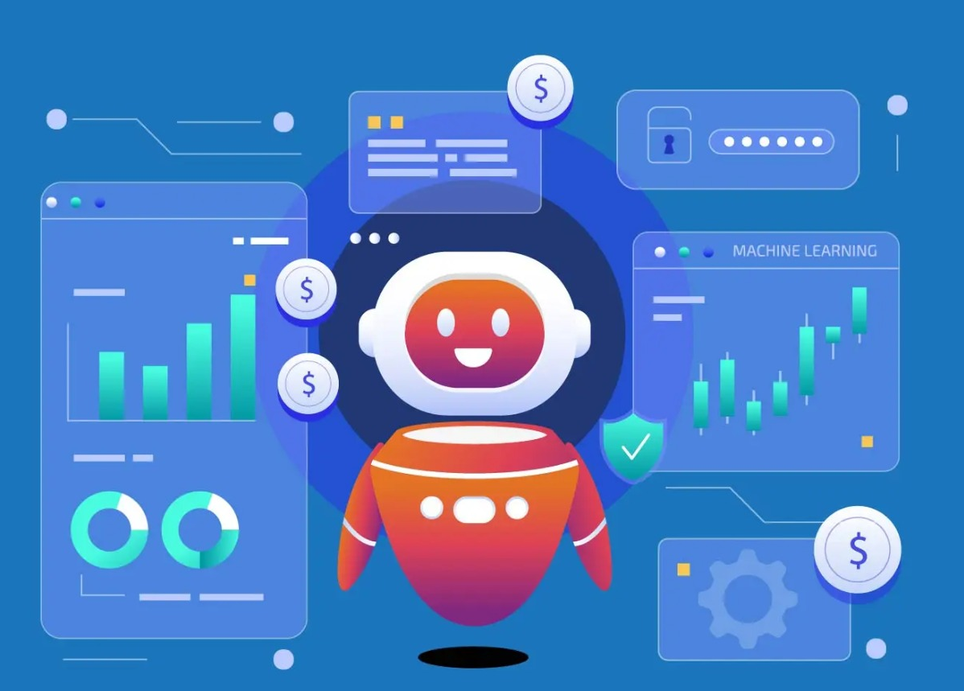
Pre-Requisite
The alternatives/competitive products for Personalized Content Generation
Robo-Advisors
Personal Finance Apps
Banking Apps with AI
Financial Planning Software
Customized Investment Platforms

Slide 4






Tools or resources
TensorFlow
Python
For implementing deeper machine learning models
By using the python we developed quantum programs for the problem statement.
Flask
JavaScript
Flask is a lightweight and flexible web framework for Python that provides tools and patterns to build web applications quickly.
Using for building interactive and dynamic web pages.
MongoDB
Visual studio code
Using as a backend database for web applications. (For Prototype only)
Using as a streamlined code editor with support for development operations.

Slide 5
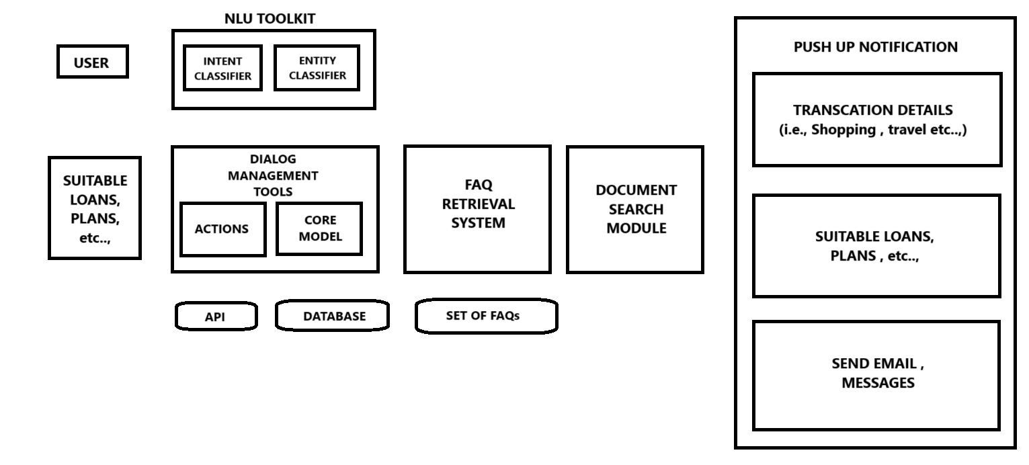
Architecture

Slide 6
Key Differentiators & Adoption Plan
Advantages over Alternatives:
Personalization: Tailors recommendations based on individual financial data.
Data-driven: Uses machine learning for accurate, personalized advice.
Efficiency: Automates analysis for quicker decisions.
Scalability: Scales with cloud infrastructure, accommodating growth.
Compliance: Integrates securely with bank APIs, adhering to regulations.
Adoption Strategy:
Education: Market benefits through campaigns and content.
Partnerships: Collaborate with banks for broader reach and trust.
Feedback: Iterate based on user input to improve satisfaction.
Value Demonstration: Show effectiveness through case studies and metrics.

Slide 7
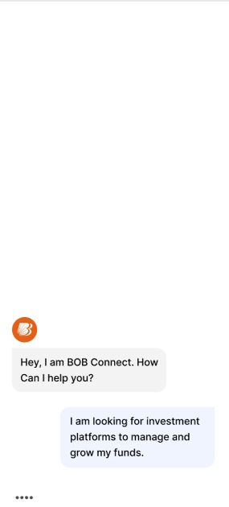
GitHub Repository Link & supporting diagrams, screenshots.
Repository Link - https://github.com/ShobikaG/BOB_CONNECT
Demo YouTube Link - https://youtu.be/0FzzOscxNnM?si=oT0RkZnA_-VvbiS0

Slide 8
Business Potential and Relevance
Personal Finance Management: Provides personalized investment recommendations for individuals.
Wealth Management: Enhances advisory services for financial advisors and wealth managers.
Retail Banking: Offers digital advisory tools to attract and retain customers.
Fintech Innovation: Integrates advanced financial services into fintech platforms.
Compliance and Risk Mitigation: Ensures regulatory compliance and manages financial risks.
Customer Engagement: Improves engagement by offering tailored financial advice.
Market Differentiation: Provides a competitive edge with technology-driven financial solutions.

Slide 9

Uniqueness of Approach and Solution
The idea involves analyzing customer bank balances and transaction histories to recommend optimal investment schemes based on individual financial goals and age demographics. This AI-driven system provides personalized advice, considering factors like customer age and current financial resources (e.g., Rs 100,000 for a 1-month duration). By leveraging these insights, the platform suggests bank schemes that maximize returns and align with customer interests. This approach uniquely combines personalized financial guidance with data-driven insights, enhancing user engagement and satisfaction through tailored investment recommendations.

Slide 10
User Experience
Intuitive Interface: Design a user-friendly interface for easy navigation and interaction.
Personalization: Tailor recommendations and content based on user data and preferences.
Accessibility: Ensure compatibility across devices and accessibility standards.
Performance: Optimize loading times and responsiveness for seamless user interaction.
Security: Implement robust security measures to protect user data and transactions.
Feedback Mechanism: Provide ways for users to provide feedback and improve their experience.
Clear Communication: Use clear language and visuals to communicate financial advice effectively.
Support: Offer responsive customer support to address user inquiries and issues promptly.

Slide 11
Scalability
Modular Architecture: Divides the application into manageable components for independent scaling.
Orchestration (Kubernetes): Automates management of containerized applications, scaling resources dynamically.
Horizontal Scaling: Distributes workload across multiple servers or containers to handle increased traffic and data volume.
Database Scaling (MongoDB): Supports horizontal scaling through sharding, accommodating growing datasets and improving performance.
Monitoring and Optimization: Continuous monitoring and optimization identify and address performance bottlenecks, ensuring efficient scalability.

Slide 12
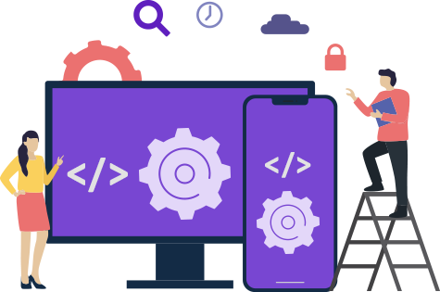
Ease of Deployment and Maintenance
Implementing our solution in AI-driven personalized content generation platform using Flask, MongoDB (for prototype purposes), Python with TensorFlow, and JavaScript is efficient and straightforward. Flask accelerates API development for tailored recommendations, MongoDB handles diverse customer data, and Python with TensorFlow powers advanced data analysis and machine learning. JavaScript supports dynamic frontend interfaces if required. Maintenance is simplified with modular design, automated testing, and proactive monitoring, ensuring agility in meeting customer needs while enhancing security. This setup delivers personalized financial advice effectively, fostering ongoing customer engagement and satisfaction.

Slide 13

Security Considerations
Data Encryption: Encrypt sensitive data in transit and at rest.
Access Control: Implement role-based access and strong authentication.
Security Audits: Conduct regular assessments and testing.
Monitoring: Monitor system activities for anomalies.
Data Integrity: Verify data integrity with validation checks.
Backup and Recovery: Maintain robust disaster recovery and backup plans.

Slide 14
Thank You
Team Members name | Role
Suriya Prasaaad S | Leader
Sudharsanam P | Member
Mona B | Member
Shobika G | Member

