Slide 1
Concurrency Control

Slide 2
Concurrency Control
Lock-Based Protocols
Timestamp-Based Protocols
Validation-Based Protocols

Slide 3


Slide 4
Lock-Based Protocols

Slide 5
Lock-Based Protocols
T₂: lock-S(A);
read (A);
unlock(A);
lock-S(B);
read (B);
unlock(B);

Slide 6
Lock-Based Protocols
A lock is a mechanism to control concurrent access to a data item
Allow a transaction to access a data item only if it is currently holding a lock on that item.
Data items can be locked in two modes:
1. exclusive (X) mode.
2. shared (S) mode.

Slide 7
Lock-Based Protocols
exclusive (X) mode.
  Data item can be both read as well as written.
  Instruction - lock-X

Slide 8
Lock-Based Protocols
exclusive (X) mode.
  Data item can be both read as well as written.
  Instruction - lock-X
shared (S) mode.
  Data item can only be read.
  instruction. - lock-S

Slide 9
Lock-Based Protocols
exclusive (X) mode.
  Data item can be both read as well as written.
  Instruction - lock-X
shared (S) mode.
  Data item can only be read.
  instruction. - lock-S
Lock requests are made to concurrency-control manager. Transaction can proceed only after request is granted.

Slide 10
Lock-Based Protocols
Every transaction request a lock to the concurrency-control manager

Slide 11
Lock-Based Protocols
Every transaction request a lock to the concurrency-control manager
Transaction Proceed with the operation after manager grants

Slide 12

Lock-Based Protocols
Lock-compatibility matrix

Slide 13
Lock-Based Protocols
A transaction may be granted a lock on an item
  if the requested lock is compatible with locks already held on the item by other transactions
Any number of transactions can hold shared locks on an item
Any transaction holds an exclusive on the item no other transaction may hold any lock on the item.

Slide 14
Lock-Based Protocols
If a lock cannot be granted,
  Transaction is made to wait till all incompatible locks have been released.
  Lock is then granted.

Slide 15
Lock-Based Protocols
T₂: lock-S(A);
read (A);
unlock(A);
lock-S(B);
read (B);
unlock(B);
display(A+B)

Slide 16
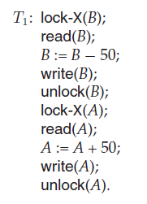

Slide 17
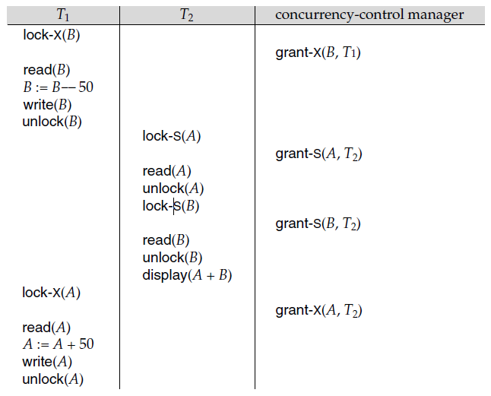

Slide 18
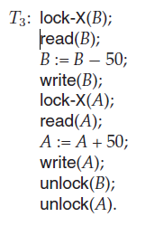

Slide 20
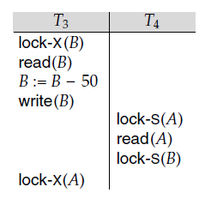
Pitfalls of Lock-Based Protocols
T4 is waiting for T3 to unlock B
T3 is waiting for T4 to unlock A
This is Deadlock

Slide 21
When deadlock occurs, the system must roll back one of the two transactions.
Once a transaction has been rolled back, the data items that were locked by that transaction are unlocked.
These data items are then available to the other transaction, which can continue with its execution.

Slide 22
A locking protocol is a set of rules followed by all transactions while requesting and releasing locks.
Locking protocols restrict the set of possible schedules.

Slide 24
Two-Phase Locking Protocol

Slide 25
The Two-Phase Locking Protocol
Protocol which ensures conflict-serializable schedules.
Phase 1: Growing Phase
Phase 2: Shrinking Phase

Slide 26
The Two-Phase Locking Protocol
Phase 1: Growing Phase
  Transaction may obtain locks
  Transaction may not release locks

Slide 27
The Two-Phase Locking Protocol
Phase 2: Shrinking Phase
  transaction may release locks
  transaction may not obtain locks

Slide 28
The Two-Phase Locking Protocol
Initially, a transaction is in the growing phase. The transaction acquires locks as needed.
Once the transaction releases a lock, it enters the shrinking phase, and it can issue no more lock requests.

Slide 29
The Two-Phase Locking Protocol
The protocol assures serializability.
It can be proved that the transactions can be serialized in the order of their lock points

Slide 30
The Two-Phase Locking Protocol (Cont.)
Two-phase locking does not ensure freedom from deadlocks
Cascading roll-back is possible under two-phase locking.

Slide 31
The Two-Phase Locking Protocol (Cont.)
Two-phase locking does not ensure freedom from deadlocks
Cascading roll-back is possible under two-phase locking.
To avoid this, follow a modified protocol called
  strict two-phase locking. Here a transaction must hold all its exclusive locks till it commits/aborts.
  Rigorous two-phase locking is even stricter: here all locks are held till commit/abort.

Slide 32
Lock Conversions
Two-phase locking with lock conversions:
– First Phase:
    can acquire a lock-S on item
    can acquire a lock-X on item
    can convert a lock-S to a lock-X (upgrade)
– Second Phase:
    can release a lock-S
    can release a lock-X
    can convert a lock-X to a lock-S (downgrade)
This protocol assures serializability.

Slide 33
Implementation of Locking
A lock manager can be implemented as a separate process to which transactions send lock and unlock requests
The lock manager replies to a lock request by sending a lock grant messages (or a message asking the transaction to roll back, in case of a deadlock)

Slide 34
Implementation of Locking
The requesting transaction waits until its request is answered
The lock manager maintains a data-structure called a lock table to record granted locks and pending requests
The lock table is usually implemented as an in-memory hash table indexed on the name of the data item being locked

Slide 35

Lock Table
Granted
Waiting

Slide 36
Lock Table
Black rectangles indicate granted locks,
White ones indicate waiting requests
Records the type of lock granted or requested
New request is added to the end of the queue of requests for the data item, and granted if it is compatible with all earlier locks
Unlock requests result in the request being deleted, and later requests are checked to see if they can now be granted
If transaction aborts, all waiting or granted requests of the transaction are deleted
  lock manager may keep a list of locks held by each transaction, to implement this efficiently

Slide 37


Slide 38
Timestamp-Based Protocols

Slide 39
Timestamp-Based Protocols
Each transaction is issued a timestamp when it enters the system. If an old transaction T_{i} has time-stamp TS(T_{i}), a new transaction T_{j} is assigned time-stamp TS(T_{j}) such that TS(T_{i}) <TS(T_{j}).
The protocol manages concurrent execution such that the time-stamps determine the serializability order.
In order to assure such behavior, the protocol maintains for each data Q two timestamp values:
  W-timestamp(Q) is the largest time-stamp of any transaction that executed write(Q) successfully.
  R-timestamp(Q) is the largest time-stamp of any transaction that executed read(Q) successfully.

Slide 40
Timestamp-Based Protocols (Cont.)
The timestamp ordering protocol ensures that any conflicting read and write operations are executed in timestamp order.
Suppose a transaction T_{i} issues a read(Q)
  If TS(T_{i}) ≤ W-timestamp(Q), then T_{i} needs to read a value of Q that was already overwritten.
    Hence, the read operation is rejected, and T_{i} is rolled back.
  If TS(T_{i})≥ W-timestamp(Q), then the read operation is executed, and R-timestamp(Q) is set to max(R-timestamp(Q), TS(T_{i})).

Slide 41
Timestamp-Based Protocols (Cont.)
Suppose that transaction T_{i} issues write(Q).
  If TS(T_{i}) < R-timestamp(Q), then the value of Q that T_{i} is producing was needed previously, and the system assumed that that value would never be produced.
    Hence, the write operation is rejected, and T_{i} is rolled back.
  If TS(T_{i}) < W-timestamp(Q), then T_{i} is attempting to write an obsolete value of Q.
    Hence, this write operation is rejected, and T_{i} is rolled back.
  Otherwise, the write operation is executed, and W-timestamp(Q) is set to TS(T_{i}).

Slide 42
Example Use of the Protocol
A partial schedule for several data items for transactions with
timestamps 1, 2, 3, 4, 5
T₁
T₂
T₃
T₄
T₅
read(X)
read(Y)
read(Y)
write(Y)
write(Z)
read(Z)
read(X)
abort
read(X)
write(Z)
abort
write(Y)
write(Z)

Slide 43
Correctness of Timestamp-Ordering Protocol
The timestamp-ordering protocol guarantees serializability since all the arcs in the precedence graph are of the form:
Thus, there will be no cycles in the precedence graph
Timestamp protocol ensures freedom from deadlock as no transaction ever waits.
But the schedule may not be cascade-free, and may not even be recoverable.
transaction
with smaller
timestamp
transaction
with larger
timestamp

Slide 44
Recoverability and Cascade Freedom
Problem with timestamp-ordering protocol:
  Suppose T_{i} aborts, but T_{j} has read a data item written by T_{i}
  Then T_{j} must abort; if T_{j} had been allowed to commit earlier, the schedule is not recoverable.
  Further, any transaction that has read a data item written by T_{j} must abort
  This can lead to cascading rollback --- that is, a chain of rollbacks
Solution 1:
  A transaction is structured such that its writes are all performed at the end of its processing
  All writes of a transaction form an atomic action; no transaction may execute while a transaction is being written
  A transaction that aborts is restarted with a new timestamp
Solution 2: Limited form of locking: wait for data to be committed before reading it
Solution 3: Use commit dependencies to ensure recoverability

Slide 45
Thomas’ Write Rule
Modified version of the timestamp-ordering protocol in which obsolete write operations may be ignored under certain circumstances.
When T_{i} attempts to write data item Q, if TS(T_{i}) < W-timestamp(Q), then T_{i} is attempting to write an obsolete value of {Q}.
  Rather than rolling back T_{i} as the timestamp ordering protocol would have done, this {write} operation can be ignored.
Otherwise this protocol is the same as the timestamp ordering protocol.
Thomas' Write Rule allows greater potential concurrency.
  Allows some view-serializable schedules that are not conflict-serializable.

