Slide 1
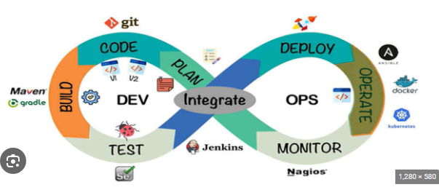
U20ITCM08 Automation Techniques and Tools-DevOps Mrs.N.Kalaiselvi, Assistant Professor, Department of IT,SMVEC

Slide 2
Course Outcomes
CO1 - Explains about traditional software methodologies and about software project estimation, roles of developers and IT operations conflicts (K2)
CO2 - Realize the importance of agile software development practices in determining the requirements for a software system and about agile manifesto, values and principles (K3)
CO3 - Provides basic ideas of devops and its role in terms of version control, automated testing, continuous integration and delivery (K3)
CO4 - Illustrates the purposes of devops with MVP, continuous integration and delivery (K2)
CO5 - Explains the role of CAMS in devops (K3)

Slide 3
Syllabus
UNIT I- TRADITIONAL SOFTWARE DEVELOPMENT
The Advent of Software Engineering - Software Process, Perspective and Specialized Process Models - Software Project Management: Estimation - Developers vs IT Operations conflict.
UNIT II- RISE OF AGILE METHODOLOGIES
Agile movement in 2000 - Agile Vs Waterfall Method - Iterative Agile Software Development - Individual and team interactions over processes and tools – Working software over comprehensive documentation -Customer collaboration over contract negotiation - Responding to change over following a plan
UNIT III- INTRODUCTION DEVOPS
Introduction to DevOps - Version control - Automated testing - Continuous integration - Continuous delivery -Deployment pipeline - Infrastructure management – Databases
UNIT IV – PURPOSE OF DEVOPS
Minimum Viable Product- Application Deployment- Continuous Integration- Continuous Delivery
UNIT V – CAMS (CULTURE, AUTOMATION, MEASUREMENT AND SHARING)
CAMS – Culture, CAMS – Automation, CAMS – Measurement, CAMS – Sharing, Test-Driven Development, Configuration Management-Infrastructure Automation- Root Cause Analysis- Blamelessness- Organizational Learning

Slide 4
Text Books and References
Text Books:
Dev Ops – Volume 1 , Pearson and Xebia Press
Grig Gheorghiu, Alfredo Deza, Kennedy Behrman, Noah Gift, Python for DevOps,2019
Reference Books:
The DevOps Handbook - Book by Gene Kim, Jez Humble, Patrick Debois, and Willis Willis
What is DevOps? - by Mike Loukides
Joakim Verona, Practical DevOps ,2016.
Websites:
www.ibm.com/cloud/devops.
www.softwaretestinghelp.com>devops-automation.

Slide 5
UNIT II
UNIT II- RISE OF AGILE METHODOLOGIES
Agile movement in 2000 - Agile Vs Waterfall Method - Iterative Agile Software Development - Individual and team interactions over processes and tools – Working software over comprehensive documentation -Customer collaboration over contract negotiation - Responding to change over following a plan

Slide 6
Agile movement in 2000

Slide 7
Agile movement in 2000
Agile Manifesto
In February 2001, at the Snowbird resort in Utah, a team of 17 software developers met to discuss lightweight development methods. The result of their meeting was the following Agile Manifesto for software development:-
We are uncovering the better ways of developing software by doing it and helping others to do it. Through this meeting, we have come to four value -
Individuals and interactions over Processes and tools.
Working software over comprehensive documentation.
Customers collaboration over contact negotiation.
Responding to change over following a plan.
So that, while there is value in the items on the right, we value the items on the left more.
https://business.adobe.com/blog/basics/agile-manifesto

Slide 8
The Twelve Principle of Agile Manifesto
Customer Satisfaction: Manifesto provides high priority to satisfy the costumer's requirements. This is done through early and continuous delivery of valuable software.
Welcome Change: Making changes during software development is common and inevitable. Every changing requirement should be welcome, even in the late development phase. Agile process works to increase the customers' competitive advantage.
Deliver the Working Software: Deliver the working software frequently, ranging from a few weeks to a few months with considering the shortest timeperiod.
Collaboration: Business people (Scrum Master and Project Owner) and developers must work together during the entire life of a project development phase.
https://agilemanifesto.org/principles.html

Slide 9
The Twelve Principle of Agile Manifesto
Motivation: Projects should be build around motivated team members. Provide such environment that supportsindividual team members and trust them. It makes them feel responsible for gettingthe job donethoroughly.
Face-to-face Conversation: Face-to-face conversation betweenScrum Master and development team and between the Scrum Master and customers for the most efficient and effective method of conveying information to and within a development team.
Measure the Progress as per the Working Software: The working software is the key and primary measure of the progress.
Maintain Constant Pace: The aim of agile development is sustainable development. All the businesses and users should be able to maintain a constant pace with the project.

Slide 10
The Twelve Principle of Agile Manifesto
Monitoring: Pay regular attention to technical excellence and good design to maximize agility.
Simplicity: Keep things simple and use simple terms to measure the work that is not completed.
Self-organized Teams: The Agile team should be self-organized. They should not be depending heavily on other teams because the best architectures, requirements, and designs emerge from self-organized teams.
Review the Work Regularly: The work should be reviewed at regular intervals, so that the team canreflect on how to become more productive and adjust its behavior accordingly.

Slide 11
Agile Vs Waterfall Method

Slide 12
Agile Vs Waterfall Method
There are numerous SDLC (Software Development Life Cycle) models that are followed during the software development phase. Each model follows a series of phases unique to its type to ensure success in the step of software development.
Here, we are going to discuss two SDLC models that are Agile and Waterfall. Here, we will discuss both models separately, and then we will see the difference between them.

Slide 13
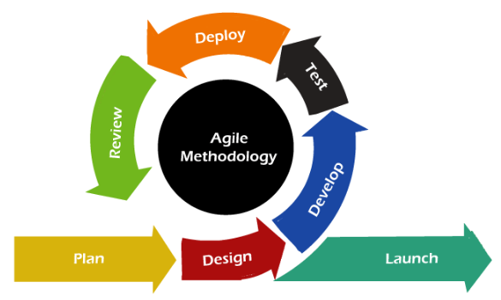
Agile Model
The Agile methodology promotes the continuous interaction of the development and testing during the SDLC process of any project. Unlike the waterfall model, the development and testing activities in the agile model are simultaneous. Agile methodology allows much communication between the customers, developers, testers, and managers.
In the Agile method, the entire project is divided into small incremental builds. All of these builds are provided in iterations, and each iteration lasts from one to three weeks.

Slide 14
Agile development methodology and testing practices have worked wonders for several organizations with positive aspects. The positive aspects of agile are not hidden. They are very much visible in organizations. There are some of the important points related to the agile model listed as follows –
Agile focuses on customer feedback, collaboration, small and rapid releases.
Its purpose is to manage complex projects.
The Agile produces better application suites with the desired requirements. Moreover, it can quickly adapt according to the changes made on time during the project life.
It has a small team size. Therefore, fewer people work on it so that they can move faster.
The agile model is not a suitable model for small projects. The expenses of developing the small projects using agile are more than compared to other models.
In agile methodology, the interaction of customers is very high, as after each iteration an incremental model is deployed to customers.

Slide 15
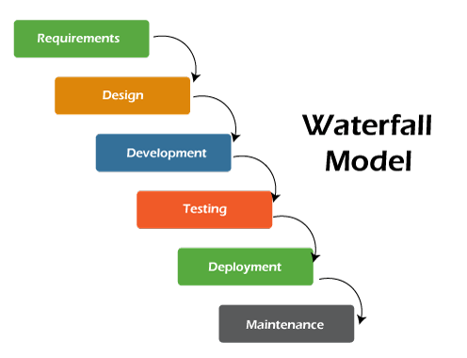
Waterfall model
It is one of the easiest and traditional model to manage. Because of its traditional development nature, each phase has specific deliverables and a review process. The waterfall model works well in smaller size projects where requirements are easily understandable.

Slide 16
The waterfall model is a universally accepted SDLC model. In this method, the whole process of software development is divided into various phases. The development in the waterfall model is seen as flowing steadily downwards (like a waterfall) as it is a continuous software development model. This model is named "Waterfall Model", because its diagrammatic representation resembles a cascade of waterfalls. Some important points related to the waterfall model are listed as follows –
Waterfall model is not an ideal model to develop a large scale project size.
The requirements in the waterfall model should be clear cut at the beginning time; otherwise, it may lead to a less effective method.
In the waterfall model, it is hard to move back in order to make changes in the previous phase.
The testing process in the waterfall model starts after the completion of development. So, there is a high chance of bugs to be found later in the project development.

Slide 17
Agile model v/s Waterfall model
S.no. | Purpose | Agile model | Waterfall model
1. | Definition | Agile model follows the incremental approach, where each incremental part is developed through iteration after every timebox. | Waterfall model follows a sequential design process.
2. | Progress | In the agile model, the measurement of progress is in terms of developed and delivered functionalities. | In the waterfall model, generally the measurement of success is in terms of completed and reviewed artifacts.
3. | Nature | Agile model is flexible as there is a possibility of changing the requirements even after starting the development process. | On the other hand, the waterfall model is rigid as it does not allow to modify the requirements once the development process starts.
4. | Customer interaction | In Agile model, there is a high customer interaction. It is because, after every iteration, an incremental version is deployed to the customer. | Customer interaction in waterfall model is very less. It is because, in a waterfall model, the product is delivered to the customer after overall development.

Slide 18
Agile model v/s Waterfall model
5. | Team size | It has a small team size. As smaller is the team, the fewer people work on it so that they can move faster. | In the waterfall model, the team may consist more members.
6. | Suitability | Agile model is not a suitable model for small projects. The expenses of developing the small projects using agile is more than compared to other models. | Waterfall model works well in smaller size projects where requirements are easily understandable. But waterfall model is not suitable for developing the large projects.
7. | Test plan | The test plan is reviewed after each sprint. | Test plan is reviewed after complete development.
8. | Testing | Testing team can take part in the requirements change phase without problems. | It is difficult for the testing team to initiate any change in needs.

Slide 19
Iterative Agile Software Development

Slide 20
What is the Iterative Development Process?
Iterative development breaks down large tasks into smaller pieces that can be repeated, refined, and researched throughout the software development cycle.
Project developers use the most recent development, or iteration, as a base from which to design further products or processes. The iterative development model seeks to advance and refine a product or process in every iteration.

Slide 22
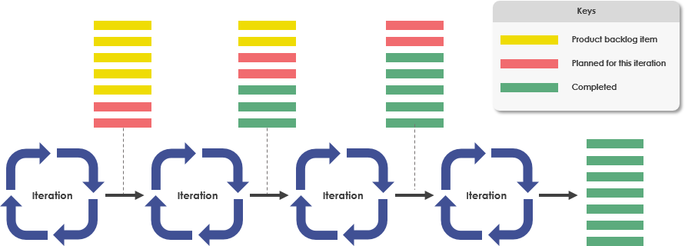

Slide 23
Agile Development: Iterative and Incremental
The combination of the two approaches: iterative and incremental has been long-standing and has been widely suggested for large development efforts.
Through repeated cycles (iterative) and smaller and simpler portions of the software to be developed at a time (incremental), allowing software developers to take advantage of what was learned during the development of earlier parts or versions of the system.
Learning comes from both the development and use of the system, where possible key steps in the process start with a simple implementation of a subset of the system requirements and iteratively enhance the evolving larger (or more complex) versions until the full system is implemented.
At each iteration, design modifications are made and new functional capabilities are added.

Slide 24
What is the Incremental Development Process?
An incremental development process works on the basis that work is sliced into pieces (increments). Each increment builds on top of what has gone before. So, fully functioning modules of functionality are built up over time, with each adding to what has already been produced. Iterative development is the process of repeating and refining a cycle/way of working (an iteration).

Slide 25
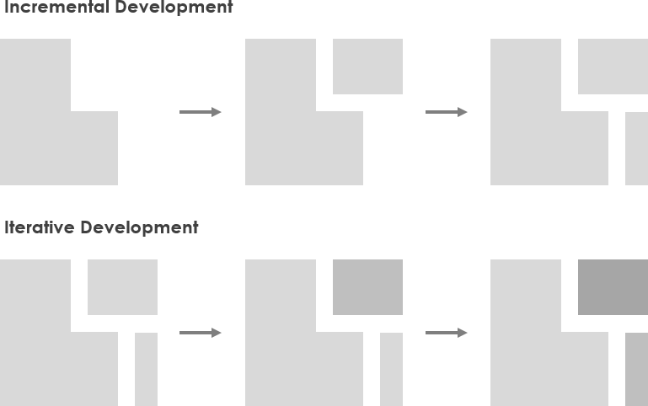
What is the Incremental Development Process?

Slide 26
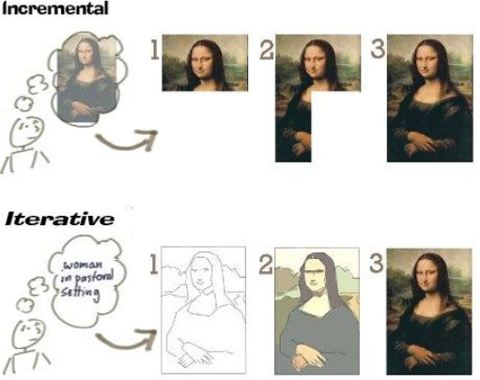
What is the Incremental Development Process?

Slide 27
Why Agile Approach is both Iterative and Incremental?
Agile approach incorporates the philosophy of iterative and incremental software development that is modeled around a gradual increase in feature additions and a cyclical release and upgrade pattern. The outcome of the subsequent iteration is an enhanced working increment of the product. This is repeated until the product accomplishes the required functionalities.
Agile development such as Scrum, it involves a series of short iterative development cycles (1-4 weeks), and continuous working software demos, user feedback, review and the incremental addition of features at the end and in between iteration as shown in the Figure below:

Slide 28
https://www.visual-paradigm.com/scrum/agile-development-iterative-and-incremental/
https://www.zstream.io/blog/what-is-the-agile-iterative-approach-and-where-is-it-used

Slide 29
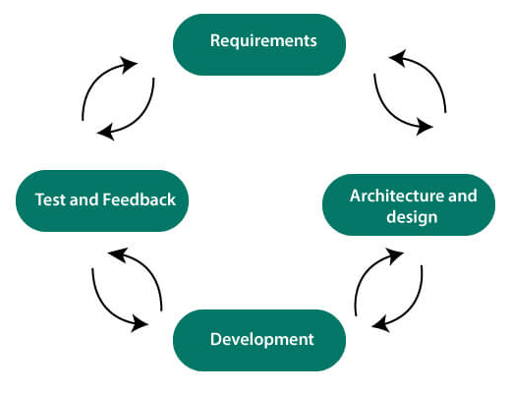
Iterative Agile Software Development
Software development life cycle (SDLC) is a phenomenon to design, develop and, test high-quality software. The primary aim of SDLC is to produce high-quality software that fulfills the customer requirement within times and cost estimates.
Agile Software Development Life Cycle (SDLC) is the combination of both iterative and incremental process models. It focuses on process adaptability and customer satisfaction by rapid delivery of working software product. Agile SDLC breaks down the product into small incremental builds. These builds are provided into iterations.

Slide 30
In the agile SDLC development process, the customer is able to see the result and understand whether he/she is satisfied with it or not. This is one of the advantages of the agile SDLC model. One of its disadvantages is the absence of defined requirements so, it is difficult to estimate the resources and development cost.
Each iteration of agile SDLC consists of cross-functional teams working on various phases:
Requirement gathering and analysis
Design the requirements
Construction/ iteration
Deployment
Testing
Feedback

Slide 31
Agile SDLC
Requirements gathering and analysis
In this phase, you must define the requirements. You should explain business opportunities and plan the time and effort needed to build the project. Based on this information, you can evaluate technical and economic feasibility.
Design the requirements
When you have identified the project, work with stakeholders to define requirements. You can use the user flow diagram or the high-level UML diagram to show the work of new features and show how it will apply to your existing system.
Construction/ Iteration
When the team defines the requirements, the work begins. The designers and developers start working on their project. The aims of designers and developers deploy the working product within the estimated time. The product will go into various stages of improvement, so it includes simple, minimal functionality.

Slide 32
Deployment
In this phase, the team issues a product for the user's work environment.
Testing
In this phase, the Quality Assurance team examine the product's performance and look for the bug.
Feedback
After releasing of the product, the last step is to feedback it. In this step, the team receives feedback about the product and works through the feedback.

Slide 33
Agile SDLC Process Flow
Concept: Project are imagined and prioritized.
Inception: Team members are created, funding is put in place, and basic environments and requirements are discussed.
Iteration/Constriction: The software development team works to deliver working software. It is based on requirement and feedback.
Release: Perform quality assurance (QA) testing, provides internal and external training, documentation development, and final version of iteration into the product.
Production: It is ongoing support of the software.

Slide 34
Advantages of Agile SDLC
Project is divided into short and transparent iterations.
It has a flexible change process.
It minimizes the risk of software development.
Quick release of the first product version.
The correctness of functional requirement is implemented into the development process.
Customer can see the result and understand whether he/she is satisfied with it or not.
Disadvantages of Agile SDLC
The development team should be highly professional and client-oriented.
New requirement may be a conflict with the existing architecture.
With further correction and change, there may be chances that the project will cross the expected time.
There may be difficult to estimate the final coast of the project due to constant iteration.
A defined requirement is absent.

Slide 35
Individual and team interactions over processes and tools

Slide 36
Individual and team interactions over processes and tools
The first core value of the Agile Manifesto is to value individuals and interactions over processes and tools. When you allow each person to contribute unique value to your software development project, the result can be powerful
If processes and tools are seen as the way to manage product development and everything associated with it, people and the way they approach the work must conform to the processes and tools. Conformity makes it hard to accommodate new ideas, new requirements, and new thinking.
Agile approaches, however, value people over process. This emphasis on individuals and teams puts the focus on people and their energy, innovation, and ability to solve problems. You use processes and tools in agile project management, but they’re intentionally streamlined and directly support product creation.
The more robust a process or tool, the more you spend on its care and feeding and the more you defer to it. With people front and center, however, the result is a leap in productivity. An agile environment is human-centric and participatory and can be readily adapted to new ideas and innovations.

Slide 37
If you value processes and tools, the benefits are that the processes are generally clear and well-understood, and you have a written record of communications about the project. However, if you value individuals and interactions highly, you realize greater benefits:
Communication is clear and effective.
Communication is quick and efficient.
Teamwork becomes strong as people work together.
Development teams can self-organize.
Development teams have more chances to innovate.
Development teams can customize processes as necessary.
Development team members can take personal ownership of the project.
Development team members can have deeper job satisfaction.

Slide 38
Of course, development team members must have the capacity to be involved, responsible, and innovative. Team members may need to let go of ego to work well within the team. But these disadvantages are minor compared with those that often attend processes that value process above people:
People may over-rely on processes instead of finding the best ways to create good products.
One process doesn’t fit all teams — different people have different work styles.
One process doesn’t fit all projects.
Communication can be ambiguous and time-consuming.

Slide 39
Working software over comprehensive documentation

Slide 40
https://www.nuclino.com/articles/agile-documentation

Slide 41
Agile development methodology
Agile development methodology have persisted. “Over” got replaced by “instead of” and what was intended as “It's best to dedicate more attention to the software rather than invest time in overly detailed upfront documentation” seems to have turned into “Let's ditch documentation altogether and hope to remember everything we talk about.”

Slide 42
Working software over comprehensive documentation
Agile development methodology did not set out to eliminate internal documentation completely. It simply placed more value on working software than on comprehensive documentation because of the dynamic nature of software development.
So there is nothing in the Agile development methodology that inherently prevents us from creating as much documentation as the project requires.
There are, in fact, situations in which documentation is absolutely required. Adding user stories to the backlog, creating flowcharts, drafting wireframes, documenting client meetings – Agile simply suggests being smart about it.

Slide 43
Working software over comprehensive documentation
Documentation should be “just barely good enough” (JBGE).
Too much or overly comprehensive documentation would be a waste of time, and, as any manager familiar with the hourly rates for software developers will tell you, time is money.
Moreover, developers themselves rarely trust detailed documentation anyway because it's usually out of sync with the actual code.
On the other hand, experience shows that too little documentation is always a source of problems with team communication, learning, and knowledge sharing.

Slide 44
Reasons to invest in Agile documentation
Your project stakeholders require it. The creation of documentation is fundamentally a business decision, you are investing the resources of the project stakeholders in the development of the documentation, so they should have a say on whether their money is to be spent that way.
To support communication with external groups, such as software outsourcing companies. It isn't always possible to co-locate a development team and it isn't always possible to have project stakeholders available at all times. Shared documentation is often part of the solution in combination with occasional face-to-face discussions, teleconferencing, email, and collaborative tools.

Slide 45
Reasons to invest in Agile documentation
To support organizational memory. That means that while you need to develop software, you also need to develop the supporting documentation required to use, operate, support, and maintain it over time.
For audit purposes. Depending on the type of system you are developing, it might fall under certain audit guidelines. In that case, you would need to follow a defined process and capture proof that you did so , resulting in more documentation.

Slide 46
Reasons to invest in Agile documentation
To think something through. The act of putting ideas down on paper can help you solidify them and discover problems with your thinking. What appears clear and straightforward in your mind can often prove to be very complicated once you attempt to describe it in detail, and you can often benefit from writing it down first.

Slide 47
Customer collaboration over contract negotiation

Slide 48
Agile management principles extend to your relationship with the customer. Agile's third core value emphasizes customer collaboration. The agile pioneers understood that collaboration, rather than confrontation, produces better, leaner, more useful products. As a result of this understanding, agile methodologies make the customer part of the project on an ongoing basis.
Historical project management approaches usually involve customers at three key points:
Project start: When the customer and the project manager — or another project team representative — negotiate contract details.
Any time scope changes during the project: When the customer and the project manager negotiate changes to the contract.
End of a project: When the project team delivers a completed product to the customer. If the product doesn’t meet customer expectations, the project manager and the customer negotiate additional changes to the contract.

Slide 49
This historical focus on negotiation discourages potentially valuable customer input and can even create an adversarial relationship between customers and project teams.
Using an agile approach in practice, you experience a partnership between the customer and development team in which discovery, questioning, learning, and adjusting during the course of the project are routine, acceptable, and systematic.
On an agile project, customer review is built into the process and the customer gets to see the product at the end of every sprint. You can create the highest-priority features first, which gives you the opportunity to ensure maximum value early on, when little of the customer’s money has been invested.

Slide 50
If you use a traditional development model, any changes to product requirements, priorities, timelines, and budgets can greatly disrupt the project. In contrast, agile processes handle project and product changes in beneficial ways. For example:
Agile projects create an opportunity for increased customer satisfaction and return on investment by handling change effectively.
Changes can be incorporated into subsequent iterations routinely and smoothly.
Customers like agile projects because they can accommodate changing requirements and generate higher-value products.

Slide 51
Responding to change over following a plan

Slide 52
Traditional project management methodologies have always tried to control the amount of change within a project.
Change management procedures, meticulously scripted legal contracts and rigorous budget policies, are designed to fend change off as long as possible and keep change within a project to a bare minimum.
This has often led to “successfully” completed projects with significantly diminished or even none of the benefits hoped for.

Slide 53
Agile project management, being the new kid on the block, turned this approach to change management upside down with its Agile Manifesto.
“Responding to change over following a plan,” is arguably the most contentious point with senior management when they are first confronted with this revolutionary approach to working.
On agile projects, the ability to not only respond to but welcome change is the most powerful tool. The ability to embrace change is built in to every agile process, practice and attitude.
For example, while scrum has a rule of “no change within the sprint”, you are free to add, remove, reprioritize or even chuck away the whole product backlog.
In essence, this means that scrum accommodates any degree of change in between sprints. This also means that the shorter your sprints are, the more opportunities you have to accommodate change! Many agile teams now only have a sprint cycle of 1 week or shorter.

Slide 54
Another example of how change is inherently built into agile is its feedback cycle. Besides sprint cycles, agile encourages teams to find other feedback cycles and to shorten them as much as possible.
In recent years this has led to a higher emphasis on practices of continuous integration (CI). CI allows you to reduce feedback cycles from what used to be months to a mere seconds.

Slide 55
To take things more to the extreme, one could even claim that a project without change is a failed project! Think about it for a while – change is everywhere and happens all the time. Without the ability to change things, our life would be a series of constant failures and, quite frankly, boring.
Starting from the alternative route to work you took this morning because of traffic, to the way you handled the meeting due to a sudden change of direction from a stakeholder, up to your unplanned impulse decision to buy Apple’s latest magical device – change permeates through our lives every day. Most of the time, we don’t even notice it!

Slide 56
End of Unit II
Notes:
https://www.youtube.com/watch?v=ayUT0GF8lDQ
https://www.youtube.com/watch?v=pDNSChUoJ28
https://www.youtube.com/watch?v=oUdB2XqtGmk

