Slide 1

(Online PPT -3 )
Needle Insertion mechanism FINAL
Shobit Verma
(Sho.)
ONLINE UPDATE - PPT 3

Slide 2
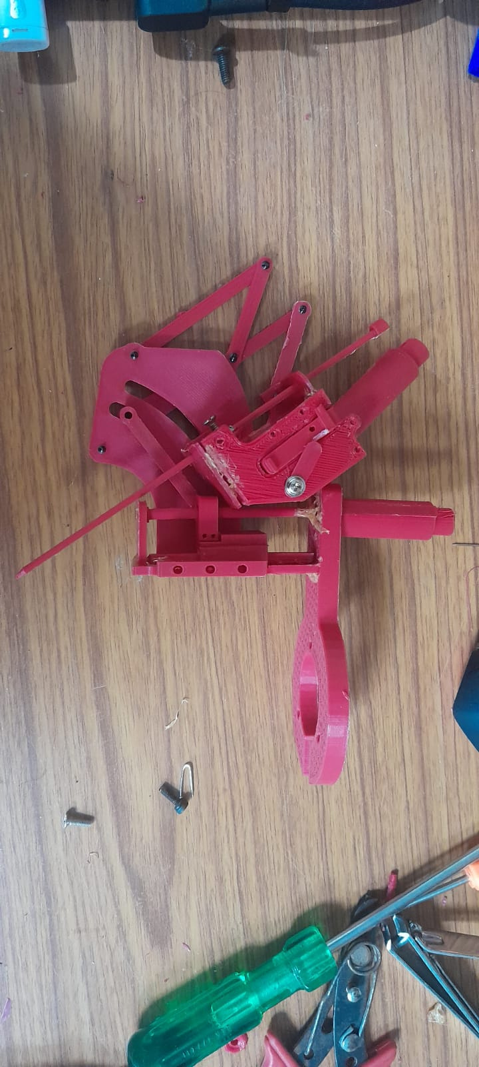
PAGE 01/10
Outline of the period
  Needle range optimise
  mechanism smoothen
  removed all errors
  develop the 3d printed prototype

Slide 3
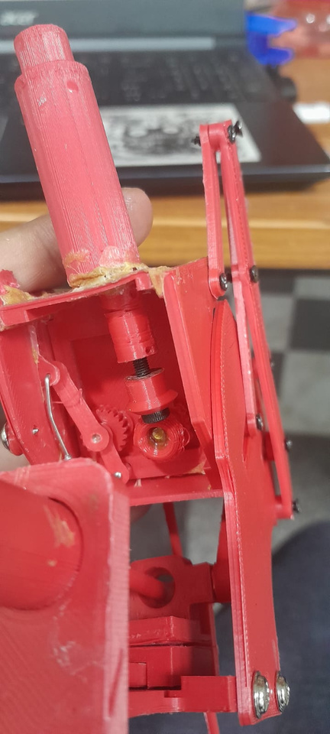

PAGE 9.7/10
Needle Insertion project

Slide 4
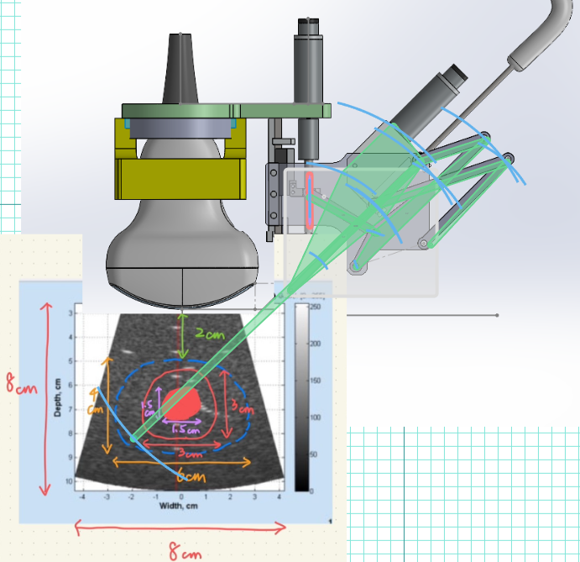
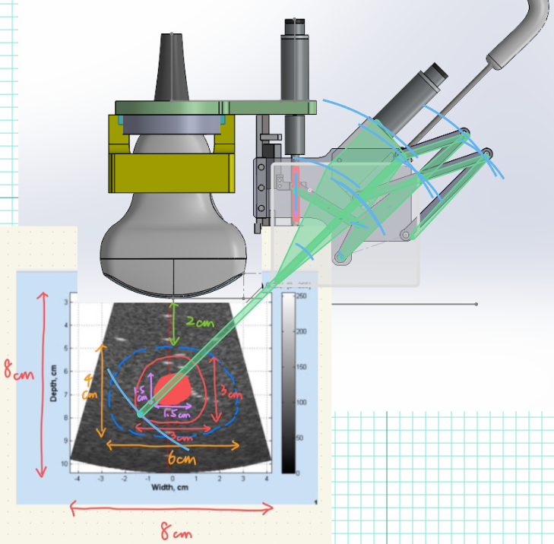





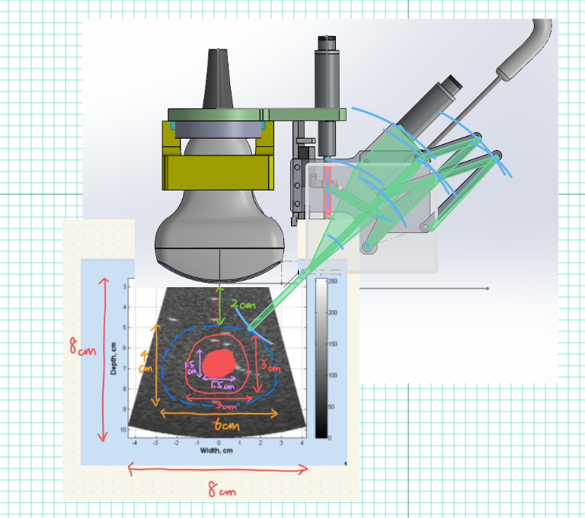
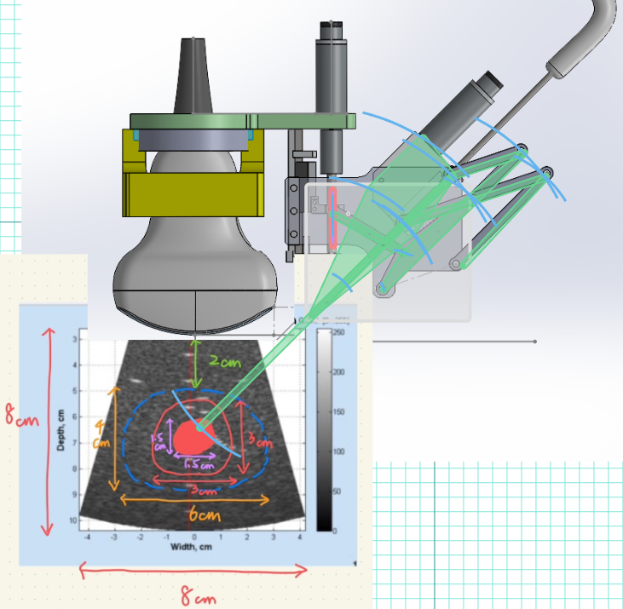
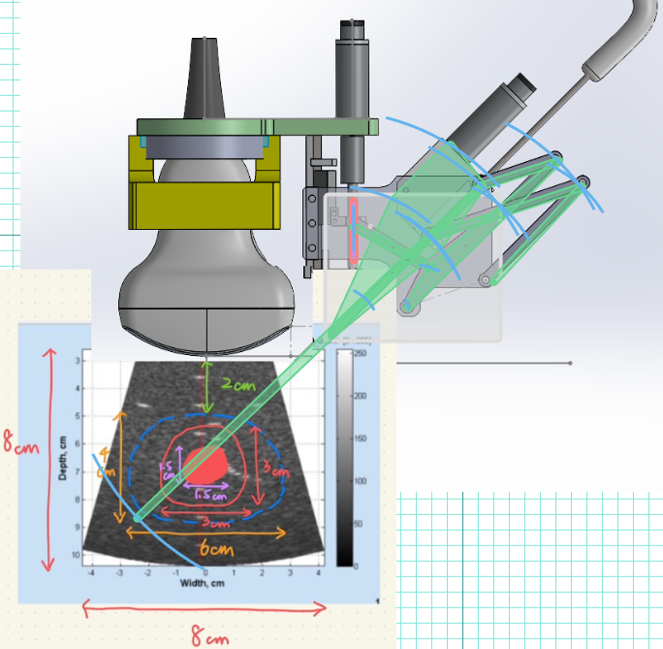
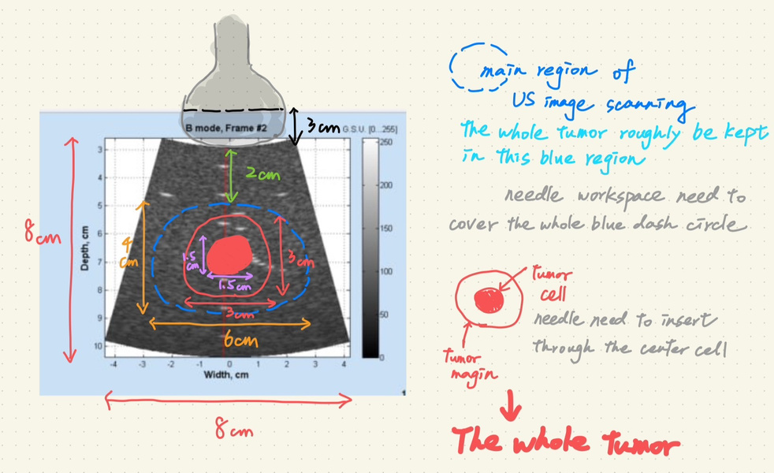

PAGE 09/10
Previously in Taiwan
Had successfully designed the concept of the mechanism and got it approved
Workspace achieved
out of bounds

Slide 5
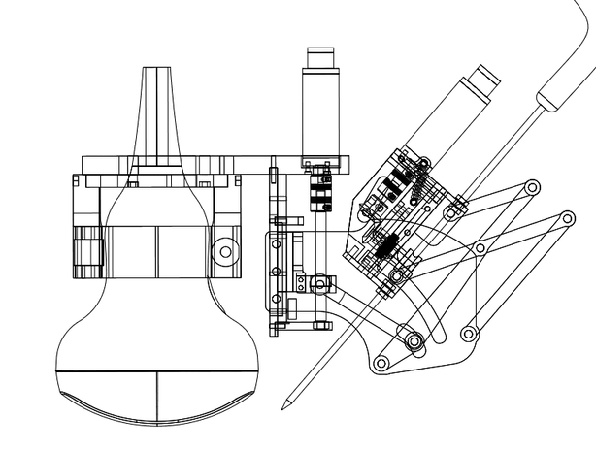
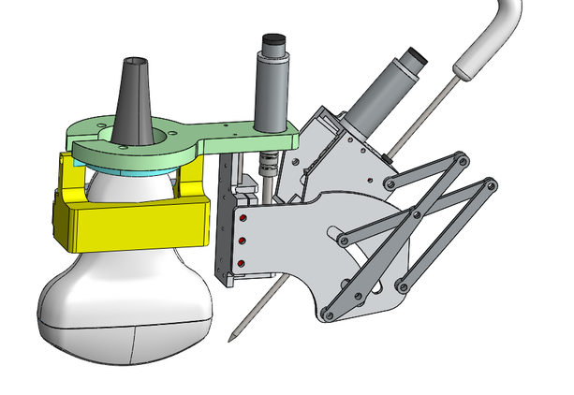
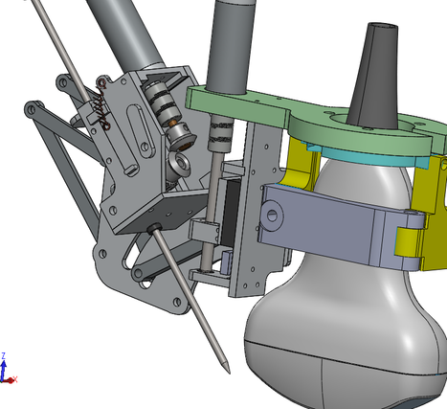
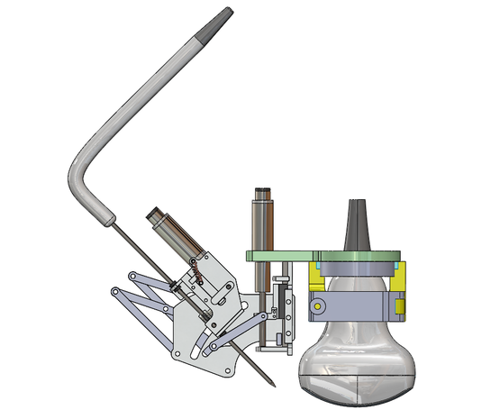
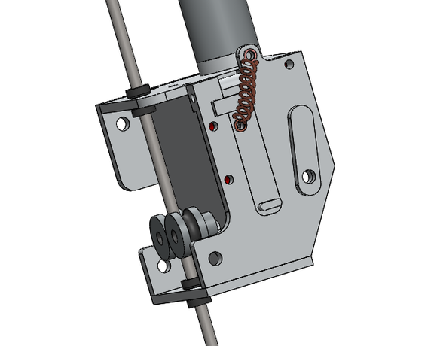
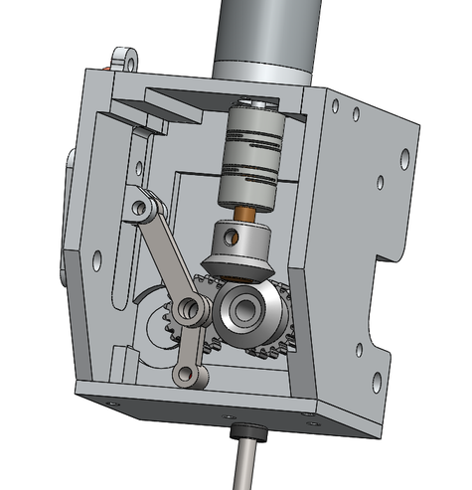
FINAL DESIGN

Slide 6
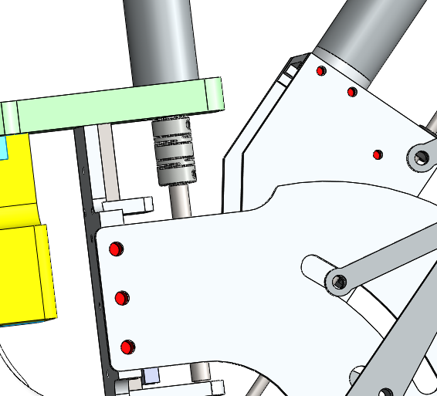
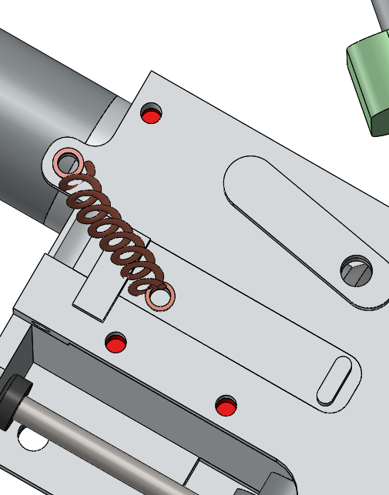
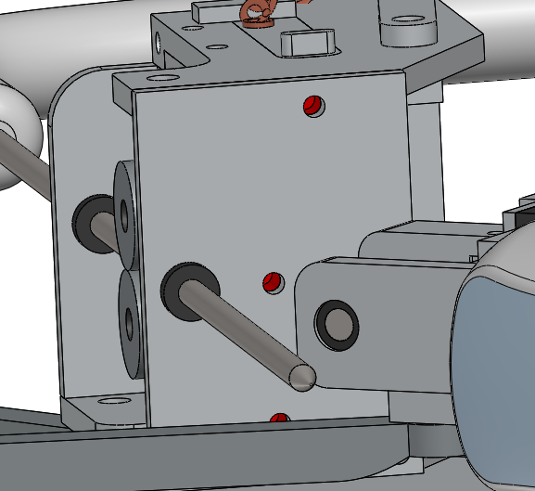
RED COLOUR MEAN THREADED REGION
PAGE 9.991/10
RED COLOUR MEAN THREADED REGION

Slide 7
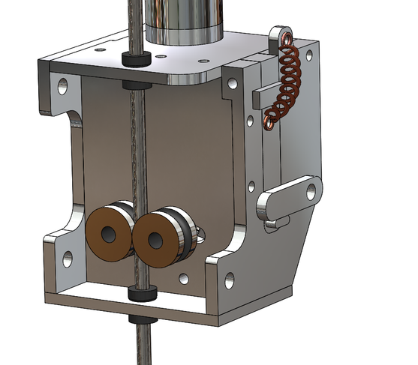
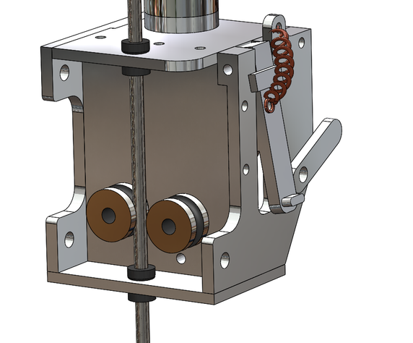

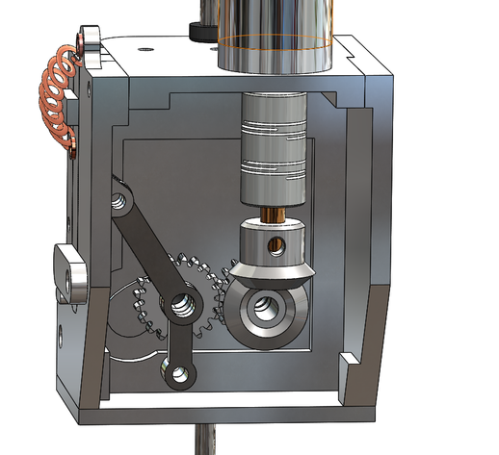
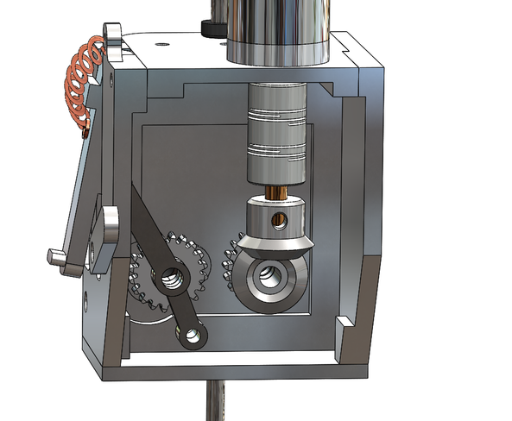

Needle engagement and disengagement mechanism
⇒
State 1
Gear Engaged
Needle deploy ✔
State 2
Gear Disengaged
No Needle deploy X
Needle freely move

Slide 8
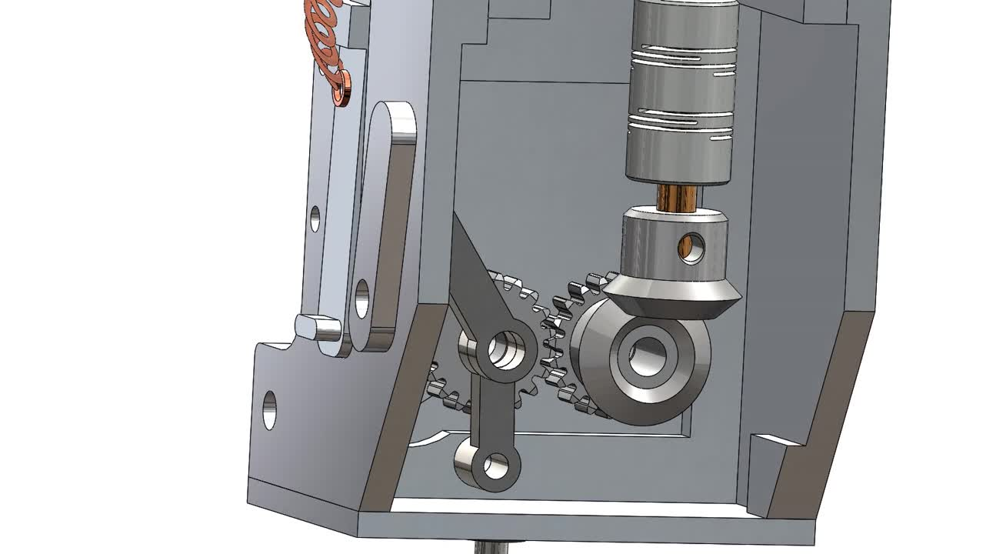
PAGE 9.991/10
Just pull the side handle to disengage gear and let needle flow freely

Slide 9
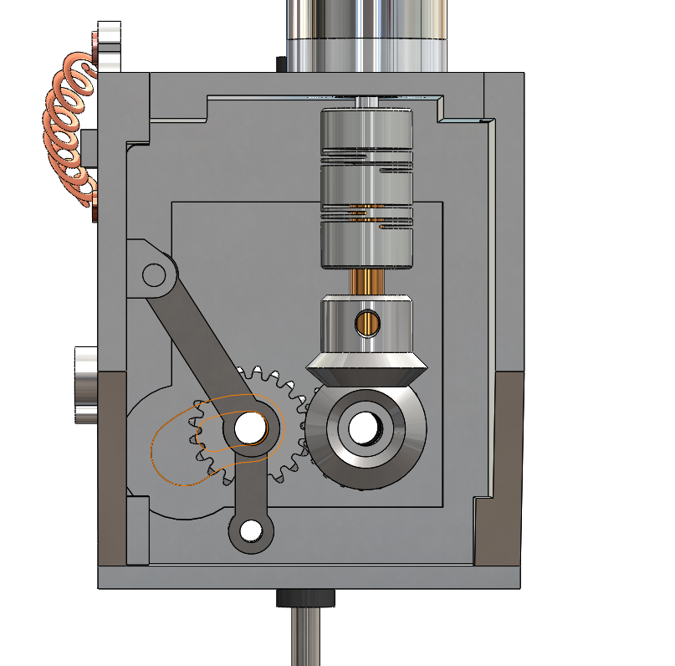
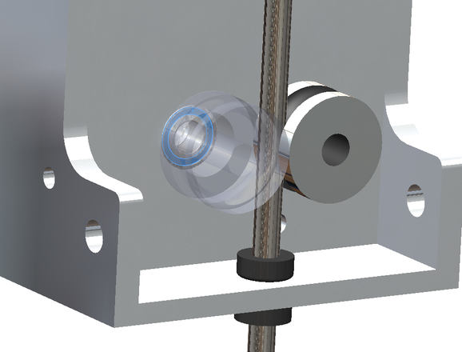
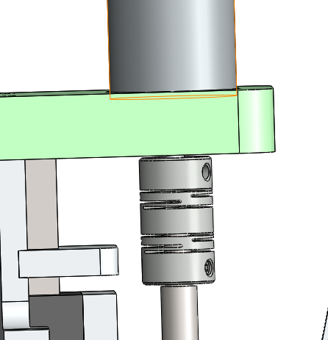
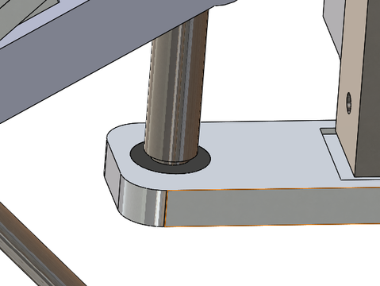
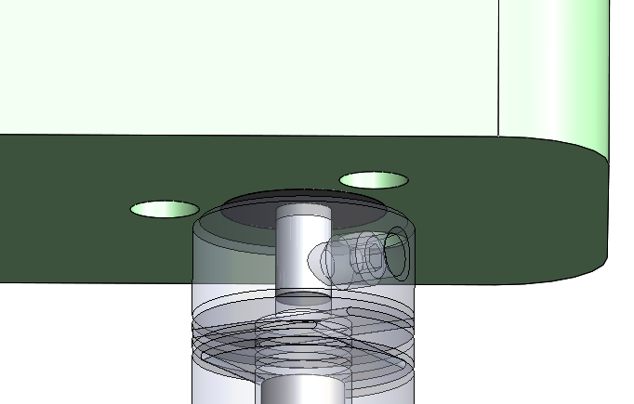
PAGE 9.92/10
Usage of standard gears, coupler, bearings
Misumi
C-E673ZZ
Misumi
SH-CPLS8-2-3
Misumi
SH-CPLS8-2-3
Misumi
M50B20_1103_
Misumi
2-6-2.5 bearing
Misumi
3-6-2.5 bearing
Misumi
GEAHB0.5-20-3-A-3_b

Slide 10
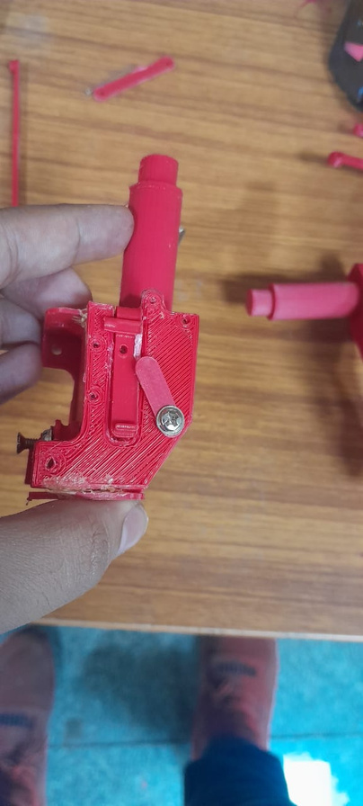
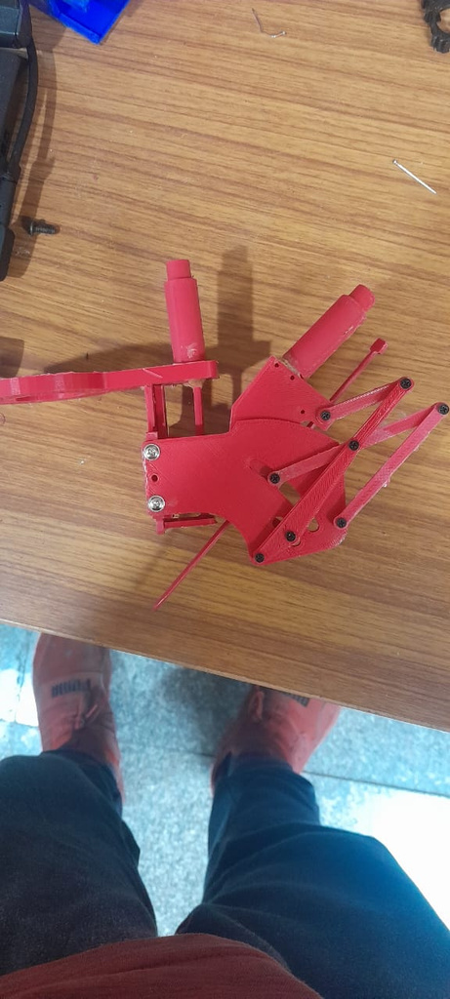
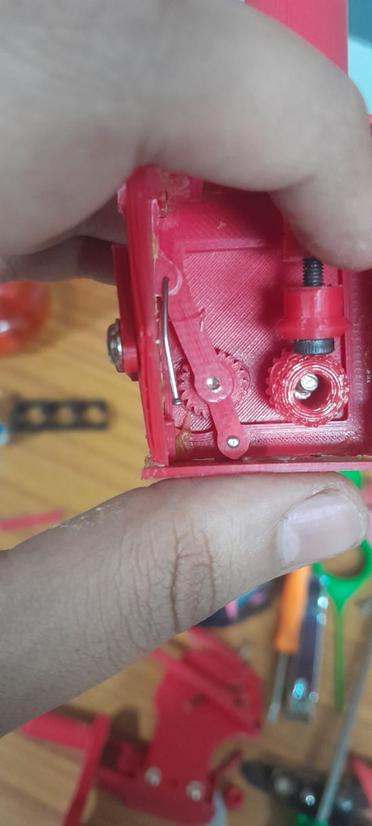
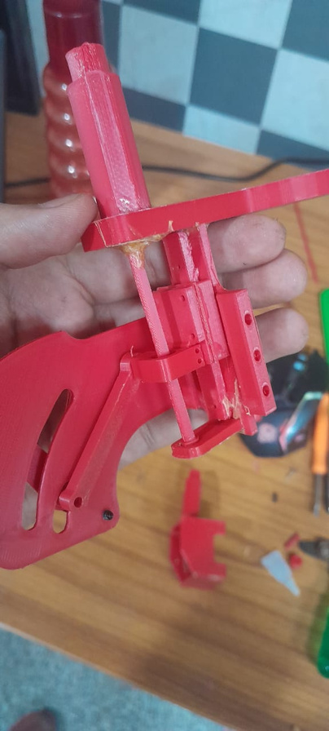
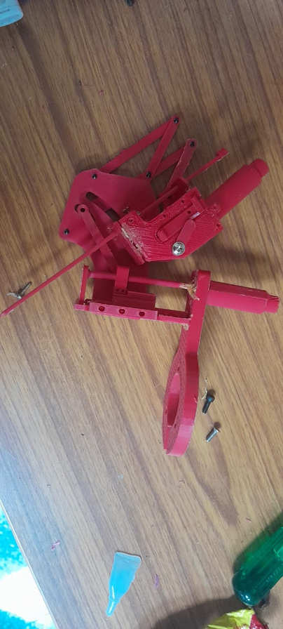
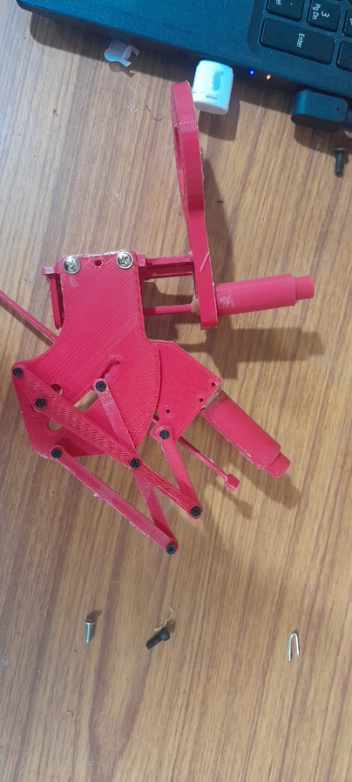
PAGE 9.92/10
3D printed prototype

Slide 11
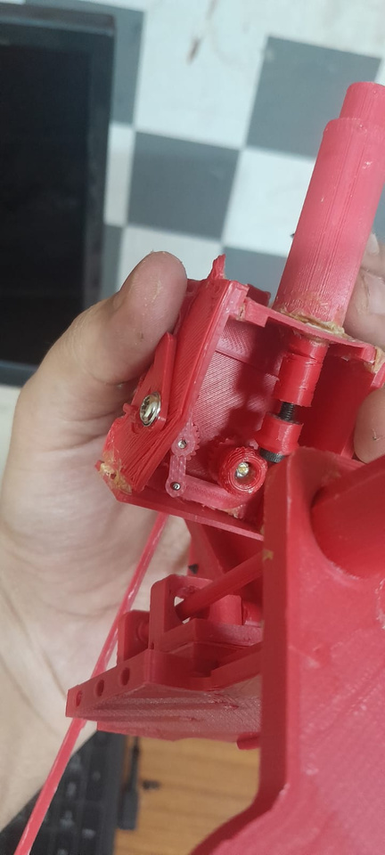
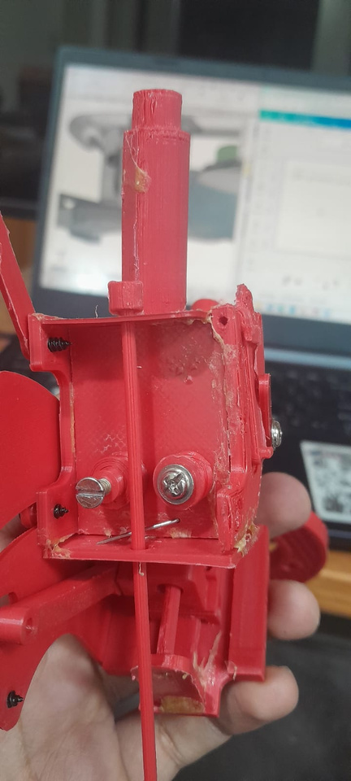
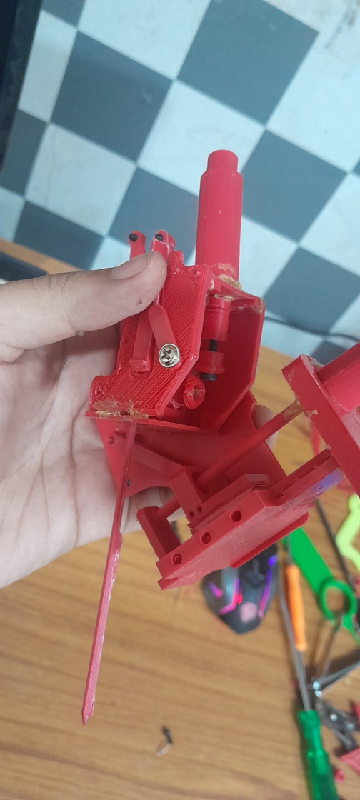
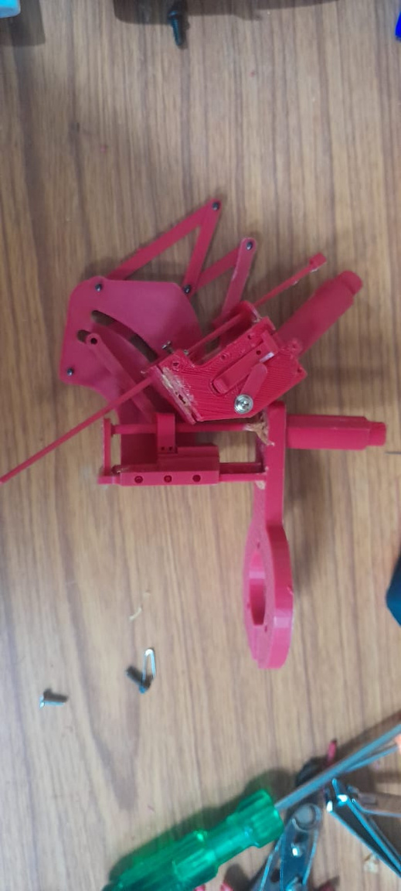
PAGE 9.92/10
3D printed prototype cont.

Slide 12
4. Actuators to be arriving soon
PAGE XIÈ XIÈ!
謝謝!
THANK YOU!

