Slide 1
Students
Project Expo
Organised by: Department of Computer Application

Slide 2
Website: Resort website using HTML, CSS and JavaScript

Slide 3
Table of contents
01
02.
03.
04.
Introduction
Structure of website
Demo
Conclusion

Slide 4

Introduction
Topic: Resort Website Design
Objective: Build an attractive, user-friendly website for a resort.
Technologies Used: HTML, CSS, JavaScript

Slide 5
Technologies Used
HTML
CSS
JavaScript

Slide 6
Structure of website
HTML
HTML (HyperText Markup Language): Defines the structure of the webpage.
Key Elements:
<header>: Includes resort name, logo, and navigation links.
<section>: For displaying resort details, rooms, and amenities.
<footer>: Contains contact details and social media links

Slide 7
Sample code
<header>
<h1>Sunny Beach Resort</h1>
<nav>
<ul>
<li><a href=“#home”>Home</a></li>
<li><a href=“#rooms”>Rooms</a></li>
<li><a href=“#contact”>Contact</a></li>
</ul>
</nav>
</header>

Slide 8
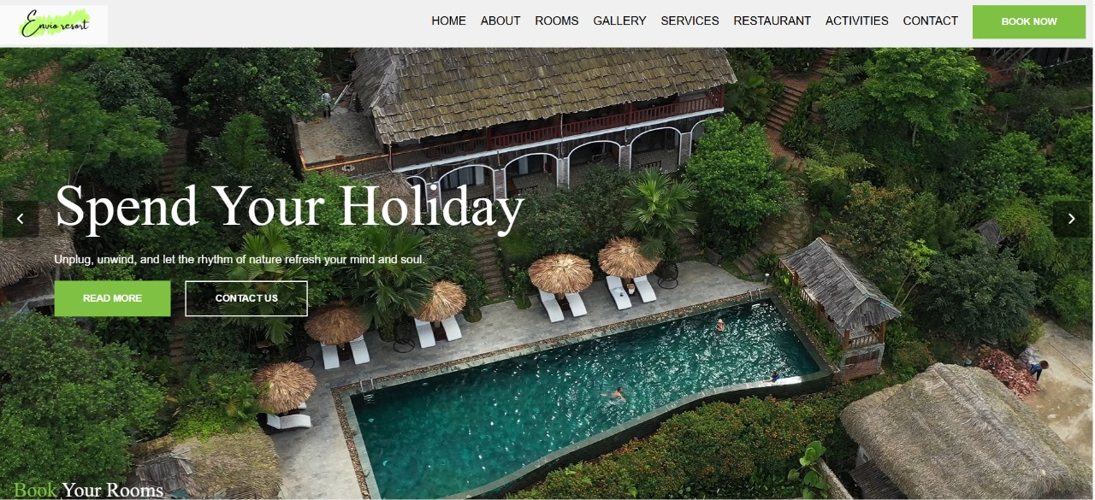

Slide 9
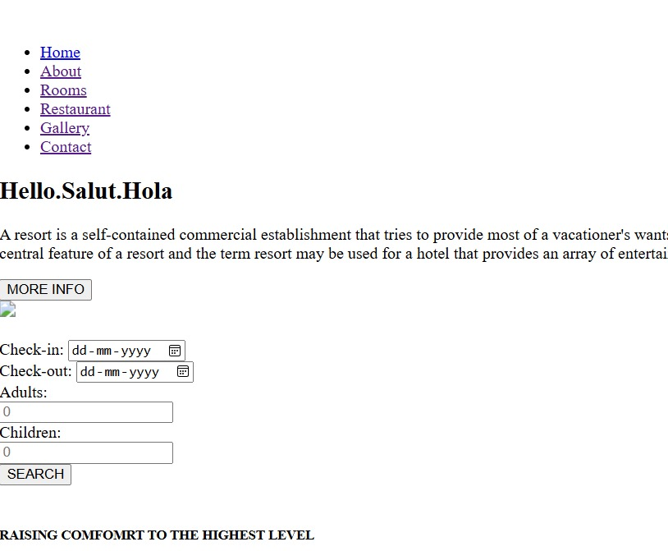

Slide 10
CSS – Styling the Website
CSS (Cascading Style Sheets) controls the layout and appearance of the HTML elements. It allows you to:
Change the background color of sections (e.g., blue for the header).
Adjust text properties (font size, type, color) to match the resort’s branding.
Create responsive layouts that adapt to different screen sizes (mobile, tablet, desktop).

Slide 11
Sample code:
header {
background-color: #004080;
color: white;
padding: 20px;
}

Slide 12
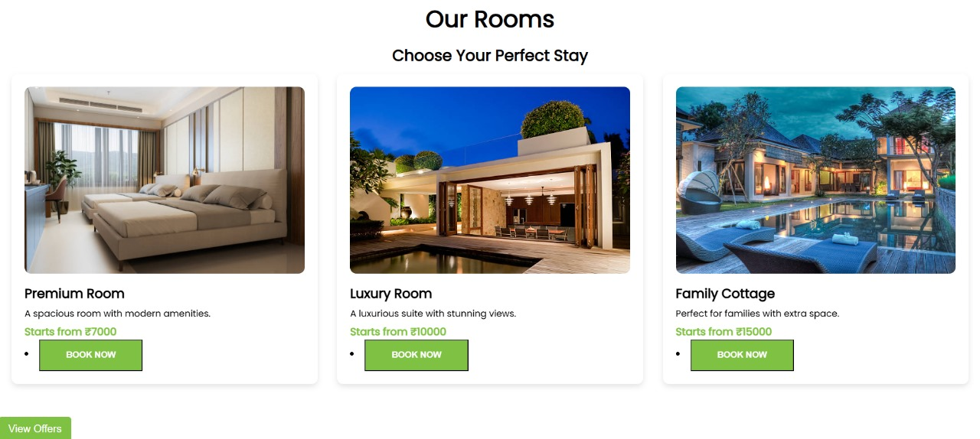

Slide 13
Responsive Design
Many users will visit the website on mobile phones or tablets. A responsive design adapts the layout so it looks good and functions properly on any device.
Example of Media Query:
@media screen and (max-width: 600px) {
header {
font-size: 18px;
padding: 10px;
}
nav ul {
display: block;
}
}

Slide 14
JavaScript – Adding Interactivity
Form Validation: This ensures users submit all necessary information before sending a booking request. For example, you can make sure the name and email fields aren’t left empty.
Image Carousel: A carousel is a rotating image slider that can show different resort images. JavaScript handles the logic for switching between images.
Interactive Map: You can use JavaScript to integrate a map (like Google Maps) that shows the resort’s location, allowing users to interact with it (e.g., zoom in/out).

Slide 15
Sample code
Document.querySelector(‘form’).addEventListener(‘submit’, function(event) {
let name = document.getElementById(‘name’).value;
if (name === “”) {
alert(“Please enter your name.”);
event.preventDefault(); // Stops form submission
}
});

Slide 16
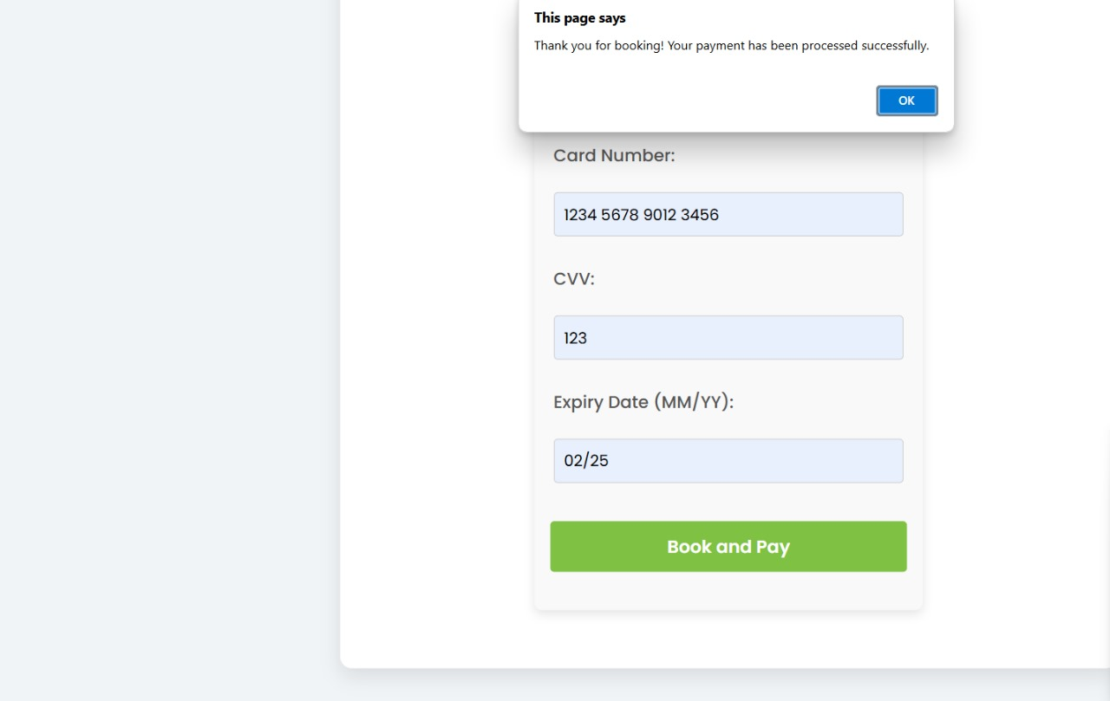

Slide 17
What is use of creating website?
1. Increased Visibility and Reach: A website makes the resort accessible to a global audience and helps attract more potential guests.
2. Convenient Online Booking: Guests can easily book rooms directly through the website, improving convenience and reducing the need for third-party platforms.
3. Enhanced Customer Engagement**: Features like photo galleries, virtual tours, and reviews provide a rich, interactive experience, encouraging visitors to book.
4. Professional Branding: A well-designed website establishes the resort’s professional image, helping build trust and create a strong first impression.

Slide 18
Key Takeaways:
HTML builds the foundation and structure.
CSS makes the site visually appealing and responsive.
JavaScript enhances the user experience by adding interactivity.
End Goal: A functional, attractive, and user-friendly resort website that drives bookings and enhances customer satisfaction

Slide 19
Features of website
Home page
Rooms page
Booking page
Restaurant page
Activities page

Slide 20
Future Enhancements:
Interactive Map:Use Google Maps API to embed an interactive map showing the location of the resort and nearby attractions.
Live Chat:Add a live chat widget using JavaScript for real-time customer support or inquiries.
Weather Widget: Include a live weather widget using JavaScript to show current weather conditions at the resort.
Booking System: Add a booking form with date pickers, room options, and a guest count field. You can later integrate it with backend technologies (like PHP or Node.js) to manage real-time bookings.

Slide 21
Presented by:
SHOBITHA
5TH SEMESTER BCA
DON BOSCO COLLEGE

Slide 22
Thank you.

