Slide 1
A Transformer based Vulnerability Detection & Locate Vulnerable Statements
Shobnom Roksana
nok057

Slide 2
Agenda
Challenges in Vulnerability Detection Practices
Generic Vulnerable Prediction Model Overview
Overview Architecture of the Transformer based Model
Dataset
Experimental Results
Conclusion

Slide 3
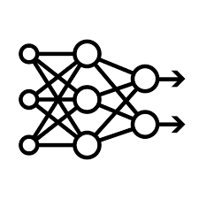





Vulnerable Prediction Model Overview
Transform
Input
Vector Representation
ML/DL Model
Prediction (Vulnerable/ Clean)
Code Function

Slide 4
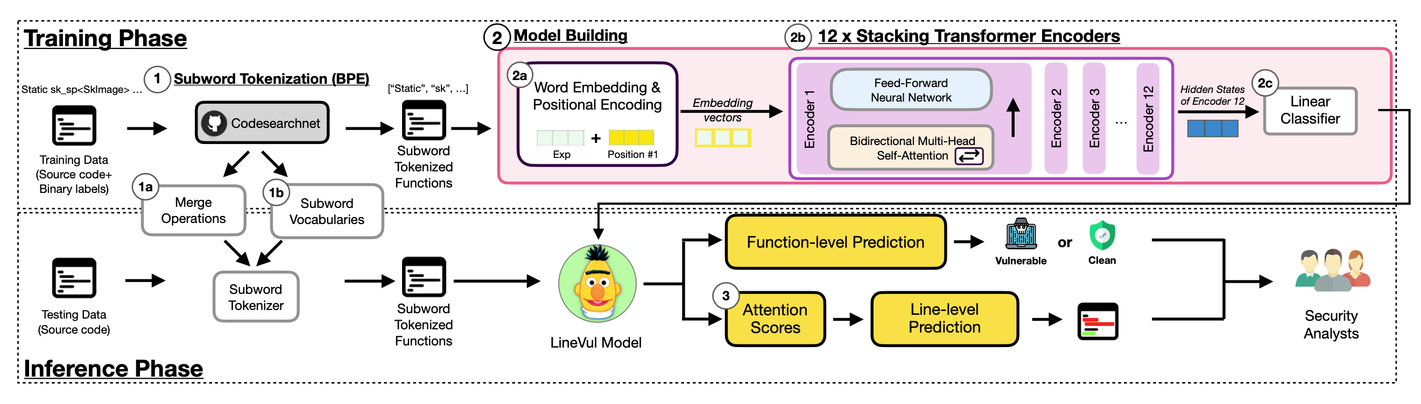
Project Definition
LineVul: A Transformer-based Line-Level Vulnerability Prediction [1]
Function Level Vulnerability Prediction
Vulnerable Line Localization
Figure 2: An overview architecture of our LineVul[1]

Slide 5
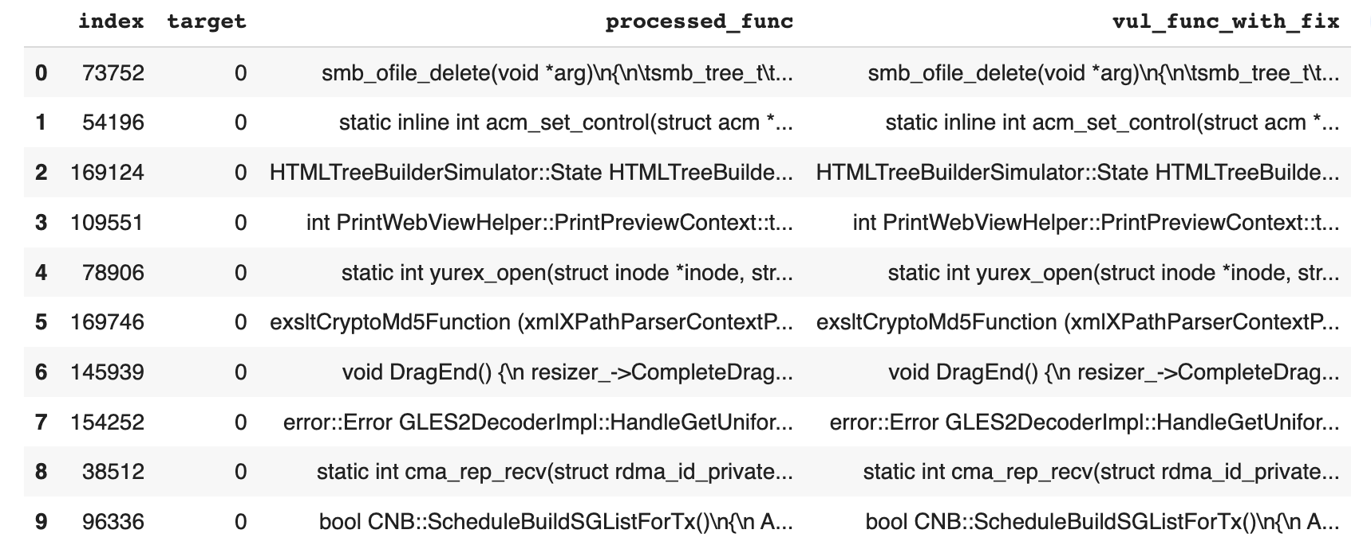
Dataset
A C/C++ Code Vulnerability Dataset with Code Changes and CVE Summaries [1]
- 348 open-source GitHub projects,188,636 C/C++ functions with a ratio of vulnerability functions of 5.7%.
- 80% of training data, 10% of validation data, and 10% of testing data
3 columns out of 39 columns -
processed_func (str): The original function written in C/C++
target (int): The function-level label that determines whether a function is vulnerable or not
vul_func_with_fix (str): The fixed function with added in deleted lines labeled

Slide 6
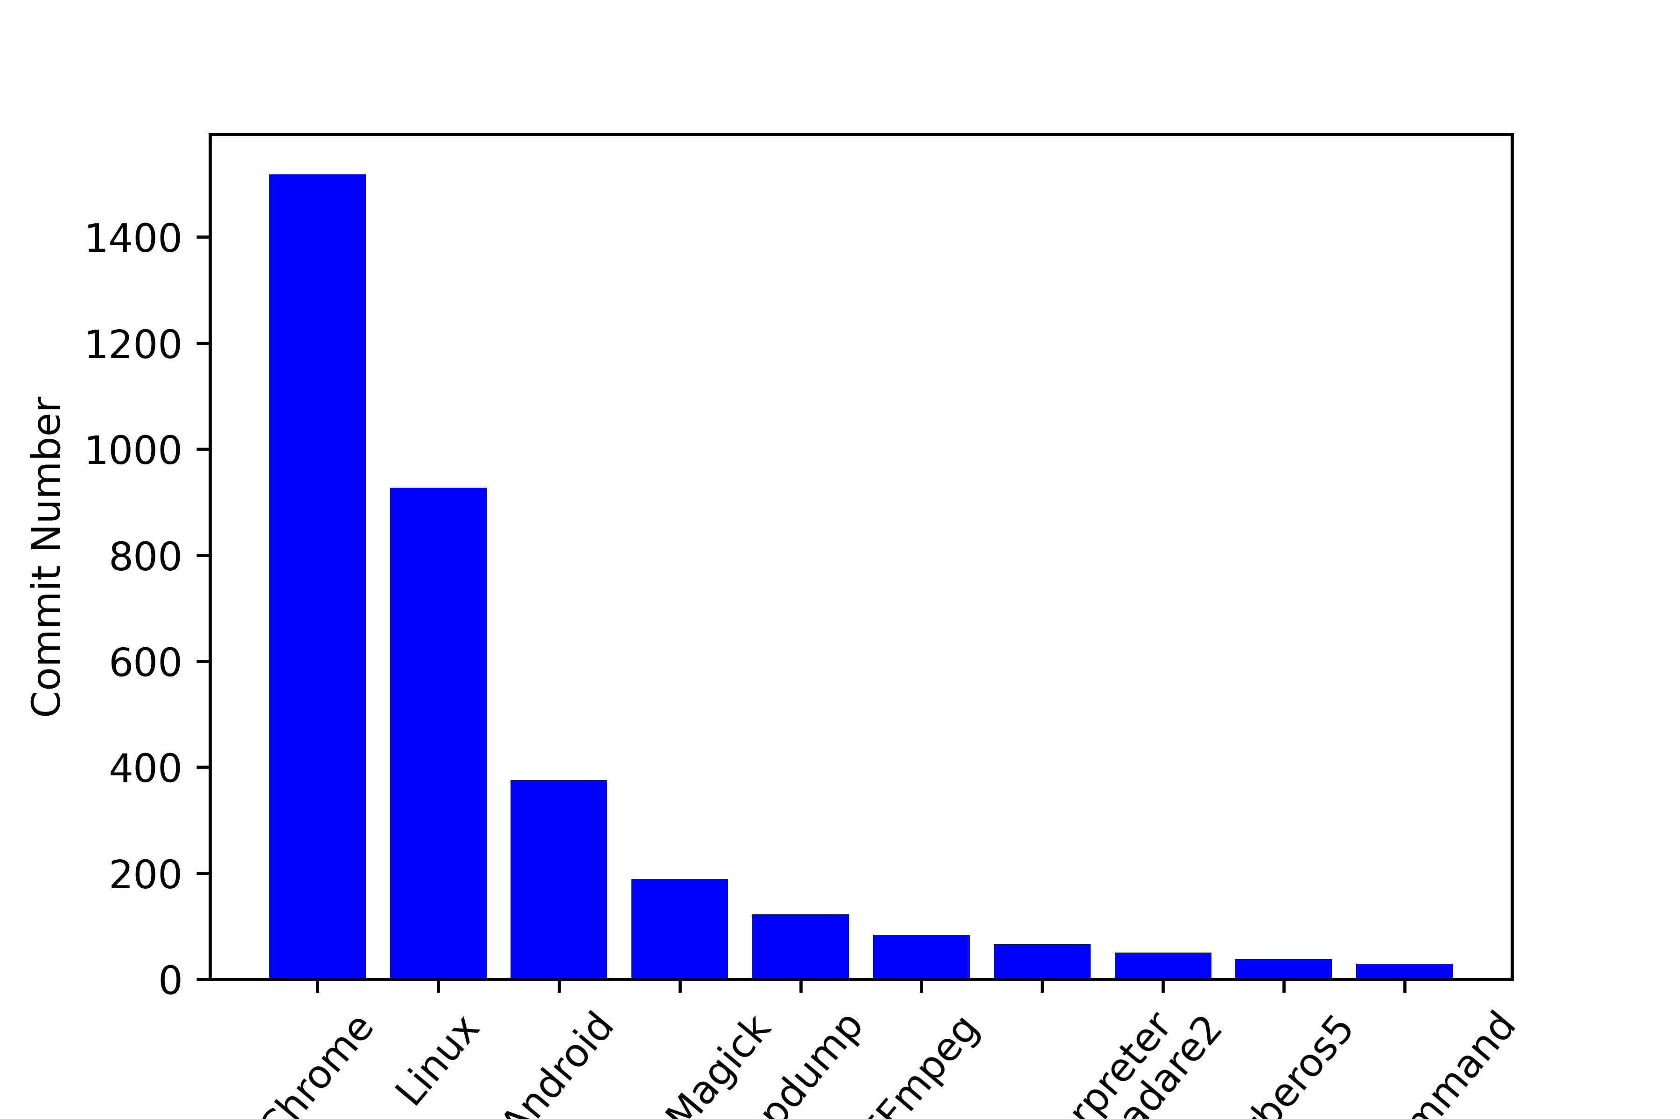
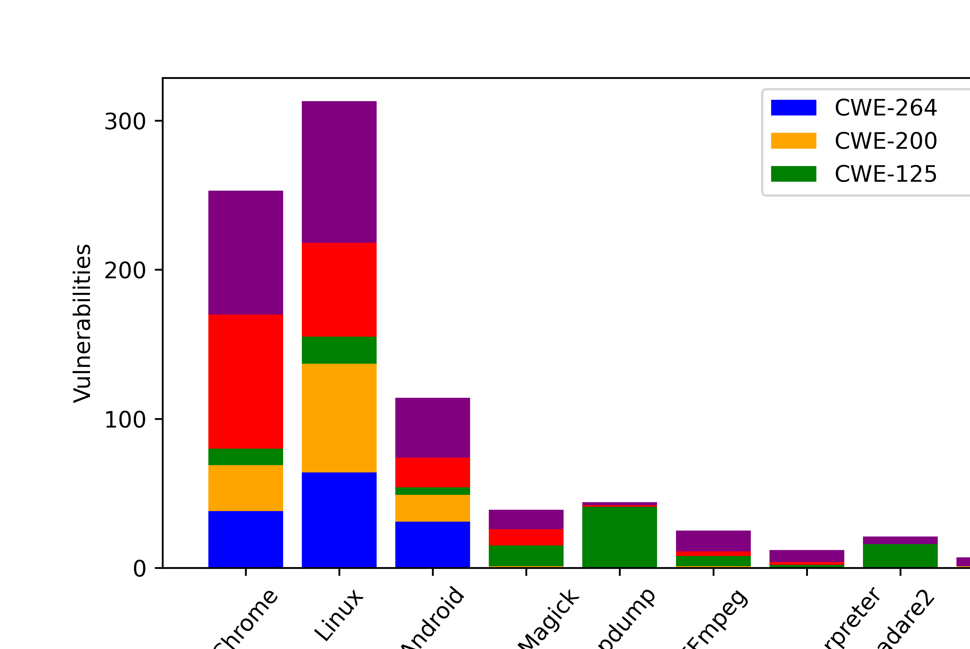
Dataset – Graphical Representation
Fig-1
Fig-2

Slide 7
Dataset – Visual Representation with TSNE
Fig-1
Fig-2
Fig-3

Slide 8
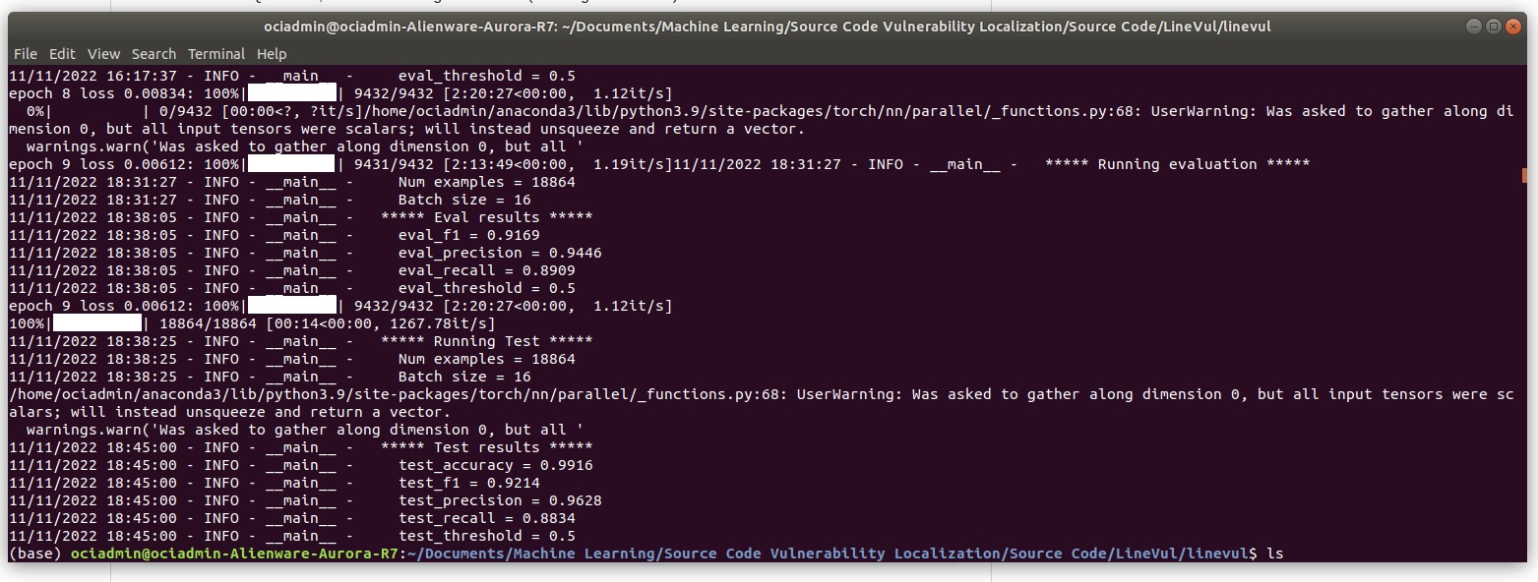
Experimental Results
Model name: LineVul -> BPE Tokenizer + Pre-training (Codesearchnet) + BERT
F-measure of 0.92
Precision of 0.96
Recall of 0.88
No. of epochs 10
Learning rate 2𝑒⁻⁵
Fig: Experiment result after 10 epochs

Slide 9
Line-level vulnerability localization with Attention Score
Layer Integrated Gradient (LIG) - is an axiomatic path-attribution method that attributes an importance score to each input feature by approximating the integral of gradients of the model’s output with respect to the inputs along the path (straight line) from given baselines to inputs.
Saliency - takes a first-order Taylor expansion of the network at the input, and the gradients are simply the coefficients of each feature in the linear representation of the model. The absolute value of these coefficients can be taken to represent feature importance.
Deeplift - compares the activation of each neuron to its reference activation and assigns contribution scores according to the difference.
Deeplift shap - extends DeepLift algorithm and approximates SHAP values using DeepLift approach.
Gradient shap - approximates SHAP values by computing the expectations of gradients by randomly sampling from the distribution of baselines.

Slide 10
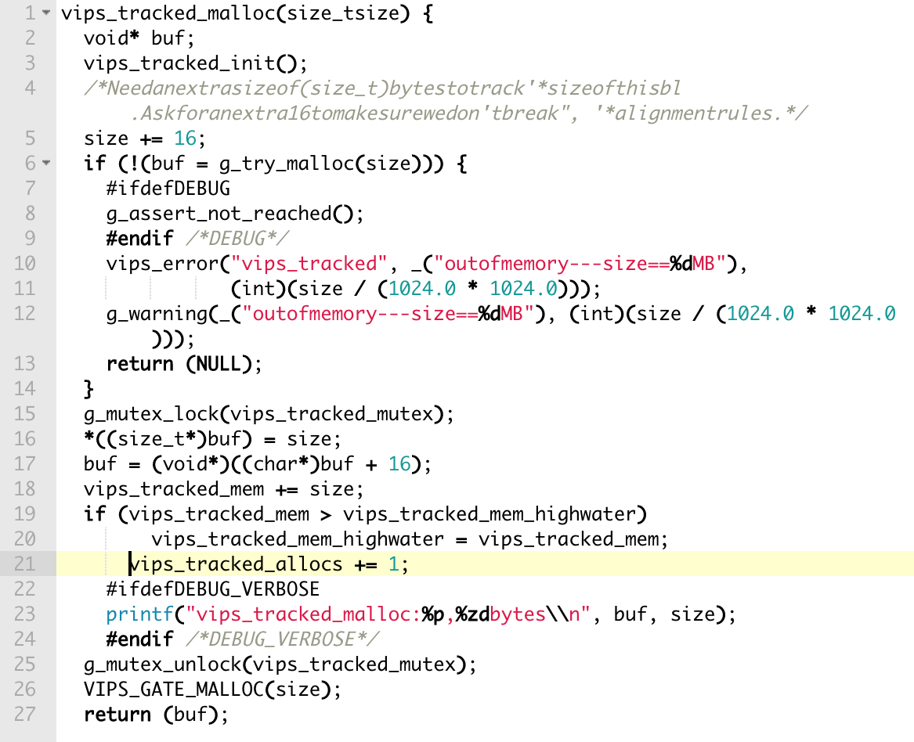
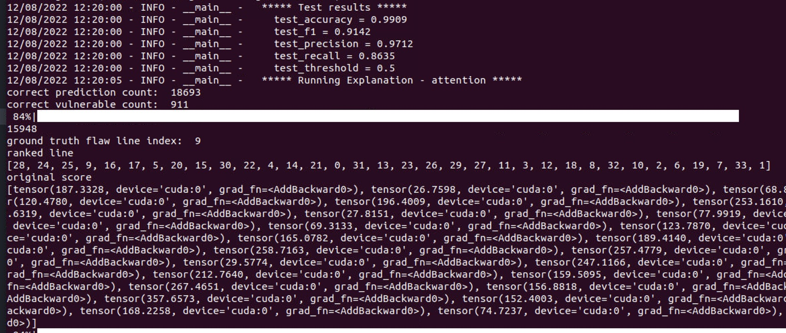
Explainibility
Function1: index: 15948
Ground truth flaw line index: 9
Predicted flaw line index: 28
Running explanation: Attention

Slide 11
Explainibility
Running Explanation – Gradient Shap
Running Explanation – Deeplift shap
Function2: index: 18107
Ground truth flaw line index: 3 Predicted flaw line index: 3 ranked line [3, 2, 1, 0, 9, 8, 10, 6, 5, 7, 4]
Function2: index: 18107
Ground truth flaw line index: 3 Predicted flaw line index: 1 Ranked line [1, 10, 3, 0, 8, 5, 9, 7, 6, 4, 2]
Function3: index: 17721
Ground truth flaw line index: 2 Predicted flaw line index: 4 ranked line [4, 5, 0, 3, 2, 7, 6, 1]
Function3: index: 17721
Ground truth flaw line index: 4 Predicted flaw line index: 4 ranked line [4, 0, 7, 6, 3, 2, 1, 5]

Slide 12
Conclusion
Explainability of AI models in Software Enginnering
Transformer-based vulnerability prediction approach
-Dataset with 188k+ C/C++ functions
160%-379% higher F1-measure for function-level predictions
12%-25% higher Top-10 Accuracy for line-level predictions and
29%-53% less Effort@20%Recall

Slide 13
References
[1] Fu, M. and Tantithamthavorn, C., 2022. LineVul: A Transformer-based Line-Level Vulnerability Prediction.
[2] Fan, J., Li, Y., Wang, S. and Nguyen, T.N., 2020, June. AC/C++ code vulnerability dataset with code changes and CVE summaries. In Proceedings of the 17th International Conference on Mining Software Repositories (pp. 508-512).
[3]Zhangyin Feng, Daya Guo, Duyu Tang, Nan Duan, Xiaocheng Feng, Ming Gong, Linjun Shou, Bing Qin, Ting Liu, Daxin Jiang, et al. 2020. CodeBERT: A PreTrained Model for Programming and Natural Languages. In Findings of the Association for Computational Linguistics: EMNLP 2020. 1536–1547.
Dataset - https://drive.google.com/uc?id=10-kjbsA806Zdk54Ax8J3WvLKGTzN8CMX
Video recording link- https://drive.google.com/file/d/1oNjwYkSm6G7NZ4_0ZpAkC5T97cTZOmAn/view?usp=share_link

