Slide 1
University Registration System
Team Beta(β)
Syed Zafrul Bahar (13101062)
Tabia Afrose Promi (15201018)
Shamim Rayhan (15201054)
Department of Computer Science & Engineering,
University of Asia Pacific

Slide 2
Outline
Motivation
Purpose
System Design
Testing
Implementation Note

Slide 3
Motivation
We have made a plan to make a registration system where a student can’t get registered for a course without completing the prerequisite courses of that course.

Slide 4
Purpose
Prerequisite Checking
All Course Detail
Student Detail
Notice board
Give students no opportunity to change their major details
Make good user interface for students and administration

Slide 5
System Design
For our system we have made a design with which we can control almost everything of a registration process. This design is upgradeable also.

Slide 6
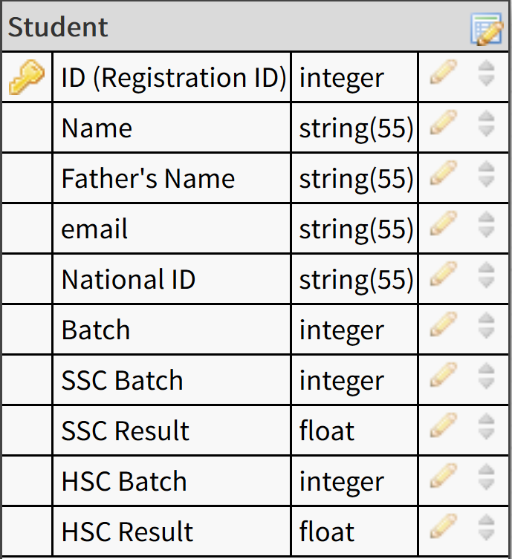
Student Table

Slide 7
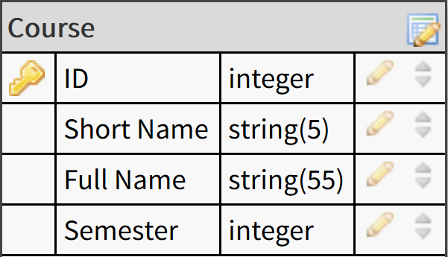
Course Table

Slide 8
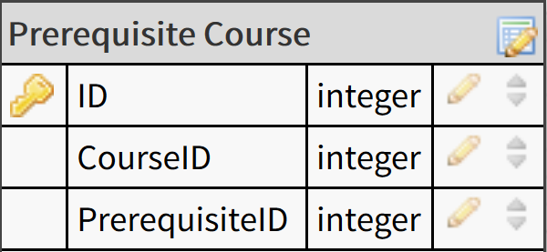
Prerequisite Course Table

Slide 9
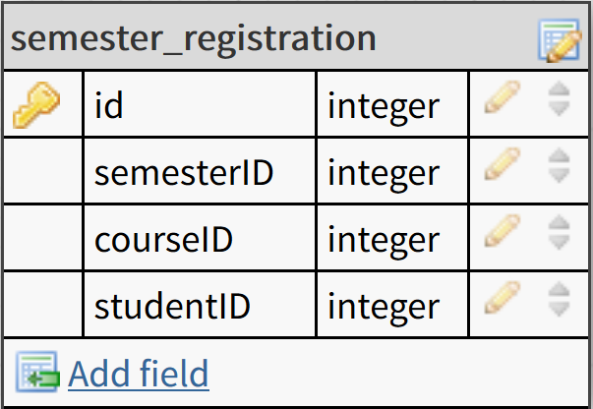
Registration Table

Slide 10
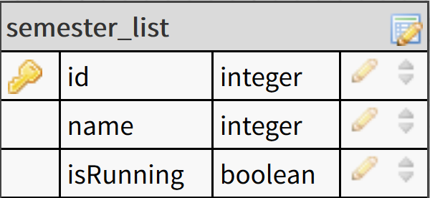
Table to Store Semesters

Slide 11
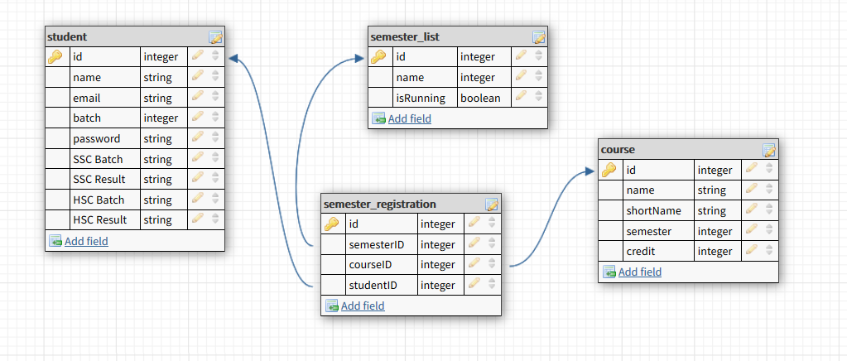
Relation between Tables for Registration

Slide 12
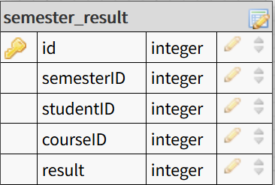
Result Table

Slide 13
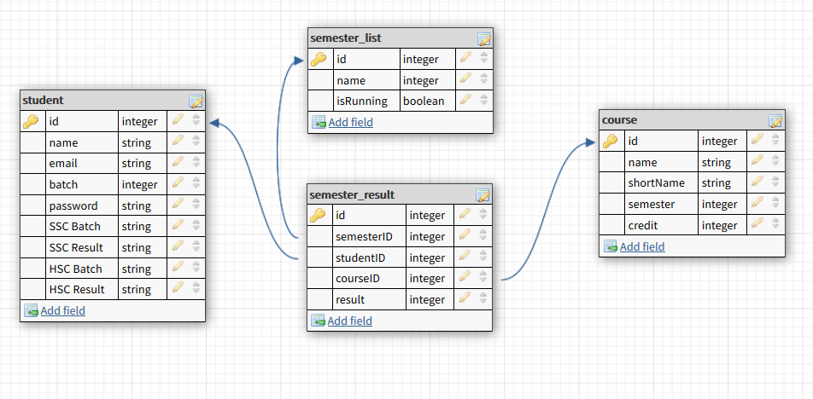
Relation Between Tables for Result

Slide 14
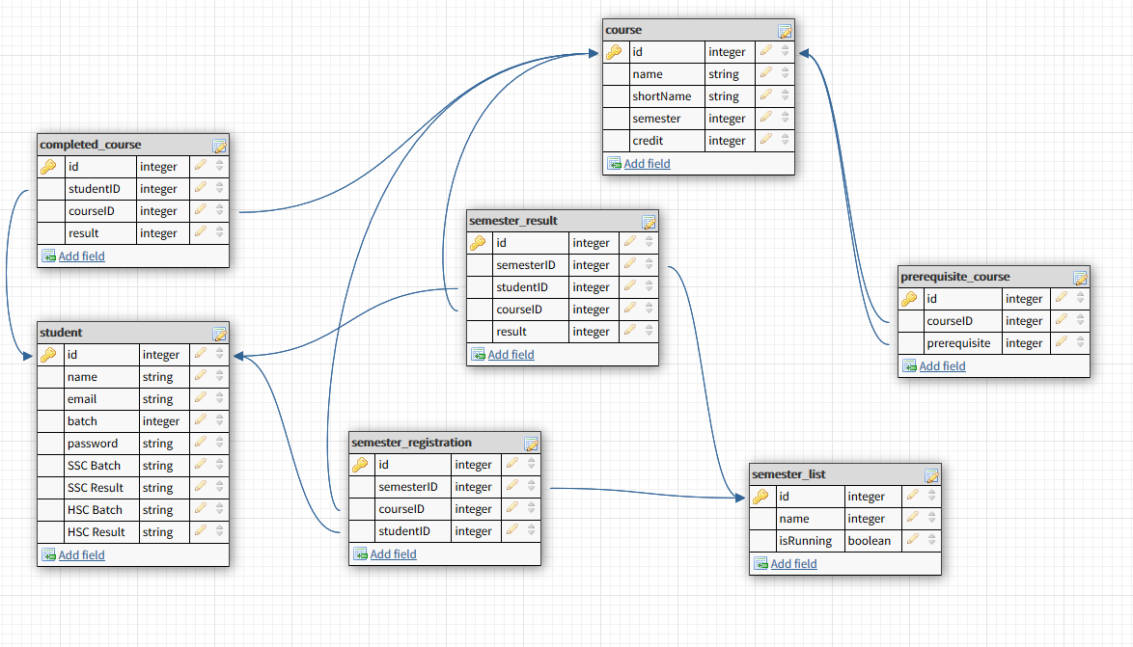
Complete Database

Slide 15
Requires Testing
Collect data from our university.
Make a online registration process for a particular semester.

Slide 16
Implementation Note
We have used HTML5(Hypertext Markup Language), CSS(Cascading Style Sheets), JS(Javascript) and PHP(PHP: Hypertext Preprocessor).
We have used jQuery library and Bootstrap template.

Slide 17
Thank You

