Slide 1
Sales Performance Dashboard
Task 4 Deliverables • Interactive Dashboard + Summary

Slide 2
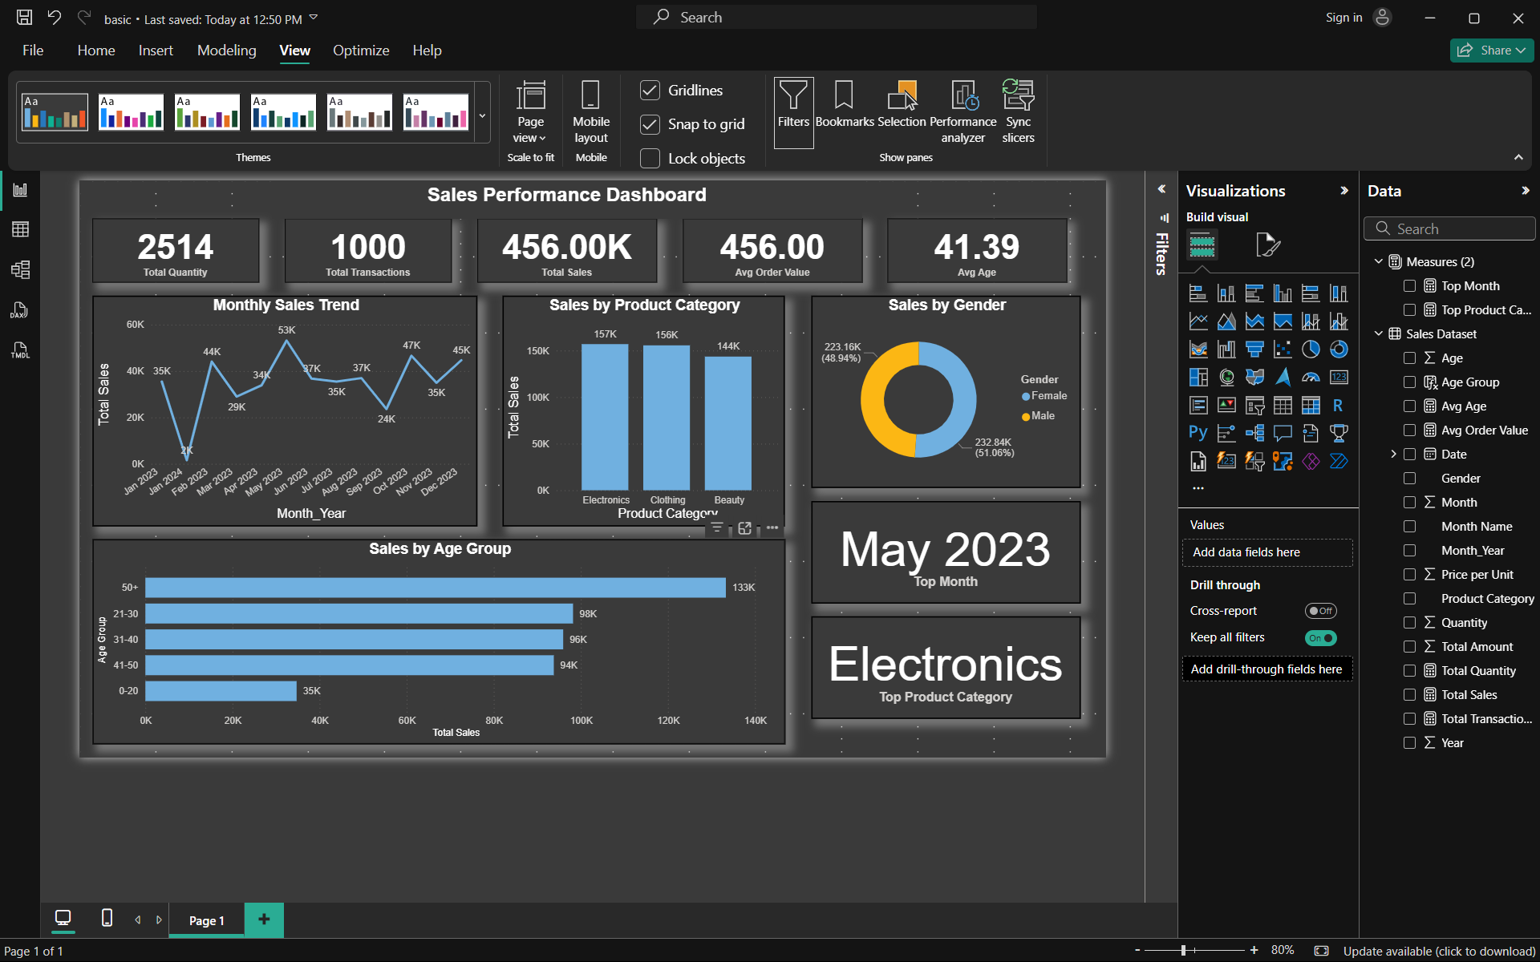
Interactive Dashboard Overview

Slide 3
Key Performance Indicators
• Total Sales
• Total Transactions
• Total Quantity
• Average Order Value (AOV)
• Average Customer Age

Slide 4
Key Insights
• Peak sales in May 2023
• Electronics is the highest-selling category
• Gender distribution is balanced
• Customers aged 50+ contribute the most
• Sales trend shows stable growth with seasonal peaks

Slide 5
Dashboard Components
• Monthly Sales Trend (Line Chart)
• Sales by Product Category (Bar Chart)
• Sales by Gender (Donut Chart)
• Sales by Age Group (Bar Chart)
• KPI Cards & Top Insights Cards

Slide 6
Thank You!

