Slide 1
Characterization of GJ 436 b
Aiden Zelakiewicz, Sydney Petz, Justin Anderson

Slide 2
Aims
Want to characterize extrasolar planets to help gain an insight to if our solar system is standard.

Slide 3
Characterizing Three Critical Features of GJ 436 b
RADIUS
Transit Photometry
MASS
Radial Velocity
DENSITY
Math :)

Slide 4
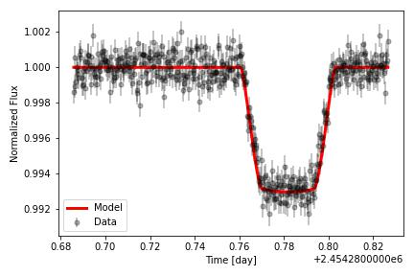
Spitzer Photometry
8.0 𝝻m Spitzer photometry
Used Exofast’s emcee methods to fit transit
Results in transit depth of 𝝳 = 7.09 ± 0.12 x 10⁻³

Slide 5
Planetary Radius
R_{p}= 3.83±0.08 R⨁
Use transit depth and stellar radius to get planetary radius
𝝳 = (R_{p}/R*)²
Use stellar radius from Rosenthal et al. 2021, R*= 0.416±0.008 R⊙

Slide 6
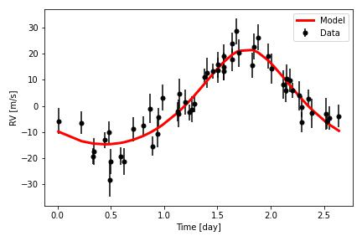
Keck Radial Velocity
V-band observations from HIRES instrument on Keck
Used Exofast to obtain RV orbital motion parameters
Results in RV semi-amplitude of K = 18.2 ± 1.1 m/s

Slide 7
Planetary Mass
M_{p}= 24.6±2.0 M⨁
Use Radial Velocity Equation to get planetary mass
M_{p}= K/sin(i) (a×M*/G)^{½}
Use stellar mass from Rosenthal et al. 2021, M*= 0.441±0.009 M⊙

Slide 8
Planet Density
𝞺_{p}= 2.41±0.19 g/cm³
Use standard density calculation
Density = M_{p}/(4/3 𝝿 R_{p}³)

Slide 9
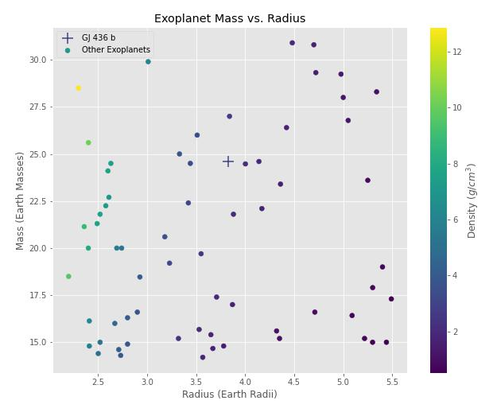

Slide 10
GJ 436 b - A Super-Neptune
RADIUS
3.83 R⨁
MASS
24.6 M⨁
DENSITY
2.41 g/cm³

