Slide 1
Virus & anti-virus

Slide 2
PROJECT TEAM
Amaan Akhtar - 201P016 - 39
Chaitanya Parab - 201P022 - 32
Shaikh Mohd Shoeb - 201P029 - 53
Katheem Kizhar Ahmed - 201P036 - 13

Slide 3
PROBLEM STATEMENT :
This Project has been undertaken to understand and fight against viruses using antivirus. Many antiviruses do remove the virus but take more memory, we are developing an antivirus that removes the virus without affecting the efficiency and speed of the computer. The antivirus also helps to show loopholes in computers.

Slide 4

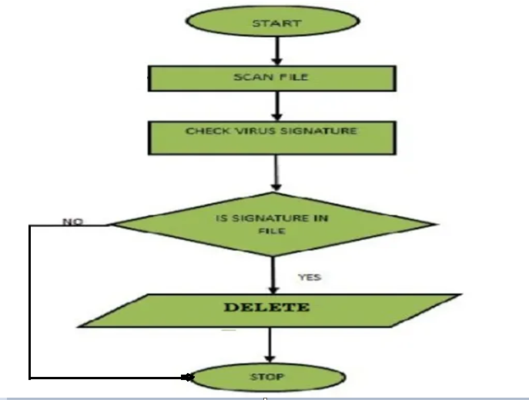
FLOWCHART

Slide 5
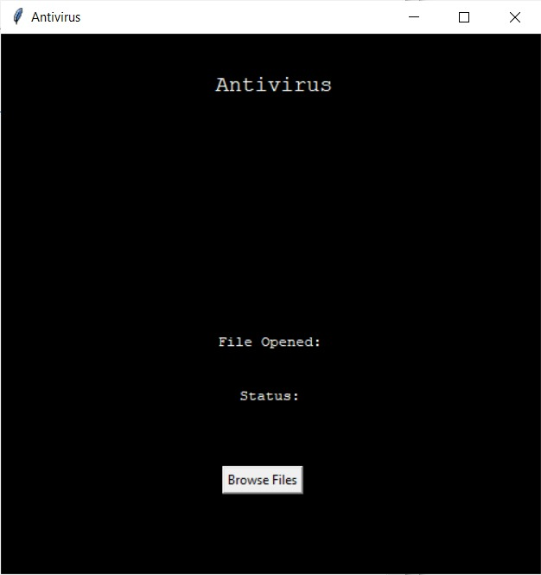
oUTPUT

Slide 6
Literature Referred :
Book -
[1] Martin C. Brown, 2018, Python: The Complete Reference.
Journal Paper -
[2] Muchelule Yusuf Wanjala & Neyole Misiko Jacob, 2017, Review of Viruses and Antivirus Patterns, Global Journal of Computer Science and Technology.
Proceeding Paper -
[3] Bhaskar V. Patil, Rahul J. Jadhav, 2015, Computer Virus and Antivirus Software –A Brief Review, International Journal of Advances in Management and Economics.

Slide 7

WORK DONE BY EACH MEMBER

Slide 8
THANK YOU

