Slide 1
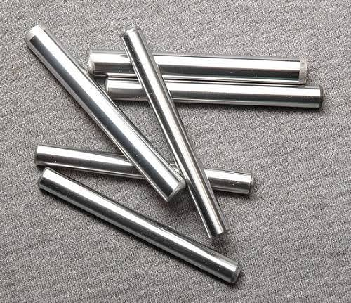
Static Tension Test of Mild Steel Using MATLAB

Slide 2

Presented By
Group-7
Shoeb Ahmed Tanim (1804165)
Md. Sifat-E- Rabbi (1804167)
Arman Hossain (1804174)
Sahea Maharuj Mahadi (1804187)
Shoeb Ahmad Tanim (1804165)
Sifat E Rabbi (1804167)
Arman Hossain (1804174)
Sahea Maharuj Mahadi (1804187)

Slide 3
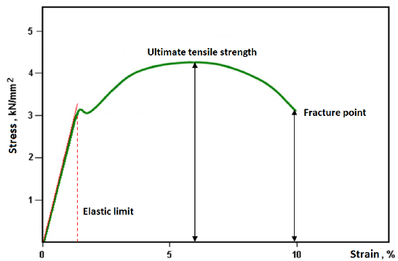
What is Static Tension Test
Tensile testing is a fundamental materials science and engineering test in which a sample is subjected to a controlled tension until failure. Properties that are directly measured via a tensile test are ultimate tensile strength , breaking strength, maximum elongation and reduction in area.

Slide 4
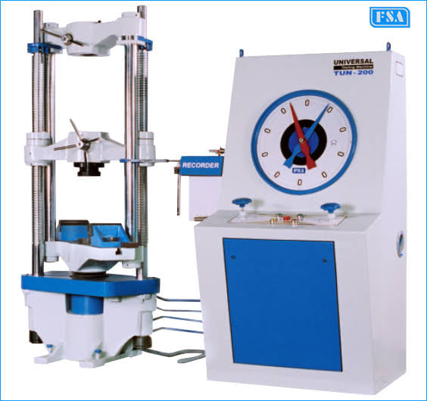
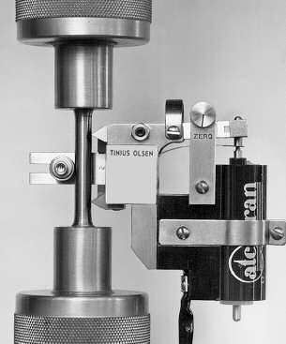
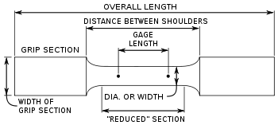
Machineries

Slide 5
OBJECTIVES
To analyse ‘Tension Test of Mild Steel’, an application of basic MATLAB knowledge and determine required parameters.
Plot Stress-Strain Curve for Mild Steel.
Use A GUI to do this test for any dataset

Slide 6
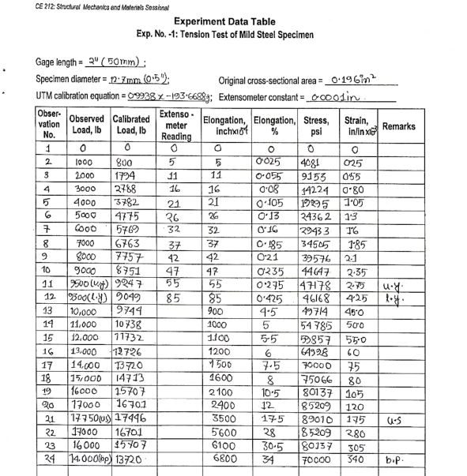
Taking Input Data From Lab Experiment

Slide 7
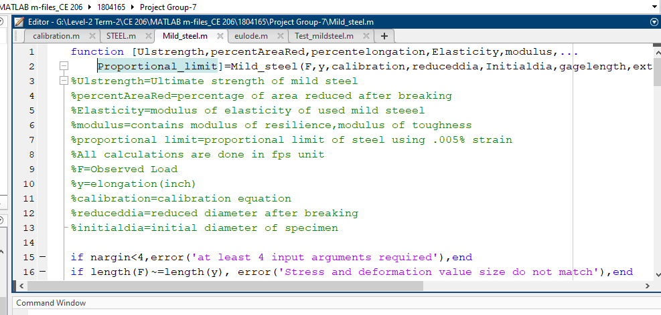
Taking Input Data in Mild_Steel .m file for computation

Slide 8
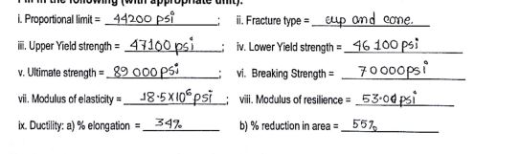
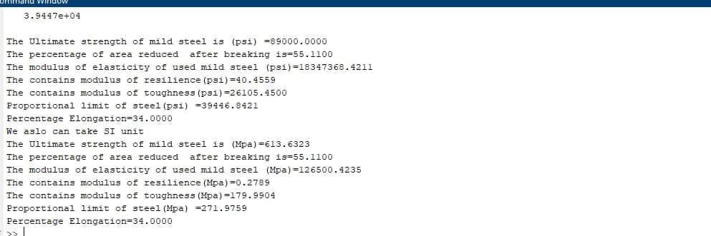
Comparing Output Results

Slide 9
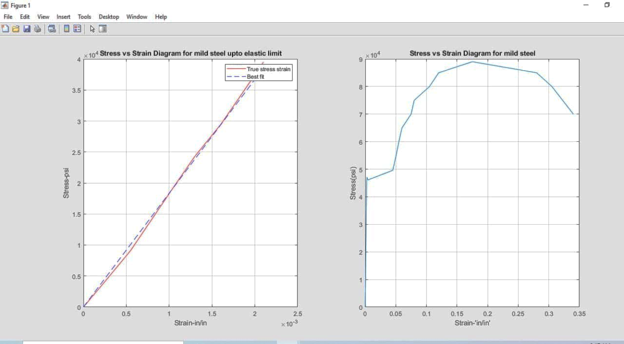
Obtained Graphs of Stress Vs Strain

Slide 10
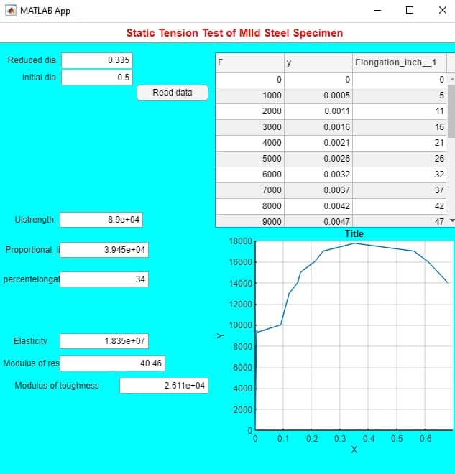
Graphical User Interface (GUI) For Test

Slide 11
OUTCOMES
PROPORTIONAL LIMIT
ULTIMATE STRENGTH
MODULUS OF ELASTICITY
MODULUS OF RESILIENCE
ELONGATION
REDUCTION OF AREA
STRESS VS STRAIN PLOTTING

Slide 12
THANK YOU!

Slide 13


