Slide 1

Data Analysis and Grade Prediction Lending Club Loan Data
Datamining – Final Project
Fall 2020
Presented by:
Mohammed Shoebuddin Habeeb Divya Bhuvanapalli

Slide 2
Contents
Problem Statement
Data: Background and Introduction
Data: Pre-processing and Exploratory Analysis
Prediction
ML Models Accuracy Comparison
Results
Conclusion

Slide 3
Data: Background and Introduction
Lending Club (LC) is the world’s largest online marketplace connecting borrowers and investors.
Borrowers generally apply through an online platform where they are assigned an internal score.
Lenders decide
whether to lend
the terms of loan such as interest rate, monthly instalment, tenure etc.
Type of loan; Some popular products are credit card loans, debt consolidation loans, house loans, car loans etc.
The original dataset is available for download on the Lending Club website. So far the data is available till 2020 Q1 and can be dated back to 2007.
For our analysis, we consider data for the years 2007-2011.
The dataset contains information on almost all the loans issued by LC, except a few that LC was not authorized to release publicly.

Slide 4
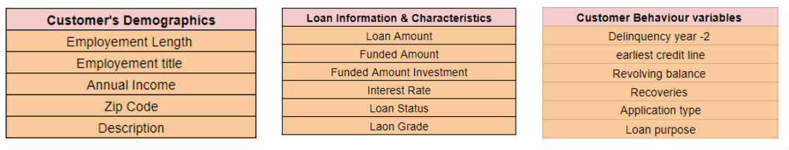
Data: Background and Introduction
The dataset includes the following information for each loan:
Customer demographics
All the details of the loans at the time of their issuance
The latest status of loan such as how much principal has been paid so far, how much interest, if the loan was fully paid or defaulted, or if the borrower is late on payments etc.
Customer - Loan behavior (if the loan is granted or not).

Slide 5
Problem Statement
The aim of this project is to
Perform exploratory analysis on Lending club loan dataset.
Apply various machine learning techniques to predict the grade of the loan.
Compare efficiency and accuracy of various machine learning methods.

Slide 6
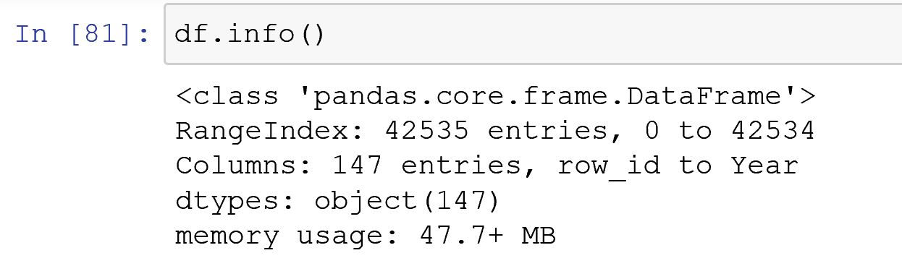
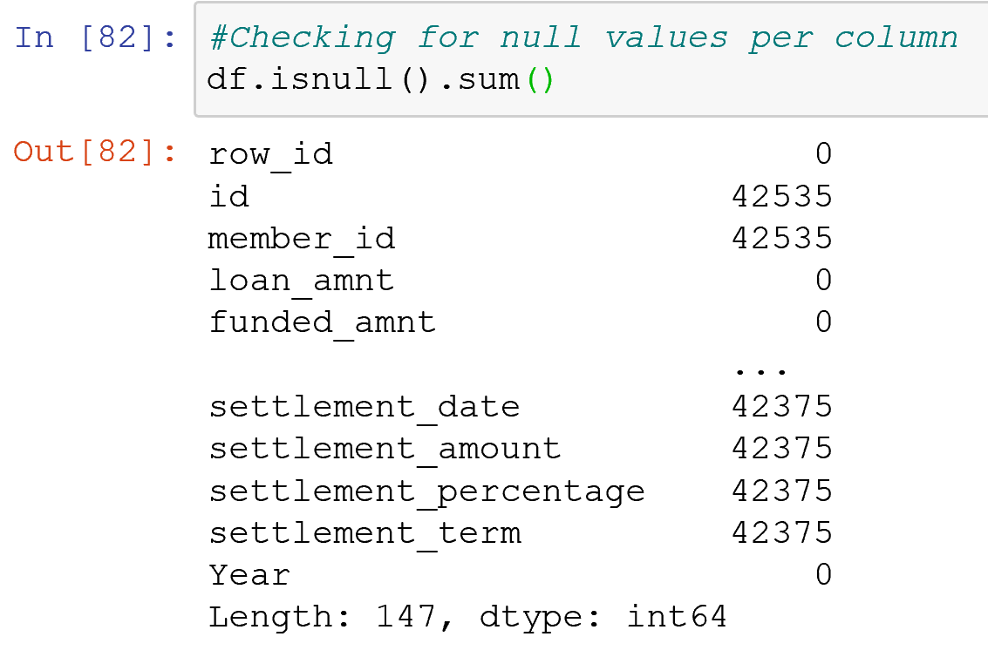
Data: Pre-processing and Exploratory Analysis
There are 147 data attributes and a total of 42535 records in the dataset.
There are several columns with null values.

Slide 7
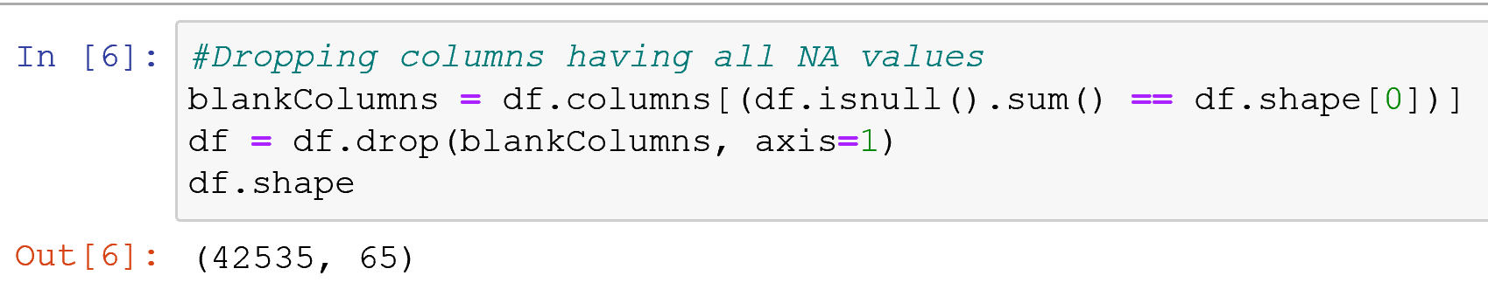
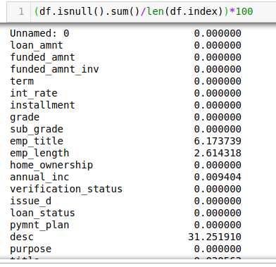
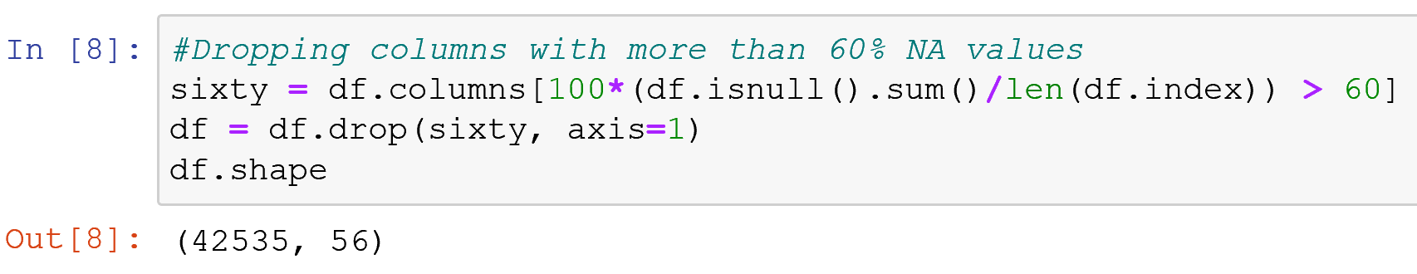
Data: Pre-processing and Exploratory Analysis
Removing columns that have all values as null, we bring down the shape to (42535, 65).
We further remove columns that have more than 60% values as null.

Slide 8
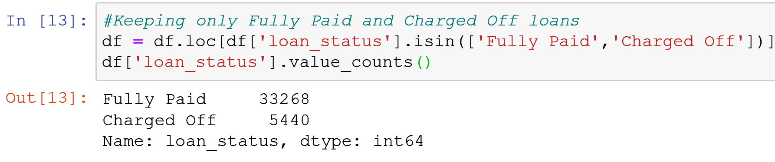
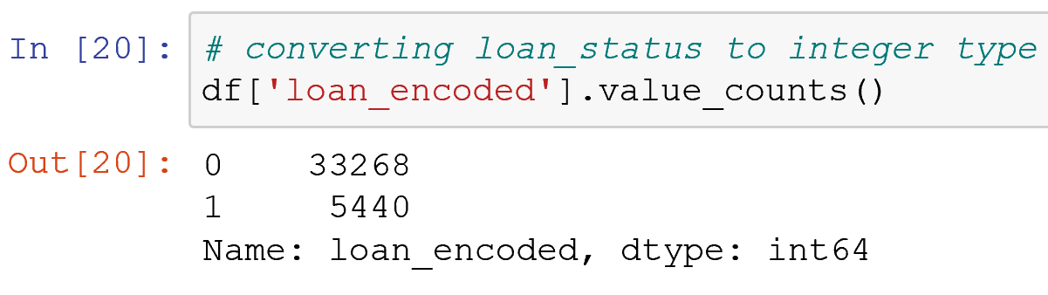
Data: Pre-processing and Exploratory Analysis
Keeping only data with loan status as Fully Paid and Charged off.
Also, encoding these categorical values.

Slide 9
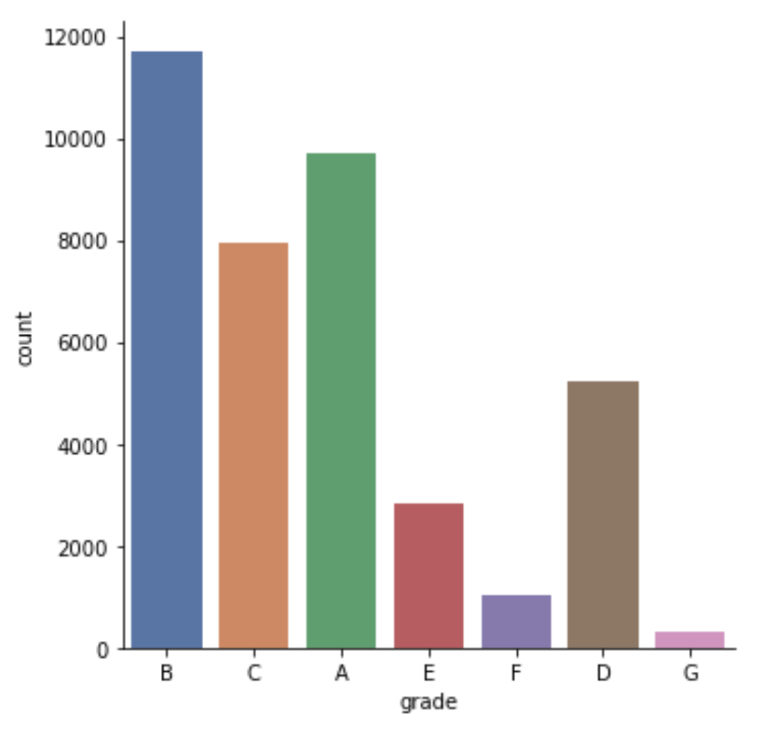
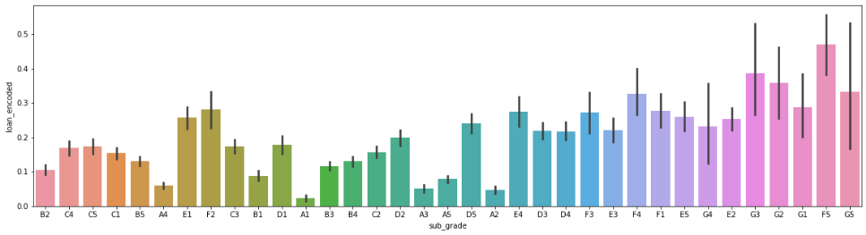
Understanding Grades
There are a total of 7 grades of loans issued each of which is rated from A to G where A is the best and G is lowest.
Each of this Alphabetic grade is again divided into 5 subgrades to give a more clearer picture.

Slide 10
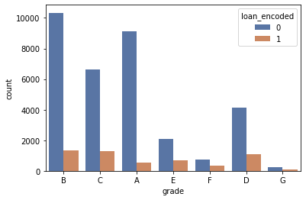
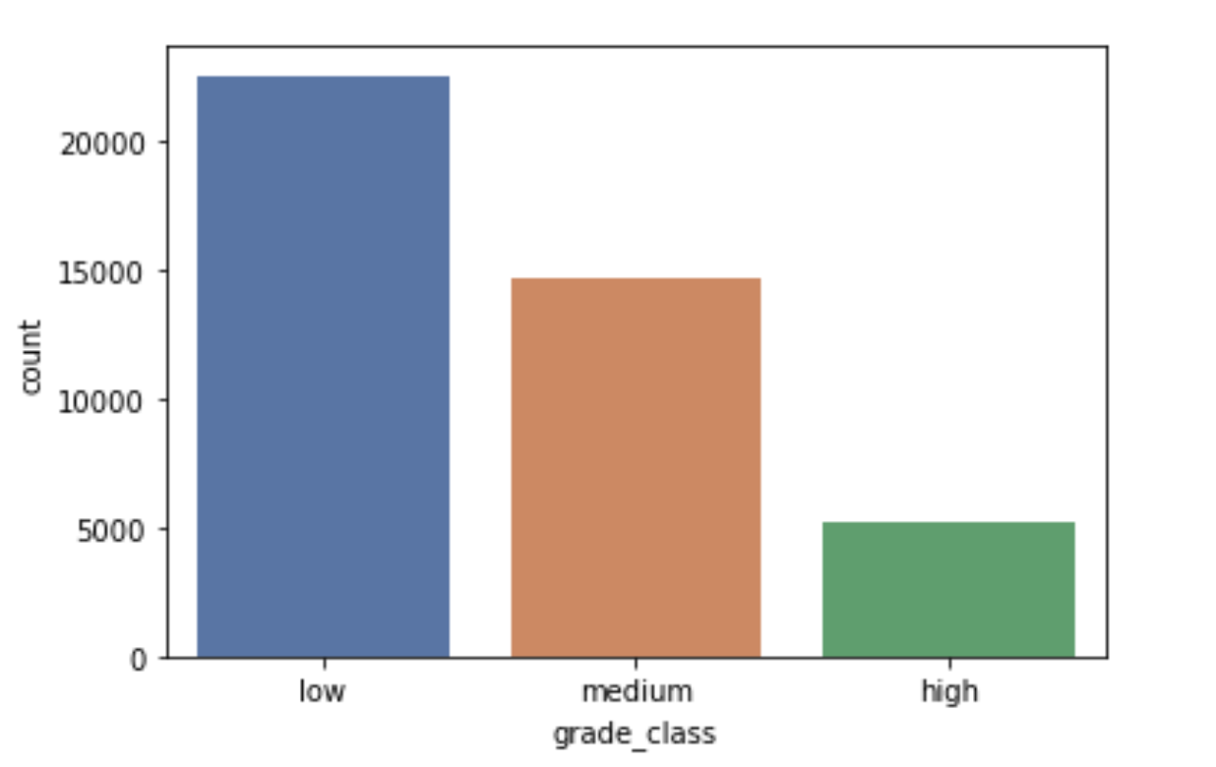
Data: Pre-processing and Exploratory Analysis
The original grades range from A-G are now changed to grade classes as low, medium and high.
Grade vs the type of loans helps us understand the class distribution

Slide 11
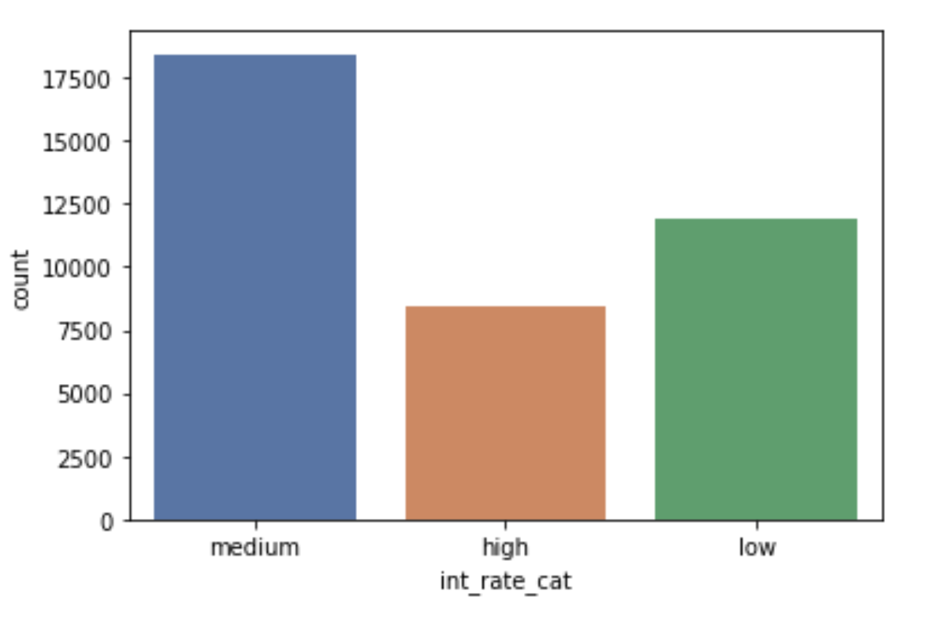
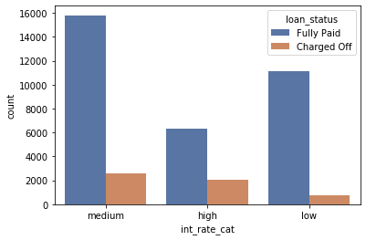
Data: Pre-processing and Exploratory Analysis
One-hot encoding to convert categorical values to numerical.
Binning of continuous variables like Interest rate & Grade(Target).
Binning is process of transforming numerical variables into categorical counterparts.
Interest rates < 10 as low, between 10 – 15 as medium, others as high.

Slide 12
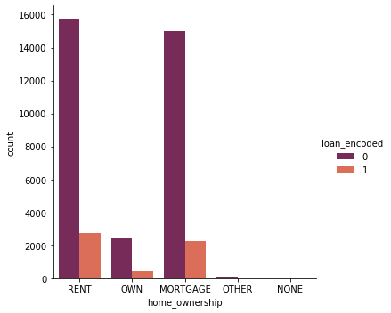
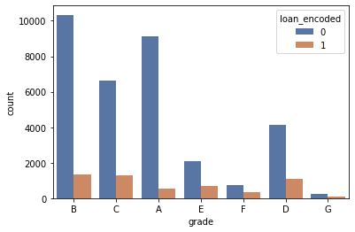
Data: Pre-processing and Exploratory Analysis
Loan status per homeownership: Loan status per grade:

Slide 13
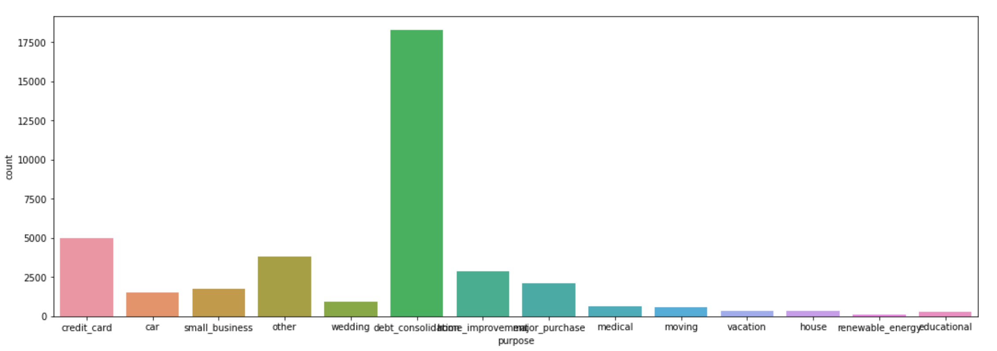
Data: Pre-processing and Exploratory Analysis
The following plot shows the loan distribution per loan purpose

Slide 14
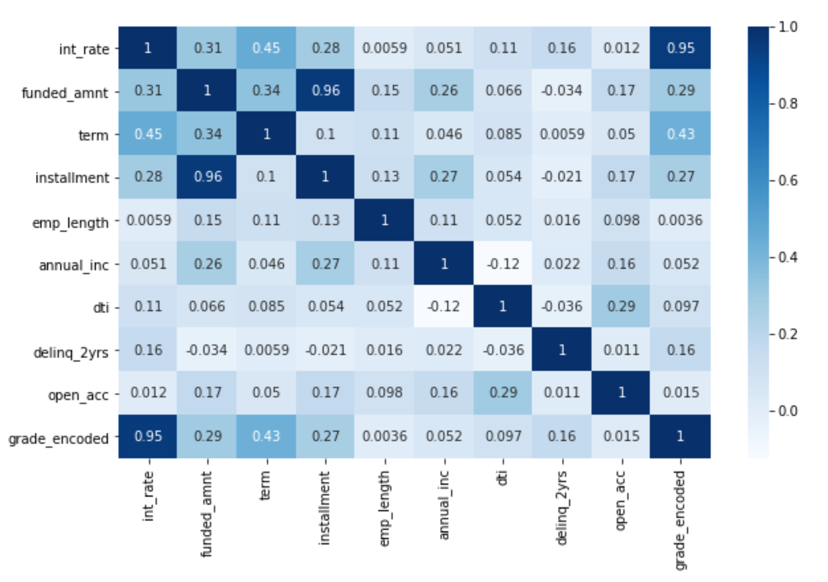
Data: Pre-processing and Exploratory Analysis
Correlation Matrix
strong positive correlation between grade
and interest rate.
employment length has almost no correlation
With interest rate. Since correlation is zero
we can infer there is no linear relationship
between these two predictors.

Slide 15
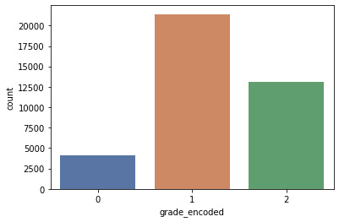

Grade Assumption
After all the preprocessing we want to make our problem simpler by reducing Grade classes from 7 class prediction to 3 class prediction.
We merge the grades to 3 categories ‘low’, ‘medium’ and ‘high’ and encode them as 0,1,2 respectively.
This merging is done so that A and B is high, C and D is medium and all the others are High.
Final Shape:

Slide 16
Prediction
From a customer point of view, we want to predict the grade a customer is going to get before applying for a loan. A low grade means a low interest on the loan.
Implemented the following ML techniques to predict the grade:
Random Forest Classifier with n_estimators=1000
Accuracy: 0.6201670541634375
Gaussian Naive Bayes
Accuracy: 0.33247222939808835
Support Vector Machines
Using Linear Kernel; Accuracy: 0.6019977611297683

Slide 17
Prediction
Logistic Regression
Accuracy: 0.6110393524498406
KNN
n_neighbors=11
Accuracy: 0.5875312150176526
AdaBoost
Accuracy: 0.6236114699044175

Slide 18
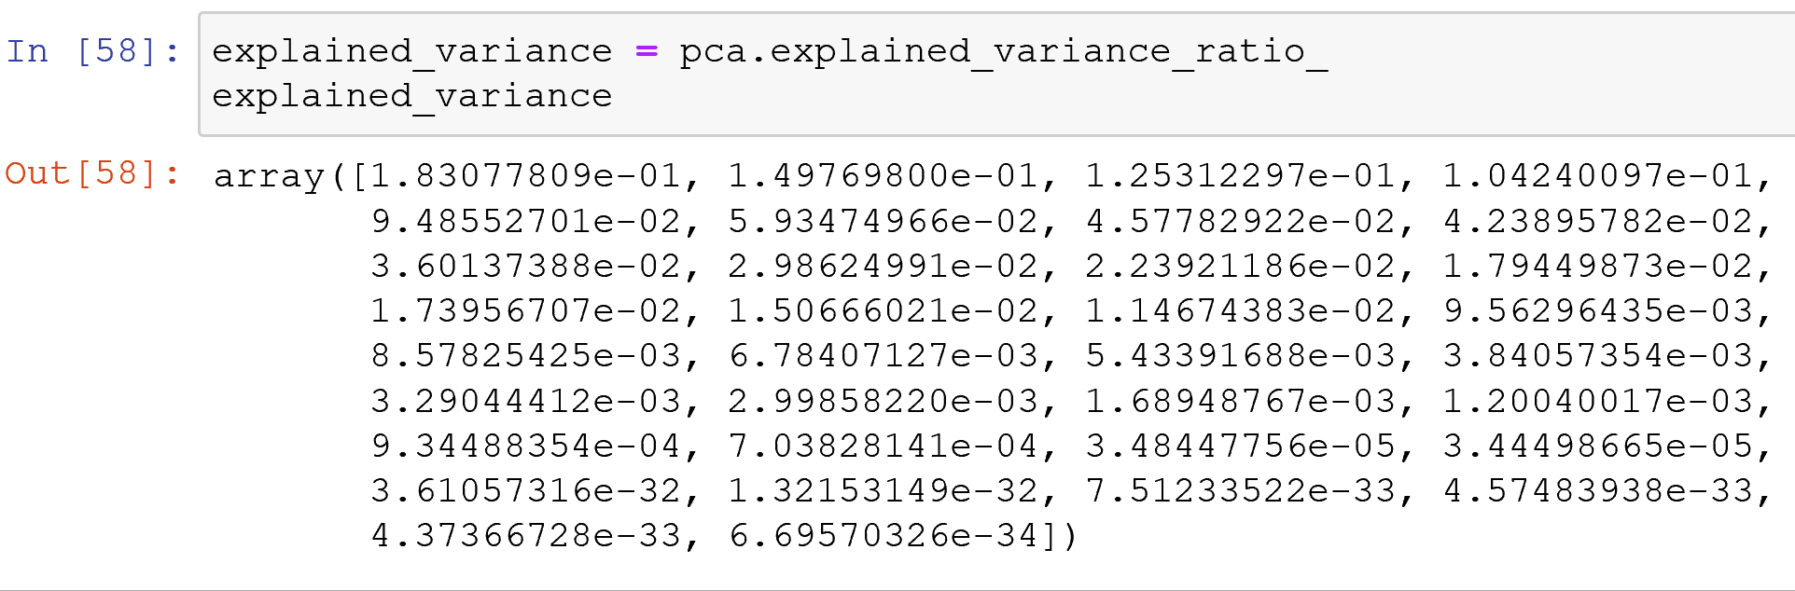
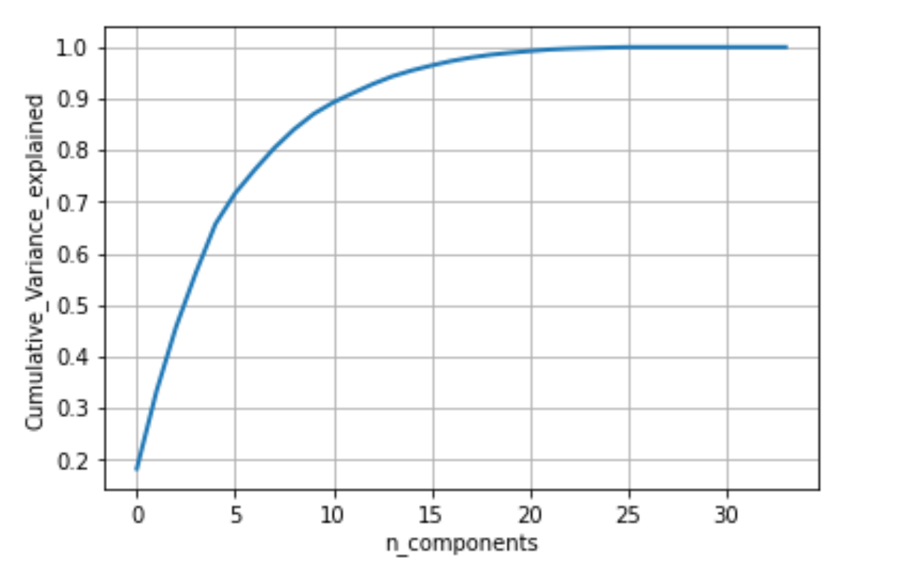
Prediction
PCA
Covariance Matrix:
Covariance Plot:
No. of components needed to explain
90% variance is 12.
shape of PCA data (27095, 2).
Accuracy of Logistic Regression after PCA reduction
Accuracy: 0.5337983294583656

Slide 19
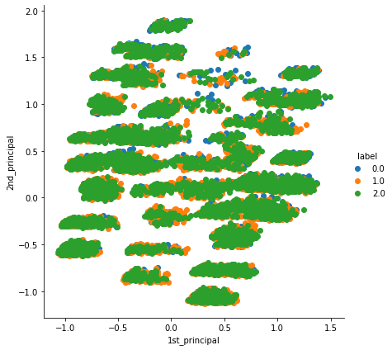
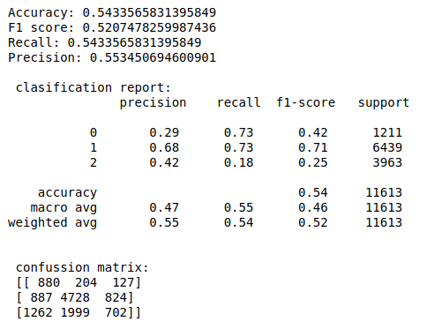
Prediction using PCA
2D PCA Logistic Regression using 12 components

Slide 20
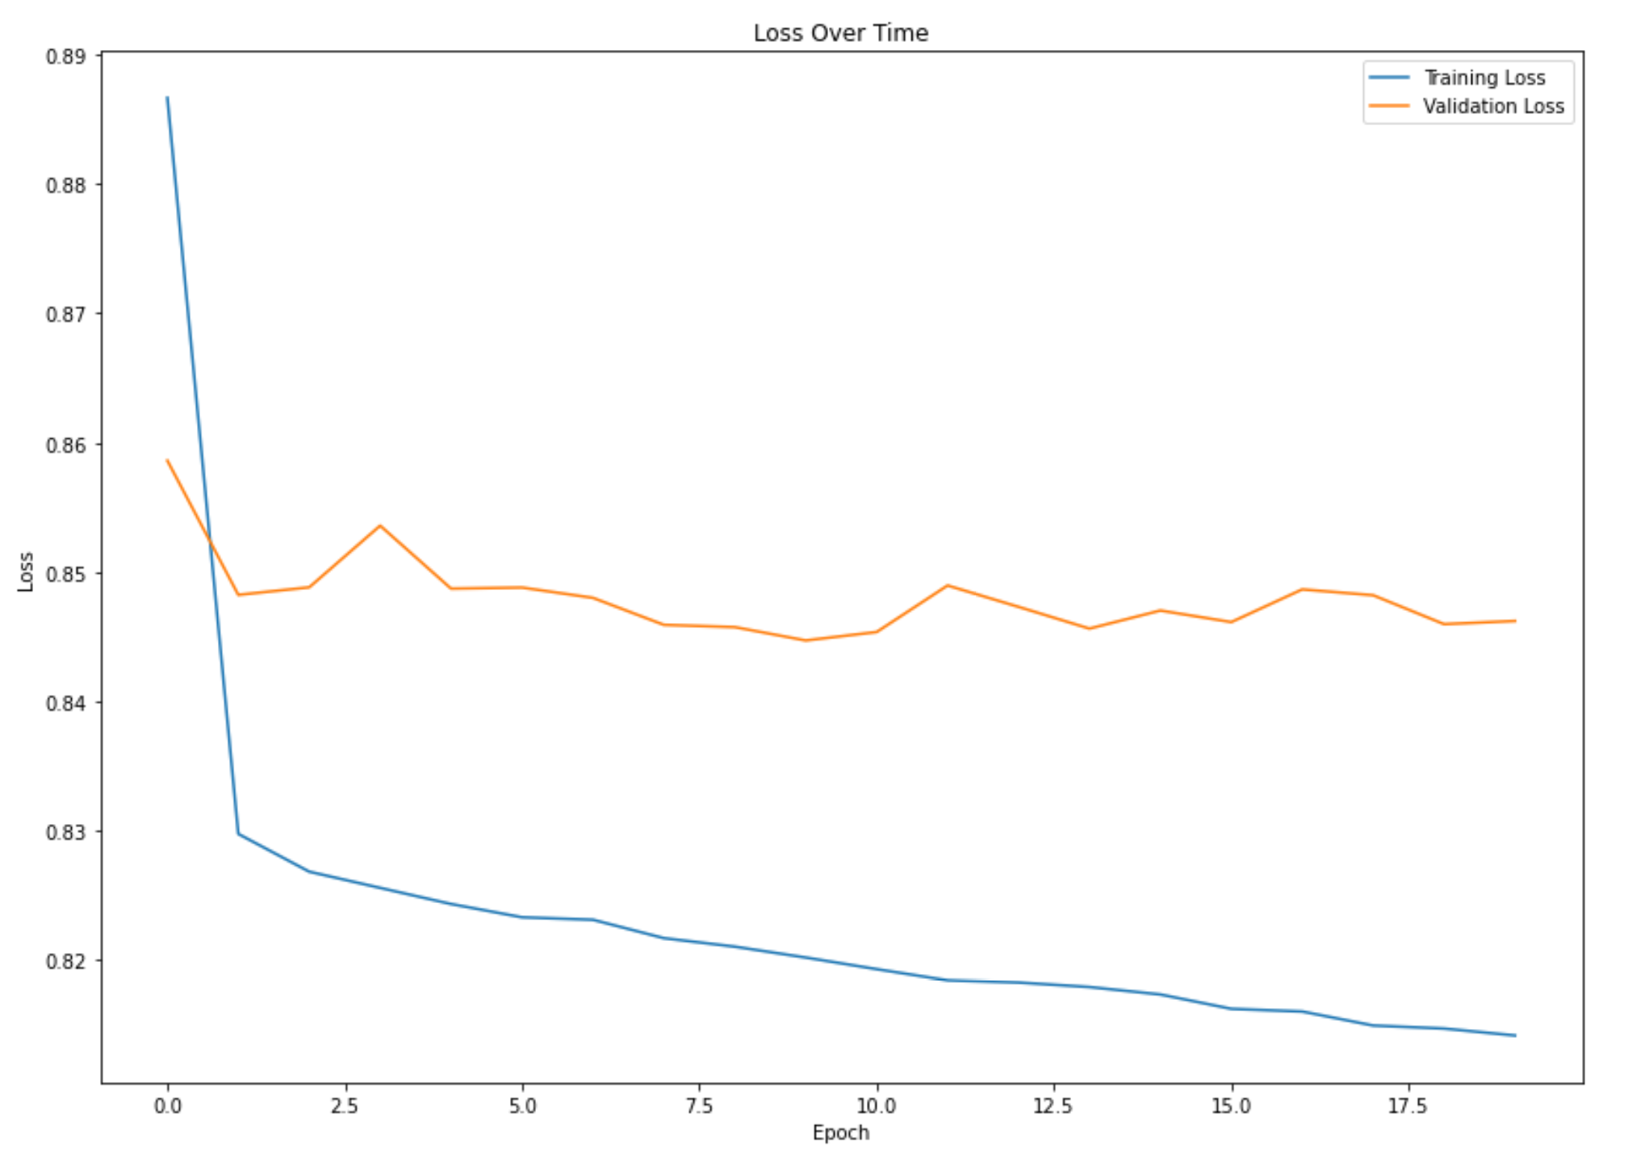
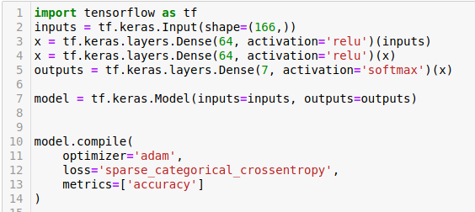
Prediction
Neural Network
Training Accuracy: 0.6066 after 20 epochs
Test Accuracy: 0.5973

Slide 21
Results Comparison
Model | Accuracy
Random Forest Classifier | 62.1%
Gaussian Naive Bayes | 33.5%
Support Vector Machines | 60.4%
Logistic Regression | 61.1%
KNN | 58.7%
AdaBoost | 62.3%
PCA | 53.3%
Neural Network | 59.7%

Slide 22
Conclusion
We see that all the ML classifiers have average performances as the dataset is real world problem
Tried GridSearchCV to increase the performance
Reducing the components (<5) is giving higher performance but implies high bias in the data
Using alternate bigger dataset is a better alternative
NN classifer is tuned with training but could be improved by increasing the layers

Slide 23


