Slide 1

Parallelizing Sobel edge detection
A comparison of different approaches
Michael Shlega
Carleton University, Ottawa, Ontario
michael.shlega@cmail.Carleton.ca

Slide 2
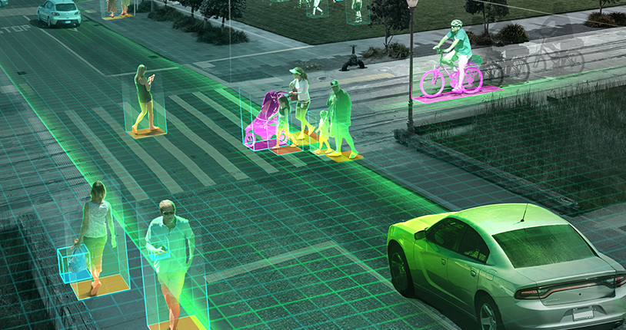
What is edge detection?
Algorithms to identify edges of an image
Base for a lot of computer vision
A speedup here leads to a faster computer vision algorithm, so this remains an active area of research

Slide 3

Background

Slide 4
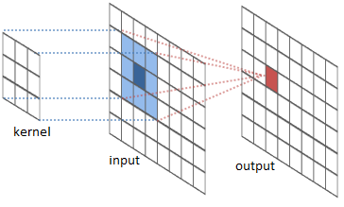
Edge Detection Algorithms
Work by applying a kernel to an image, which gives a pixel value
The value is then compared to other values to identify if an edge exists

Slide 5
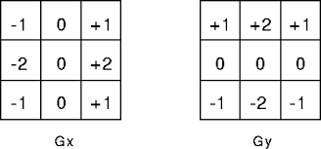
Sobel Algorithm
One of the many available
Most used
Main importance here is the kernels
One applied in the x direction
One applied in the y direction
Combined at the same time or later

Slide 6
Edge Detection Improvement

Slide 7
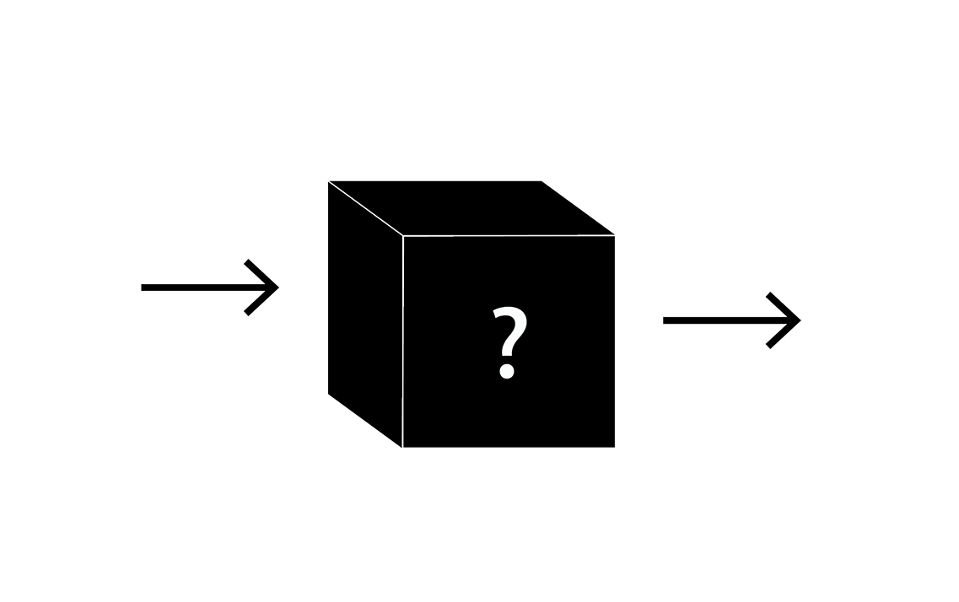
Algorithmic approach
Attempt to improve time complexity by utilising algorithm improvements
In general, research ends up showing that while speed can be increased, it comes at the price of image quality
Alternatively, image quality can be improved but at the price of time
A key improvement is actually image smoothing
Rosenfeld and Thurston introduce this operation to reduce image noise, improving edge quality
We will utilise their approach to improve our edge quality

Slide 8
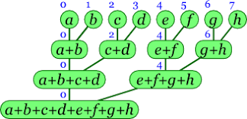
Parallelism approach
Two methods exist in literature
Pipeline and data parallelism
Pipeline is the MIMD approach
Data is the SIMD approach
A lot of papers focus on GPU based speedup using CUDA
Splitting up image into chunks
The way that the image is split is what a lot of papers differentiate
Some use randomized splitting leading to an amortized time benefit
We build off of their work

Slide 9

Research Question

Slide 10

How do we improve the Sobel algorithm using parallelism?
What are the different ways we can do this and what is the comparison between approaches?

Slide 11
Methodology

Slide 12


Base Image

Slide 13

MISD parallel approach
Split the two filters
Apply Gx and Gy kernels separately in different processes on the same piece of data
Combine the two results at the end
Speedup here maximum factor of 2
Max two processes working at once

Slide 14
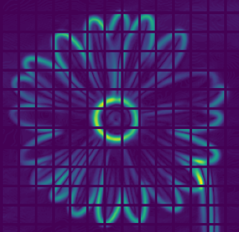
SIMD Approach
Apply parallel logic
Break the image into chunks equal to cores
Apply convolution to each of the chunks in parallel
Combine the chunks later in serial
The speedup here is based on the amount of cores
CPU vs GPU, adding cores will allow us to be faster up to the limit of CORES=PIXELS

Slide 15
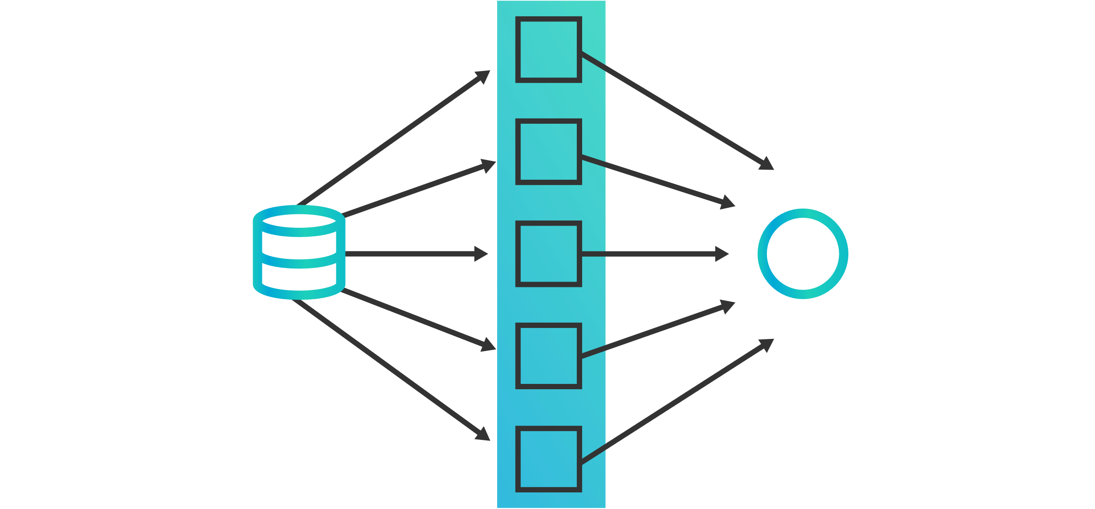
MIMD approach
A combination of previous approaches
We utilize the processors to start two functions that then work on their sections of the image, applying the Gx and Gy kernels
We have multiple instruction running in parallel on multiple data streams

Slide 16

Results

Slide 17
Speed Comparison
MISD parallelism statistically the slowest way of approaching the problem
Even with more cores, we are unable to fully utilise a MISD approach to make the most of parallelism
Only two kernels to split up
MIMD is effective
Approach of splitting kernel application, as well as splitting processors
SIMD is the statistically the most effective
Splitting up the image and applying a processor to each of the chunks

Slide 18
Quality of image comparison
Parallel output was compared against original serial output
Found no difference in quality of image
This is expected

Slide 19

Discussion

Slide 20
Comparing ease of implementation
MISD
Most basic implementation
Really easy to figure out the parallelism because we are ultimately creating only two processes
SIMD
A bit more difficult in that splitting and reassembling image requires some planning
Lends itself very well to image processing
MIMD
Harder to implement due to the multiple instruction on multiple data
Requires more planning and pipeline work

Slide 21
On timing differences
Edge detection naturally lends itself to a SIMD approach
We split image into chunks
Carry out convolution
Combine convoluted chunks and reassemble output

Slide 22
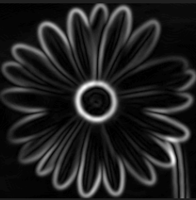
Quality of result
No visible difference in between results
Since we aren’t using any randomization based algorithms in our parallel approach or a form of guessing this makes sense

Slide 23

Conclusion
Our results have demonstrated that SIMD approach is the most effective approach at parallelizing edge detection algorithms

Slide 24
Relation to previous work
Other research supports our claim of SIMD approach being quickest
This is argued to potentially be not because of the taxonomical split up,
Difficult to produce a proper MIMD algorithm
Only a few papers have explored MIMD and all have found less speedup than SIMD approach

Slide 25

Future Research
It would be interesting to see alternative approaches to MIMD edge detection
For example, drawing on previous literature and using guessing based MIMD
It would be interesting to explore if this is the case with all edge detection algorithms

Slide 26
Parallelizing Sobel edge detection
Michael Shlega
Carleton University, Ottawa, Ontario
michael.shlega@cmail.Carleton.ca

Slide 27

Questions
What algorithm did we parallelize?
What was the fastest taxonomical approach?
What was taxonomy of the approach that applied the two kernels separately with no image split-up?

