Slide 1
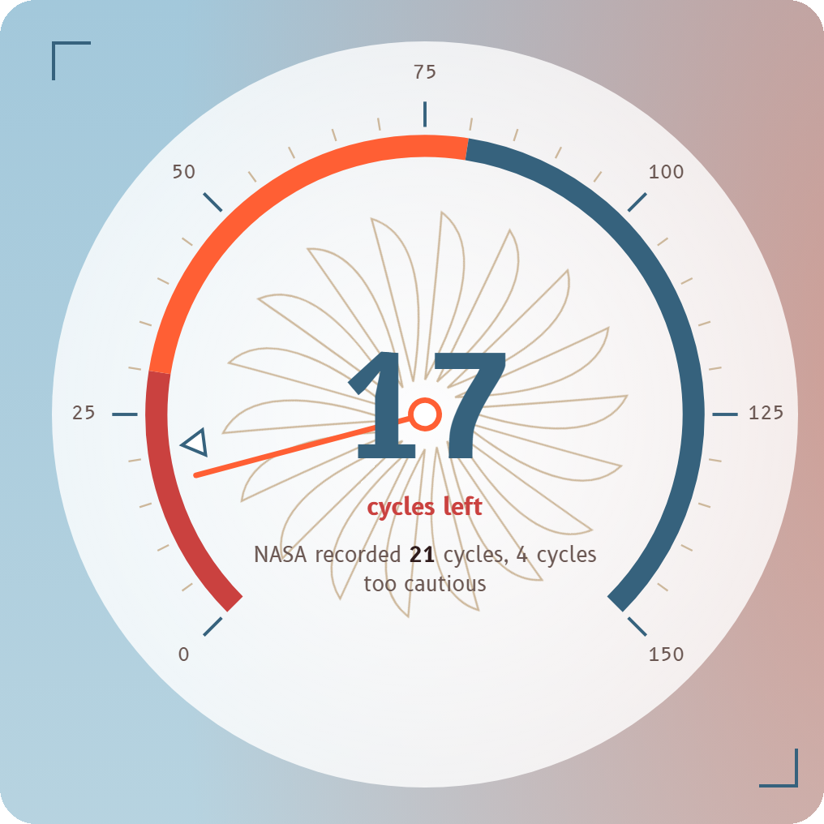
How many cycles does this engine have left?
Predicting the remaining useful life of aircraft engines with machine learning
Regression project
NASA C-MAPSS FD001, presented by Zainab Alshingiti and team
Our web app: 17 cycles estimated, NASA recorded 21
Notes:
Open with the question. Our project predicts the remaining useful life (RUL) of an aircraft engine from its sensors. The gauge is our own web app, which we demo near the end. The deck follows the three parts of the project: data and exploration, models and evaluation, and the apps with documentation.

Slide 2
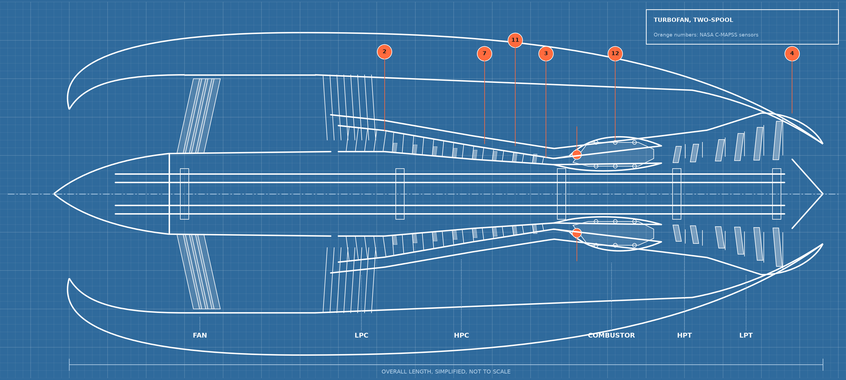
Part 1: data and exploration
Engines fail, and sensor data can warn us first
Remaining useful life (RUL) is the number of operating cycles an engine can still run before it fails. It is the number our regression models predict.
100
20,631
18
training engines
sensor readings
model inputs
Where the data comes from
NASA C-MAPSS FD001: simulated turbofans run until failure
Each row: cycle, 3 operating settings, 21 sensors
7 columns never change, so 18 inputs remain
Orange numbers on the drawing are the NASA sensors
Notes:
Define RUL once and clearly. The data is NASA C-MAPSS FD001: 100 simulated turbofan engines run to failure, 20,631 rows. The blueprint shows where six of the most informative sensors sit on the engine. This is the first part of the project.

Slide 3
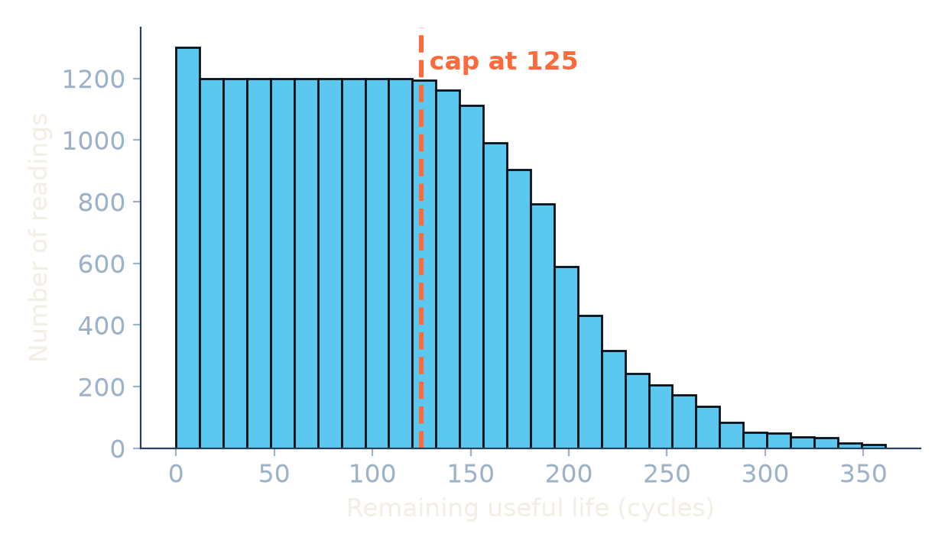
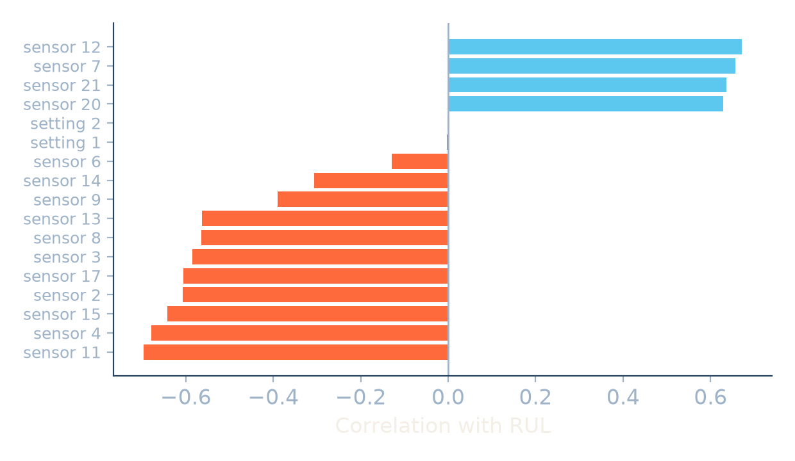
Part 1: data and exploration
Exploring the data: what we found
Clean data
Skewed target
Sensors tell the story
No missing values or duplicates. 7 of 24 setting and sensor columns never change, so we drop them.
RUL runs from 0 to 361 cycles, mean 108. Engines live 128 to 362 cycles (median 199).
Sensors correlate with RUL by 0.56 to 0.70 in size. The operating settings do not.
Notes:
Three findings. The data is clean. RUL is mildly skewed. The sensors correlate with RUL in both directions, orange bars go down and cyan bars go up, and the operating settings carry almost nothing.

Slide 4
Part 1: data and exploration
The key insight: sensors only drift in the last 125 cycles
The evidence
Change per 10 cycles: 0.05 when RUL is 130 or more, 0.22 when it is 120 or less
39% of training rows sit in the flat zone
The decision
Train on min(RUL, 125).
Always evaluate against the real RUL of the NASA test engines.
A prediction of 125 means at least 125 cycles left.
Notes:
The most important slide of Part 1. Early in an engine's life nothing visibly wears out, so the sensors cannot tell 300 cycles left from 200. We cap the training target at 125, a standard choice for this data set, and always score against the real RUL.

Slide 5
Part 1: data and exploration
Preprocessing: every decision has a reason
What we found | What we did | Why
No missing values, no duplicates | No imputation, no removal | Nothing to fix
7 constant columns | Dropped them | They carry no information about wear
Statistical outliers | Kept them | They come from real end-of-life degradation
All columns numeric | No encoding | Nothing to encode
Features on different scales | StandardScaler inside the pipelines | Fitted on training data only, so no leakage
Rows of one engine depend on each other | Split and validate by engine (GroupKFold) | Random row splits would leak
Output: Data/Cleaned/train_FD001_cleaned.csv with 20 columns. The original files are never edited, and the real RUL stays in the file.
Notes:
Each row is a finding, a decision and a reason. We keep outliers because they are the most degraded readings, and we scale inside the pipeline because scaling the whole file would leak validation statistics into training.

Slide 6
Part 2: models and evaluation
Five models, compared without leakage
Linear Regression
Ridge
Lasso
Random Forest
Gradient Boosting
Scaler + linear fit. The simple baseline.
Linear with shrinkage. Tuned alpha = 100.
Linear that can zero out inputs. Alpha 0.01; none were zeroed.
200 trees, leaf size 10, no depth limit.
200 trees, learning rate 0.1, depth 3.
1
Split by engine
2
Tune
3
Fit
4
Test once
GroupKFold, 5 folds, seed 42 for the hold-out
GridSearchCV by validation RMSE on 4 models
Final models on all 100 training engines
The last cycle of 100 NASA test engines
The scaler is part of each pipeline, so it is fitted on training data only and is saved with the model
Cross-validation: Gradient Boosting RMSE 16.6, Random Forest 16.8, the three linear models 20.1 (capped target)
Notes:
Five models: a baseline, two regularised linear models (Lasso comes from a teammate's own notebook) and two tree ensembles. All splits are by engine. We tuned four models with a grid search and chose by validation RMSE. The test set was used once, at the end.

Slide 7
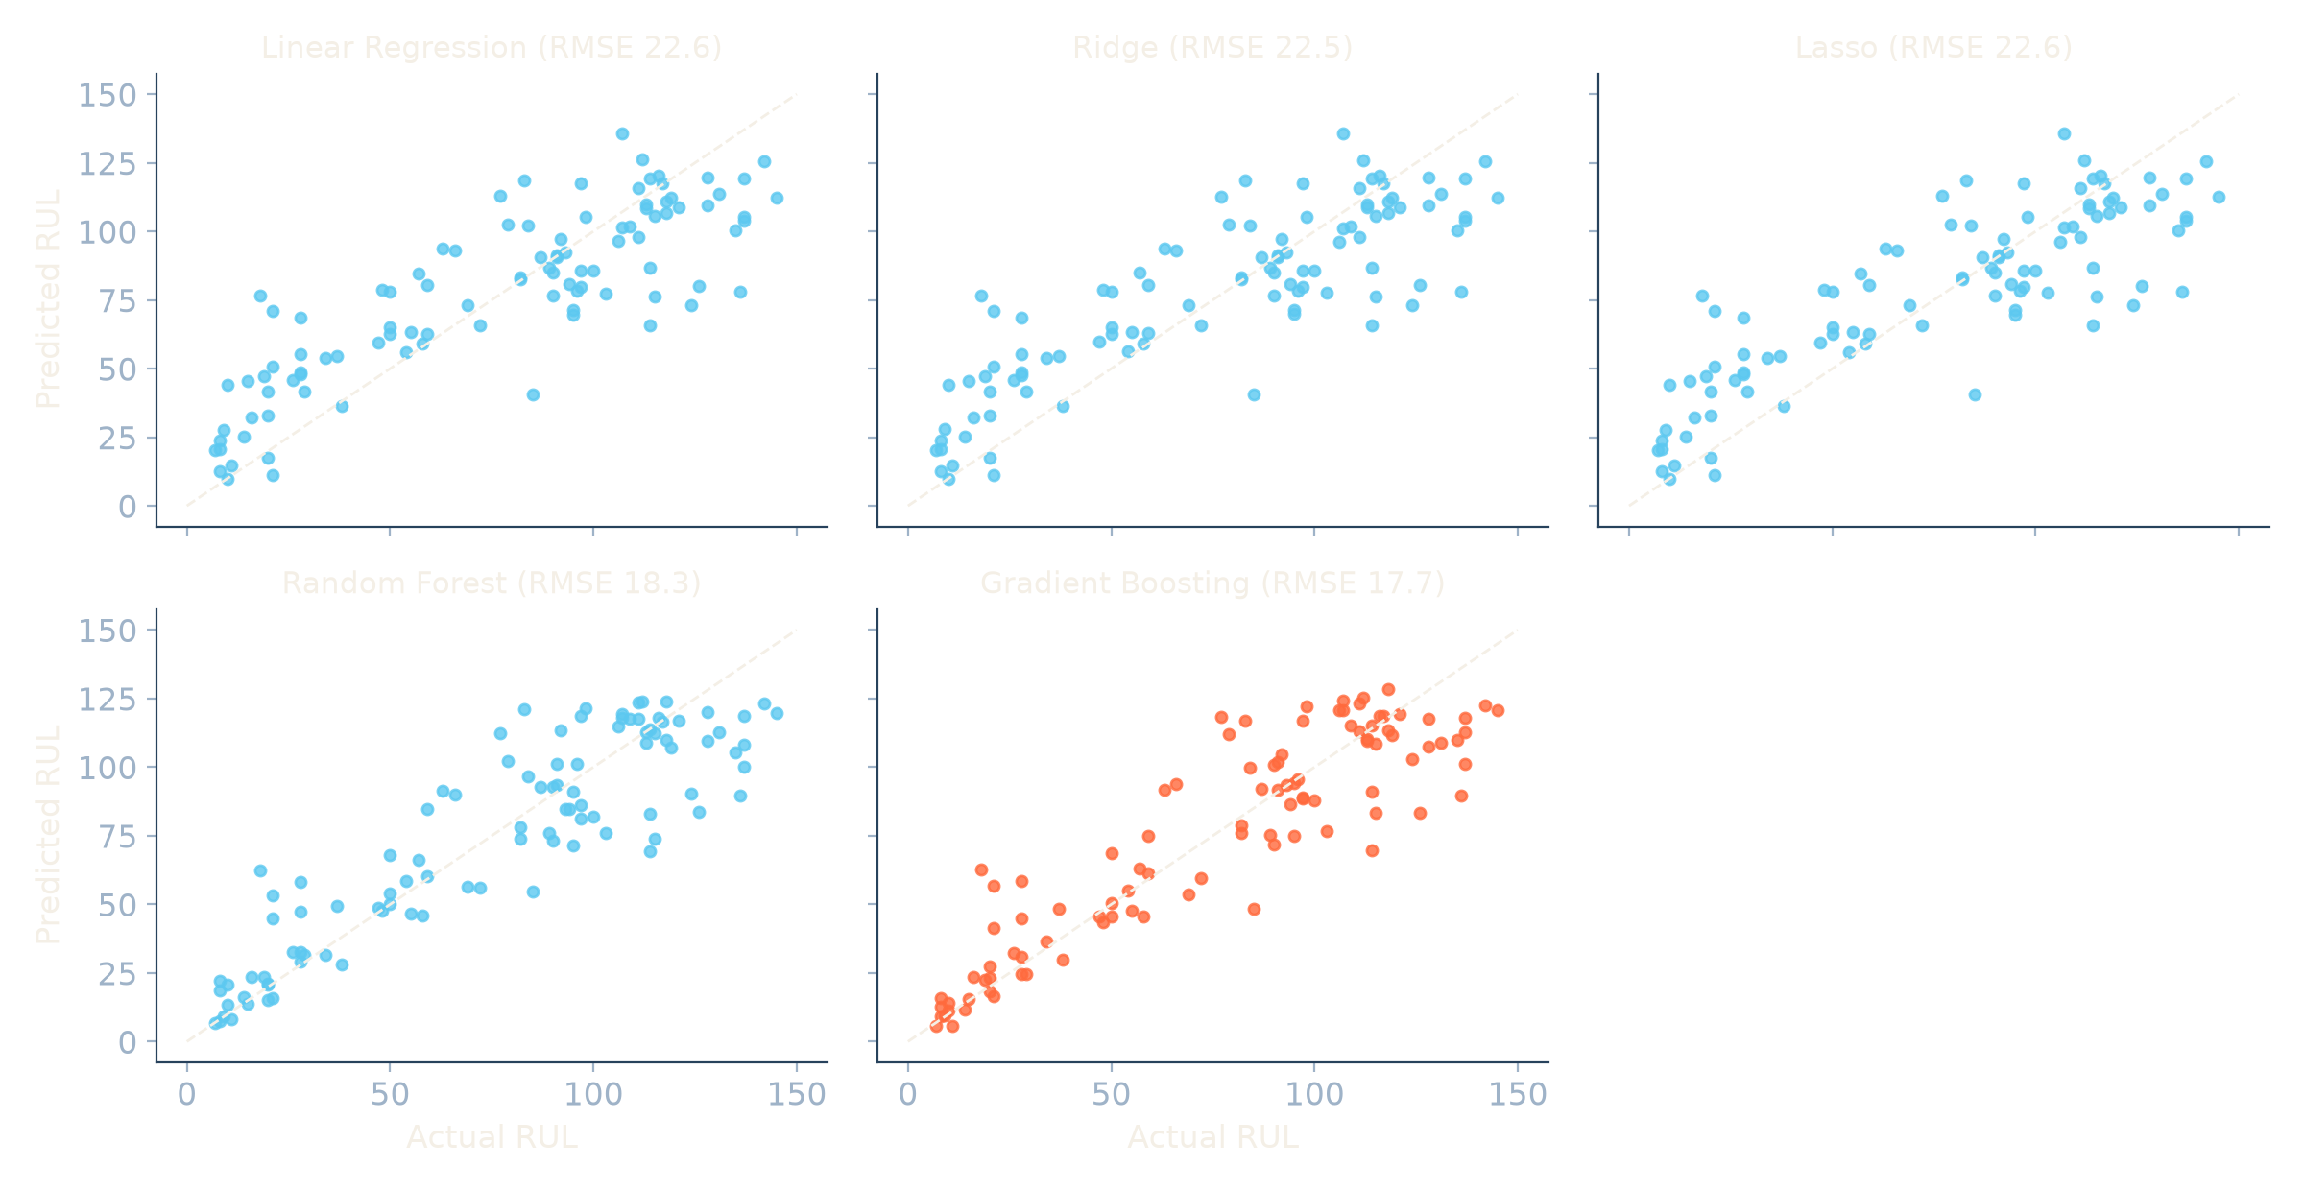
Part 2: models and evaluation
Every model against the real RUL
How to read it
The dashed line is a perfect prediction
Linear, Ridge and Lasso look almost identical: a straight line that is too high near failure and too low for long-lived engines
Trees hug the diagonal: near failure only about 7 to 8 cycles too high
Lasso zeroed none of the 18 inputs, so every input helps
Takeaway: the straight-line models are limited by their shape, not by tuning. The tree models follow how the sensors really change.
Notes:
One panel per model, an idea from our Part 2 teammate's own notebook. The three linear models give almost the same picture. The tree models follow the diagonal more closely. Gradient Boosting is in orange.

Slide 8
Part 2: models and evaluation
Results: Gradient Boosting is the most accurate
Model | MAE | RMSE | R²
Gradient Boosting | 13.05 | 17.72 | 0.818
Random Forest | 13.71 | 18.30 | 0.806
Ridge | 17.78 | 22.54 | 0.706
Linear Regression | 17.79 | 22.55 | 0.705
Lasso | 17.79 | 22.56 | 0.705
NASA test set, 100 engines. MAE and RMSE are in cycles.
Selected model: Gradient Boosting
Off by 13.0 cycles on average on engines it never saw. A bootstrap over the 100 test engines gives about 10.7 to 15.4.
Notes:
Gradient Boosting wins on all three metrics and cross-validation agrees. Random Forest is close, and the bootstrap interval says the gap between the two tree models is within the noise. Both tree models are about 21 percent better in RMSE than the linear models, which are nearly identical. R squared is 0.82.

Slide 9
Part 2: models and evaluation
Why we trust it, and where it fails
Big gain
Leans late near failure
Saturates at 125
The cap cuts Gradient Boosting RMSE from 25.6 to 17.7 and NASA's PHM08 score from 5,725 to 575.
18 of 25 engines within 30 cycles of failure are overestimated, by 7 cycles on average.
Predictions top out near 125, so engines with more life left are underestimated.
Notes:
Left: the same tuned pipelines trained on the real RUL versus the capped RUL, both scored against the real RUL of the test engines, so the gain is not an artefact. The PHM08 score is NASA's asymmetric metric where late predictions cost more. Right: actual vs predicted. Be honest about the limits: it leans late near failure and cannot say more than about 125.

Slide 10
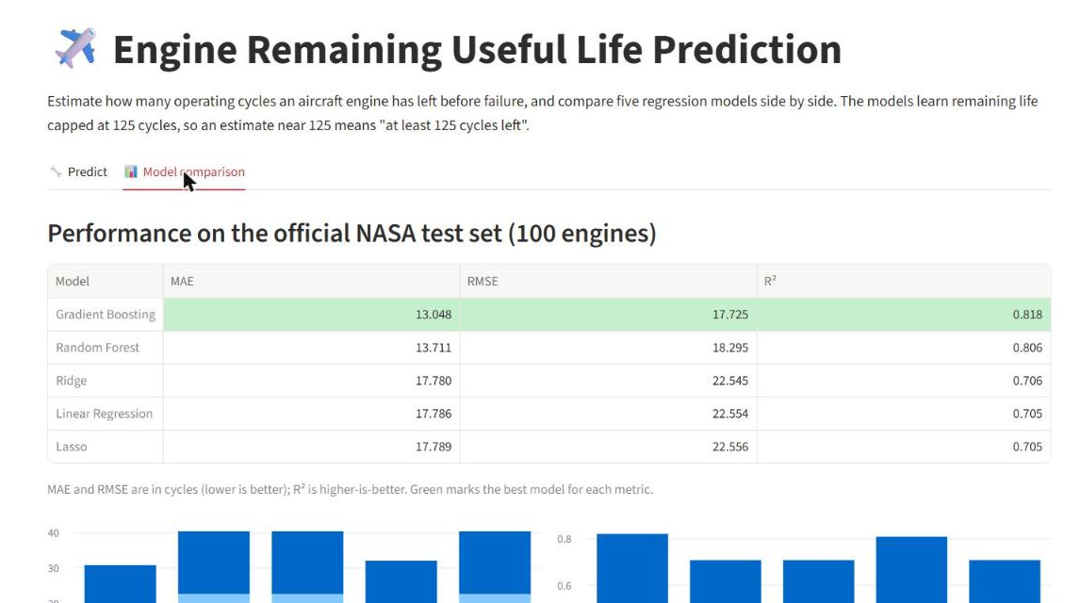
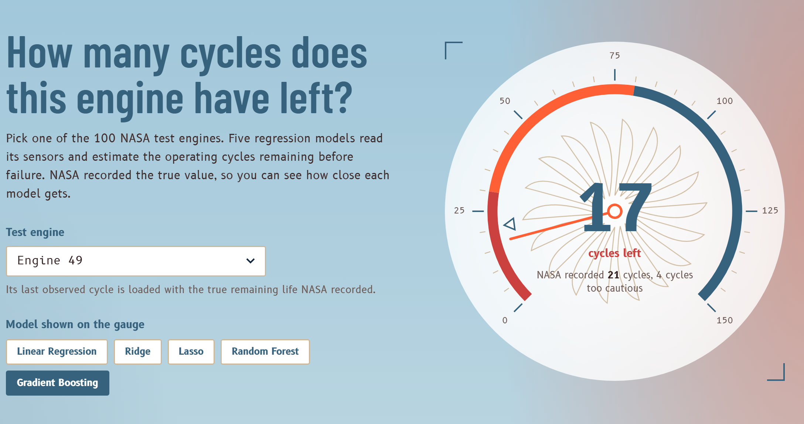
Part 3: apps and documentation
Live demo: the Streamlit app and the web app
Streamlit python -m streamlit run main.py
Required by the brief: choose a model, enter values, compare all five
Web app python -m uvicorn webapp.server:app
Our FastAPI bonus: gauge, engine blueprint, charts, warnings
Pick engine 49: the gauge reads 17 cycles, NASA recorded 21. Switch between the five models.
Edit a sensor reading: the app warns when it leaves the range seen in training.
Notes:
Run the demo live. Start with the Streamlit app, which the brief requires: choose a model, edit the inputs, press predict and compare. Then show the web app: engine 49, switch models, edit a sensor value to show the out-of-range warning. Keep a screenshot as backup.

Slide 11
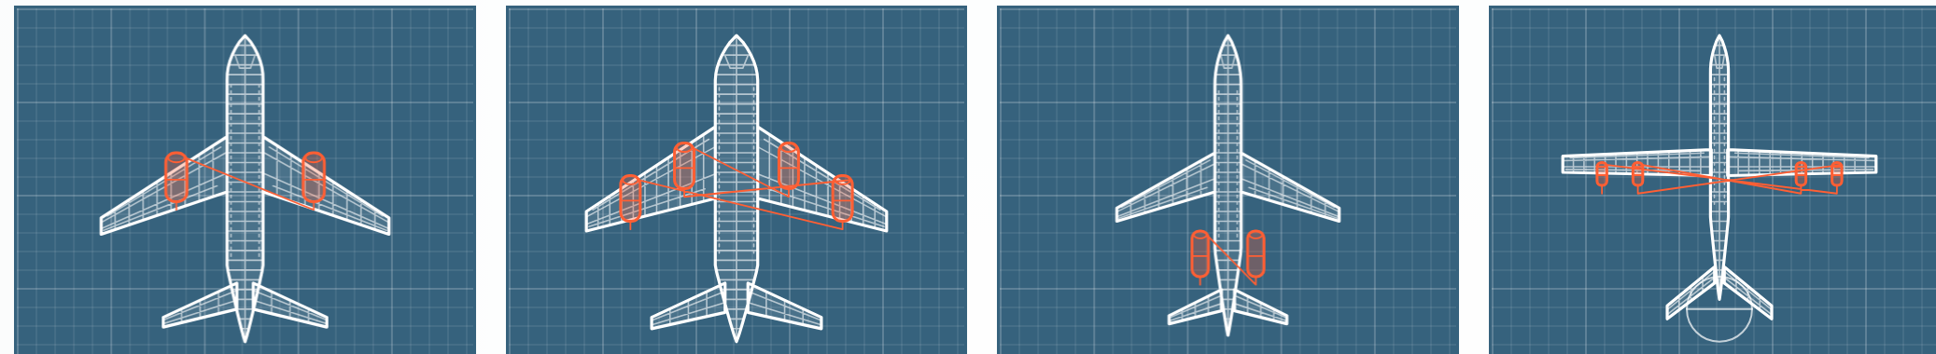
Part 3: apps and documentation
A project anyone can clone and run
Repository structure
Reproducible from a fresh clone
Data/Original, Data/Cleaned
Notebooks/01_EDA_and_Preprocessing
Notebooks/02_Modeling_and_Evaluation
Helper/helper.py
Models/ five saved pipelines
main.py (Streamlit)
webapp/ (FastAPI)
tests/ (20 automated checks)
README.md, requirements.txt
Pinned requirements, Python 3.14
Both notebooks run top to bottom without errors
Relative paths only, fixed random seed 42
Tests check the data, the saved models, the README table and every API endpoint
README: setup for Windows, macOS and Linux, results and limits
Same idea for every engine in a fleet, with its own data and models.
Notes:
The brief asks for a repository anyone can clone and run. We tested exactly that from a fresh clone: install, both notebooks, the tests and both apps. The blueprints at the bottom are the aircraft types an engine health model could serve.

Slide 12
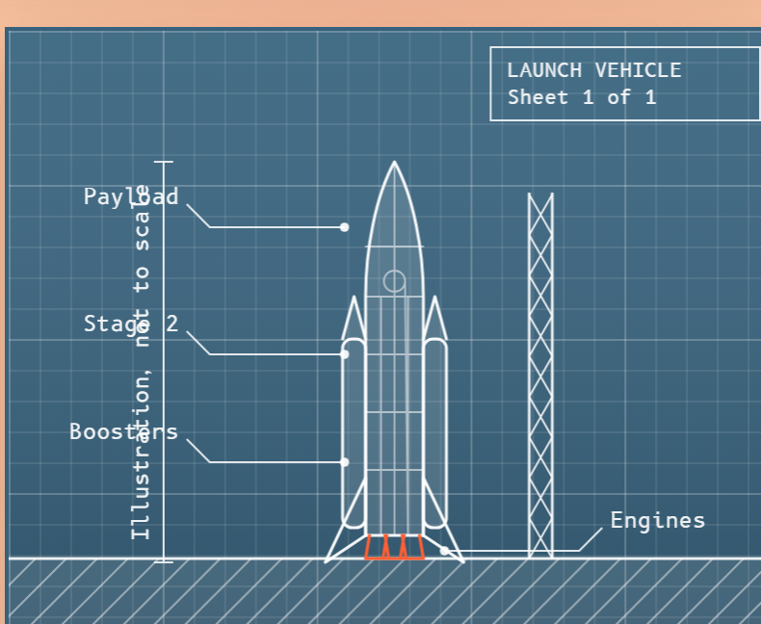
Conclusions, limits and next steps
What we achieved
Limits
Next steps
Gradient Boosting: MAE 13.0, RMSE 17.7, R² 0.82 on unseen engines
The 125 cap was the biggest gain
Leakage-safe pipelines, saved with their scaler
20 automated tests, two working apps
Estimates saturate near 125 cycles
Leans late close to failure
One row per prediction, no history
FD001 only, simulated data
Add each engine's recent history (cut RMSE by about 1 cycle in a quick test)
Give an uncertainty range, not one number
Penalise late predictions more
Try FD002 to FD004 and sequence models
Every engine wears out.
We estimated how long this one lasts. Thank you, we are ready for your questions.
Notes:
Close with what works, what does not, and what we would do next. Be upfront about the limits. The quick test with recent history gave roughly one cycle of RMSE improvement on top of the cap, which is why it is the first next step. Every team member should be ready to answer on any part.

