Slide 1
A survey on the latest technologies of web
Sekiya Lab
M1 Shogo Fujii

Slide 2
Outline
Introduction
Process of developing web
The previous problem of web
Solution
Related research
Conclusion

Slide 3
Process of developing web
Web1.0

Slide 4
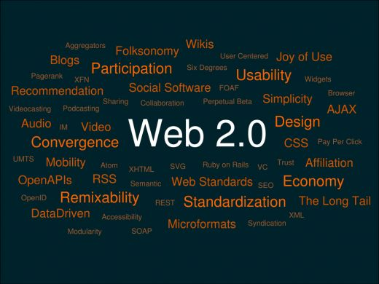
The previous problem of web
Web2.0

Slide 5
Solution
Web Technologies of data center
web socket←XMLHttpRequest

Slide 6
Related research

Slide 7
Conclusion

