Slide 1
Paper 1
Title : Design, implementation and evaluation of congestion control for multipath TCP.
Wischik, Damon, et al : University College London
Proceedings of the 8th USENIX conference on Networked systems design and implementation.
USENIX Association, 2011.

Slide 2
Introduction
Motivation :
Multipath TCP has benefits for reliability
More efficient use of networked resources
Methodology :
Designing multipath congestion control
Improving throughput and fairness

Slide 3
Window-based congestion control
Algorithm : Regular TCP
Each ACK, increase the congestion window w by 1/w , resulting in an increase of one packet per RTT
Each loss, decrease w by w/2
Timeout …
In Multipath TCP

Slide 4

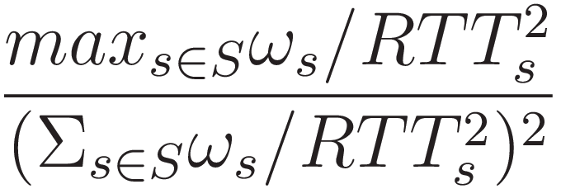

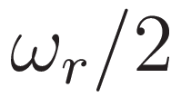
Window-based congestion control
A connection consists of set of subflows R
Algorithm : MPTCP :
Each ACK on subflow r, for each subnet S R that includes path r, compute
Increase the window by that much
Each loss on subflow r, decrease the window by

Slide 5
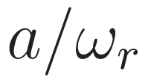
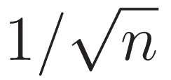
Fairness at shared bottlenecks
If multipath TCP ran regular TCP congestion control on both paths, the multipath flow would obtain doubled throughput. (unfair)
Algorithm : EWTCP(weighting approach)
For each ACK on path r, increase window by
For each loss on path r, decrease window by
a = , where n : number of path (RTTs is equal)

Slide 6

Choosing efficient paths
EWTCP is fair, but not efficient
12Mb/s
12Mb/s
12Mb/s
Each flow obtain just 8Mb/s

Slide 7
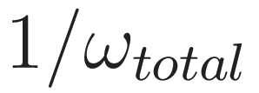
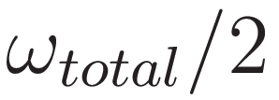
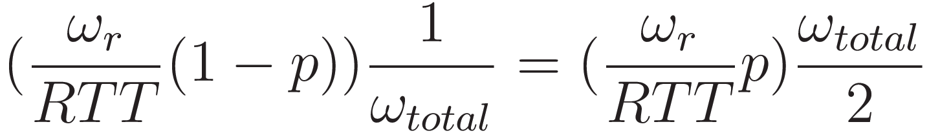
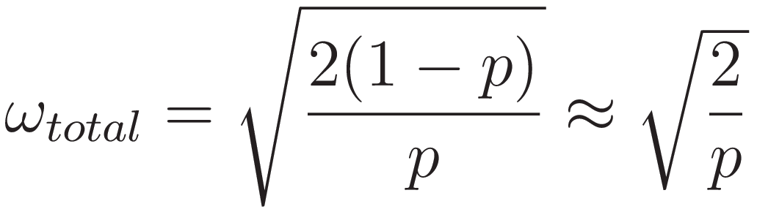
Choosing efficient paths
Algorithm : COUPLED
For each ACK on path r, increase window by
For each loss on path r, decrease window by
Approximate throughput formula(the same loss rate of all paths)

Slide 8
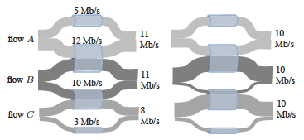
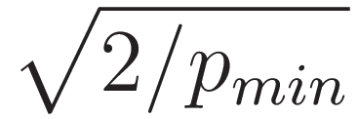
Choosing efficient paths
Only use a path if that path has lowest drop probability
Total throughput is estimated by

Slide 9
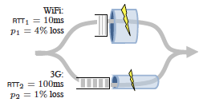
Problems with RTT mismatch
Both EWTCP and COUPLED have problems when the RTTs are unequal
Wifi : 707pkt/s, 3G : 141pkt/s
EWTCP
(707+141)/2=424 pkt/s
COUPLED
141pkt/s

Slide 10

Semicoupled
Suppose that one of the flows on the top link terminate
Moving all traffic onto the top link
Not using the bottom link, so no ACKs
Unable to increase the window size on the bottom subflow

Slide 11
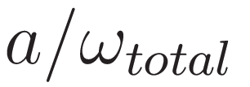
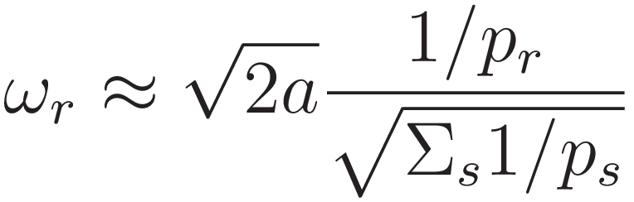
Semicoupled
Algorithm : SEMICOUPLED
For each ACK on path r , increase window by
For each loss on path r , decrease window by
a : control the aggressiveness, to achieve fairness tuning the a parameter

Slide 12
Requirement for multipath congestion control
A multipath flow should give a connection at least as much throughput as it would get with single-path TCP on the best of its paths.
A multipath flow should take no more capacity on any path or collection of paths than if it was a single-path TCP flow using the best of those paths.

Slide 13
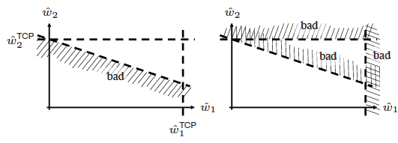
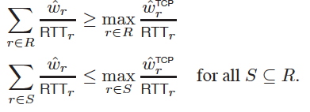
Requirement for multipath congestion control
1.
2.

Slide 14
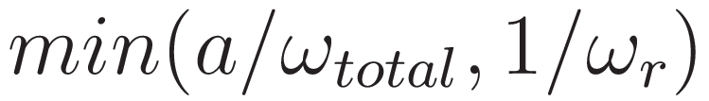
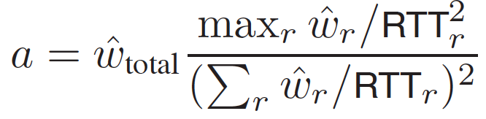

Final MPTCP algorithm
Algorithm :
Each ACK on subflow r, increase the windows by
Each loss on subflow r , decrease the window by
: current window
: equilibrium window

Slide 15
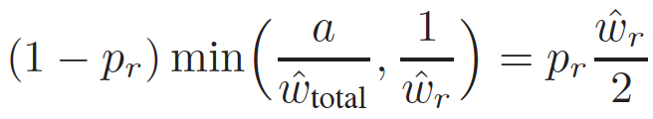

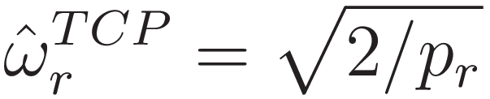
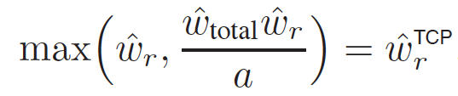
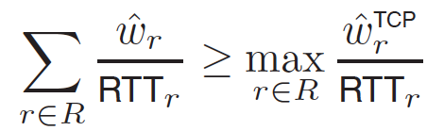
Final MPTCP algorithm
Calculate a from balance equation

Slide 16
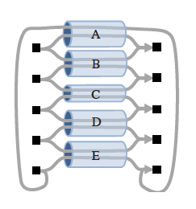
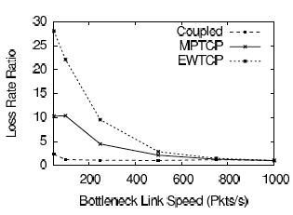
Multihomed server

Slide 17
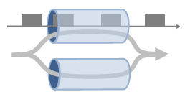
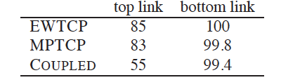
Multihomed server
a

Slide 18
Data centers
TP1
a random permutation where each host opens a flow to a single destination chosen uniformly at random
TP2
each host opens 12 flows to 12 destinations
TP3
a sparse traffic : pattern: 30% of the hosts open one flow to a single destination chosen uniformly at random

Slide 19
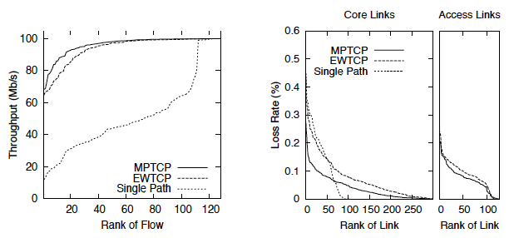
Data centers
FatTree

