Slide 1
Paper 1
Title : Design, implementation and evaluation of congestion control for multipath TCP.
Wischik, Damon, et al : University College London
Proceedings of the 8th USENIX conference on Networked systems design and implementation.
USENIX Association, 2011.

Slide 2
Introduction
Motivation :
Multipath TCP has benefits for reliability
More efficient use of networked resources
Methodology :
Designing multipath congestion control
Improving throughput and fairness

Slide 3
Proposed protocol

Slide 4
Window-based congestion control
Algorithm : Regular TCP
Each ACK, increase the congestion window w by 1/w , resulting in an increase of one packet per RTT
Each loss, decrease w by w/2
Timeout …
In Multipath TCP

Slide 5

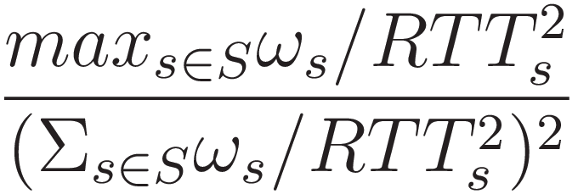

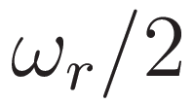
Window-based congestion control
A connection consists of set of subflows R
Algorithm : MPTCP :
Each ACK on subflow r, for each subnet S R that includes path r, compute
Increase the window by that much
Each loss on subflow r, decrease the window by

Slide 6
Requirement for multipath congestion control
A multipath flow should give a connection at least as much throughput as it would get with single-path TCP on the best of its paths.
A multipath flow should take no more capacity on any path or collection of paths than if it was a single-path TCP flow using the best of those paths.

Slide 7
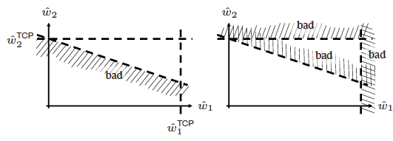
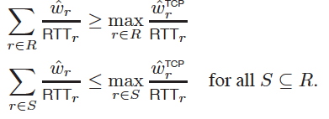
Requirement for multipath congestion control
1.
2.

Slide 8
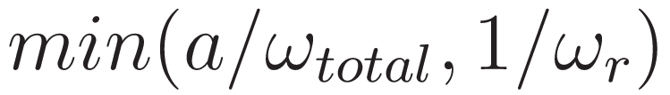
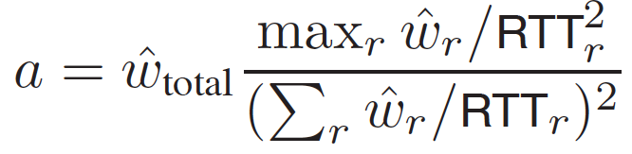

Final MPTCP algorithm
Algorithm :
Each ACK on subflow r, increase the windows by
Each loss on subflow r , decrease the window by
: current window
: equilibrium window

Slide 9
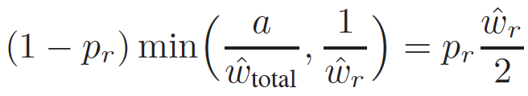

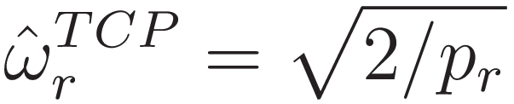
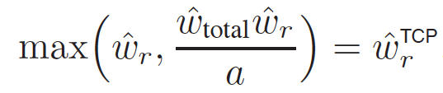
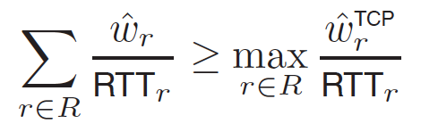
Final MPTCP algorithm
Calculate a from balance equation

Slide 10
Efficient routing in data centers

Slide 11
Efficient routing in data centers
Assumption
Traffic between machines is huger than to the Internet
Denser interconnects of proposals, such as FatTree and Bcube
Experiment with simulation
FatTree : 128 single-interface hosts and 80 eight-port switches (choosing 8 paths)
Bcube : 125 three-interfaces hosts and 25 five-port switches (choosing 3edge-disjoint paths)
All links : 100Mb/s
Multipath TCP is beneficial when the network core is the bottleneck

Slide 12
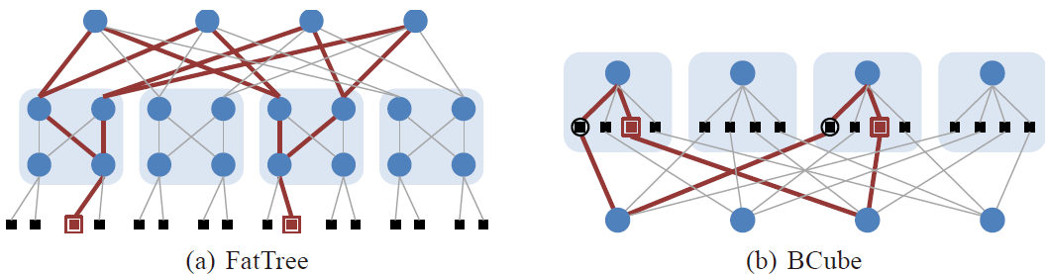
Experiment with simulation
Three traffic patterns
Random permutation where each host opens a flow to a single destination
Each host opens 12 flows to 12 destinations
Sparse traffic : 30% of the hosts open one flow to a single destination

Slide 13
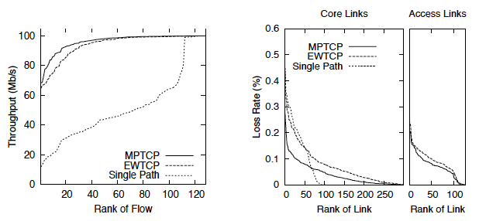
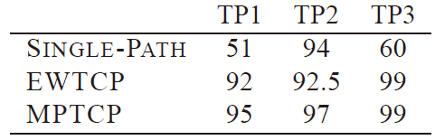
FatTree simulations
Result
Per-host throughputs obtained
in FatTree in Mb/s
Distribution of throughput and loss rate,
in 128-node FatTree for TP1
EWTCP and MPTCP get close to full utilization of 100Mb/s NIC
MPTCP does a better job of allocating throughput fairly than EWTCP
Fairness matters for many datacenter distributed computations that farm processing out to many nodes and are limited by the response time of the slowest node
MPTCP does a better job of balancing congestion

Slide 14
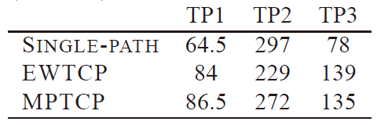
BCube simulation
Result
Multipath algorithms allow a host to use all three of its interfaces whereas single-path TCP can use only one, is clearest in TP3
some paths will be more congested than others
EWTCP does not shift its traffic away from congestion
MPTCP does not move all its traffic away from the most congested path
When the least-congested paths happen to all be shortest-hop paths, shortest-hop single-path TCP will do better(in TP2)

Slide 15
In summary
MPTCP performs well across a wide range of traffic patterns
In some cases EWTCP achieves throughput as good as MPTCP, and in other cases it falls short
Even when its average throughput is as good as MPTCP it is less fair

Slide 16
Protocol implementation

Slide 17
Protocol implementation
There are many tricky issues regarding middleboxes which further constrain the design
Subflow establishment
Loss Detection and StreamReassembly
Flow Control
Encoding

Slide 18
Subflow establishment
Implementation of MPTCP requires both client and server to have multipath extensions
A TCP option in the SYN packets of the first subflow is used to negotiate the use of multipath
Relying on multiple interfaces or multiple IP addresses to obtain different paths
we have not yet studied the question of when additional paths should be started

Slide 19
Loss Detection and Stream Reassembly
Goal
With MPTCP, loss and reassembly are subflow issues
Solution
The sequence numbers and cumulative ack in the TCP header are per-subflow, allowing efficient loss detection and fast retransmission
As the result
Then to permit reliable stream reassembly, an additional data sequence number is added stating where in the application data stream the payload should be placed

Slide 20
Flow control
Multipath TCP needs to implement flow control, although packets now arrive over multiple subflows
separate buffer pools are maintained at the receiver for each subflow, and their occupancy is signalled relative to the subflow sequence space using the receive window field
a single buffer pool is maintained at the receiver, and its occupancy is signalled relative to the data sequence space using the receive window field

Slide 21
Flow control
Consider 2 scenarios
Suppose subflow 1 stalls due to an outage, but subflow 2’s receive buffer fills up
RTTs differ so as to cause the acks to arrive in a different order from that in which they were sent

Slide 22
Scenario 1
Suppose subflow 1 stalls due to an outage, but subflow 2’s receive buffer fills up
The packets received from subflow 2 cannot be passed to the application because a packet from subflow 1 is still missing
However, there is no space in subflow 2’s receive window to resend the packet from subflow 1 that is missing
Solution : using a single shared buffer
all subflows report the receive window relative to the last consecutively received data in the data sequence space

Slide 23
Scenario 2
different order of acks
There are 2 paths, and 2 acks, for 10 and 20
Because the RTT on path 2 is shorter than that on path , unfortunately the ack for 20 arrives faster
The sender can send packet 3 and must drop it
Solution
we add an explicit data acknowledgment field in addition to the subflow acknowledgment field in the TCP header

Slide 24
Encoding
Two methods to encode data sequence numbers and data acknowledgments in TCP packets
Carry them in TCP options
embed them in the payload using an SSL-like chunking mechanism

Slide 25
Encoding
Scenario : deadlock cycle
There are host A and B, A’s buffer is full B’s empty respectively. Assumption ; A wish to send data to B(i.e. – pipeline request)
However, flow control imposed by A’s receive window stop.
Because no data acks are received from B, A cannot free its send buffer.
The send buffer can only empty when A receives an data ack from B, but B cannot send a data ack until A’s application reads.
Solution
using TCP options to avoid this and similar issues

Slide 26
Related work
Network layer multipath
Multipath TCP can use ECMP to get different paths through the network without having multihomed endpoints
Application layer multipath
BitTorrent
Different chunks of the same file are downloaded from different peers to increase throughput

Slide 27
Conclusion
MPTCP performs well across a wide range of traffic patterns
It should be beneficial to the operation of the Internet, since it selects efficient paths and balances congestion

Slide 28
Future work
Microsoft incorporate Compound TCP in Vista and Windows 7
Recent Linux kernels use Cubic TCP
Compound TCP kicks in when a link is underutilized to rapidly fill the pipe, but it falls back to NewReno-like behavior once a queue starts to build

