Slide 1
Paper
Title : Longer is better: exploiting path diversity in data center networks.
Tso, Fung Po, et al. : University of Glasgow
IEEE 33rd International Conference on Distributed Computing Systems.
2013.

Slide 2
Introduction
Motivation :
DC network is much more centralized characteristics than the legacy Internet
Multipath protocols, node-local and heuristic information
Methodology :
Schedule flow over both shortest and non-shortest paths
To mitigate the performance degradation of heavily utilized links

Slide 3
Proposed method

Slide 4
Proposed method
Baatdaat : a flow scheduler to reduce congestion and increase the usable capacity of DC topologies
Requirements
A hardware-assisted traffic monitor that measures link utilization on the switches at line-speed
without impacting their forwarding performance
A SDN-based adaptive flow scheduling system that enforces network-wide traffic engineering based on link-local metrics
by spreading load over shortest and detour paths, at the same time reducing flow completion time.
For short-term traffic

Slide 5
System design & Architecture

Slide 6
Design requirements
Each switch should be able to monitor link utilization at line rate
NetFPGA’s OpenFlow implementation with stable line-rate throughput
Flows should be allowed to opportunistically take detours
so long as it doesn’t impact individual flow performance.
flow scheduling should easily scale to the size of a DC network
In order not to turn the controller into the bottleneck, the controller only determines detour paths, basically ECMP

Slide 7
System architecture
Using multiple controllers
Multiple controllers can work independently requiring no synchronization
Each controller can interact with switches within a pod and compute pod-local paths

Slide 8
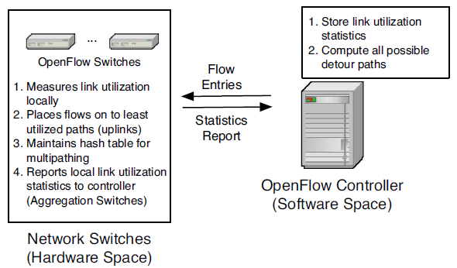
System architecture

Slide 9
Benefits of Hardware Implementation
Three platforms
NetFPGA hardware
the Open vSwitch kernel module
the Stanford reference user-space OpenFlow implementation
Comparison the benefit of offloading work
between software and hardware implementation
Polling interval is 1ms

Slide 10
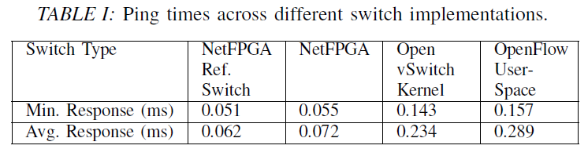
Benefits of Hardware Implementation
Experiment:
testbed setup was two end-host systems connected via a switch
AMD Athlon 64 X2 5600+ systems, 3.5GB RAM and a 82571EB Gigabit Ethernet NIC installed
NetFPGA box, AMD Phenom II X4 965 with 3.5GB RAM, a 4x1G NetFPGA, card, and a 2x1GB Intel 82571EB Gigabit Ethernet NIC
Intel NIC was used to test the kernel and user-space implementation
10,000
back-to-back pings

Slide 11
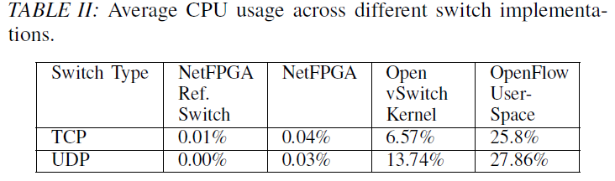
Benefits of Hardware Implementation
Experiment : CPU utilization
throughput tests using Iperf with TCP and a variety of UDP datagram sizes for 60 seconds
UDP : 956Mb/s
TCP : 940Mb/s
The same throughput rates as the reference NIC
Not impact the line-rate forwarding capabilities
lower ping times, and lower CPU utilization
NetFPGA Ref. Switch does not support multipathing

Slide 12
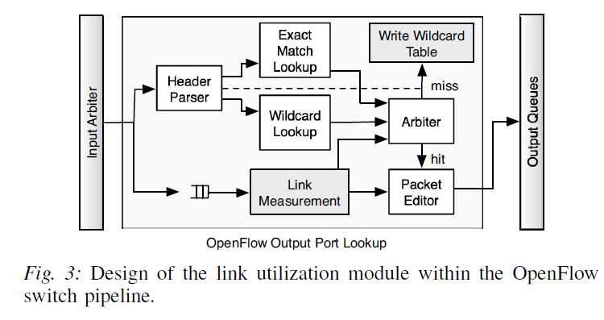
Measurement module design
OpenFlow v1.1 has added support for ECMP
However the reference, hardware implementation is not yet available
Baatdaat ensures that all packets belonging to the same flow due to TCP ‘s out-of-order packet

Slide 13
Baatdaat SCHEDULING

Slide 14
Baatdaat scheduling
Baatdaat is a flow-based scheduler
when all links have 0% utilization, the flow is randomly scheduled using commodity ECMP
Measurement loop to run every 1 ms with an aim to capture instantaneous traffic bursts
Aggregation switches
need to report statistics to the controller
The report frequency is set to 100 ms

Slide 15
Baatdaat scheduling
Two constraints
the flow is downlink traffic of the aggregation switches
detours only happen between the aggregation and the Top-of-Rack
cross-aggregation-switch traffic is more common than cross-core-switch
the flow can only take a detour of 2 hops longer than the shortest path
to prevent oscillation and flooding-like effects in the network

Slide 16
Baatdaat scheduling
A link utilization matrix M, is a m×n matrix
m : the number of aggregation switches in a pod
n : the number of downlink ports on an aggregation switch
path diversity in the fat tree network(2 hops)
k/2 × (k/2-1)×(k/2-1-2)
Shortest path : k/2
The path utilization of detour paths
max(detour links) ×c
c : a weighting factor to reflect the fact that it is a longer path(c=1.5 works well)

Slide 17
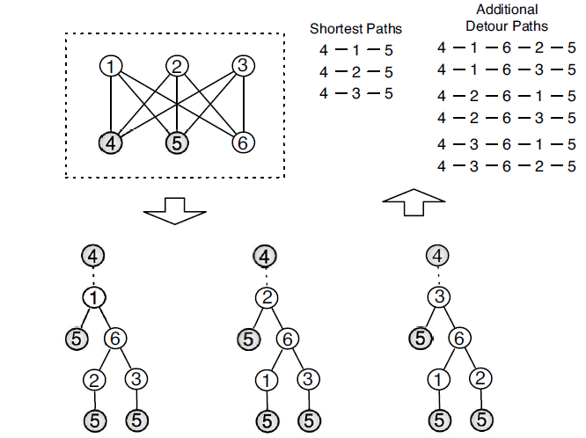
How does the controller determine detour paths?
Starting by constructing an acyclic tree of depth 3(using matrix M)
The time complexity of this search is
O((k/2-1)^2)
Link2-3-4 is the actual detour determined by the controller.

Slide 18
How does the controller determine detour paths?
Canonical tree DC topology
every set of m switches connect to two aggregation switches
2 × (m-1) : complexity O(m)

Slide 19
Performance evaluation

Slide 20
Performance evaluation
Fat tree :
k = 8 fat-tree topology(128 servers, 8 pods amd 8switches each )
1Gb/s interconnect links in ns-3 with the OpenFlow module
Simulated flows consist of uniformly chosen 4 KB, 8 KB, 100 KB flows
latency-sensitive flows common in DC networks
Target
small flows which are mostly found in the production data mining and Web service Cloud DCs

Slide 21
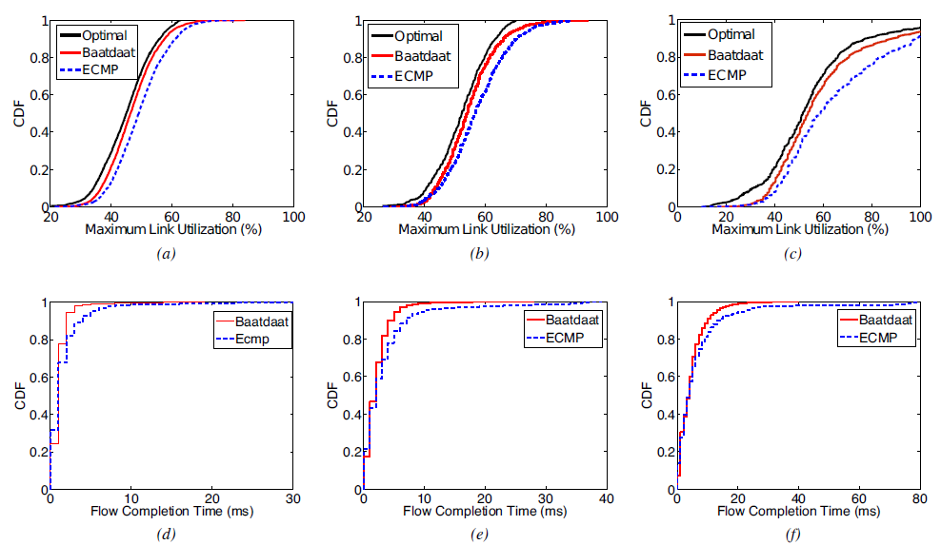
Network-wide Experimental Results
all types of flows by up to 18%
only deviates by 3% from optimal
Allowing larger number
of flows to complete faster
4KB
8KB
100KB

Slide 22
Impact of Measurement Intervals
Baatdaat uses temporal network load to schedule network flows
the link utilization measurement interval becomes crucial
Experiment :
increased the measurement interval from 1 ms to 10 ms and 100 ms

Slide 23
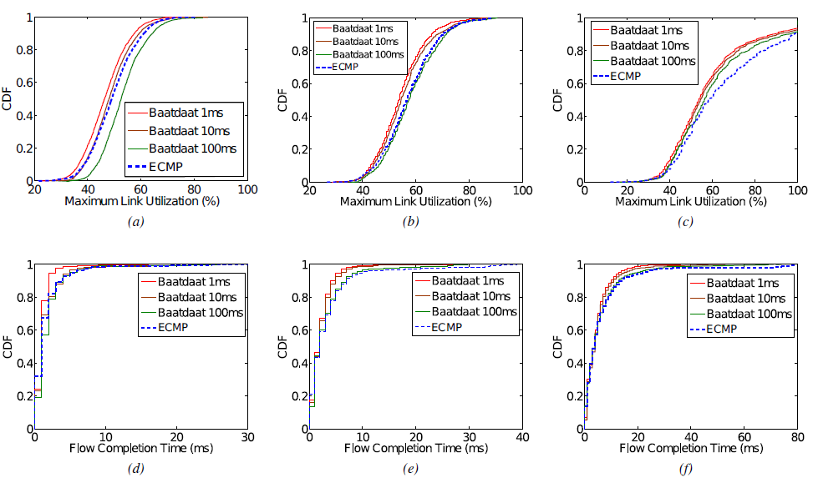
Impact of Measurement Intervals
4KB
8KB
100KB

Slide 24
Impact of Measurement Intervals
Traffic flows with smaller flow size are more vulnerable to sparse measurement intervals.
Long measurement interval leads to less responsive to transient changes in network load

Slide 25
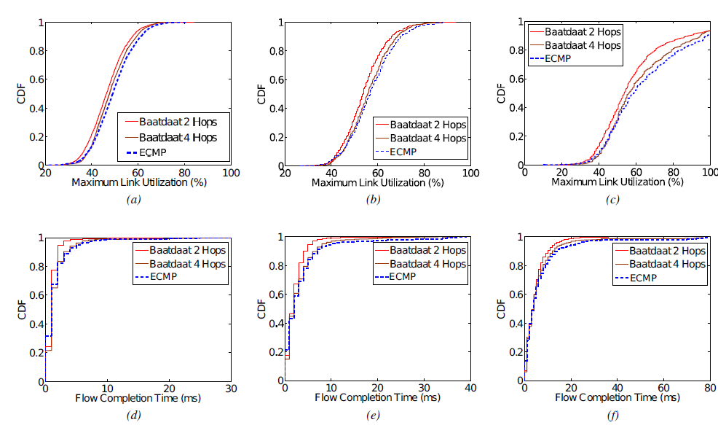
Impact of Longer Paths
How much longer is the ideal for DC networks?
suggest that only
detours of two extra hops

Slide 26
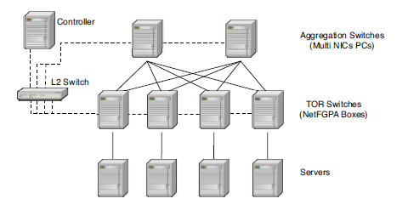
Testbed Experimental Results
Canonical tree topologies
implemented Baatdaat
6 OpenFlow switches and 4 server hosts
2 aggregation switches with the controller through out-of-band connections, do not carry any data
To accurately capture DC network characteristics, oversubscription ratio of 1 : 5, from 1 Gb/s to 100 Mb/s

Slide 27
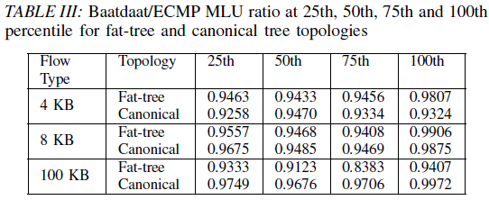
Testbed Experimental Results

Slide 28
Baatdaat Overhead
In Baatdaat
the control message overhead would be attributed to
8 × 48 = 384 Bytes (assuming a 48 port switch)
384000 Byte/sec
This is a marginal cost, for improving flow completion times.

Slide 29
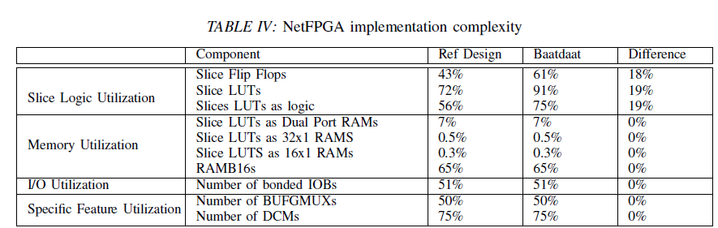
Hardware Implementation Complexity

Slide 30
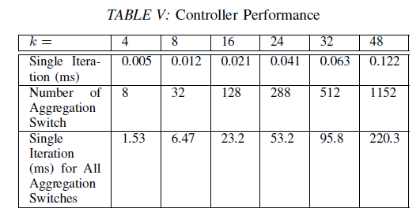
Controller Efficiency
How many flows the controller can handle at a time?
The controller runs on a machine with an Intel i5 2.3Ghz CPU and 4GB RAM

Slide 31
Related work
ECMP suffers from hash collisions, which can result in unbalanced flow allocations
Valiant Load Balancing(VLB) to randomize packet forwarding
VL2, Monsoon
DeTail
using flow priorities
Dcell, SPAIN
Modifications to end-hosts are required
DevoFlow
replace the OpenFlow model

Slide 32
Conclusion
Baatdaat, a novel flow scheduling system for DC networks
Using a modified NetFPGA implementation of OpenFlow to directly measure the temporal network-wide utilization
Using shortest and non-shortest paths
Unlike existing flow scheduling, Baatdaat uses the current state of the network dynamically
Reducing network-wide maximum link utilization by up to 18%
Reducing flow completion times by up to 10%

