Slide 1
Paper
Title : DevoFlow: Scaling flow management for high-performance networks
Curtis, Andrew R, et al. : University of Waterloo, HP Labs
ACM SIGCOMM Computer Communication Review 2011

Slide 2
Outline
Motivation :
OpenFlow’s current design does not meet the demand of high performance network
OpenFlow involves the controller in the handling of too many microflows
excessive load on the controller and switches
Methodology :
reducing the need to transfer statistics for boring flows
reducing the need to invoke the control-plane for most flow setups.

Slide 3
Proposed method

Slide 4
Introduction
OpenFlow … fine-grained, flow-level control
Correct enforcement of flexible policies and visibility over all flows, allowing for management of network traffic
OpenFlow is not perfect
Controller must visibility over all flows
Centralized bottlenecks are difficult scale
Switches themselves can be be a bottleneck in ow setup.
Full control and visibility over all flows is not the right goal but effective flow management

Slide 5
Introduction
“DevoFlow” :
aggressive use of wild-carded OpenFlow rules
reducing the number of switch-controller interactions
reducing the number of TCAM entries
Design principles :
Keep flows in the data-plane as much as possible (reducing overheads in controller etc.)
Effective flow management by only aggregated flow statistics

Slide 6
Introduction
DevoFlow attempt to resolve two dilemmas
Control dilemma :
Invoking the OpenFlow controller on every flow setup provides good start-of-flow visibility, but too much load on the control plane and too much setup delay to latency-sensitive traffic
Aggressive use of OpenFlow flow-match wildcards reduces control-plane load, but not effectively ,managing traffic
Statistics-gathering dilemma:
Collecting OpenFlow counters on lots of flows can create too much control-plane load

Slide 7
Openflow’s Benefits of central control

Slide 8
Avoids the need to construct global policies from switch-by-switch configurations
OpenFlow can provide..
optimal admission control
flow-routing in support of QoS policies
All flow setups should be mediated by a central controller
Ex(microflows)
security-sensitive flows(are handled centrally)
significant flows(to maintain global QoS)
normal flows(at individual switches)
Central control of flow setup is also required for some kinds of QoS guarantees for some flows
Other flows can be categorically treated as best-efort traffic
OpenFlow QoS framework that detects flows requiring QoS guarantees
Notes:
all flow setups should be mediated by a central controller

Slide 9
Near-optimal traffic management
With stats of current load, the controller achieves effective management
Load-balancing does not require the controller to be aware of the initial setup of every flow
Some flows (“mice”) may be brief enough. They are only interesting in the aggregate
Intense flows (“elephant”) is worth handling individually
the controller should be able to efficiently detect elephant flows as they become significant
paying the overhead of treating every new flow as a potential elephant
Fares et al. proposed “Hedera”, they dene “large” as 10% of the host-NIC bandwidth
The controller schedules these elephant flows
the switches route mice flows using equal-cost multipath to randomize their routes.

Slide 10
Openflow overheads

Slide 11
Intrinsic overheads
Flow-based networking intrinsically relies on a communication medium between switches and the central controller
To set up a bi-directional flow on an N-switch path
OpenFlow generates 2N flow-entry installation packets
These exchanges also add latency up to twice the controller-switch RTT

Slide 12
Implementation overheads
Flow setup overheads
Gathering flow statistics
Impact on flow setup of statistics-gathering
Switch state size

Slide 13
Flow setup overheads
Flow-setup latency is far too high for high performance networks, where most flows carry few bytes and latency is critical
controller's installation of new flow-table entries can create many out-of-order packets
leading to a collapse of the flow's initial throughput
The case : the switch-to-controller RTT is larger than that seen by the flow's packets

Slide 14
Gathering flow statistics
OpenFlow supports three per-flow counters
packets; bytes; flow duration
Push-based
The controller learns of the start of a flow whenever it is involved in setting up a flow
The existing push-based mechanism does not inform the controller about the behavior of a flow before the entry times out
Pull-based
The controller can send a Read-State message to retrieve the counters for a set of flows matching a wild-card flow specification
can save switch-to-controller bandwidth, but loses the ability to learn

Slide 15
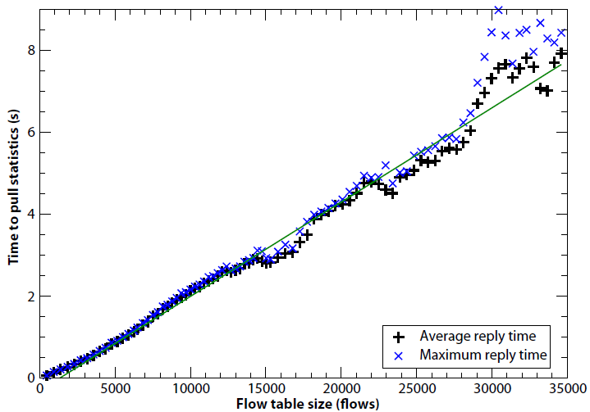
Gathering flow statistics : pull-based
Three servers to the switch: two servers were clients and one was the OpenFlow controller(10 connections)
pull-based statistics cannot be
collected frequently enough.
Switch : HP 5406zl

Slide 16
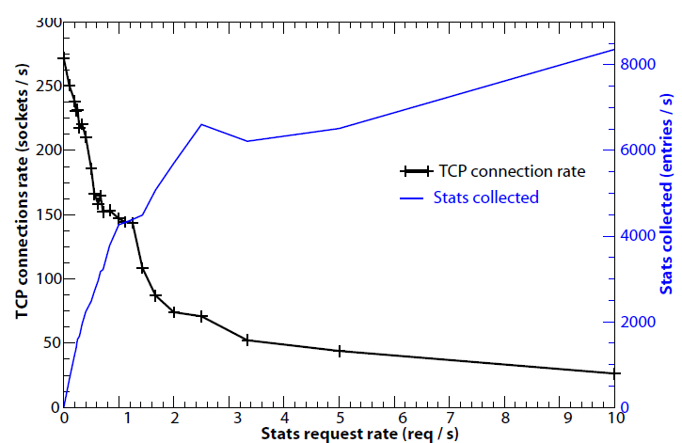
Impact on flow setup of statistics-gathering
varying the number of statistics-pulling requests between 0-10 requests per second
It is clear that statistics-pulling interferes with flow setup

Slide 17
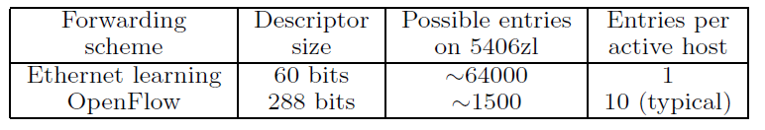
Switch state size
A limited number of flow entries can be supported in hardware

Slide 18
Proposed method : Devoflow

Slide 19
DevoFlow :
DevoFlow avoids the overheads by two new mechanisms
rule cloning
local actions

Slide 20
Rule cloning
If a “boolean CLONE flag” is clear, the switch follows the standard wildcard behavior
Otherwise, the switch locally “clones” the wildcard rule to create a new rule
this rule goes into the exact-match lookup table
reducing the use of the TCAM

Slide 21
Local actions
the heavyweight flow : invoke the controller
the lightweight flow : forward via this specific port
If a switch does not support an action, it defaults to invoking the controller
Local actions solve “multipath support” and “rapid re-routing”

Slide 22
Local actions
e.x.) ECMP’s routing
uniformly select an output port uniformly at random
require that the cost of the multiple forwarding paths to be equal
DevoFlow solves by allowing a clonable wildcard rule rule to select an output port for a microflow according to some probability distribution
On 1st path 1Gbps and 2nd path 10Gbps, ECMP splits ows evenly
On 1st path 1Gbps, 1 / 11th microflows
On 2nd path 10Gbps, 10 / 11th microflows

Slide 23
Local actions
If the designated output port goes down, using fallback paths
If the switch can execute decision locally, it can recover from link failures almost immediately without waiting several RTTs for the discover of the failure
OpenFlow almost supports this already, with overlapping rules
However, it does not tell the switch
We need a small change to make indicate explicitly

Slide 24
Efficient statistics collection
DevoFlow provides three different ways to improve the efficiency of OpenFlow statistics collection
Sampling
Triggers and reports
Approximate counters

Slide 25
Sampling
sFlow protocol randomly choses packets to a monitoring node
Sampling : uniformly choses at a rate of 1/1000 packets
the incremental load on the network is just less than 0.1%

Slide 26
Triggers and reports
extends OpenFlow with a new push-based mechanism
threshold-based triggers on counters
When a trigger condition is met, the switch sends a report to the controller
Trigger ; packets, bytes, and flow duration
Simpler rule leads not to be harder to implement with overhead

Slide 27
Approximate counters
Viewing on the statistics for the top-k largest microflows
e.x.) Golab et al.'s algorithm :
correctly classifies 80-99% of the flows that transfer more than a threshold k of bytes.

Slide 28
Implementation feasibility of DevoFlow
Rule cloning:
is similar to existing MAC learning mechanism
the switch ASIC would need to be modied
Multipath support:
using specialized rule cloning or using a virtual port
virtual port method is similar to link aggregation groups and ECMP support
Triggers:
require a counter and a comparator
similar existing flexible rate limiters
Approximate counters:
Require the most extensive changes to current ASICs.
hashing on packet headers and incrementing some of those counters.

Slide 29
Using DevoFlow
Elephant flow defines :
at least a threshold number of bytes X(1-10MB)
using any combination of DevoFlow's statistics collection mechanisms(e.x.) place triggers)
however, their theoretical results indicates their algorithm will perform as well as any other heuristic for flow scheduling
Using only edge switches to encapsulate new flows to send to the central controller for less overheads

Slide 30
Using DevoFlow
Static multipath routing:
oblivious routing microflow according to some probability distribution
Kodialam et al. achieves at least 94% of the dynamic routing throughput with packet-level oblivious routing, comparing to Oblivious routing

Slide 31
evaluation

Slide 32
Evaluation
Compare Devoflow to OpenFlow in simulation
Topology
three-level Clos topology and two-dimensional Hy perX topology(1Gbps)
The Clos : 1600 servers
80 access switches (each with 8 uplinks), 80 aggregation switches, and 8 core switches
8 core switches, 1:2.5 oversubscribed;(bisection bandwidth is 640 Gbps)
HyperX : 1620 servers
99 grid, 81 access switches, each attached to 16 other switches
1:4 oversubscribed, 405 Gbps

Slide 33
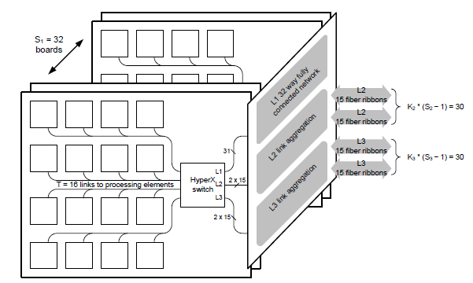
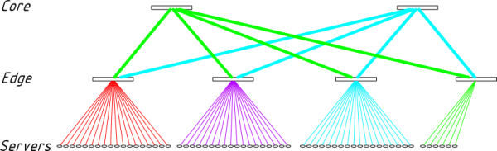
Topology
Clos topology
Hyper X

Slide 34
Workloads
MapReduce job that has just gone into its shuffle stage
randomly selecting n servers to be part of the reduce-phase shuffle
transfers 128 MB with k connections
a workload based on measurements of a 1500-server cluster by Microsoft Research (MSR)
Generating flows based on distributions flow inter-arrival times and flow sizes
first determining whether the flow is to be an inter- or intra-rack flow, and then selecting a destination uniformly at random
Simulating a workload that combines
for the first minute : shuffle, three minutes : MSR flows

Slide 35
Schedulers
compare static routing with ECMP to flow scheduling with several schedulers
DevoFlow scheduler:
using either sampling or threshold triggers to classify the flow as an elephant
New flows are routed using ECMP
Classification with less than a 10% false-positive rate
distribution to select how many packets it will transfer; all packets are 1500 bytes.

Slide 36
Other attention
Fine-grained control using statistics pulling :
Using OpenFlow in active mode.
Wildcard routing:
Wildcard routing only on the Clos topology, because we are still de veloping the spanning tree algorithm for HyperX
Valiant load balancing (VLB):
each flow through an intermediate switch chosen uniformly at random only on Clos
Distributed greedy routing:
routes each flow by first greedily selecting the least-congested next-hop
only on HyperX

Slide 37
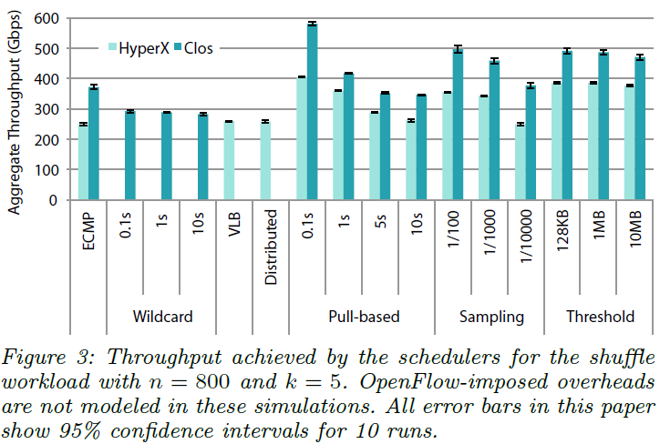
Performance
800servers and 5 connections
Pull-based 100ms is the best, but the highest overhead

Slide 38
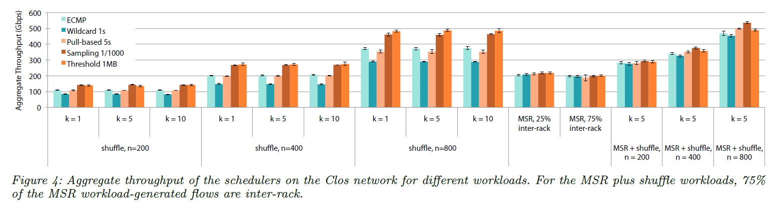
Clos topology
ECMP vs. DevoFlow(sampling and threshold)
29% improving
Pull-based 5s vs. DevoFlow(sampling and threshold)
It does not mean Devoflow is better(Why 5s and 1/1000?)
Inter-rack
Not improve(the traffic does not include aggregate – core )

Slide 39
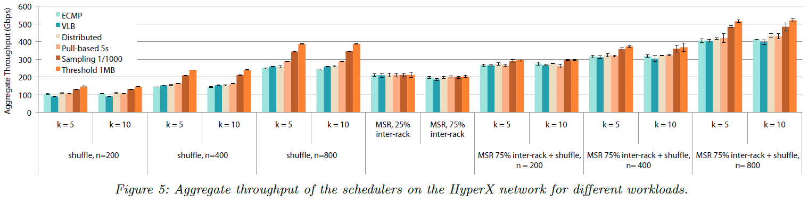
HyperX topology
ECMP vs. DevoFlow(sampling and threshold)
29% improving
Pull-based 5s vs. DevoFlow(sampling and threshold)
It does not mean Devoflow is better(Why 5s and 1/1000?)
Inter-rack
Not improve(the traffic does not include aggregate – core )

Slide 40
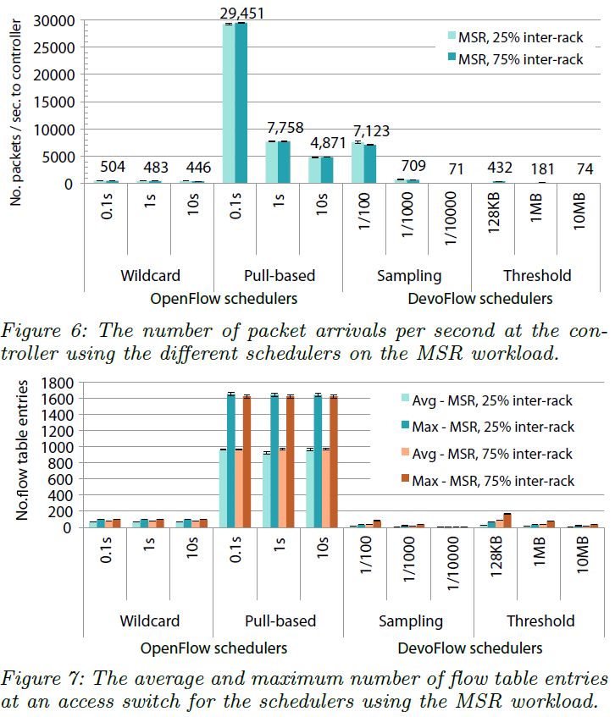
Overheads
DevoFlow does not require many table entries, since it uses a single wildcard rule for all mice flows
stores only exact-match entries for elephant flow

Slide 41
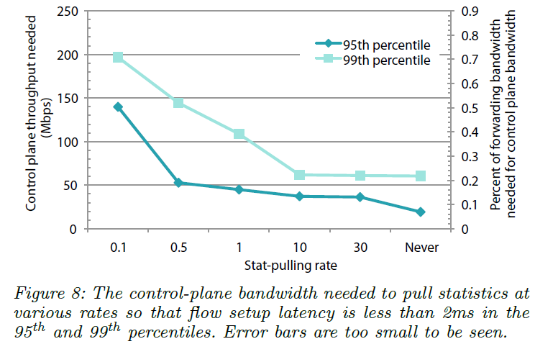
Overheads
Pull rate is at least 1ms
but, the throughput is dramatically lower
DevoFlow's statistics-collection mechanisms are the better option because they are handled entirely within the data-plane.

Slide 42
Conclusion
OpenFlow
Separate data-plane and control plane; flexible policy
Not for high performance network
DevoFlow :
Reducing overhead improving throughput

