Slide 1
Paper
Title : DeTail: Reducing the flow completion time tail in datacenter networks
Zats, David, et al. University of California, Berkeley, Berkeley
ACM SIGCOMM Computer Communication Review 2012

Slide 2
Outline
Motivation :
Reducing the tail of
completion times
latency-sensitive flows critical for page creation
Methodology :
Cross-layer
In-network mechanisms to reduce packet losses and retransmissions
Prioritize latency-sensitive flows
Evenly balance traffic across multiple paths

Slide 3
introduction

Slide 4
Problem of current DC network
Background
Modern Web pages are made up of many components
generated by independent subsystems and “mixed”
“subflow”:intra-datacenter flow is increased
Partial delay
Deadlines are 200 -300ms for satisfaction for user demands
Purpose:
reducing the long flow completion tail

Slide 5
Problem of current DC network
Flow completion times
depend on round-trip-times(RTTs)
Congestion affects performance
DC RTTs is as low as 250µs, while they grows by two orders of magnitude[1]
Each contributes to increasing the long tail of flow completion(congestion)
Traffic bursts cause packet loss and retransmissions
Uneven load balancing causes high congestion for subflow
The absence of traffic prioritization causes to wait latency-sensitive flows
[1] ALIZADEH, M., GREENBERG, A., MALTZ, D. A., PADHYE, J., PATEL, P.,PRABHAKAR, B., SENGUPTA, S., AND SRIDHARAN, M.
Data center tcp(dctcp). In SIGCOMM (2010).

Slide 6
Problem of current DC network
Solution : detecting flash congestions
Proposed method : Detail
Quantification of the impact of long-tailed flow completion times
Assessment of the causes of long-tailed flow completion times
A cross-layer network stack that addresses them
On simulation, reducing 99.9th percentile flow completion time

Slide 7
Analysis of long tail

Slide 8
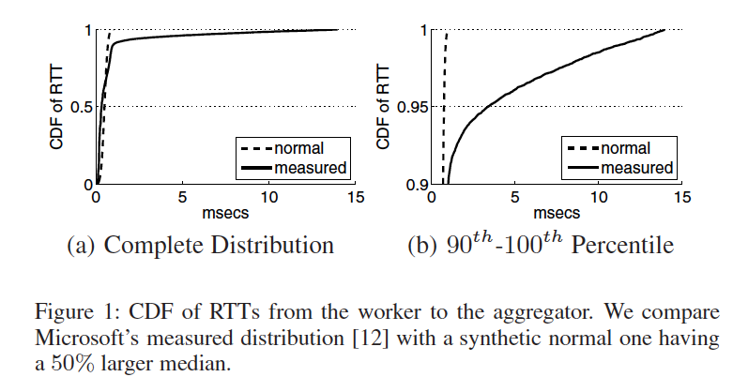
Long-tail flow
Rack
Top-level aggregator
Mid-level aggregator
Worker
Intra-rack RTTs take 61µs as average, and the median is 334µs
In 10% of the cases, average RTTs take 14ms

Slide 9
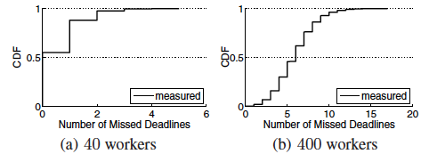
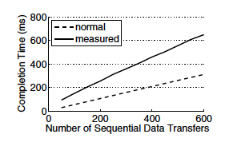
Web workloads
Partition-Aggregate
Sequential
“Normal” : the normal distribution having a 50% higher median than the measured one
If RTT follows the Normal, no worker missed the deadline
Long-tail flow is critical

Slide 10
Cause of long tails
Flash congestion have three problems leading to long-tailed flow completion time
packet losses and retransmissions
absence of prioritization
uneven load balancing

Slide 11
Packet losses and retransmissions
Packet losses often lead to flow timeouts
In DC, timeouts are set to 10[ms]
Datacenter RTTs are commonly 250μs
Just one timeout guarantees that the short flow will hit the long tail (tradeoff between timeout and page creation)
Multiple workers respond to the same aggregator
correlated losses and timeout hitting the long tail

Slide 12
Absence of prioritization
There are both latency-sensitive and latency-insensitive flows, with the range from 2KB to 100MB
In case,
short latency-sensitive flows can become enqueued behind long latency-insensitive flows
latency-sensitive flows will hit the long tail
Notes:
datacenters must support both latencysensitive and latency-insensitive flows, with sizes that typically range from 2KB to 100MB

Slide 13
Uneven load balancing
Modern DC networks have scaled out, creating many paths
Two static approaches
Flow hashing : Imperfect hashing, as well as varying flow sizes often lead to uneven flow assignment
Packet scatter : randomly picks the output ports for using multiple paths

Slide 14
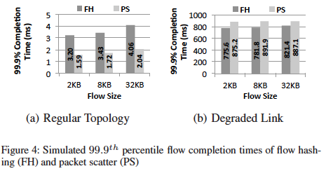
Uneven load balancing
・Simulation :
128-servers FatTree topology
Oversubscription : ½ × ½
All-to-all workload, 2KB, 8KB,32KB
100Mbps : link of core-aggregate
In asymmetries, they can’t be adaptive
Asymmetry : incremental deployment or network reconfigurations

Slide 15
Related work
DCTCP. D3, and HULL
single path solutions : fairness and congestion control
No uneven load balancing
Hedera
Monitoring link state and remap flows
Takes more costs : remap per 5sec and using 10% of link capacity
MPTCP
Multiple TCP subflows and balances traffic based on congestion
Using standard TCP congestion detection mechanisms
Effective for flow sizes larger than 70KB
The flow more than 10packets

Slide 16
Problem of these solutions
Trend : to minimize in-network functionality
host-based or controller-based approaches
Critical factor
Quick response times are needed to support latency-sensitive flows
Network-oriented approach

Slide 17
Proposed method

Slide 18
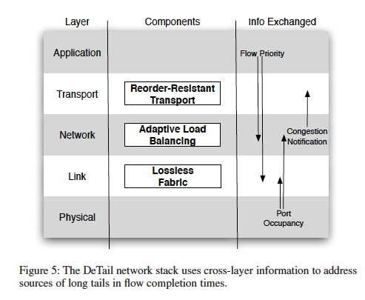
Proposed method : Detail
Detail is ..
Cross-layer network-based approach for reducing the long flow completion time tail

Slide 19
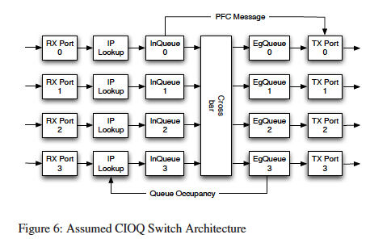
Assumed switch architecture
Combined Input/Output Queue(CIOQ) Switch
CIOQ architecture is commonly used in today’s switch
IP Lookup : Forwarding engine
Ingress/Egress queue : buffer
Drain byte counter : monitor of buffer

Slide 20
Link layer
Lossless fabric :
the switch monitors ingress queue occupancy to detect congestion
When the drain byte counters of an ingress queue pass a threshold, the switch send Pause message to previous hop

Slide 21
Network Layer
Congestion-based load balancing decisions
Picking an acceptable port with the smallest drain byte counter at egress queue
Setting threshold for saving computational cost
By reacting to local egress queue occupancies, making globally-aware hop-by-hop decisions without additional control messages(PAUSE)
Adaptive load balancing
Setting multiple thresholds for priorities

Slide 22
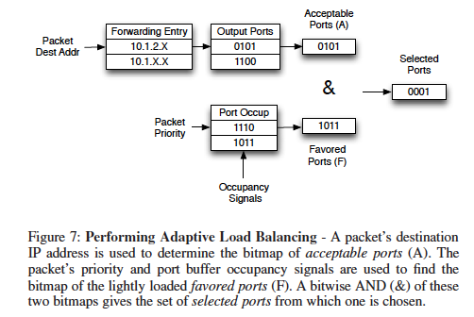
Network Layer
Detail choose randomly one of multiple ports
To obtain the set of lightly loaded ports

Slide 23
Transport Layer
Load balance
Packet drops no longer happen due to congestion.
When the appropriate counter is above a threshold, and low priority packets enqueued, setting ECN FLAG
Lossless fabric
Standard TCP
Reaction to out-of-order packet delivery
Notes:
Low priority packets enqueued when the appropriate counter is above a threshold have their ECN flag set

Slide 24
Application layer
DeTail depends upon applications to properly specify flow priorities based on how latency-sensitive they are
At Detail, using only two priorities
Notes:
DeTail depends upon applications to properly specify flow priorities based on how latency-sensitive they are

Slide 25
Choice of settings

Slide 26
Choice of settings
Choosing the parameters of Detail’s mechanisms
Link layer flow control : triggering PFC (Priority flow control) messages
Adaptive load balancing : threshold
Explicit Congestion Notification(ECN)
End-host timers : timeout

Slide 27
Link layer flow control
For 1GibE, 128KB buffers and eight priorities
Unpause threshold (min) : 4557 Drain Bytes
Pause threshold (min) : 8192 Drain Bytes
The time to generate PFC message is 36.456µs for 4557B
131072B(128KB)/8 – 4557 = 11827B (maximum)
8192B(halfway between the minimum and the maximum)
Notes:
halfway between the minimum and the maximum

Slide 28
Adaptive load balancing
When performing threshold-based adaptive-load balancing, we must determine how many thresholds to have for a given priority
In this simulation,
Setting two threshold 16KB and 64KB

Slide 29
Explicit Congestion Notification(ECN)
Threshold of 64KB drain bytes
Tradeoff(ex.
Setting too low, reducing the likelihood of head-of-line blocking, but increases the chance that low-priority flows will back off too much

Slide 30
End-host timers : timeout
Setting the timeout duration of end host timers too low may lead to spurious retransmissions that waste network resources.
In simulation,
We saw that values of 10ms and higher effectively avoid spurious retransmissions
DC topologies typically have multiple hops, so 200ms as RTOmin

Slide 31
experiment

Slide 32
Experimental setup
NS-3 Simulation
ingress and egress queues of 128KB buffers per port
Switch delays : 25μs
12.24μs transmission delay of a full-size 1530B Ethernet frame on a 1GigE link.
3.06μs crossbar delay
0.476μs propagation delay
5μs transceiver delay
4.224μs forwarding engine delay

Slide 33
Experimental setup
Click-based implementation
Modifying Click to have both ingress and egress queues
Implementing DMA(Direct Memory Access) etc..

Slide 34
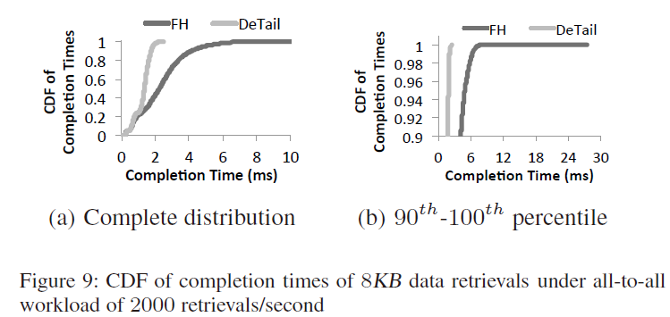
(1)microbenchmarks
FatTree with 128servers
Four pods
Four Tor switches
Four aggregate switches
Oversubscription : ½ × ½
The data retrievals follow a Poisson process
Rates ranging from 500 to 2000
All-to-all:Each server randomly selects another server
FH (b): 6.3~7.3ms
Detail (b):2.1~2.3ms
The worsts are 2.6ms and 28ms

Slide 35
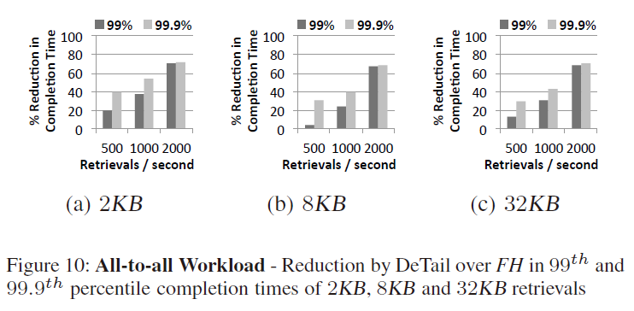
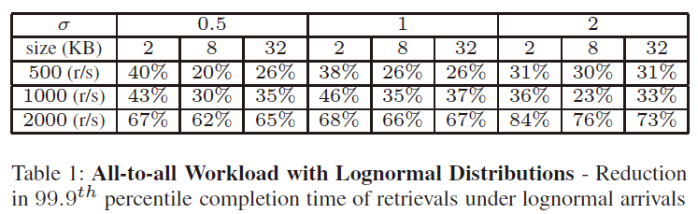
(1)microbenchmarks

Slide 36
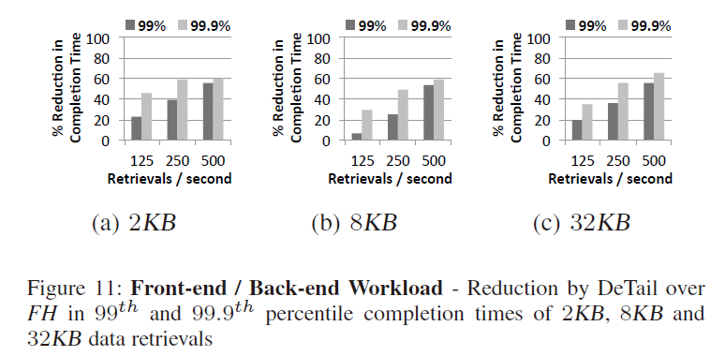
(1)microbenchmarks
Front-end/Back-end:
Each server in first three pods (i.e, front-end server) retrieves data from a randomly selected server in the fourth pod (i.e., back-end server)
30%~65%

Slide 37
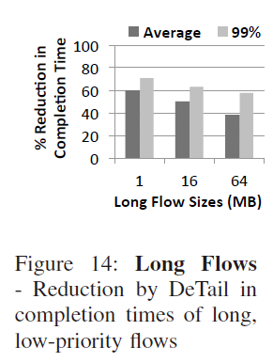
(1)microbenchmarks
16-server FatTree
300 retrievals/sec
The background flows are 1MB, 16MB or 64MB
38~60% reducing

Slide 38
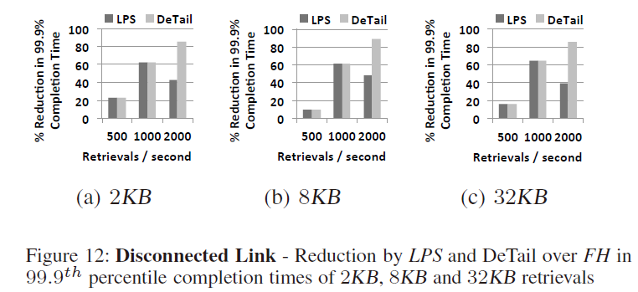
(2)Topological asymmetries
Disconnected Link
One disconnected aggregate-to-core link
LPS(Lossless Packet Scatter):packet scatter with Priority Flow Control, not including Adaptive Load Balancing
At 2000 retrievals, almost an order of magnitude improvement(18ms and 159ms)

Slide 39
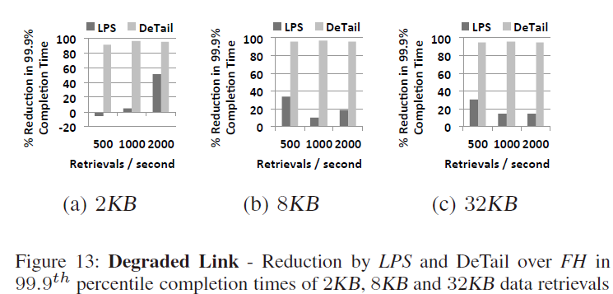
(2)Topological asymmetries
Degraded Link
Core-to-agg link can be downgraded from 1Gbps to 100Mbps
More than 91% reduction compared to FH by redirecting traffic to alternate paths(ALB)
under FH and LPS was more than 755ms
37ms under DeTail

Slide 40
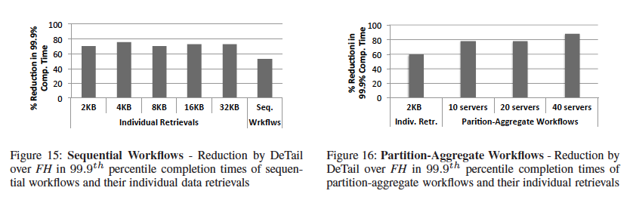
(3)Workload
Sequential : 38ms ~ 18ms
Partition : 17ms(40 servers)
Deadline : 200~300ms

Slide 41
Conclusion
Avoiding congestion leads to reduction of flow completion time, not hitting long-tail(10%)
Proposed method : Detail
Cross-layer approach
In-network mechanisms to reduce packet losses and retransmissions
Prioritize latency-sensitive flows
evenly balance traffic across multiple path
DeTail can reduce 99.9th percentile flow completion times by over 50% for many workloads.

