Slide 1
Improving Datacenter network with MPTCP
Sekiya Lab.
M1 Fujii Shogo

Slide 2
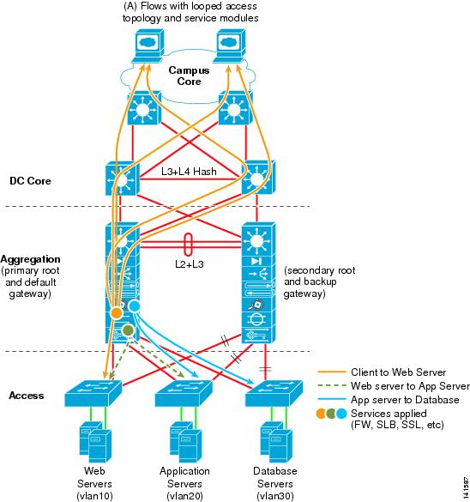
Introduction
Background
Modern Web pages are made up of many components
generated by independent subsystems and “mixed”
“subflow” : intra-datacenter flow is increased
Partial delay
Growing the number of hosts per DC
Deadlines are 200 -300ms for satisfaction for user demands
A approach for DC topology
Replacing traditional hierarchical structure
FatTree, Bcube and VL2 etc…

Slide 3
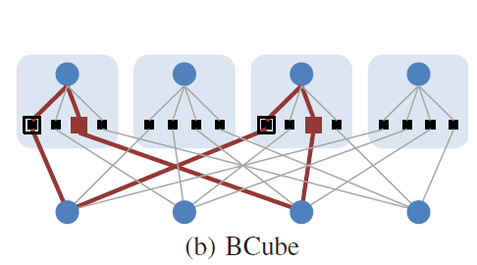
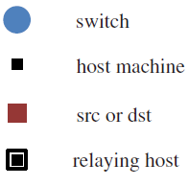
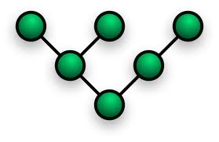
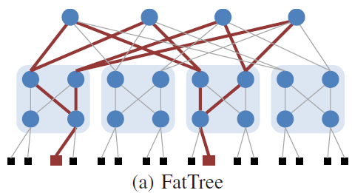
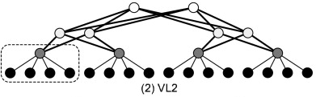
A approach for DC topology
Tree Topology
(Traditional)
These topologies take advantage to distributed processing
Basically, multiple paths are for redundancy
Multipath TCP

Slide 4
What is MPTCP?
MPTCP :
An ongoing effort of the IETF's Multipath TCP working group
The aims at allowing a TCP connection to use multiple paths to maximize resource usage and increase redundancy
For Datacenter
Paper : “Improving datacenter performance and robustness with multipath TCP”
Raiciu, Costin, et al., University College London
ACM SIGCOMM Computer Communication Review. Vol. 41. No. 4. ACM, 2011

Slide 5
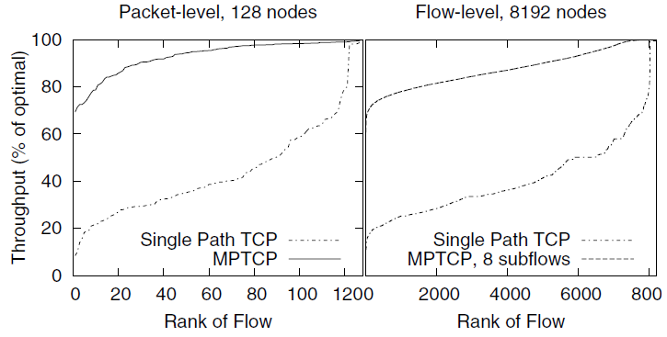
Benefit of MPTCP
FatTree topology, 128(80-eight port switch) and 8192 nodes, and 100Mb/s links
Packet-level(htsim), Flow-level simulators
Show the aggregate throughput achieved by long-lived TCP and MPTCP
With eight subflows, most MPTCP flows get at least
90% of the available capacity
Benefit for Long-lived flow

Slide 6
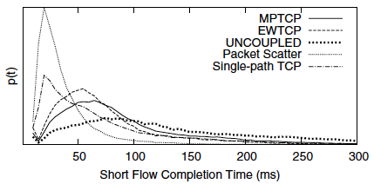
The current problem of MPTCP 1/2
FatTree topology, 128nodes, 4:1oversub
Sending 70KB file on average 200ms(poisson arrivals)
Using 33% of nodes by 1 to 1traffic
Effective for flow sizes smaller than 70KB
Algorithm | Short Flow Finish Time(mean/stdev) | Network Core Utilization
SINGLE-PATH TCP | 78 ±108 ms | 25%
MPTCP | 97 ± 106 ms | 62%
Compared to TCP, MPTCP increases mean completion time by 25%
MPTCP’s lower aggressiveness and better load balancing greatly reduce impact on competing traffic

Slide 7
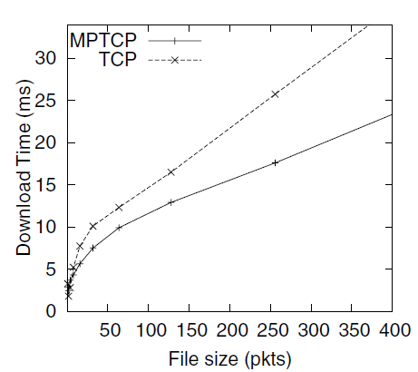
The current problem of MPTCP 2/2
The flow less than 10packets
FatTree topology, 128nodes, 4:1oversub
File size(pkt) is changed
Showing that a Download time with TCP and MPTCP
Most of flows are better for MPTCP
The flows less than 10 packets are not effective for MPTCP

Slide 8
My research
Topic
Improvement the completion time of short flow in FatTree with MPTCP
Target
Flow : Less than 70KB or 10 packets flow
Network: DC network FatTree
Goal
Improving 99.9th percentile flow completion time within 300ms by MPTCP than TCP
The solution for not only long-lived but short-lived flow

Slide 9
Related Work 1/2
Packet scatter : improving for short flow
per-packet load balancing with round-robin ECMP
a single congestion window as it is unaware of the multiple paths
Paper
“Improving datacenter performance and robustness with multipath TCP”
Raiciu, Costin, et al., University College London
ACM SIGCOMM Computer Communication Review. Vol. 41. No. 4. ACM, 2011

Slide 10
The current problem of MPTCP 1/2
FatTree topology, 128nodes, 4:1oversub
Sending 70KB file on average 200ms(poisson arrivals)
Using 33% of nodes by 1 to 1traffic
Effective for flow sizes larger than 70KB
Algorithm | Short Flow Finish Time(mean/stdev) | Network Core Utilization
Packet Scatter | 42 ± 63 ms | 30%
MPTCP | 97 ± 106 ms | 62%
Compared to MPTCP, Packet Scatter can finish short flow faster
About core utilization, Packet Scatter gets low utilization

Slide 11
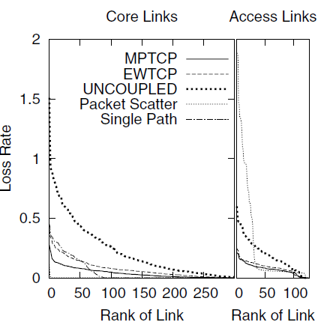
The current problem of MPTCP 1/2
Individual link loss rates
FatTree topology, 128nodes,
running a permutation traffic matrix of long flows
At access link, Packet Scatter is worst rate
Because of fine-grain control, per-packet round-robin
Constraint its transmit rate

Slide 12
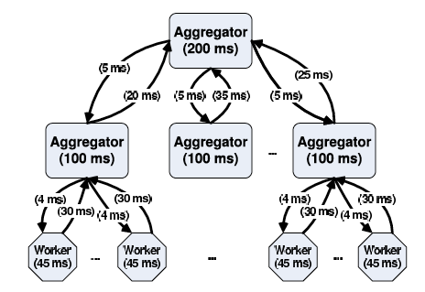
Update : Q at the last meeting
Wilson, Christo, et al. "Better never than late: Meeting deadlines in datacenter networks." ACM SIGCOMM Computer Communication Review. Vol. 41. No. 4. ACM, 2011.
In DC, there are short message(50KB~1MB) uploading control state and long background flows(5KB~50MB) providing fresh data
DC have a diverse a mix of flows with widely varying deadlines

Slide 13
Future Work
論文でのシナリオの再現[1]
70KB以下のflow, 10パケット以下のflowに対して, TCPよりも性能が悪いのかどうかの確認, その原因に関する解析
解析の掘り下げ(3シナリオ[2])
a) Incast : 2KB(2 packets)のflowを複数流す.
- Short Flowに対するMPTCPのオーバヘッドの影響
b) Queue buildup : Long Flow + Short Flow(20KB) を同じOutput Portへ流す
- Long Flowのセットアップのオーバヘッドの影響
c) Buffer pressure : Long Flow + Short Flow(20KB) を異なるOutput Portへ流す
- スイッチ内のバッファへの影響
[1]Alizadeh, Mohammad, et al. "Data center tcp (dctcp)." ACM SIGCOMM Computer Communication Review 40.4 (2010): 63-74.
[2] Raiciu, Costin, et al. "Improving datacenter performance and robustness with multipath TCP." ACM SIGCOMM Computer Communication Review. Vol. 41. No. 4. ACM, 2011.

Slide 14
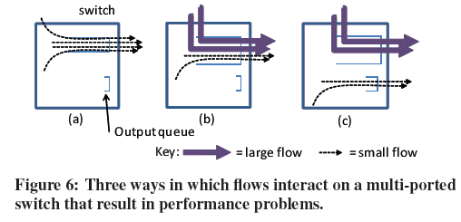
3シナリオ

Slide 15
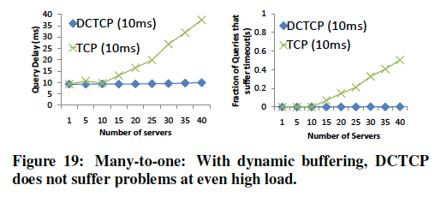
About the solution…
MPTCP : static approach
Dynamic approach
Data Center TCP(DCTCP) : Dynamic Bufferng
Alizadeh, Mohammad, et al. "Data center tcp (dctcp)." ACM SIGCOMM Computer Communication Review 40.4 (2010): 63-74.
Monitoring the sample packet (1/7)th, is queue size
Exceeding the threshold queue size, changing buffer
Optimizing OpenFlow
http://mptcp.info.ucl.ac.be/
Getting rid of collision

Slide 16
TCP in data centers
http://mptcp.info.ucl.ac.be/

Slide 17
TCP in FAT tree networks Cost of collissions
C. Raiciu, et al. “Improving datacenter performance and robustness with multipath TCP,” ACM SIGCOMM 2011.

Slide 18

How to get rid of these collisions ?
Consider TCP performance as an optimisation problem

Slide 19
Related Work 2/2
“Detail” : improving flow completion time
Cross-layer approach
In-network mechanisms to reduce packet losses and retransmissions
Prioritize latency-sensitive flows
Evenly balance traffic across multiple paths
Paper :
Title : DeTail: Reducing the flow completion time tail in datacenter networks
Zats, David, et al. University of California, Berkeley, Berkeley
ACM SIGCOMM Computer Communication Review 2012

Slide 20
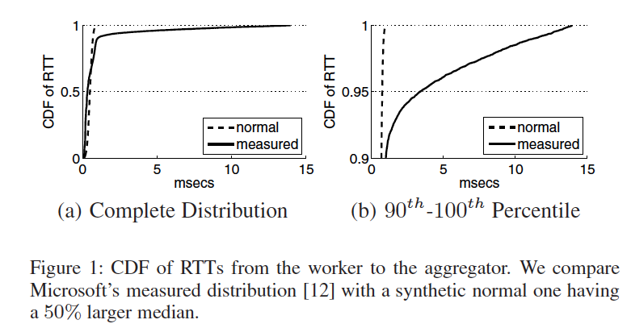
Long-tail flow
Rack
Top-level aggregator
Mid-level aggregator
Worker
Intra-rack RTTs take 61µs as average, and the median is 334µs
In 10% of the cases, average RTTs take 14ms

Slide 21
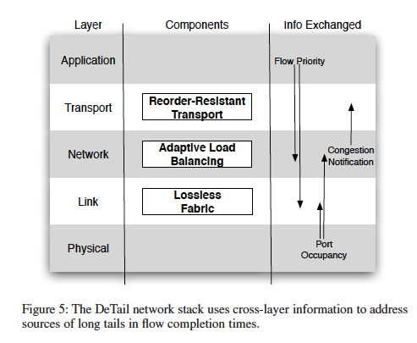
Cause of long tails
Flash congestion have three problems leading to long-tailed flow completion time
packet losses and retransmissions
absence of prioritization
uneven load balancing

Slide 22
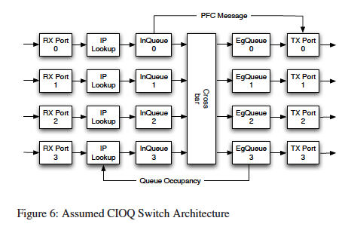
Experimental setup
Click-based implementation
Modifying Click to have both ingress and egress queues
Implementing DMA(Direct Memory Access) etc..

Slide 23
Absence of prioritization
There are both latency-sensitive and latency-insensitive flows, with the range from 2KB to 100MB
In case,
short latency-sensitive flows can become enqueued behind long latency-insensitive flows
latency-sensitive flows will hit the long tail
Notes:
datacenters must support both latencysensitive and latency-insensitive flows, with sizes that typically range from 2KB to 100MB

Slide 24
Transport Layer
Load balance
Packet drops no longer happen due to congestion.
When the appropriate counter is above a threshold of drain byte, and low priority packets enqueued, setting ECN FLAG
In this simulation,
Setting two threshold 16KB and 64KB
Notes:
Low priority packets enqueued when the appropriate counter is above a threshold have their ECN flag set

Slide 25
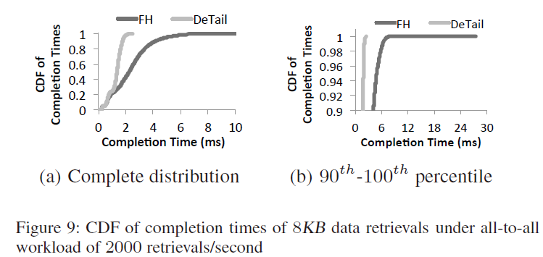
microbenchmarks
FatTree with 128servers
Oversubscription : ½ × ½
All-to-all:Each server randomly selects another server
8KB data retirvals under all-to-all workload of 2000 retrievals /sec
Flow Hashing (FH) (b): 6.3~7.3ms
Detail (b):2.1~2.3ms
The worsts are 2.6ms and 28ms

Slide 26
研究計画
短期
MPTCP + FatTree Helper on ns-3
Inspection of the influence by short-lived flow
中期
10~12月-融合情報コース成果発表
2013年12月19日-ネットワークシステム研究会
モバイル、アドホック、ユビキタス、無線、セキュリティ、マルチアクセス、アクセスネットワーク・User Network Interface、Homeネットワーク、一般
2014年1月:発表会

Slide 27
ns-3 – status quo
Setup Ns3-dce -- finish
Creating FatTree topology(128 nodes) -- finish
Configuring routing table -- 70%
Making scenario by “iperf”
Analyzing

Slide 28
Future work
Completing more than 1 scenario by ns-3
Deadline 11th
Reading RFC of MPTCP
実機も動かせるように・・小さいトポロジー
あくまでシミュレーション

