Slide 1
Improving Datacenter network with MPTCP
Sekiya Lab.
M1 Fujii Shogo

Slide 2
My research
Topic
Improvement the completion time of short flow in FatTree with MPTCP
Target
Flow : Less than 70KB or 10 packets flow
Network: DC network FatTree
Goal
Improving 99.9th percentile flow completion time within 300ms by MPTCP than TCP
The solution for not only long-lived but short-lived flow

Slide 3
Future Work
論文でのシナリオの再現[1]
70KB以下のflow, 10パケット以下のflowに対して, TCPよりも性能が悪いのかどうかの確認, その原因に関する解析
解析の掘り下げ(3シナリオ[2])
a) Incast : 2KB(2 packets)のflowを複数流す.
- Short Flowに対するMPTCPのオーバヘッドの影響
b) Queue buildup : Long Flow + Short Flow(20KB) を同じOutput Portへ流す
- Long Flowのセットアップのオーバヘッドの影響
c) Buffer pressure : Long Flow + Short Flow(20KB) を異なるOutput Portへ流す
- スイッチ内のバッファへの影響
[1]Alizadeh, Mohammad, et al. "Data center tcp (dctcp)." ACM SIGCOMM Computer Communication Review 40.4 (2010): 63-74.
[2] Raiciu, Costin, et al. "Improving datacenter performance and robustness with multipath TCP." ACM SIGCOMM Computer Communication Review. Vol. 41. No. 4. ACM, 2011.

Slide 4
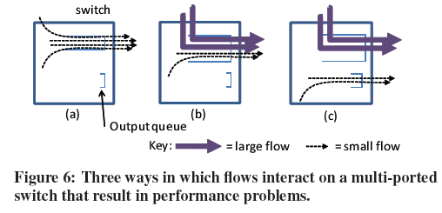
3シナリオ

Slide 5
Update on implementation
FatTree : Host to Host traffic
There are three traffic patterns
core
Aggregate
edge
host
4
4
4
4
4
4
4
4

Slide 6
Upload on implementation
1. intra-pod : until edge (complete)
edge
host
2. intra-pod : cross edges (50%-2 paths) ---Demo
Aggregate
edge
host
4
4

Slide 7
Upload on implementation
3. Cross the core(uncomplete) -4 paths
core
Aggregate
edge
host
4
4
4
4

Slide 8
ns-3 – status quo
Setup Ns3-dce -- finish
Creating FatTree topology(128 nodes) -- finish
Configuring routing table -- 60%
Making scenario by “iperf”
Analyzing

Slide 9
Update on comprehension
Reading RFC of MPTCP ..
Goal for MPTCP
Network compatibility
Architectural basis

Slide 10
Functional goal
In supporting the use of multiple paths, ..
Improve Throughput :
a Multipath TCP connection over multiple paths SHOULD achieve no worse throughput than a single TCP connection over the best constituent path
Improve Resilience :
permitting segments to be sent and re-sent on any available path

Slide 11
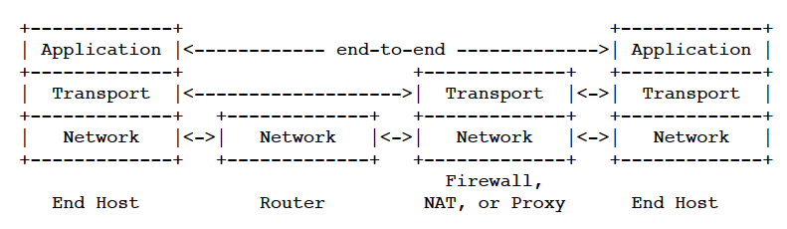
Network compatibility
The use of MPTCP is achieved merely by upgrading the OS of the end hosts
If some paths on the way, fall back system is necessary
Middlebox

Slide 12
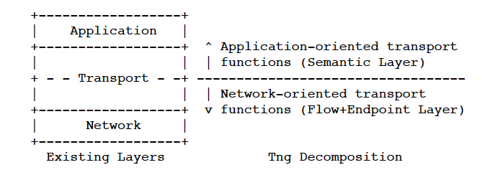
Architectural basis
In MPTCP, Transport protocol is spited by “application-oriented” and “network-oriented” layer

Slide 13
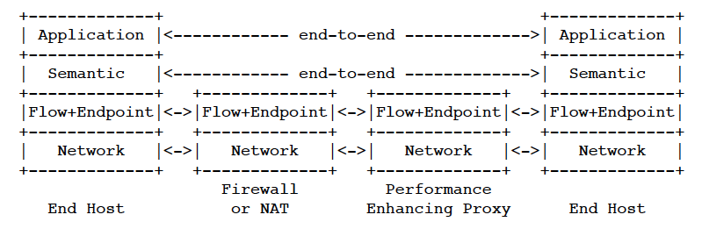
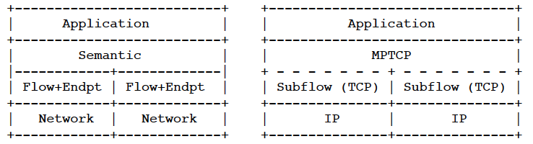
Architectural basis

Slide 14
研究計画
短期
MPTCP + FatTree Helper on ns-3
Inspection of the influence by short-lived flow
中期
10~12月-融合情報コース成果発表
2013年12月19日-ネットワークシステム研究会
モバイル、アドホック、ユビキタス、無線、セキュリティ、マルチアクセス、アクセスネットワーク・User Network Interface、Homeネットワーク、一般
2014年1月:発表会

Slide 15
Future work
Completing more than 1 scenario by ns-3
Deadline 11th
Reading RFC of MPTCP
Reference : Coupled Congestion Control for Multipath Transport Protocol, (RFC)2011

