Slide 1
Improving Datacenter network with MPTCP
Sekiya Lab.
M1 Fujii Shogo

Slide 2
Background
Explosive increase in the amount of data year after year.
the amount is doubled by 18-24months[1]!
the storage of Facebook has more than 300 petabytes data[2].
analyze 1 petabytes data for mining everyday.
Soft real-time application: Web search, recommendation system, retail, etc.
Increasing also the number of hosts in a data center.
In order to bring out the best performance,
Application approach : distributed computing.
Physical approach : network topology
Protocol approach : Multipath TCP
[1] http://www-06.ibm.com/systems/jp/storage/column/backup/01.html
[2] https://www.facebook.com/notes/facebook-engineering/presto-interacting-with-petabytes-of-data-at-facebook/10151786197628920

Slide 3
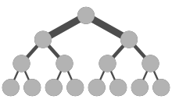
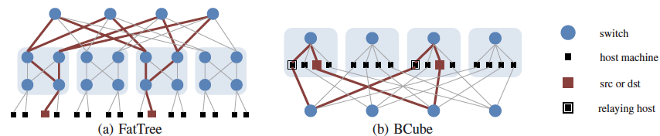
Network topology
not efficient for modern traffic
not appropriate for the assignment of bandwidth
intra-detacenter traffic
traditional hierarchy topology
Maximally utilization of bandwidth without special devices
Multi-paths at the host-to-host traffic

Slide 4
Distributed computing
The purpose is to partition the tasks and parallel computing for the scalability
ex. Presto(2013) based on Hadoop Framework
Parser
scheduling
Query
client
Task
coordinator
Partition-aggregate model is common
Installed in interactive response and file storage servers
burst-query
worker
Aggregate
Aggregate
worker
worker
worker
worker
worker
worker

Slide 5
Protocol approarch
Multipath TCP is released in 2011.
To increase the resilience of the connectivity by providing multiple paths, protecting end hosts from the failure of one.
To increase the efficiency of the resource usage, and thus increase the network capacity available to end hosts.
Some researches reported MPTCP could upgrade more performance of network than existed TCP

Slide 6
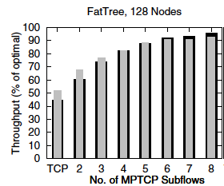
Related work(1)
“Improving datacenter performance and robustness with multipath TCP”(2011)
average completion time in 70KB-flow
Algorithm | Short Flow Finish Time(mean/stdev)
SINGLE-PATH TCP | 78 ±108 ms
MPTCP | 97 ± 106 ms
[1]
[1]
In FatTree, MPTCP is installed and improving throughput.
For short-flow(70KB), MPTCP is not effective
[1]Raiciu, Costin, et al. "Improving datacenter performance and robustness with multipath TCP." ACM SIGCOMM Computer Communication Review. Vol. 41. No. 4. ACM, 2011.

Slide 7
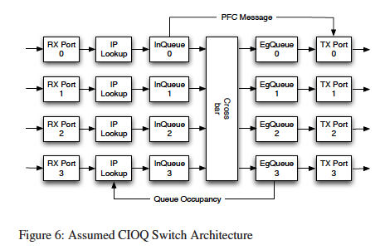
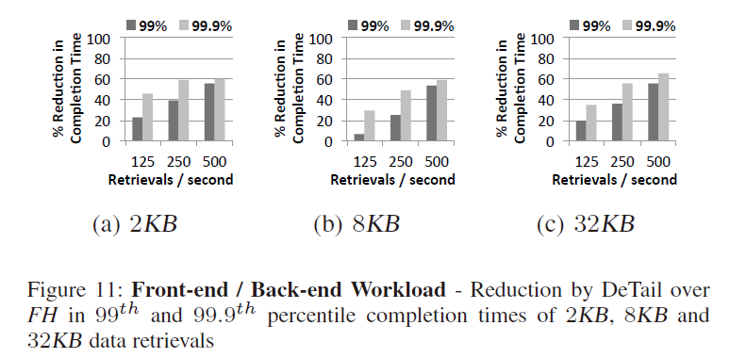
Related work(2)
DeTail: Reducing the flow completion time tail in datacenter networks. (2012)
Assumption : Short-flow is made to be behind the long-flow, and leading to delay.
[1]
[1]
Observing the traffic on cross-layer, and rearranging the queue
overall short-flow is improved
However, they implemented the special switch
[1]Zats, David, et al. "DeTail: Reducing the flow completion time tail in datacenter networks." ACM SIGCOMM Computer Communication Review 42.4 (2012): 139-150.

Slide 8
Motivation
Assumption :
Improving performance in today’s data centers with Multipath TCP(MPTCP) by solving short-flow problems
Problems :
MPTCP can work long-sized flow effectively
However, for short-flow, MPTCP does not.
Simulating reproduction of related works by ns-3
Analyzing the cause of deterioration of the performance

Slide 9
Requirements
3-requirements,
using the modern topologies for utilization massive computing resources.
improving the short-flow for the burst queries by distributed computing.
seamless approach : not using the specialized devices, but utilizing the existing resources.
My solution,
FatTree topology
Targeting on solving the problem of short-flow keeping the performance of long-flow
Using MPTCP on FatTree

Slide 10
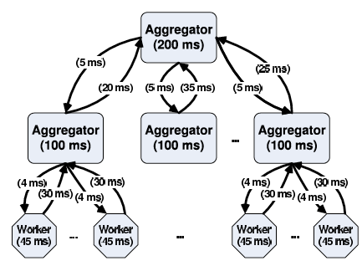
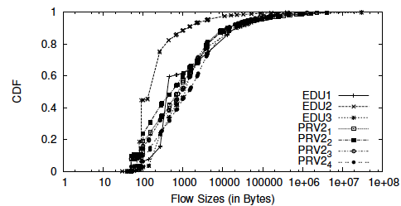
Is our target critical?
The requirements for today’s application is severe
Applications have to meet SLA is 200-300[ms], or ship out user reply.
additional latency of 100[ms] costs Amazon 1% of sales[1]
80% of the flows are smaller than 10KB in today’s datacenter[2].
[1]Wilson, Christo, et al. "Better never than late: Meeting deadlines in datacenter networks." ACM SIGCOMM Computer Communication Review. Vol. 41. No. 4. ACM, 2011.
[2]Benson, Theophilus, Aditya Akella, and David A. Maltz. "Network traffic characteristics of data centers in the wild." Proceedings of the 10th ACM SIGCOMM conference on Internet measurement. ACM, 2010.

Slide 11
Multipath TCP
Multipath TCP extends TCP so that a single connection can be striped across multiple network paths.
server
client
Relay

Slide 12
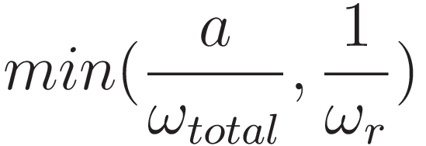




Multipath TCP
Congestion control:
Receiving each ACK
Packet loss
:window size of subflow r
:Sum of window size
:aggressiveness
Speed of window update is improved
fairness in bottleneck
Multipath TCP in data center
Better aggregate throughput
Better load balancing
Better robustness

Slide 13
Traffic patterns in today’s DC
As long as application follows partition/aggregate model, the traffic patterns is classified by data plane and control plane.
Data plane
Background traffic
For providing fresh date to the worker.
Control plane
query traffic
the command for the worker from the master
Short message traffic
update the control state

Slide 14
Traffic patterns in today’s DC
Crowd application is based on partition/aggregate model.
Therefore, the traffic patterns is classified by three patterns[1].
 | plane | frequency | size | deadline | metric
Background traffic | data | sec order | 1MB-50MB | no | throughput[bytes/sec]
Short message | control | sec-msec order | 50KB-1MB | yes | flow completion time[sec]
Query traffic | control | msec-µsec order | 2KB-50KB | yes | flow completion time[sec]
[1]Alizadeh, Mohammad, et al. "Data center tcp (dctcp)." ACM SIGCOMM Computer Communication Review 40.4 (2010): 63-74.

Slide 15
Simulation for reproduction
Repdoducing “Improving datacenter performance and robustness with multipath TCP ” scenario.

Slide 16
Topology
Benchmark traffic on FatTree.
4:1 oversubscribed, one-to-one traffic
33% node : background flow by MPTCP or TCP, remaining nodes : 70KB data sending by TCP
core
Aggregate
edge
host
Backgroung flow (TCP or MPTCP)
Short flow (TCP)

Slide 17
Topology
core
Aggregate
aggregate
aggregate
edge
edge
host
host

Slide 18
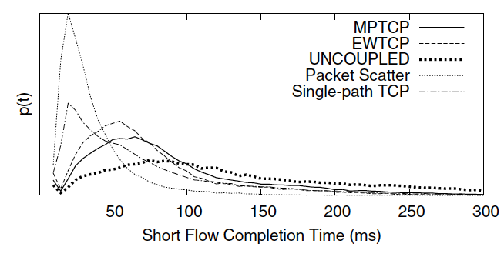
Evaluation
[1]Raiciu, Costin, et al. "Improving datacenter performance and robustness with multipath TCP." ACM SIGCOMM Computer Communication Review. Vol. 41. No. 4. ACM, 2011.
Algorithm | Short Flow Finish Time(mean/stdev)
SINGLE-PATH TCP | 78 ±108 ms
MPTCP | 97 ± 106 ms
Algorithm | Short Flow Finish Time(mean/stdev)
SINGLE-PATH TCP | 82 ±54 ms
MPTCP | 95 ± 68 ms
The peak is the almost same.
Becoming long flow is effecting the performance

Slide 19
Simulation
We simulated FatTree with MPTCP on ns-3
Assumption application
distributed computing
3-traffic patterns
Background traffic
Query traffic
Short message
environmental parameter | value
nodes | 16
Multipath TCP | v0.86
Bandwidth – core-aggr | 400Mbps
Bandwidth – aggr-edge | 200Mbps
Bandwidth – edge-node | 100Mbps
RTT | 0.5ms
Window size | 100KB

Slide 20
Topology
Backgroung flow (TCP or MPTCP)
Short flow (TCP)
core
Aggregate
edge
host
worker
master

Slide 21
Query traffic
without background
100% master-worker traffic 200ms Poisson generate
with background
100% master-worker traffic 200ms Poisson generate
static long flow

Slide 22
Query traffic

Slide 23
Query traffic

Slide 24
Query traffic
For less than 50KB traffic,
MPTCP behave like TCP with single-path.
With Background traffic,
MPTCP used wider bandwidth for background traffic, and pressure query traffic.

Slide 25
Short message
Short message traffic without background
50% master-worker traffic 0.5s Poisson generate
Short message traffic with background
50% master-worker traffic 0.5s Poisson generate
static long flow

Slide 26
Short message
Short message traffic without background

Slide 27
Short message
Short message traffic with background

Slide 28
Short message
For pure performance,
For more longer flow, MPTCP works well
With background,
Load balancing by MPTCP improve the performance

Slide 29
Conclusion
Verifying the performance of MPTCP in the FatTree topology
Modern intra-datacenter traffic
Background traffic
Short message traffic(time-sensitive)
Query traffic(time-sensitive)
Burst-traffic
For too short sized flow(less than 70KB), MPTCP behaves like TCP, single-path.
With background traffic, MPTCP’s fairness problem.

Slide 30
Future work
Problem :
wasting IP addresses
necessary IP addresses whose number is according to the number of using pathes
Short-flow is becoming long flow
Solution
By Open Flow,
Dynamic addressing
Priority control
Load balancing

Slide 31
Solution – via Core
10.32.0.2
10.33.0.2
10.32.0.1
10.33.0.1
10.32.1.1
10.33.1.1
10.32.1.2
Achieving 4-paths
10.33.1.2

Slide 32
Solution – via Core
10.32.0.2
10.33.0.2
10.32.0.1
10.33.0.1
10.32.1.1
10.33.1.1
10.32.1.2
10.33.1.2

