Slide 1
Progress report 進捗報告
Sekiya laboratory M1
Fujii Shogo

Slide 2
Constructing experiment environment
Experiment environment for MPTCP on KVM
Progress
Creating five VMs
Future work
Connecting each VMs with bridge
VM2
VM1
VM4
VM3
VM0
OS

Slide 3
Related work
Alizadeh, Mohammad, et al. "pFabric: Minimal Near-Optimal Datacenter Transport." (2013) ACM SIGCOMM.
Problem : First-in-first-out mechanism harm the flow with high priority, and it misses deadline.
Solution :
Priority-based packet scheduling
Uncoupled rate-control

Slide 4
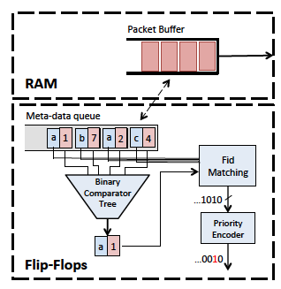
Priority-based packet scheduling
Dequeue : For the flows with the same tuple, ordering based on priority.
Priority rule : smaller remaining flow size has higher priority.
the flow that transmits earlier is made to finish earlier
Queue size sets smaller considering overhead comparator

Slide 5
Priority-based packet scheduling
Packet drop :
When a packet arrives to a port with a full buffer…
if it has priority less than or equal to the lowest priority packet in the buffer, it is dropped.
Otherwise, the packet with the lowest priority is dropped to make room for the new packet.
sending out high priority flow for RTO
The flow with low priority is harmed with existing congestion control

Slide 6
Uncoupled rate-control
Existing rate-control :
setting rate considering utilization of bandwidth
slow-start, allocating initial window…
Proposed method
Initial window size : static value using BDP
when drop, waiting for RTO; no fast retransmits, dupACKs or any other such mechanisms
the flow dropped exposes high penalty

Slide 7
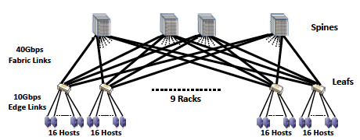
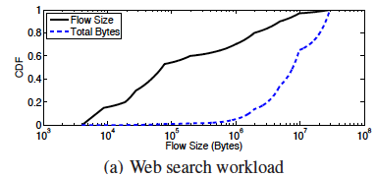
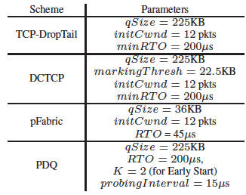
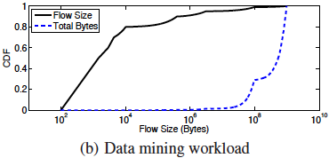
Simulation methodology
Simulation environment
Topology : FatTree 144hosts through 9 racks
Protocol : ECMP with round-robin
Simulator : ns-2
Benchmark traffic
using real distribution

Slide 8
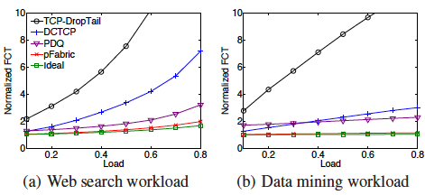
Result
pFabric achieves near-optimal flow completion times for all flow sizes

Slide 9
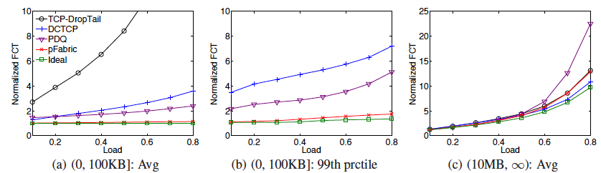
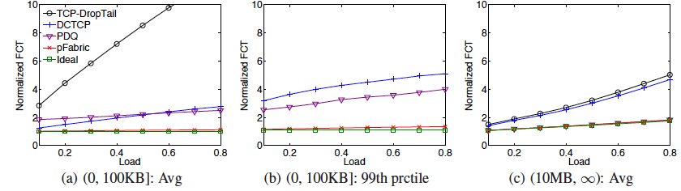
Result

Slide 10
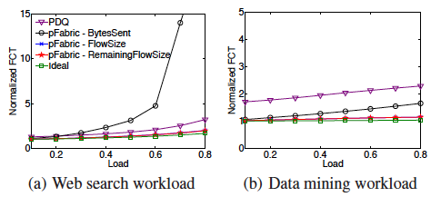
Comparing the method of prioritize
BytesSent : sending total bytes
Flow size
Remaining flow size
BytesSent : prioritize long flow

Slide 11
Considering
目標 : 並列分散処理速度を上げる
優先度を使うにしろ、どれを使えば?
高いペナルティ : 再送処理を行わず、タイムアウトまで待たせる。
レート制御 : 既存のTCPを用いない…

Slide 12
Future work
実装
仮想環境での2サーバ、2ルータの設定。サーバ周り勉強
Linux TCP/IPの勉強
論文
Traffic engineering、MPTCP
データ取得
Hadoop等ので分散処理させたときの分布をとってみる

