Slide 1
Progress report 進捗報告
Sekiya laboratory M1
Fujii Shogo

Slide 2
Constructing experiment environment
Experiment environment for on Mininet
Progress
Installing mininet, and testing some codes
Trying to test the script from CoNEXT’s paper
Studying SSH, VM
Future work
Fixed MPTCP on mininet
router1
Host1
Host2
router2

Slide 3
Related work
Dixit, Advait, et al. "On the Impact of Packet Spraying in Data Center Networks." Proc. of INFOCOM. 2013.
Problem : Utilizing effectively multiple equal-cost paths
ECMP : deciding the flow’s route by hashing 5-tuple, cannot prevent the occurrence of hot-spot
MPTCP : connection establishment complexity for short flow
Solution : switch based
Random Packet Spraying(RPS)
Simple active queue management scheme; Selective Random Early Discard(SRED)

Slide 4
RPS Overview
RPS Overview
Using all the equal-cost shortest paths between every source and destination pair.
Instead of hashing, RPS spreads all packets to the shortest paths equally
Concern
Fast retransmit : some amount of reordering can happen, but the sender wait for 3 duplicate ACK in newer Linux kernel.
Congestion window : even if the congestion window becomes half, total aggregate performance is better than ECMP
Implementation
On NetFPGA, using a random number provided by NetFPGA libraries.

Slide 5
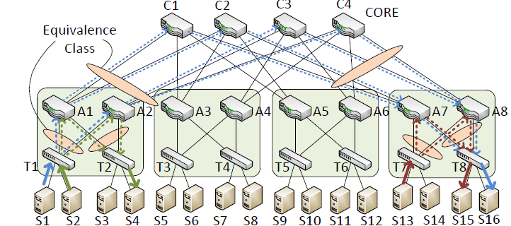
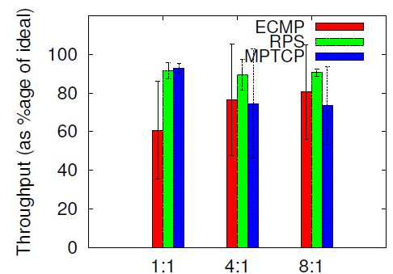
Evaluation RPS
Testbed configuration
Fat-tree : 4-ary, 1Gbp link
Servers : 4GB RAM, Intel Xeon(2.4Ghz)
Oversub:1:1, 4:1, 8:1(bottom link :125Mbs )
Evaluation for long flow
MPTCP suffers in rate-limiting
Quality of MPTCP version?
RPS : achieving high throughput with
small variance

Slide 6
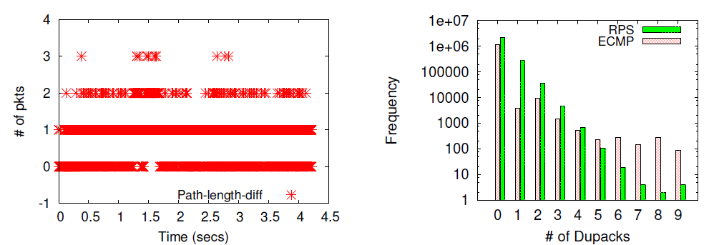
Analysis of Packet Spraying
Dupacks
Reordering will be limited because all paths between a pair of hosts have similar latencies.
Latencies are largely determined by queue lengths.
RPS improves throughput of long flow, but not effective for short flow

Slide 7
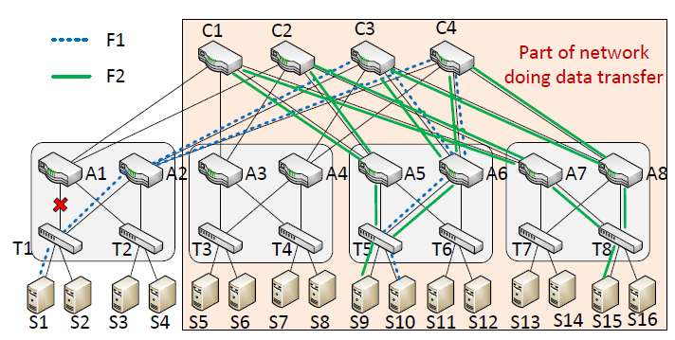
ASYMMETRY
In the real world, a data center network may not be symmetric at all times.
What asymmetric? : link/switch failure or link degradation
Problem illustration
500Mbps
↓
155Mbps

Slide 8
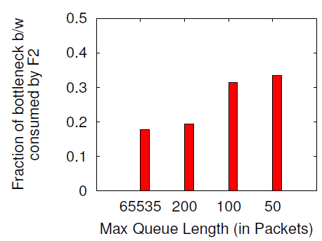
ASYMMETRY
Effect of queue length
In free buffer size, unrestricted buffer,
just 17 % of throughput
Reducing buffer sizes reduces queue
length difference, and 35% throughput
For high throughput, queue length difference gets lowers

Slide 9
Keeping Queue Lengths Equal
Existing solution : Random Early Discard(RED)
RED probabilistically drops packets as soon as the queue length crosses some threshold.
However, the total throughput is reduced as well
Proposed method : Selective RED
RED just for flows that induce a queue length differential.
That flow does not use all paths for link failure.
Using packet marking and a topology aware centralized fault manager

Slide 10
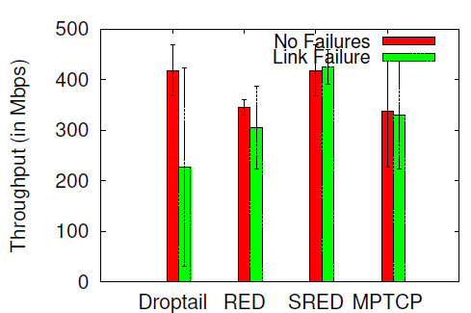
ASYMMETRY
FatTree : 4:1oversubscribed
RED :
Threshold_max = 20
Threshold_min = 10
P_max = 0.1
SRED improves total throughput comparing with RED
In link failure, RED algorithm works
MPTCP remains almost unaffected by the link failure as expected.

Slide 11
Considering
スイッチベースのアプローチ
MP-TCP requires significant end-host protocol stack changes, it is not always feasible in all environments, especially in public cloud platforms where individual tenants control the OS and the network stack
ランダムで散らす：単純な機構
エンドホストだけで実現するには。。
リンクエラーが生じたときの評価
バッファサイズは大きければいいわけではない
Modern data center operators try to keep queue lengths to the minimum to keep end-to-end latencies low and predictable

Slide 12
Future work
実装
仮想環境での2サーバ、2ルータでMPTCP。
Linux TCP/IPの勉強
データ取得
Hadoop等ので分散処理させたときの分布をとってみる
論文
Traffic engineering、MPTCP。
エンドホストへのアプローチ

